Slide 2
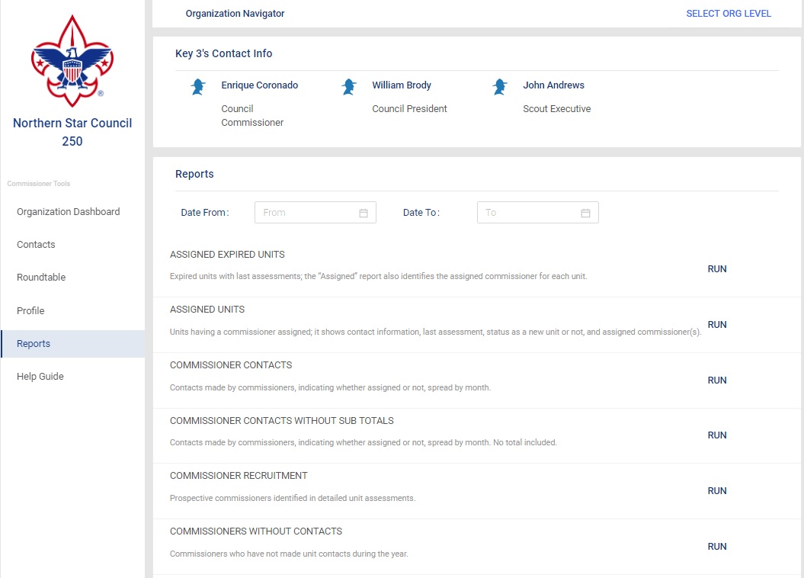
Reports
Notes:
Unit commissioners input valuable and actionable information into Commissioner Tools when they record their unit contacts. This is important for them as unit commissioners so that they have a record of the assistance they are providing to their units. It is also important for unit commissioner succession planning because newly assigned unit commissioners can view the history of the unit. Administrative commissioners at all levels of the organization can see the health of the units in their jurisdiction to provide help and guidance when needed. Reports give commissioners actionable information to ensure that units remain healthy and able to deliver the promise of Scouting to the youth they serve.
The reports available in Commissioner Tools provides the information you need as an administrative commissioner to lead your commissioners in achieving the objectives of Unit Service.

Slide 3
Reports
Notes:
The reports tab displays this window. At the very top of the page, you find the names and contact information for the Council or District Key 3.
The Reports section provides a list of all the reports that are available in Commissioner Tools. A new feature in this version of Commissioner Tools is that reports can now be generated using a range of dates instead of just a year to date range. This should improve performance and provide more relevant data to administrative commissioners. As an added benefit of the date selectable range for reports is that the number of listed reports is significantly shorter than in the last version of Commissioner Tools.
NOTE: If you’ve been in Commissioner Tools for 20 minutes without returning to the my.scouting.org site, that session will time out. As a result, you may receive an error when running any reports. You will need to logout of Commissioner Tools then log back into my.scouting.org, access Commissioner Tools and run your reports.
Not seen in the chosen district.

Slide 4
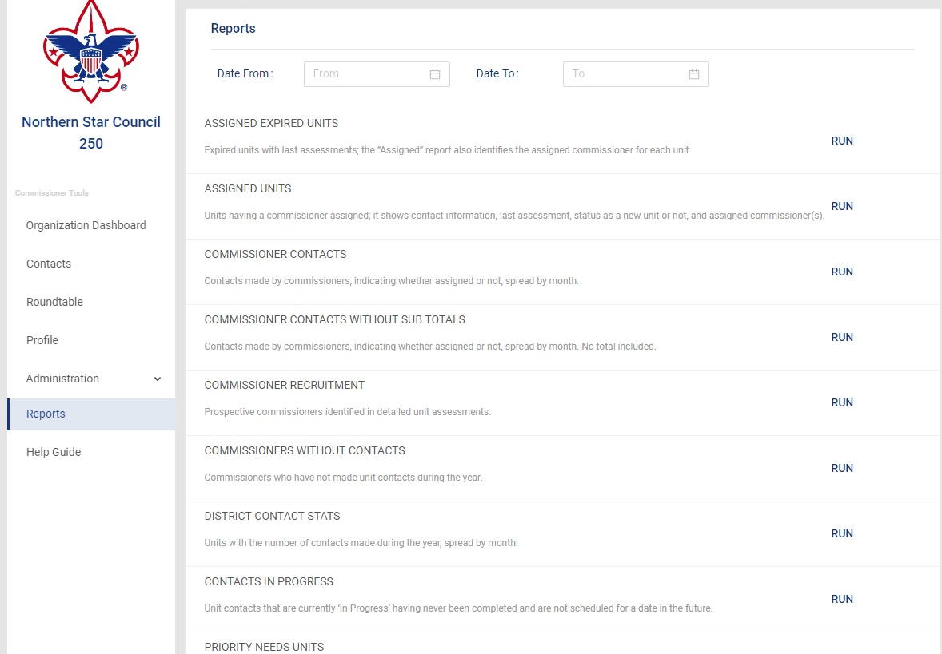
Reports
Notes:
A date selectable range is particularly helpful when you need information that has been reported for more than one year. Sometimes our “Scouting year” differs from the calendar year. The following reports are available in Commissioner Tools. This listing shows the data provided in the report.

Slide 5
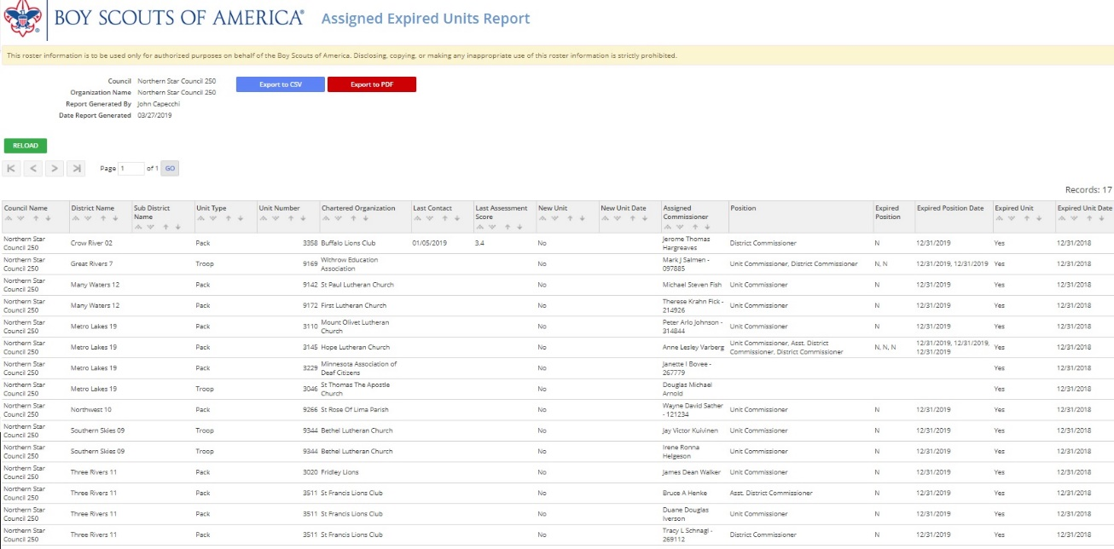
Reports
Notes:
The Assigned Expired Units report displays a list of all expired units that are currently assigned to a commissioner.

Slide 6
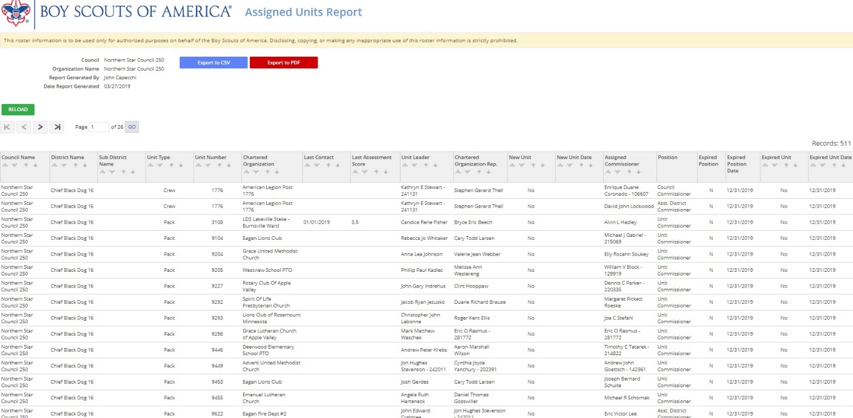
Reports
Notes:
The Assigned Units report displays a list of all units that have been assigned a unit commissioner.

Slide 7
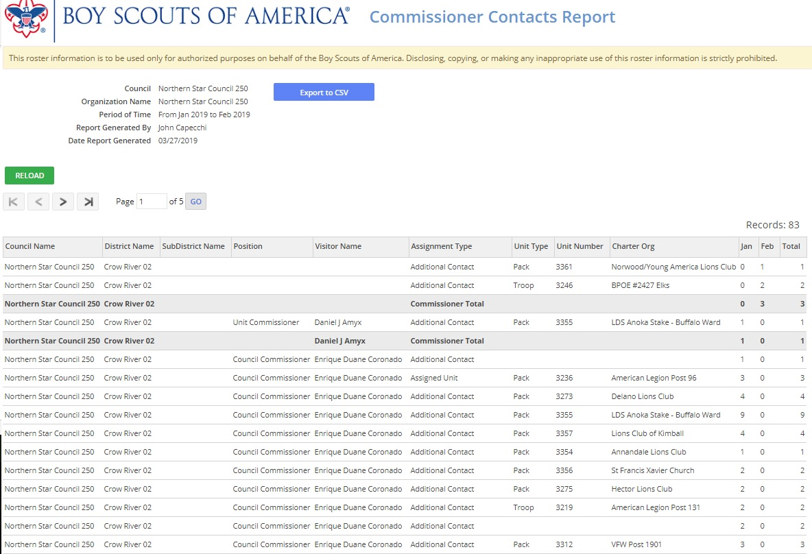
Reports
Notes:
The Commissioner Contacts Report displays all contacts made for units within the council and/or district. The report displays sub-totals for all assigned contacts.

Slide 8
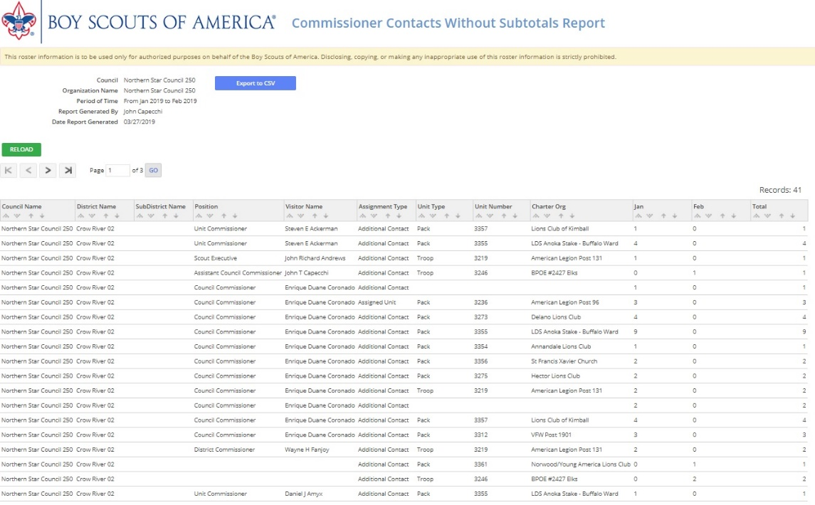
Reports
Notes:
The Commissioner Contacts Without Subtotals displays all contacts made for units within the council and/or district without the subtotals.

Slide 9
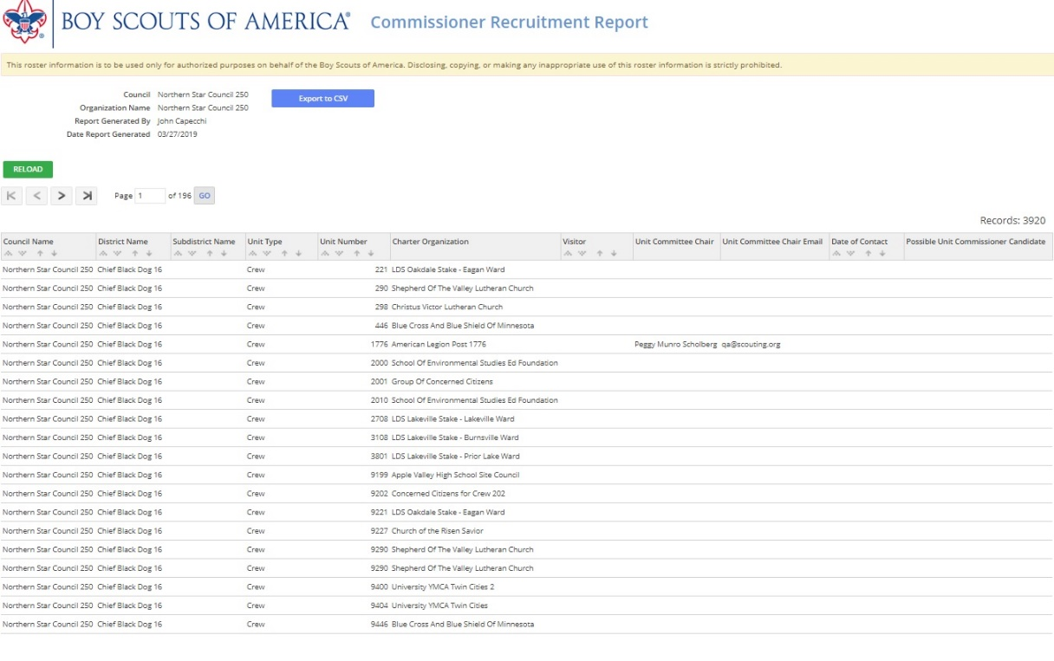
Reports
Notes:
When commissioners contact units and they encounter another adult leader whom they think might be a good commissioner, as part of the Detailed Assessment, the commissioner can enter the name and contact information of the commissioner prospect. This Commissioner Recruitment Report provides a consolidated list of leaders who might make a good commissioner. This report can also help with recruiting commissioners.

Slide 10
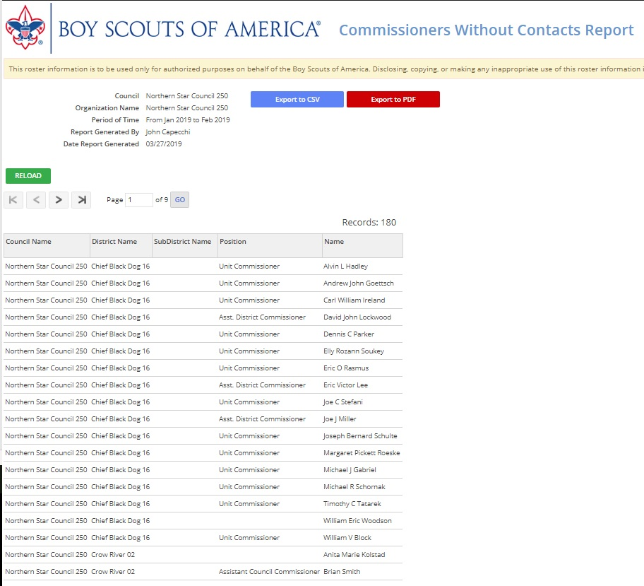
Reports
Notes:
Commissioners Without Contacts lists all commissioners that have not made a contact within the council and/or district as of the date of the report.

Slide 11
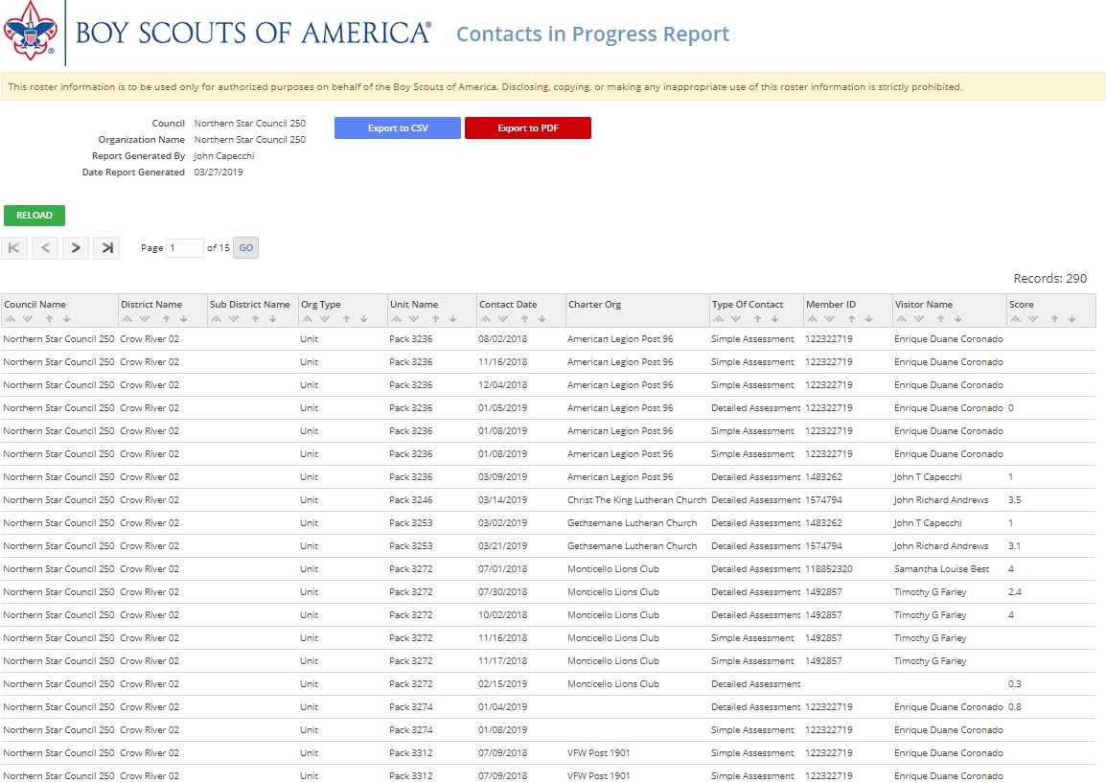
Reports
Notes:
The Contacts in Progress report lists contacts that have been started by a commissioner and have not been fully completed. This report allows an administrative commissioner to contact the individual commissioner to see if there is an issue that might require help so that the contact can be completed before the 60 day window for completing the contact expires.

Slide 12
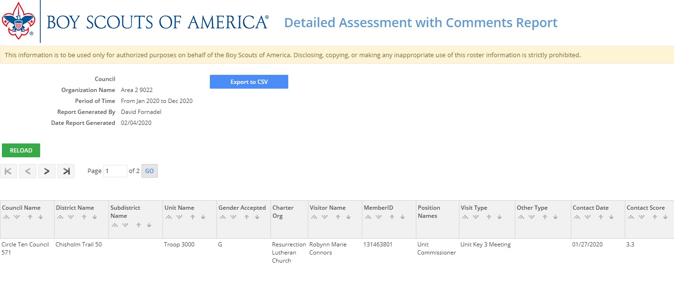
Reports
Notes:
This report shows all of the detailed assessments that have been completed along with the comments that been made for each assessment category.

Slide 13
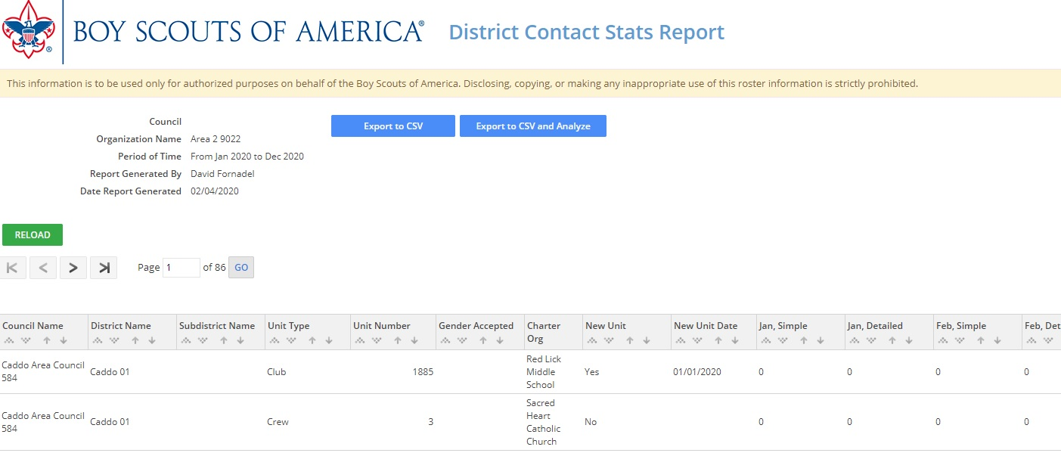
Reports
Notes:
The District Contact Stats Report displays the number of contacts made over the date range selected, for a unit either at the district or council level. Only units within the selected district or council will appear. This report also allows for a quick visual analysis of district contacts.

Slide 14
Reports
Notes:
There is a built- in web application that provides district commissioners a quick visual analysis of contacts made within a district.
The UCVA provides three types of data analysis:
Visual – the app creates compound bar graphs which show the number of simple and detailed assessments per unit versus the current JTE pro-rata unit contact scale. These graphics are interactive, and you can scroll over them for more information, zoom in, or even capture the chart as an image for your report.
Descriptive – provided detailed, but easy to read an analysis of the data
Transformed – to show the supporting information from the graphics
You can filter the data being displayed to limit the information at which you are looking. (We recommend that you use the filters when you are looking at charts displaying information for more than 100 units.)

Slide 15
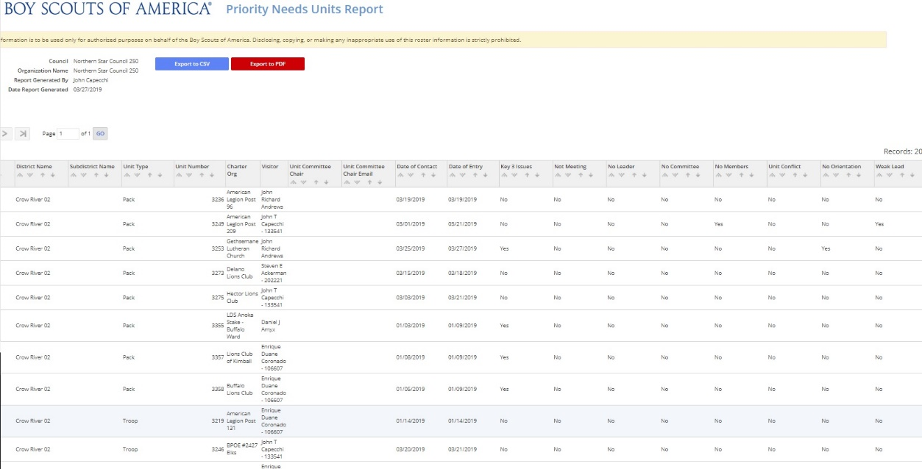
Reports
Notes:
The Priority Needs report provides critical information on units that might be at risk of not renewing their charter or of failing sooner than charter renewal time. Units on this report need help NOW!

Slide 16
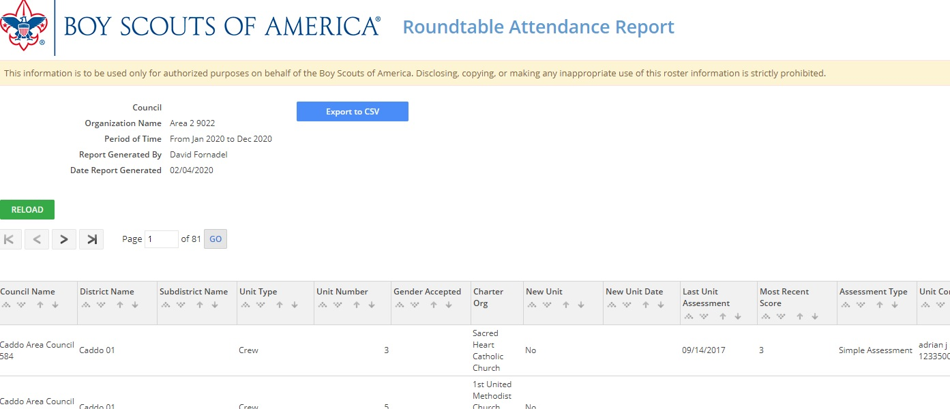
Reports
Notes:
The Roundtable Attendance Report shows monthly roundtable attendance for each unit, the last numeric health score, and the last assessment date and type of assessment (a Simple or Detailed contact) for each unit.

Slide 17
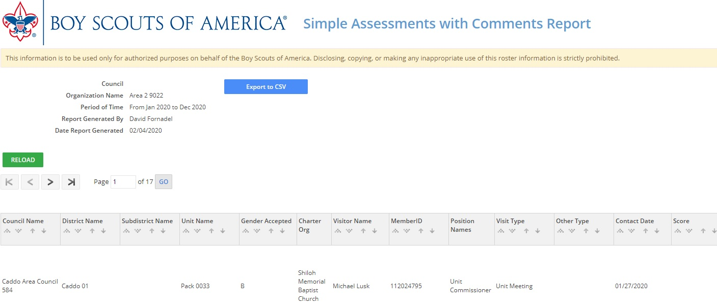
Reports
Notes:
This report provides all of the simple assessments completed along with comments from the person making the entry over the selected date range.

Slide 18
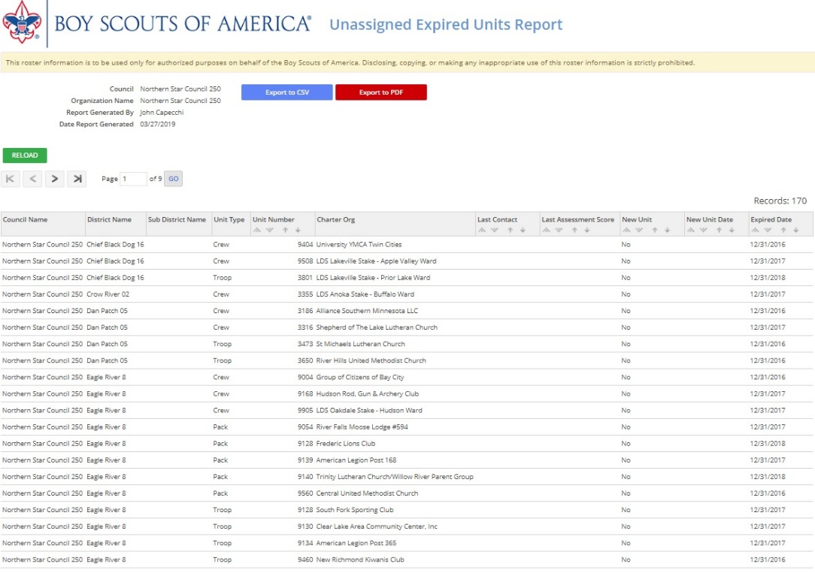
Reports
Notes:
The Unassigned Expired Units report displays units that were not assigned to a unit commissioner, and that did not renew their charter. This report stresses the need to have an adequate number of trained commissioners.

Slide 19
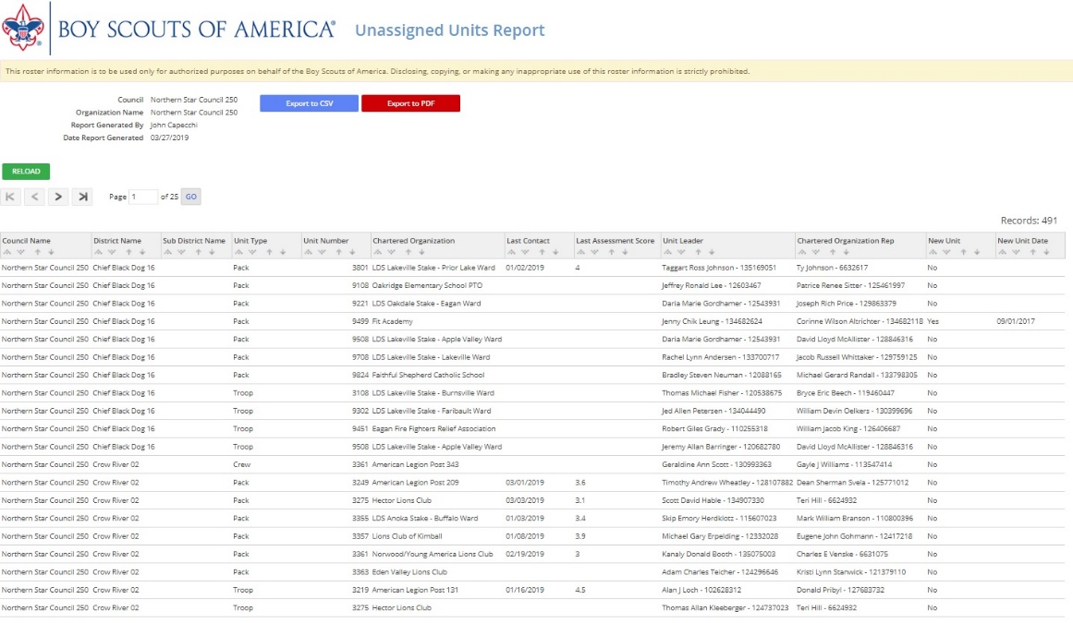
Reports
Notes:
The Unassigned Units report provides a list of units that do not have a commissioner assigned to them.

Slide 20
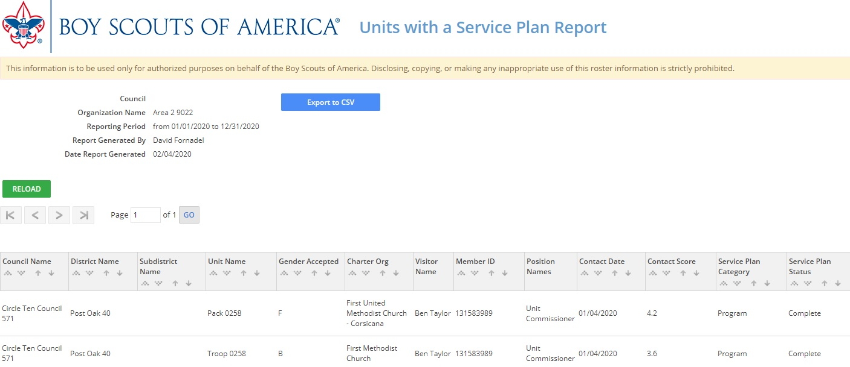
Reports
Notes:
This report displays all units that have a service . Right now because if program complexities, to see the actual service plan, you must navigate to the specific unit and open the contact that has the service plan.

Slide 21
HELP OPTIONS
Use a supported browser. Google Chrome is best.
Clear cache
Contact your Council Tools Champion or call your local council
Sub-category for commissioner tools on the MyScouting tools forum
Notes:
If you experience any problem with commissioner tools, Try and solve the problem at the lowest level possible. Be sure you are using a supported browser. Several steps are available to you when you need help in using commissioner tools. If you experience trouble logging in to the system, the first step you should take is to be sure you use Chrome as your browser. Make sure you clear the cache from your browser and retry logging in. If difficulty persists, please contact your commissioner tools champion, or call your local council. You can also raise your question on the My Scouting Tools Scouting forum, specifically to the commissioner tools sub-category: https://tinyurl.com/CommToolsHelp

