Slide 1
Online Registration
Unit Guidelines
Notes:
Thank you for having us! Today I am going to show you how to make effective use of Online Registration so that you can avoid having to carry paper applications. Having volunteers fill out the applications online also improves security as it limits who has access to their Personal information.
(click)

Slide 2
Agenda
Setup
My.Scouting
BeAScout
Unit Configurations
Invitation Manager overview
Digital Application overview
Application Manager overview
Online Registration Resources
www.Scouting.org/onlineregistration
Notes:
Our council is using an online registration process that will allow your unit to sign up new members digitally and complete the entire acceptance process without having to hand off paperwork. This system allows for digital signatures and online credit card payment making it fast and easy for the new applicant.
There are a few things that the unit needs to do to get ready – I will show you
The Invitation Manager tool
The digital application that the applicant will fill out
The Application Manager tool
And, the online resources available to help you use the system.
(click)

Slide 3
Setup
Notes:
Before the system goes live – there are some things that a unit needs to verify are correct so that the system allows access and sends unit leaders the right notifications.
(click)

Slide 4
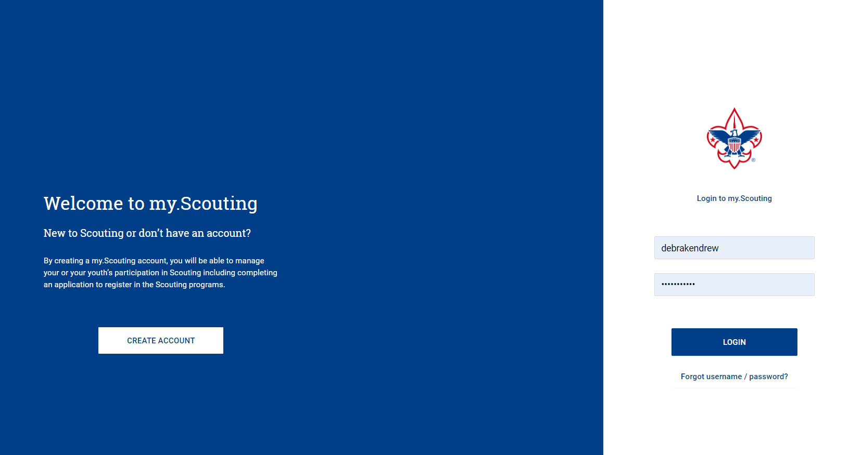
my.scouting.org
Notes:
Online registration administration tools for units are accessed through your my.Scouting account. If you don’t currently have an account, you will need to create one to use Online Registration. If you do have an account, make sure that your email address and the rest of your profile is current so that you get notifications and information that you need to use the new tools.
The tools contained within My.Scouting are role based. Therefore your unit needs to have the Unit Key 3 correctly registered so that they can take action in the system. So if you change Committee Chairs or your top leader, you need to get that information in to the council as soon as possible so that they can be registered correctly which will enable access to these tools.
Page 4 of the Online Registration Unit Guidebook walks you through the steps to update your My.Scouting account.
(click)

Slide 5
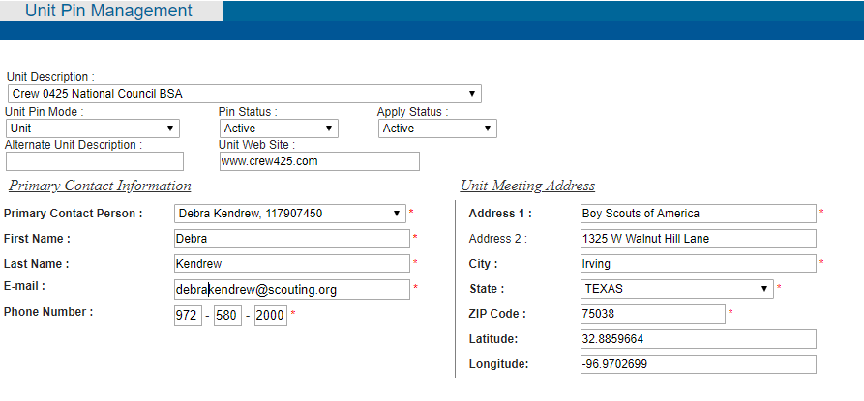
BeAScout Unit Pin
Notes:
While in your my.Scouting account, one of your unit leaders should be designated to maintain the unit pin – this leader should go in to the BeAScout set up that can be found under Legacy Web Tools, BeAScout.
Under unit pin management,
(click) verify that the contact information updated and correct.
(click) Set the unit pin to Unit mode, Pin Status to Active, and Apply Status to active if you want the “Apply Now” button to show on BeAScout. If Apply Status is not set to active only the “Request More Information” button will show on BeAScout.
Page 5 of the Online Registration Unit guidebook walks you through the steps to update your BeAScout pin.
(click)

Slide 6
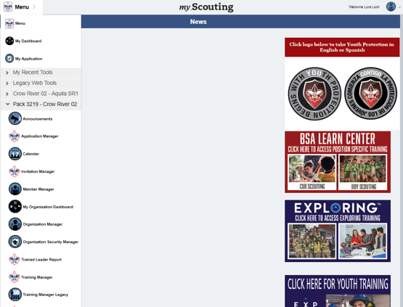
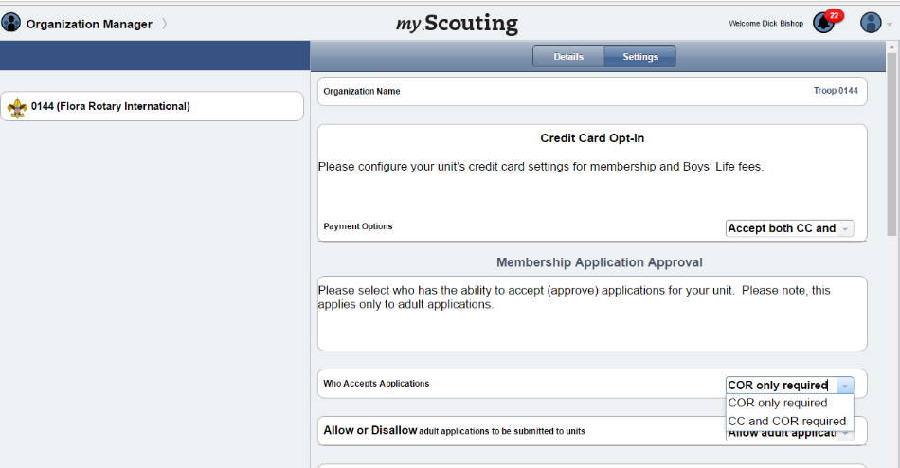
Unit Configurations
Payment options
Adult application availability
Committee Chair recommendation for adult positions
Unit Fee Message
Automated Welcome Email
Notes:
Organization Manger is the tool to set up your unit’s Online Registration Unit Configurations. Select Settings and see all of the configuration options available to your unit. If the council has made them available to the unit you will have a choice of payment options and adult application availability. If either of these is greyed out, that means that the council has set these to a council-wide configuration. If you are a pack leader this is also where you set up Family Scouting to indicate if you have dens for Boys, Girls or dens for Boys and Girls.
(click)
Page 8 of the Unit Guidebook walks you through each of the configurations and your choices within these configurations.

Slide 7
Invitation Manager
Notes:
Invitation Manager is a tool where the leads – families who indicate they want more information about Scouting through BeAScout – will come in for your unit to contact. These are people who really want to get involved, they are just waiting for you to contact them and let them know more about your unit.
Invitation manager can also help you manage leads that come in through joining nights or through personal invitations to join. I’ll show you how to do this in a minute.
(click)

Slide 8
Who has access?
Unit positions that have full access to the Invitation Manager Dashboard to add leads, manage inquiries from prospective Scouts, and send joining invitations:
Chartered organization representative (CR)*
Committee chair (CC)*
Unit leader (Cubmaster, Scoutmaster, Crew Advisor, Skipper, Coach)*
Institutional Head/Chartered Organization Executive Officer (IH)
New Member Coordinator
* = Members of the Unit Key 3
The Unit Key 3 can assign a “Registration Inquiry” functional role to other unit volunteers who need read only access to view lead status and submitted requests.
Notes:
First I want to help you understand the positions that can take action in Invitation Manager. The unit Key three the head of the Chartered Organization and the New Member Coordinator all have access to see and respond in this tool. The Key 3 of the unit can also assign a functional role of Registration Inquiry which will grant view only access for submitted requests. This person will be able to see the request, but cannot sent the invitation or take an action in the tool.
(click)

Slide 9
Invitation Manager
Notes:
Leaders in the unit will see invitation manager in their drop down menu after they select the unit in which they wish to work.
(click)

Slide 10
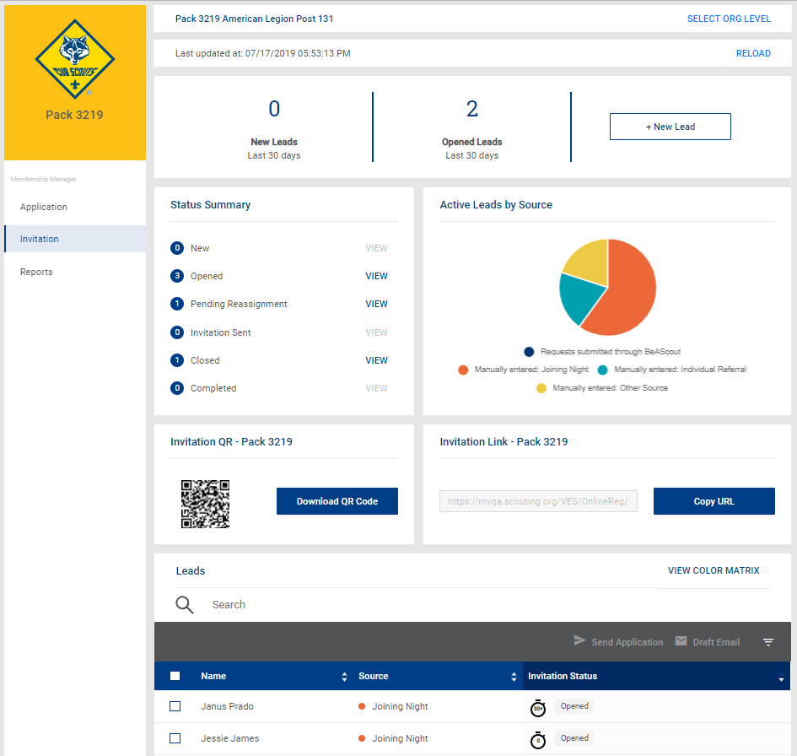
Notes:
Invitation manager is divided into several sections. The Top gives you a count of new leads (which came in via BeAScout) and opened leads (either from BeAScout and viewed or entered via Invitation Manager tool by click the New lead button).
The Plus New Lead button allows you to enter leads directly into this tool and then send them an email with an application link.
The status Summary shows how many leads are in the various statuses. Leads need to be marked closed or completed (which is the person has joined) manually. You can click view and review the lead. All units have a unique QA code and Link which directs a lead to the online application. These can be put on fliers or cards for use in recruiting.
The bottom section lets search and filter all the leads.

Slide 11
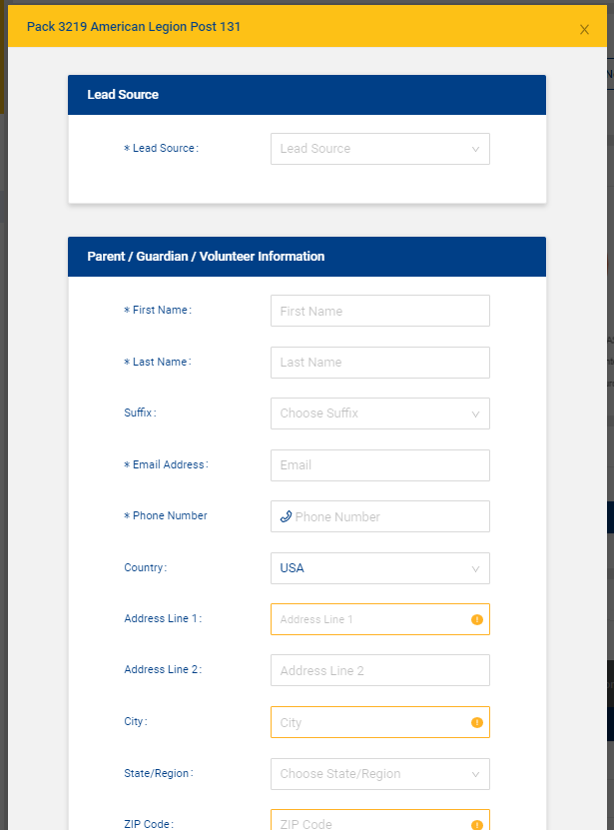
Notes:
After you select add a new lead this screen will appear. You can select the lead source from the drop down menu. You can use this to enter individual leads that you get through word of mouth.
You can also use this at joining night as your sign in page if you have internet access where you are holding the rally. One of the Key 3 would just log in to their My.Scouting account and open this page, select Joining Night as the lead source and then have the parent use the iPad or laptop to fill in their contact information then ask them to select save and add another so that the next person can sign in. Before the meeting starts someone in the unit would close this form which will take them back to the Dashboard– they could filter by Joining night and select everyone in that status and send the invitation. Parents will get the invitation on their SMART phone and will be able to fill it out while they are attending the joining night or they can always fill out the paper application if they prefer to apply that way. If they apply online, one of the key 3 can go in and accept the youth applications as they are submitted and the applicant will leave the meeting having received their welcome email and their member number. These youth will appear immediately on the roster in member Manager.
(click)

Slide 12
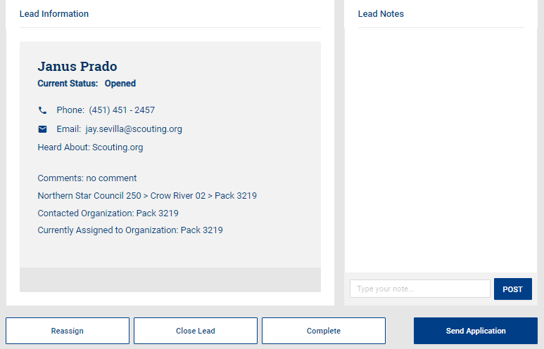
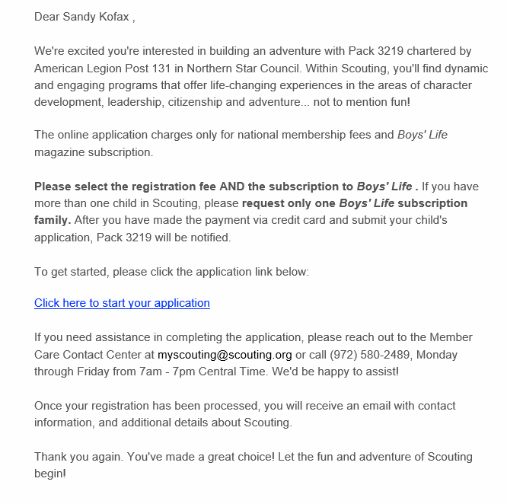
Notes:
Once you have leads in the system, you can review the lead information. You can add notes about any actions you have taken to contact the lead – this lets the others in your unit who have access to process leads know what you have done.
You can send an invitation.
You can reassign the lead to the district if there is some reason you cannot take the person into your unit.
Or, You can close the lead if the person turned in a paper application or if the person tells you they are no longer interested in joining. This will take them out of your actions and out of your reminder emails. Finally you can mark them complete which indicates they have joined.
(click) This is what the invitation generated by the system looks like. It will have the your program, your unit number and your chartered organization name in the first paragraph. The link will be specific to your unit – so anyone using this link will fill out an application that goes into your Application Manager tool where you can review and accept the applicant.

Slide 13
Digital Application
Notes:
The digital application asks for the same information as the paper application. It just presents it in a format that is easy to fill using a digital device.
(click)

Slide 14
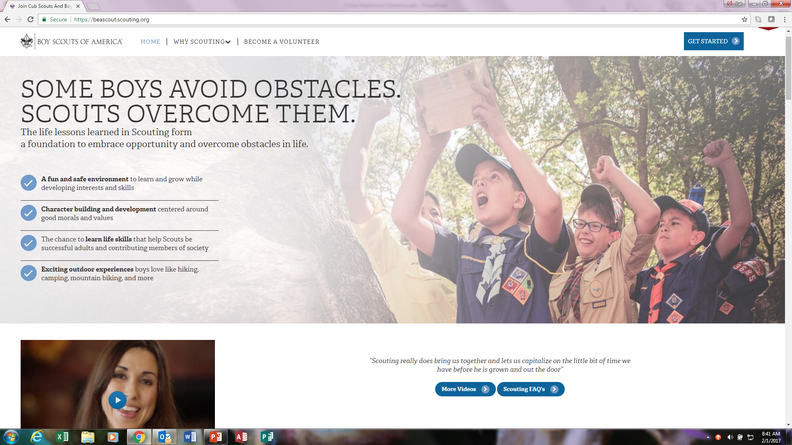
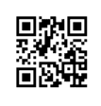
Three ways to start an application
BeAScout
Unit specific URL
QR code
Notes:
There are three ways that a family who wants to join Scouting can access the online application. One way is through BeAScout which is a web portal that allows parents to input a zip code and find nearby units. The other two ways are initiated by unit – through a URL that is attached to an email or through the use of a QR code which I just showed you how to access in the Invitation Manager tool.
(click)

Slide 15
Starting an application
Notes:
When a parent scans the QR code, opens the URL link that is emailed, or selects the Apply Now button in BeAScout they will see the create account and login screen. Here they can select New to Scouting if the child has never been in Scouting. If the child has been in Scouting before and is returning after a lapse in membership they can also go in, using their member number, and register through this system. One they have an account it will take them directly to the application.

Slide 16
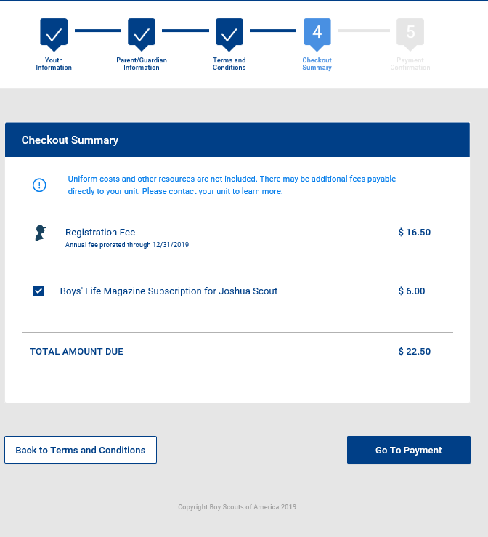
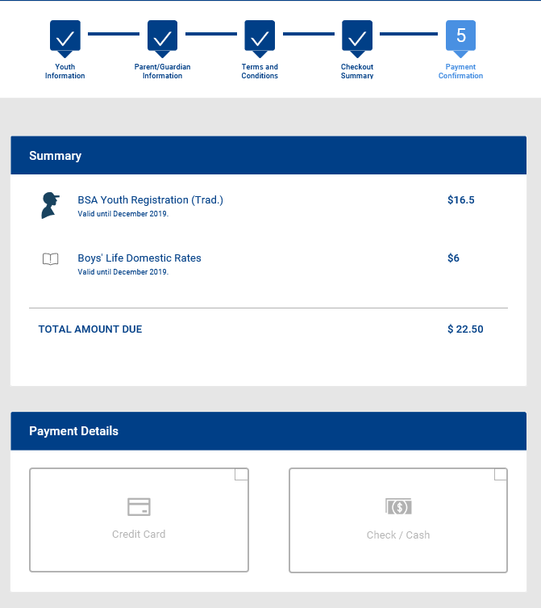
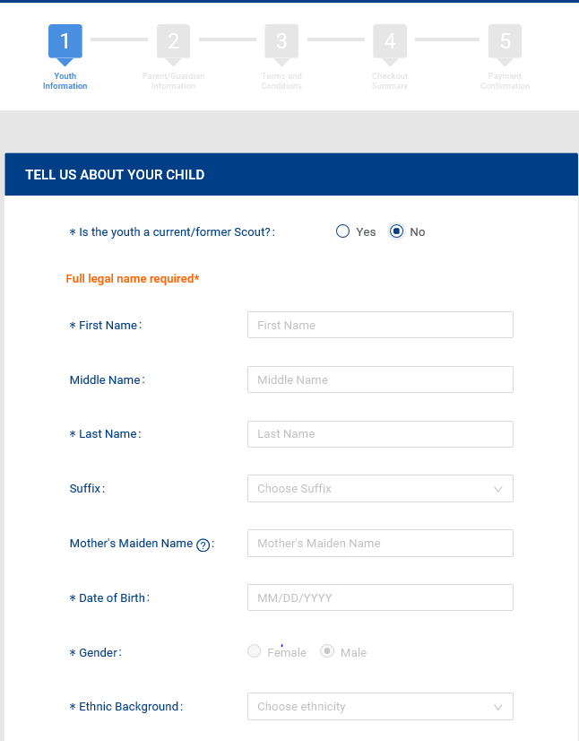
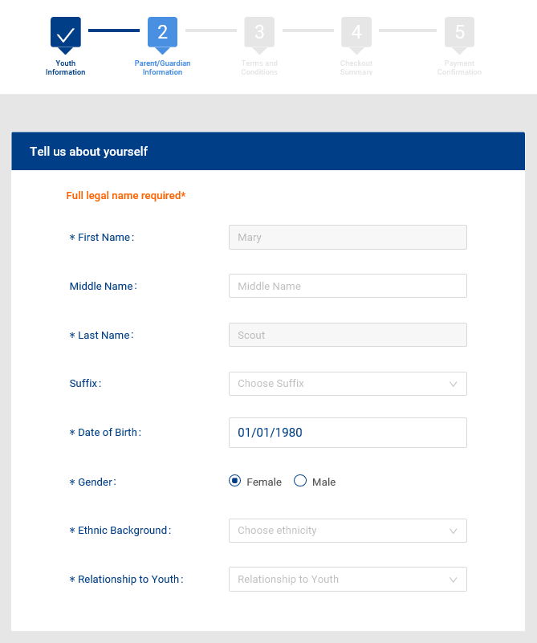
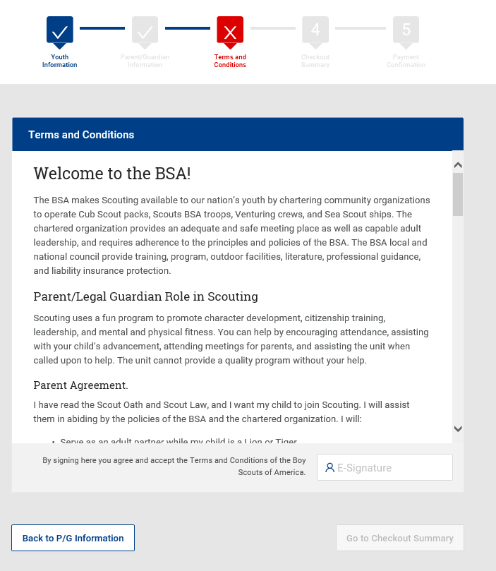
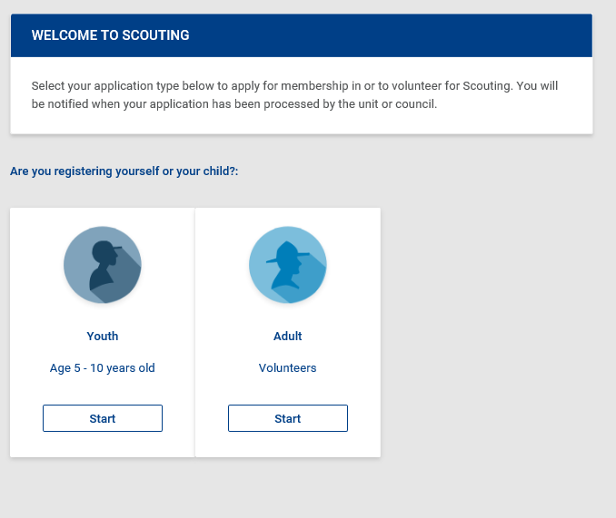
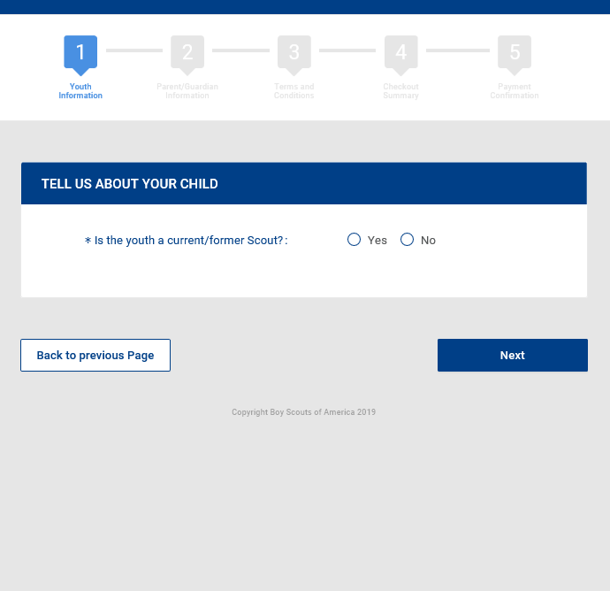
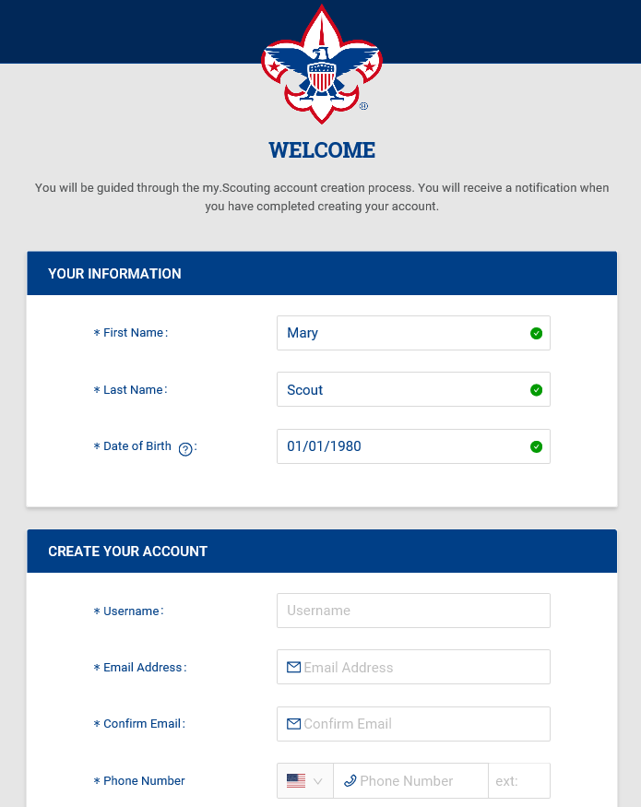
Create account & application
Notes:
This is the format as the screen appears for the parent or volunteer in creating an account (click)
Now they choose the youth or adult application. (click)
We want to know if BSA already has this person in our system so if they answer yes to being a current or former scout we ask for the member id. (click)
And then complete the application – steps 1 & 2 is entering information, (click) step 3 is agreeing to the Terms and Conditions, (click) step 4 is check out (click) and step 5 is payment (click)

Slide 17
Application Manager
Notes:
Now lets look at the tool where you can review and accept applicants.
(click)

Slide 18
Key Unit Roles in Application Manager
Unit Position | Actions
Chartered organization representative (CR) , Executive Officer (also called Institutional Head – IH)* | Review and accept or reject unit’s adult leader applications. Only the chartered Org rep and the Executive Officer roles can accept or reject adult applications. Reviews and accepts or rejects unit’s Venturing adult participant applications. Can review and accept or reject unit’s youth applications (shared unit Key 3 role.)
Unit committee chair (CC) | Can review unit’s adult applications and make position recommendations to the CR. Can review and accept or reject unit’s youth applications (shared unit Key 3 role.)
Unit leader (Cubmaster, Scoutmaster, Crew Advisor, Skipper, Coach ) | Reviews and accepts or rejects unit’s youth applications (shared unit Key 3 role – primary)
Notes:
The positions that can take action in this tool are governed by the BSA By Laws and Rules and Regulations. Therefore, only the Key 3 or the unit can take action in this tool. You can give others “Registration Inquiry” function where they can view applications, but they will not be able to take action since they are not allowed to approve applications.
The Chartered organization representative and the Executive Officer/Institutional Head are the only persons who can accept an adult applicant.
If the unit elects to turn on the “CC Recommendation” configuration in the tool. The Committee Chair will have the responsibility to review the adult applications and assign the adult position. The CR will still need to accept the adult in the system after the CC assigns the position.
Any one of the unit Key 3 can accept a youth applications, However, the Unit leader has the primary responsibility for youth approval.
(click)

Slide 19
Application Manager
Notes:
When you log in to your My.Scouting account and select the drop down menu you first need to select your unit name and then application manager.
(click)

Slide 20
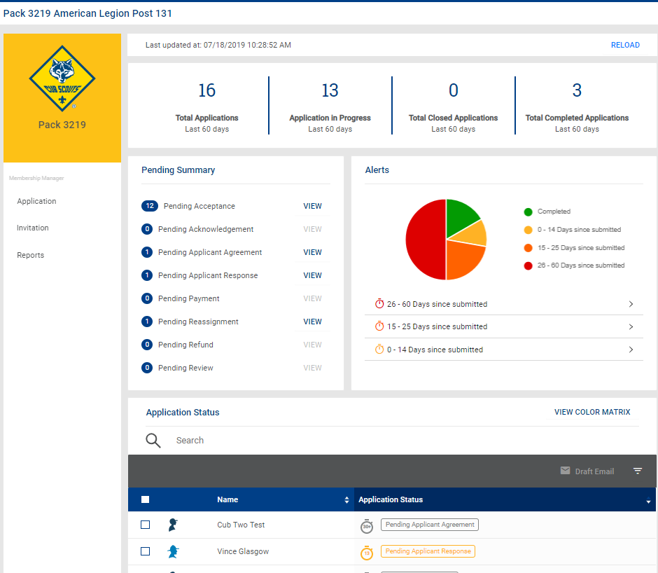
Notes:
That will take you to your Application manager dashboard. (click) You will see a Pending summary of the applications in progress by status– remember that all applications will time out if you don’t accept them within 60 days. Those applications close to timing out can be identified easily in the Alerts graph. Note, the clock does not start over with each action you take in the system – it starts the day the applicant presses the submit button until you take some type of action that completes or closes the application.
At the bottom of the screen you can search for specific applications or filter by status. In addition you can draft an email to a particular applicant.
You select the name of the applicant and open the record to view the information and take action on the application.
(

Slide 21
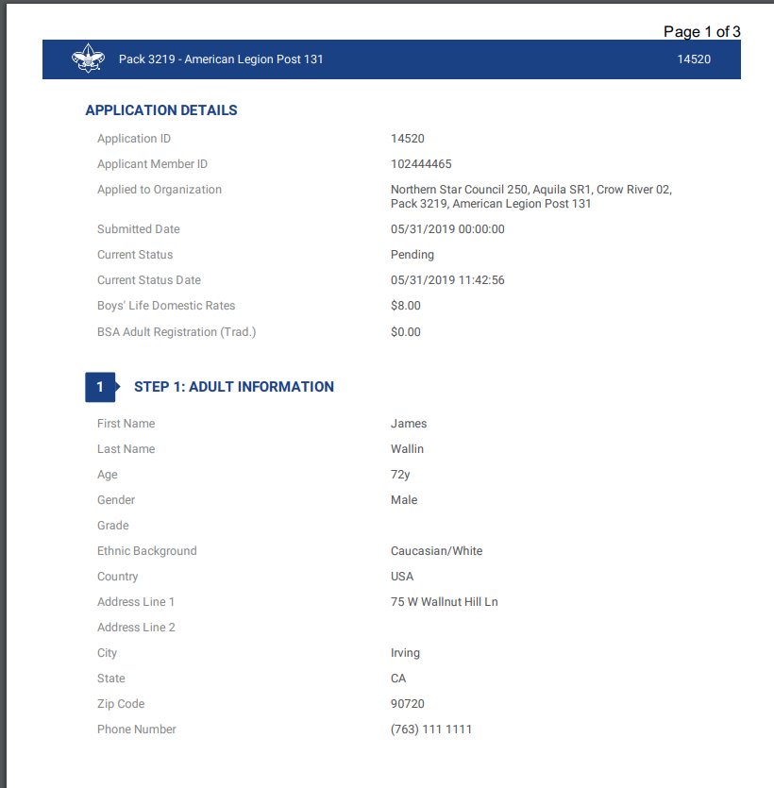
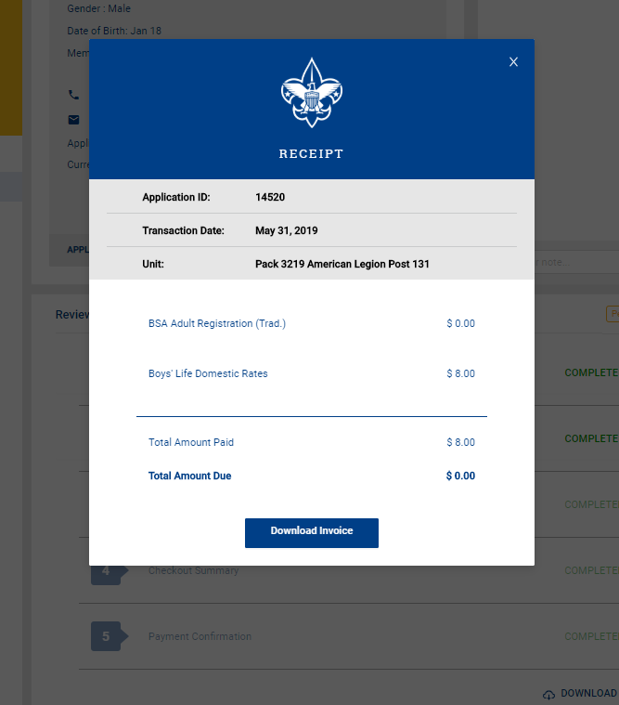
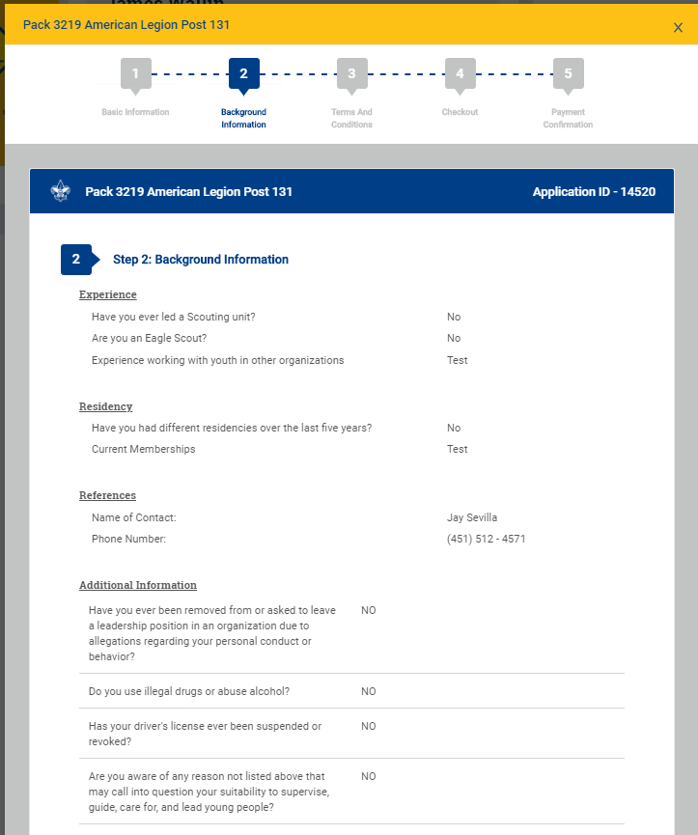
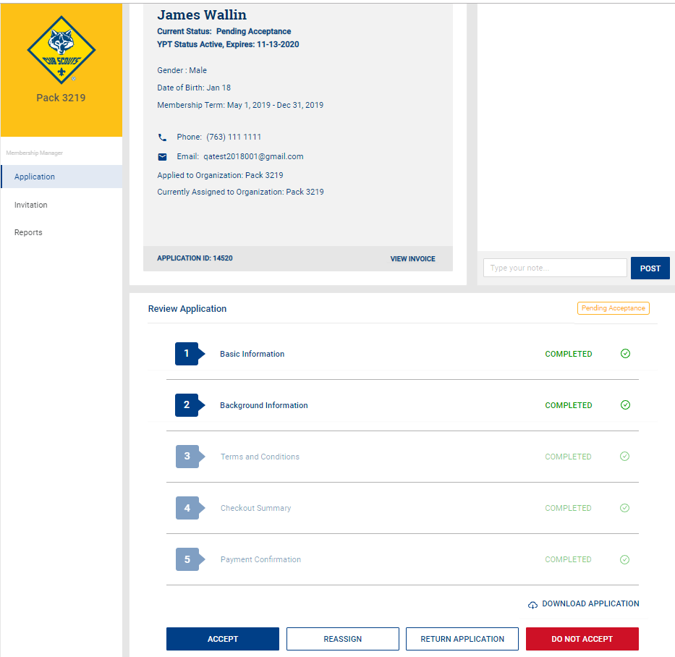
Acting on an application
Notes:
When you open an application you will see the actions that you have available at the bottom of the screen. You can accept the applicant, reassign the applicant to the district so the district can find another unit for the applicant, return the application to the applicant because you want additional information, or you can recommend this person not be accepted in Scouting. We will go over each of these actions in more detail.
First let’s review the application. You can open the Basic Information or Background Information on the application by clicking on that section in the bottom part (click) For an adult it will show you the information you need to understand this applicants background and his references. At the top you have the Application ID number for this applicant.
From the summary page you can also download an application (click) or view and download the invoice (click).

Slide 22
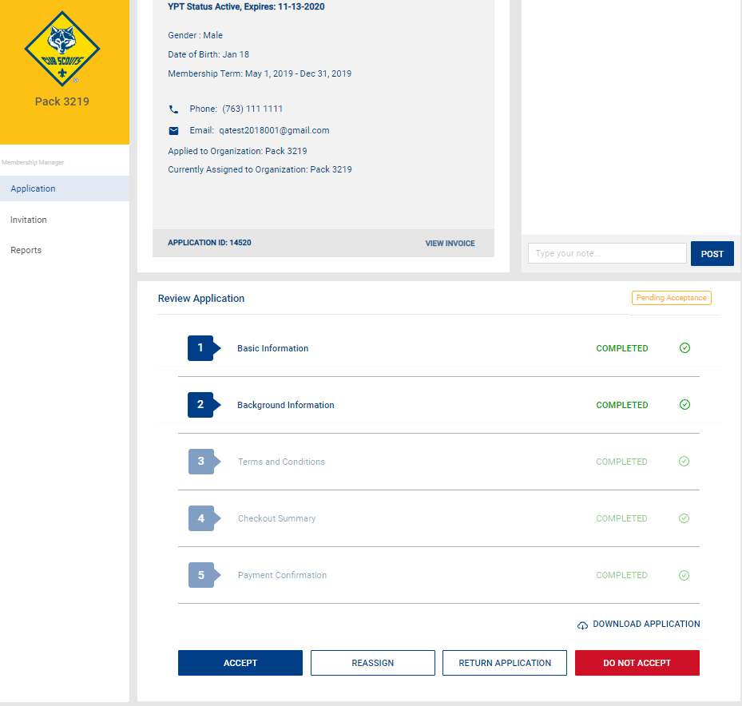
Accepting an Application
Notes:
After you have reviewed the application and you know you want this youth in your unit you can press the accept button and they will move to completed status if they have paid by credit card and they will be on your membership roster in My.Scouting. They will also receive a welcome email from the National Service Center and if your unit has elected to do so, they will also receive an auto generated welcome email with your units message.
If the applicant selected to pay by cash or check they will move to the pending payment status. The unit should collect a copy of the receipt the applicant was emailed along with the amount owed as stated on the receipt. The unit must collect the amount listed on the receipt and cannot prorate the amount any further. This is the amount must be turned in to the council with the application so that the council can mark the application as paid. Once the council has marked the application as paid the family will be sent the welcome email.
(click)

Slide 23
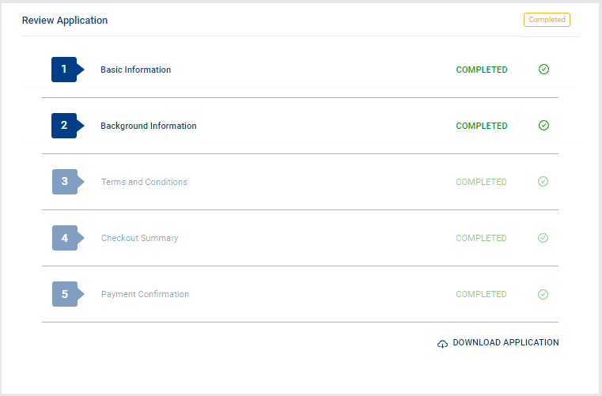
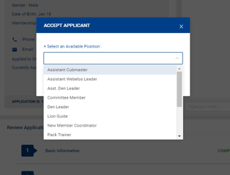
Assigning Adult Position
Notes:
When you select “Accept” on an adult application a screen will appear for the committee chair or the chartered organization representative, depending on how the unit set their configurations, so that they can select the adult position in the unit. Once the position is selected and saved, the Chartered Organization representative can complete the acceptance of the adult application. (click) The application moves into a Completed status and the buttons no longer appear at the bottom. (click)
(click)

Slide 24
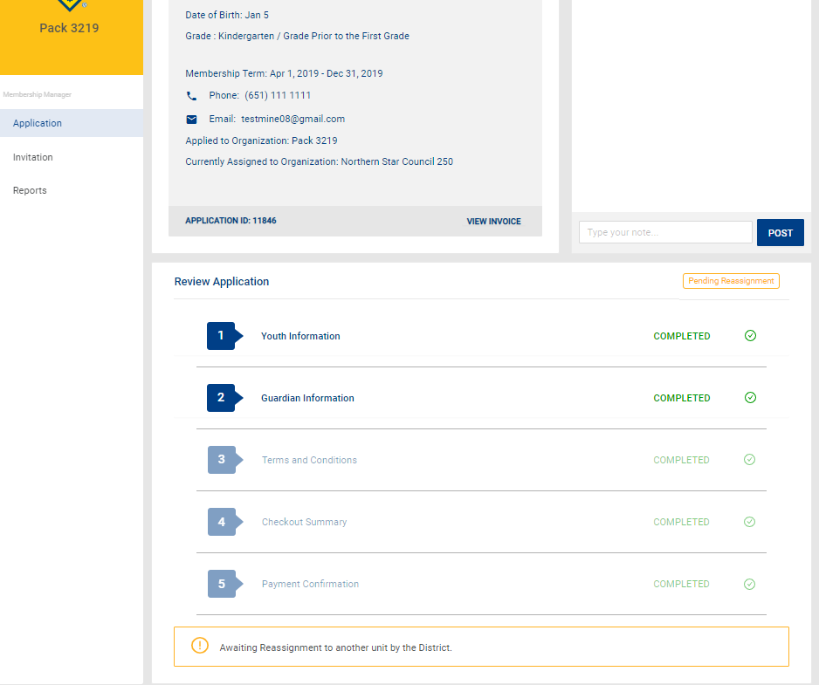
Reassign
Notes:
If you select reassign, you will be asked to give a reason that you are not accepting this youth or adult into your unit. You will select from a drop down list. The application will then be forwarded to the district for one of the district Key 3 to reassign to another unit. If you look in the Pending Reassignment View tab and click on the application (click) you will see the application in Pending reassignment status until someone at the district takes action.
(click)

Slide 25
Do Not Accept
Notes:
If you select do not accept this means that you are saying they should not be accepted into any Scouting unit. You will be asked to confirm this selection. You should not give your reason on this screen – if the council has questions they will contact you for further explanation. This moves the application to the council in a Pending Review status.
(click)

Slide 26
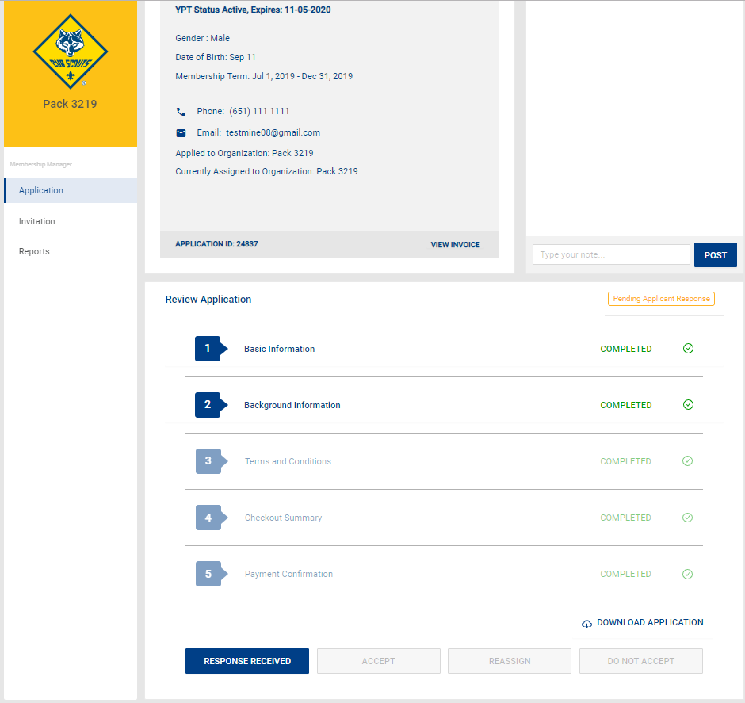
Return to Applicant
Notes:
Sometimes the unit might want a little more information from the applicant, so there is a way to return the application and write a short message explaining the additional information you need from the applicant. When confirm the message, an email will be sent to the applicant asking for the additional information. If you do not hear back from the applicant, you may want to follow up by other means to ensure the application is processed within the 60 day time period. When the applicant has answered then the status changes from Pending Applicant Response back to Pending Acceptance and a new button appears Response Received. Click on this button and Confirm.
(click)

Slide 27
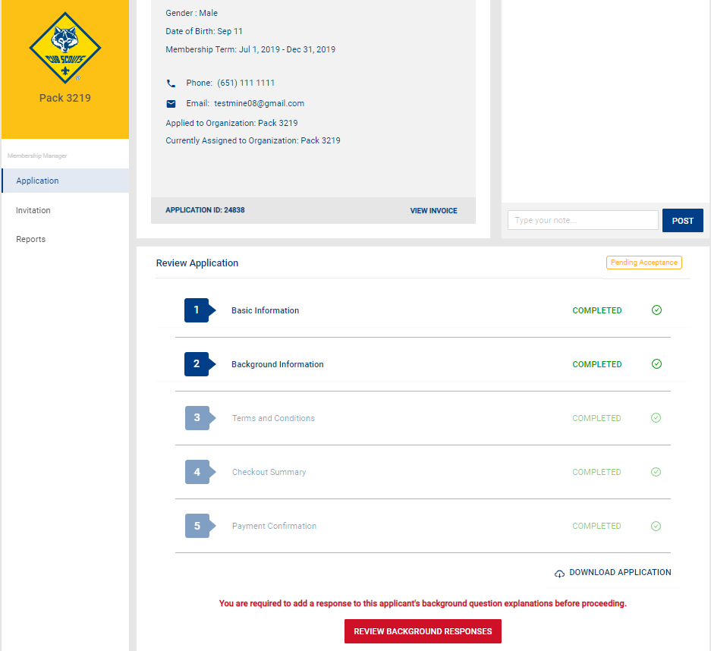
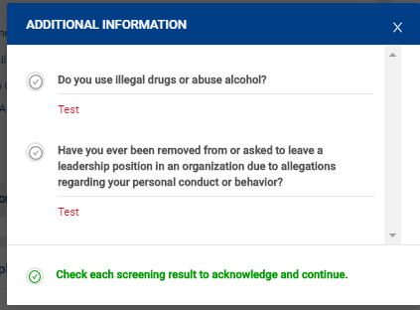
Adult Screening Questions
Notes:
If you are accepting an adult and they answered “Yes” to any of the screening questions, you will see that in the application summary. Before you can accept this person, the COR will have to review the responses and (click) check that they acknowledge the responses. After you have acknowledged the application will move to the council in a Pending Acknowledgement status for their review.
(click)

Slide 28
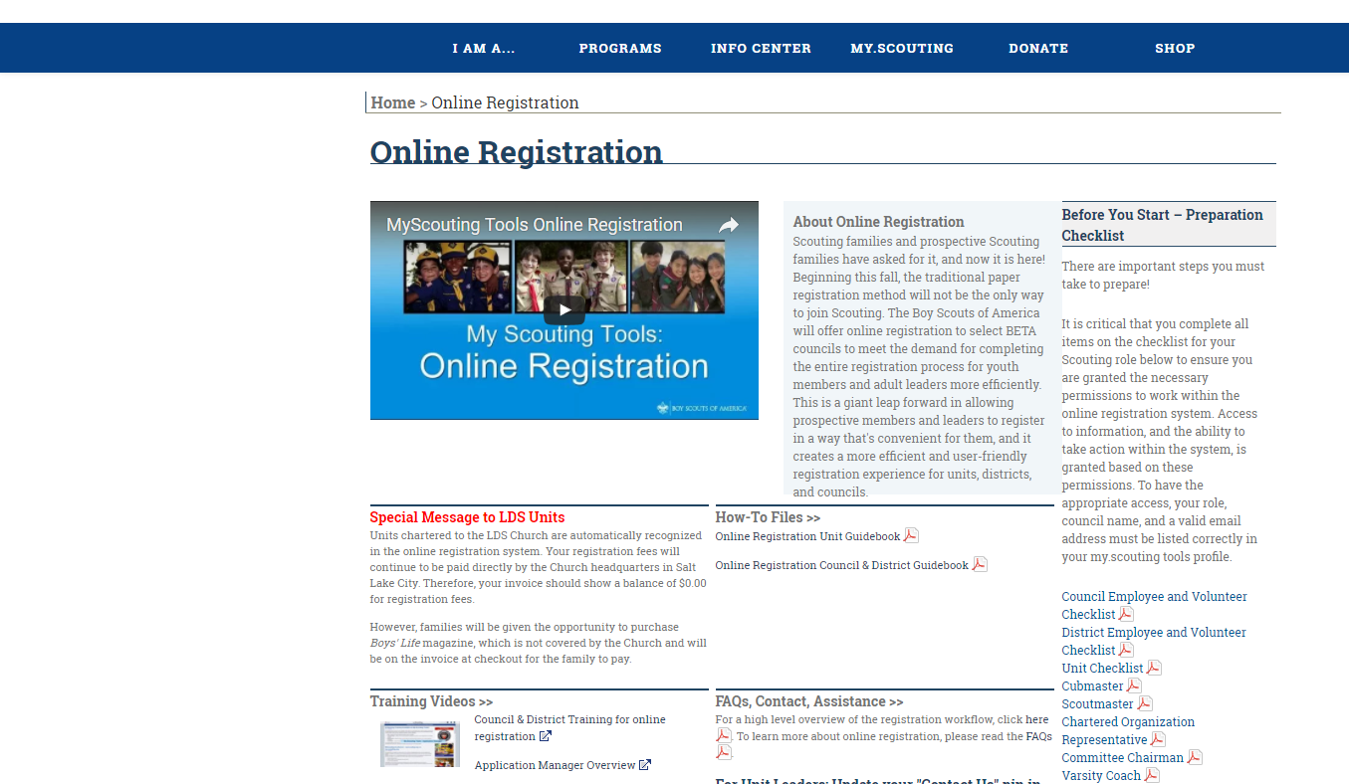
www.Scouting.org/onlineregistration
Training
Guidebooks
Checklists
Notes:
Scouting.org/onlineregistration provides online training and guidebooks that provide step by step instructions. There are also other resources such as frequently asked questions that you may also find helpful.
(click)

Slide 29
Questions??

