Slide 1
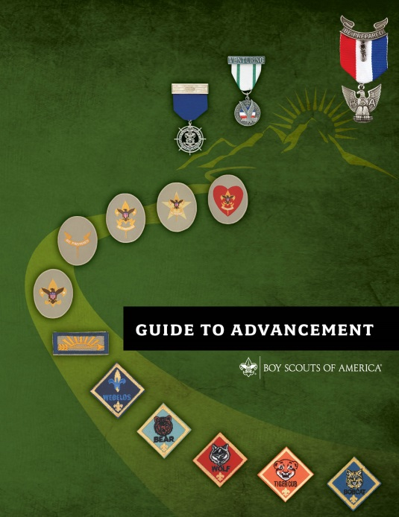
The Eagle Scout Service Project Coach
National Advancement Program Team
Expiration Date
This presentation is not to be used after Jan. 31, 2025.
Obtain an updated version at www.scouting.org/advancement
Notes:
For the Presenter:
This Eagle Scout Service Project Coach educational presentation takes approximately 60 minutes to deliver and provides service project coaches with the basic knowledge and skills needed to get started. It can also serve as a refresher for veterans.
Like all the educational presentations, this version has an expiration date; after which it is not to be used. Upon that date a replacement session should be available at the URL shown on the first slide.
We encourage presenters to have at least one CURRENT edition of each of the following publications for use during the presentation:
Guide to Advancement, No. 33088
Scouts BSA Requirements, No. 33216
Eagle Scout Service Project Workbook, No. 512-927 (one copy for each participant)
Navigating the Eagle Scout Service Project, No. 510-025 (one copy for each participant)
Guide to Safe Scouting, No. 34416
SAFE project Tool Use Guidelines - https://www.scouting.org/health-and-safety/guidelines-policies/ , No 680-028
Service Project Planning Guidelines, No 680-027
The Sweet 16 of Safety, No. 512-025
Any helpful materials provided by your council or district
A flip chart or white board with pens may come in handy.
Begin with a welcome and thank everyone for attending. Let them know you realize they could be doing something else with their time, but that they chose to be at this presentation is significant. Indicate that service project coaches provide invaluable help to our Scouts completing service project requirements for the Eagle Scout rank. Close your introductory remarks with a challenge that participants should ask questions and join in the discussions.

Slide 2


The Mission and Objectives of the Boy Scouts of America
Mission of the BSA
Objectives of Scouting
“….prepare young people to make ethical and moral choices over their lifetimes by instilling in them the values of the Scout Oath and Scout Law.”
Character Development
Citizenship Training
Leadership
Mental and Physical Fitness
Notes:
Many of you are familiar with the mission and objectives of the Boy Scouts of America. You’ve read them in our literature and you may have heard about them at leadership training sessions. The importance of the mission has not only to do with making ethical and moral choices, but that this should be done over one’s lifetime. We’re looking for long-term improvement here: life lessons. Completing the Eagle Scout service project experience is one of these methods to accomplish that goal. What the Scout gets out of the service project and takes with them throughout their lives, is a great deal more important than the project itself.
You’ve probably heard about the objectives of Scouting. If not, jot them down. And as we go through this presentation, think about how the various parts of the service project apply to the objectives. At the end we’ll close the loop on that, and see how you did.

Slide 3

The Scout Oath and Law
The Scout Oath
The Scout Law
On my honor, I will do my best to do my duty to God and my country and to obey the Scout Law;
To help other people at all times;
To keep myself physically strong, mentally awake, and morally straight.
A Scout is trustworthy, loyal, helpful, friendly, courteous, kind, obedient, cheerful, thrifty, brave, clean, and reverent.
Notes:
The concept of service to others is embedded in both the Scout Oath and the Scout Law. The helpfulness we pledge is important in the Eagle Scout Service Project, but these values we express—especially those found in the Scout Law—can also provide some guidelines on how Scouts and Scout leaders, and Eagle Scout Service Project Coaches, should approach the project process.
Ask: Which points of the Scout Law are the most important in the process, and to whom are they important?
Discuss the answers until it’s clear everyone understands that coaches should live the law as they work with Scouts. For example, “courteous,” “kind,” and “friendly,” mean that coaches are not overbearing, and that they try to keep their egos out of the way. It means they treat Scouts and parents with dignified respect. “Obedient” means that coaches work within the policies and procedures as set forth in the Guide to Advancement, and do not make up their own requirements or reinforce those inappropriately set forth by others.

Slide 4
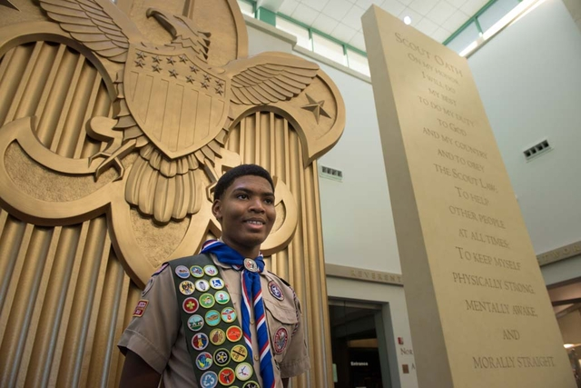

The Methods of Scouting
Ideals
Patrol method
Advancement
Association with adults
Outdoors
Leadership development
Uniform
Personal growth
Notes:
These are the Scouting methods we use to accomplish our objectives and mission.
The Eagle Scout service project is a required activity found under the advancement method, but it also involves other methods.
Ask: What other methods come into play during the planning and conducting of an Eagle Scout project? (Look for: Ideals (e.g., helpfulness), association with adults, leadership development, and personal growth. These four methods should apply to all Eagle Scout service projects. Others may apply to certain projects conducted under certain circumstances. Discuss any that are brought up.

Slide 5
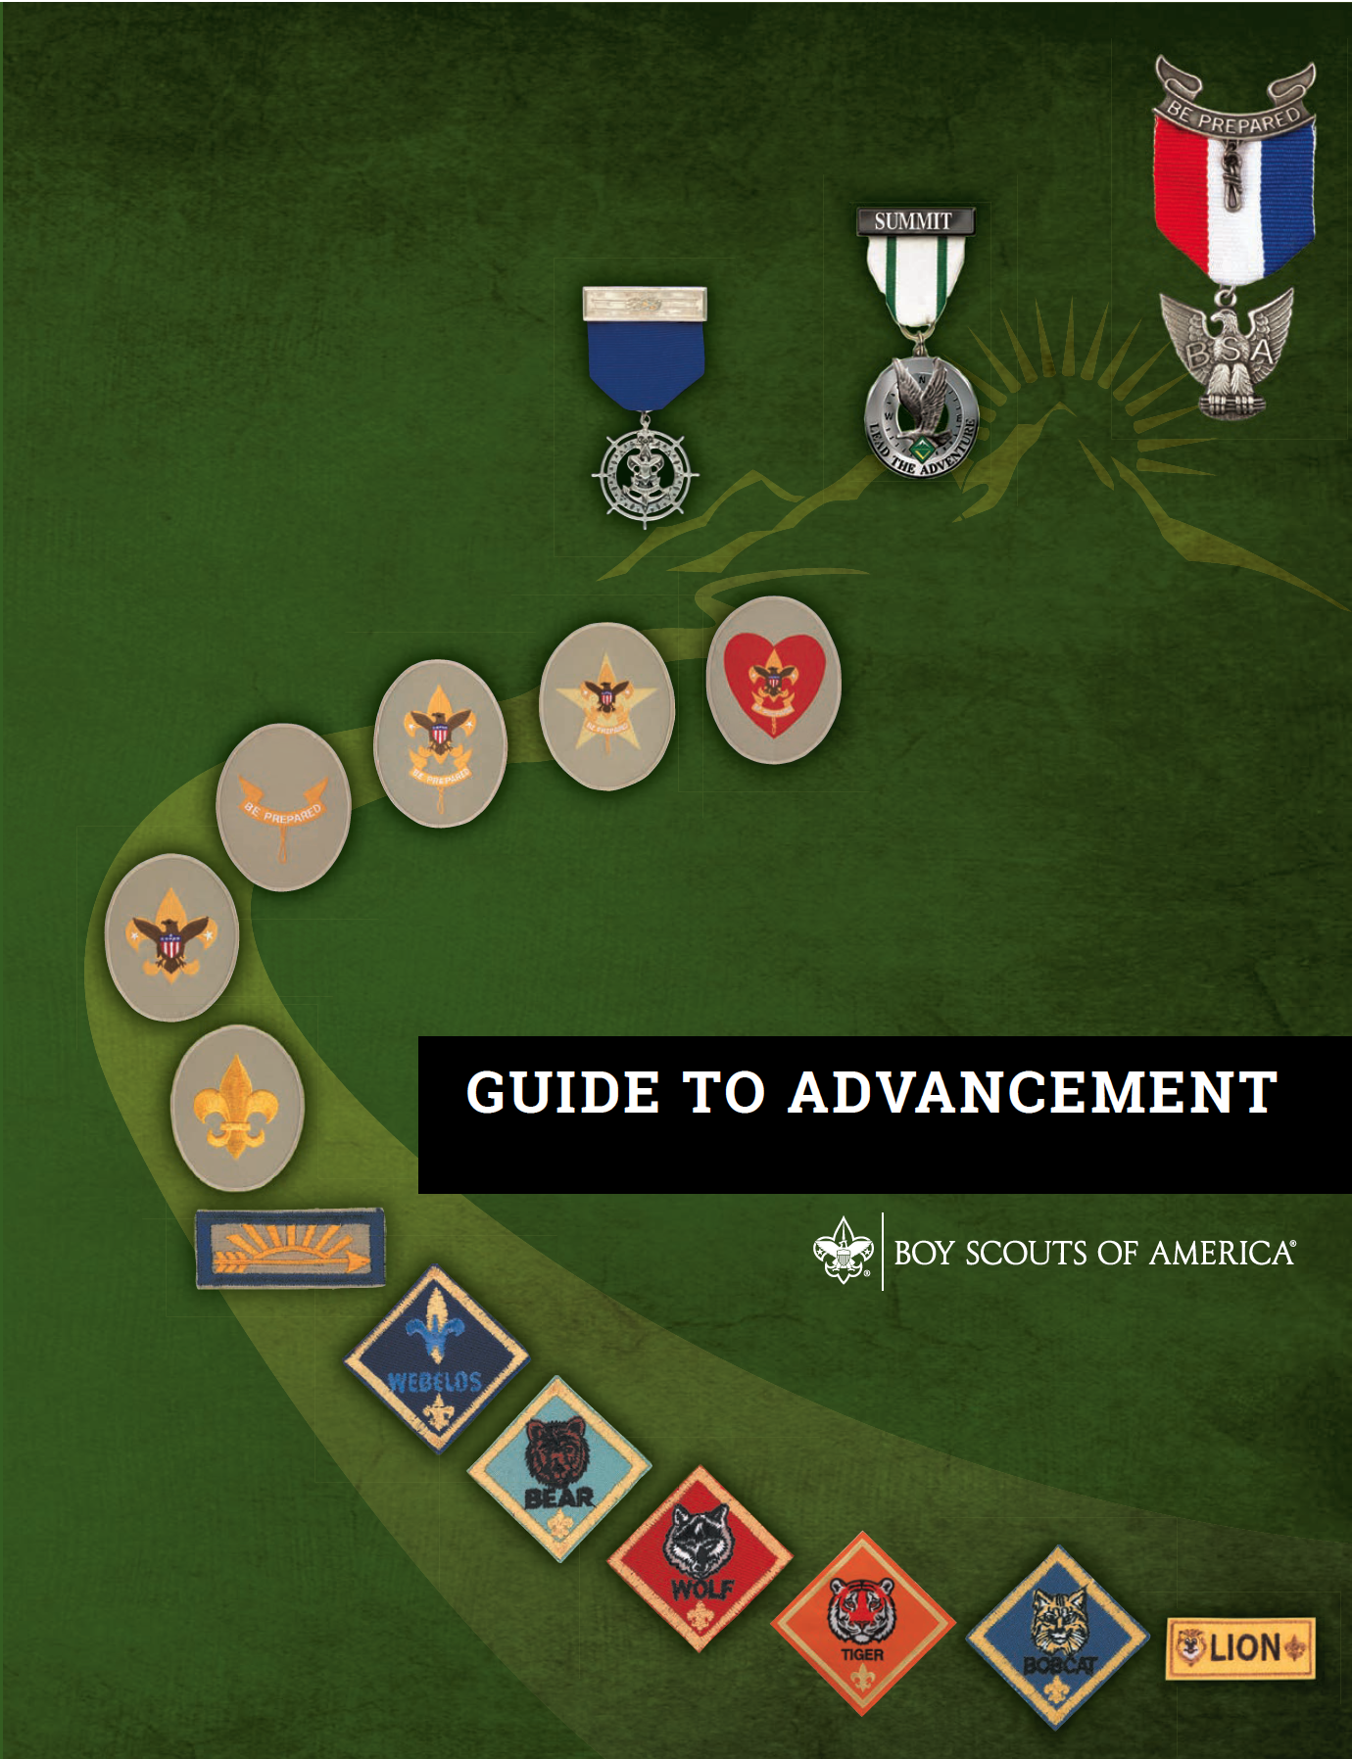
Official Sources for Guidance
Current editions of:
Guide to Advancement
Eagle Scout Service Project Workbook
Scouts BSA Requirements
Guide to Safe Scouting
  SAFE Project Tool Use
Notes:
An Eagle Scout Service Project Coach must, above all, abide by the policies and procedures outlined in these official resources. There are, of course, quite a few helpful guidelines as well. Before you work with your first Scout—or with your next Scout, if you’ve been coaching for awhile—be sure you’re familiar with the contents of the official resources – and make sure that they are current.
An improperly administered Eagle Scout service project can lead to boards of review under disputed circumstances, and to unnecessary appeals that can shatter a Scout’s dreams.

Slide 6
Qualifications of an Eagle Scout Service Project Coach
A coach must be a registered member of the BSA
  In any adult Scouting position
  Must be current in Youth Protection training
  Must be approved and designated by the council
A coach must also have a thorough understanding of the official resources previously mentioned, and especially sections 2, 8, and 9 in the Guide to Advancement.
Notes:
If you’re not registered with the BSA, or if your Youth Protection training is not up to date, then you will need to take care of those deficiencies. It doesn’t matter what your position is. To be a designated an Eagle Scout Service Project Coach—as described in the Guide to Advancement—you must be approved by your council or district advancement committee—whichever committee has the authority to do that in your council.
Note there are a few sections in the guide that called out here. Section 2 defines advancement; section 8 explains the policies and procedures for boards of review; and section 9 covers the policies and procedures regarding the Eagle Scout service project. These are critical. It is important to study them; not just to read them.

Slide 7
Eagle Scout Service Project Coach
Term of Service and Association
Term of Service: From service project proposal approval to completion of the project report.
The role of the designated project coach is not intended to require a close, frequent association.
Notes:
Since the service project coach is designated at the council or district level, a coach does not begin work with a Scout until the project proposal is approved. Service should then continue through completion of the project report.
The service project coach provides guidance, coaching, and consulting to the Scout on how to successfully plan and execute a project that will fulfill requirement 5. The coach should not become a day to day mentor. This limitation allows designated coaches to work with several Eagle Scout candidates simultaneously.
Just as units work on a day to day basis in the rest of the advancement program, so should units provide the day to day mentoring to help Scouts through the service project process. Designated coaches, with their expertise and objective perspective, should supplement assistance from the unit. They should not supplant unit efforts.

Slide 8
Appointing Coaches:
Where Do They Come From?
It is up to the council to determine:
  Who may serve as designated project coaches
  How to organize a pool of willing volunteers
  How to assign designated coaches to candidates
Unit “mentors” or “advisors”:
  Are not the same as designated coaches
  Often provide positive contributions
  Provide support with project planning and execution
  Prepare Scouts to work with designated coaches
Notes:
The council determines who may serve as designated project coaches. The ability to work well with Scouts, knowledge of applicable policies and procedures, and an understanding of how the project contributes to the objectives of Scouting are a few parameters to consider in selecting them.
If designated coaches do not take on the day to day mentoring, then each of them should be able to work with a number of Scouts at the same time. Still, depending on the size of the council or the district quite a few coaches may be needed.
Organizing a pool of willing and qualified volunteers is the best approach.
Ask: How would a council or district go about doing this?
Discuss. (Look for: Finding people who have approved project plans in the past, advised Scouts in their unit, served as unit advancement coordinators, or have been members of the council or district advancement committee.)
If there are just not enough people available to form a district or council pool, councils may decide to designate coaches from within a Scout's unit. But regardless the source, or a coach's Scouting position, the designated project coach represents the council or district's perspective. As a Scout plans and executes their Eagle Scout service project, the coach must be able to provide the level of guidance that will help the candidate successfully complete their project.
As proposals are approved, coaches should be designated routinely, and Scouts advised that a coach will be calling soon to set up a first meeting. If a young person suggests that they don’t need a coach, they should be counseled on the benefits a coach can provide and encouraged to at least have that first meeting.
Units have often used “mentors" or "advisors” to guide Scouts through the Life to Eagle process, providing that day to day support we’ve discussed. However, it must be understood that "mentors" and "advisors" are not the same as designated coaches. These helpful unit-level volunteers provide a positive contribution, but they have a different perspective. Their efforts should have a focus toward on-going support and encouragement in an effort to prepare a Scout to work with their designated coach. It may also be useful for the "mentor" or "advisor" to touch base now and then with the designated coach to ensure advice given is consistent with council expectations.

Slide 9
The Role of the Designated Coach
Different from the Life to Eagle “Mentor”
 | Life to Eagle “Mentor” | Eagle Scout Service Project Coach
Term: | Entire Life to Eagle process | From project proposal approval through project report
Focus: | Successful achievement of the Eagle Scout rank. | Successful fulfillment of the service project.
Appointment | Usually by the unit | By the council or district
Relationship: | Long-term | Short-term
Approach: | Coaching and mentoring throughout the process | Coaching and consulting on the project
Notes:
The position of Life to Eagle “mentor” or "advisor" is not actually an official BSA position, but as we’ve discussed, they can provide a valuable service. In many cases, however, they are confused with the designated Eagle Scout service project coach.
We’ve listed a few differences on this slide. Are there other differences?
Discuss.
(If it doesn't come out in the discussion, explain that these individuals working together can help candidates improve their chances for successfully meeting requirement 5.)

Slide 10
The Role of the
Service Project Coach
A service project coach’s advice is a key to success.
Serves as an advisor, consultant, coach.
Is a resource, encouraging the candidate to fully plan their project, secure resources, and to make wise decisions.
Uses positive adult association, logic, and common sense to help the candidate to reach a successful outcome.
Notes:
It cannot be said too often. A project coach is the key to success in council or district efforts to guide Scouts through the service project process.
And, yes, a coach serves as an advisor and consultant, and helps in other ways, but the coach does so without directing the Scout. Instead, a coach must use the BSA method of positive adult association, and also logic and common sense to help the candidate achieve success. (Ask for discussion on how a coach might do this.)

Slide 11
Guidelines for Coaches
Adheres to the service project process as described in Guide to Advancement, topic 9.0.2.9.
Has no authority to dictate changes, or withdraw approval that was previously granted.
Strives to make his or her involvement a positive experience.
Encourages a Scout to make the kinds of decisions that will lead to successful outcomes.
Notes:
Topic 9.0.2.9 of the Guide to Advancement provides information and guidance on the intended duties and responsibilities of an Eagle Scout Service Project Coach.
A coach's role is to support the Scout and to guide them toward making the kinds of decisions that will help them meet requirement 5. Coaches do not have the authority to dictate changes, withdraw approval previously granted by the district or council, or to take any other directive action.
Instead, Eagle Scout Service Project Coaches strive for a positive experience by encouraging Scouts to make wise decisions and follow logical processes as they work through the requirement. In this way we assist the Scout to become successful not just with their project, but because we provide an experience that will help the Scout throughout their life.

Slide 12
Bringing Scouts and Coaches Together
A coach should be designated for every Scout whose proposal is approved.
The assigned coach contacts the Scout, suggests a first meeting, telephone call, e-mail discussion, or video conference.
The Scout may choose not to accept the assistance of the coach, but should be counseled on the value a coach can add.
Notes:
Once a Scout’s project proposal is approved, a coach should be designated immediately. Don't ask the Scout if they want the help of a coach. The Scout has signed that they have read the workbook so we may assume they know coaches are not required. If a Scout doesn’t want one, they will tell us, through the unit or district leadership. The best practice is to provide the coach's name and tell the Scout to expect a call from a possible coach.
The designated coach should make contact as soon as practical after the proposal is approved. Time constraints often create challenges for Scouts to complete their projects by the time they turn 18. The sooner a coach makes contact, the better.
A coach’s work with a Scout can be through face-to-face meetings, telephone calls, e-mail, or by video conferencing, but face-to-face is preferred. Regardless the method of contact, discussions with the Scout should be relaxed, respectful, helpful, friendly, courteous, kind... Well, you get the picture.

Slide 13
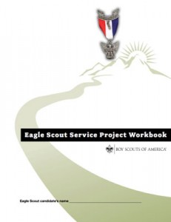
The Service Project Process
Proposal and Approval
Project Plan
Fundraising Application
Execution
Project Report
Board of Review
Notes:
Hand out copies of the current Eagle Scout Service Project Workbook. Briefly discuss the various parts.
The road to meeting the Eagle Scout rank requirement for service projects begins with the preparation and approval of the proposal and culminates in the board of review. Along the way there are many important steps.
Each section of the workbook plays an important role; especially the first, which lays the groundwork and begins—just begins—the planning process. It is critical that the Scout, their parent or guardian, the unit leaders, and the project coach study this material.

Slide 14
Reviewing an Approved Proposal
Review these five tests which should already have been applied (9.0.2.7):
The project provides sufficient opportunity to meet the requirement.
The project appears to be feasible.
Safety issues will be addressed.
Action steps for further detailed planning are included.
The Scout is on the right track with a reasonable chance for a positive experience.
Notes:
For the next several slides we’re going to cover the typical subjects a coach will discuss with a Scout concerning the service project process. But first, to give you some perspective, let’s discuss what happens during the review and approval of the Scout's proposal before the coach comes on board. Keep in mind that the proposal is an overview, and again, just the beginnings of planning.
The five tests shown here should have been applied in approving the proposal.
Ask: What is number 1 really saying? (Then cover each of the five tests with a similar question)
Listen for some of the following during the discussion:
Test 1: "... to meet the requirement." There is opportunity for planning and developing the project, for giving leadership to others, and the project will be "helpful."
Test 2: "...project appears feasible." It is a project the Scout is capable of managing, and it can be accomplished with resources that are available, or that can be obtained with a reasonable effort. Note that it says “appears to be feasible.”
Test 3: "Safety issues..." The Scout is aware of potential safety issues and hazards, and will address them in the project plan. Note that it says “You must show you have an understanding of what must be done to guard against injury, and what will be done if someone gets hurt”. We just need to be comfortable the Scout is aware of the issues, and comfortable that these issues will be addressed. However, unit leadership should be aware of project plans and schedules. The health and safety of those working on Eagle projects must be integrated into project execution. Since an Eagle Scout project is a unit activity, unit adult leadership has the same responsibility to assure safety in conducting a project as with any other unit activity.
Test 4: "Action steps...” Key action steps have been identified that the Scout will use for developing their plans. This means just what it says. The Scout has made short list of some of their next steps, so we can see that they are on the right track.
Test 5: "...positive experience." The Scout has demonstrated that they have a good understanding of what they are proposing to accomplish and they have a good chance of a successful outcome that will contribute to the Scout’s growth and development. This is where your “gut feel” comes to play.
Note that it’s not the role of the coach to question the adequacy of an approved proposal. It’s the coach's role to advise the Scout in developing their plan, but the five tests serve as a great starting point for the discussions.

Slide 15
Initial Discussions
Project Orientation
Before work begins on the project plan, discuss with the Scout:
  How the project proposal approval process went
  The information requested in the Eagle Scout Service Project Workbook project plan section
  How the Scout intends to plan the project, and then offer advice accordingly
  Any planning issues, that if ignored by the Scout could stop work or create health, safety, legal, or environmental issues.
Notes:
The first meeting between the coach and the Scout is critical in developing a positive working relationship. Strive for a relaxed atmosphere and spend a little time getting to know each other. Ask questions about their Scouting background and other interests, and ask the Scout how the proposal approval process went. The young Scout may be somewhat nervous, especially if they have never tackled something as involved as an Eagle Scout service project. Remind the Scout that each year thousands of young men and women will successfully complete a project and earn the Eagle Scout rank.
During your discussion, take a look at the Project Plan form. Assume your Scout will be using it. There will be some who may not want to complete the form, but let them know they still have to have a plan. The board of review will want to have some evidence that the required planning and development actually took place. Scouts who come up with some other way of showing this, may run the risk that it will fall short of board of review member expectations.
The project plan is an important tool that is organized to stimulate the Scout’s planning efforts and to lead them to a successful project conclusion.
Discuss the specifics of the Scout’s project, ask questions, and offer advice accordingly. Listen, also, for any issues that could become problems later; for example, the weather, building permits, the environment, safety, and other elements they may not have considered. Listen for their thoughts on how they will develop a plan appropriate to the project. Help them understand the importance of a logical step by step planning process.

Slide 16
Initial Discussions
Project Planning and Future Communication
Encourage the Scout to start work on their project plans and to develop a completion schedule.
Emphasize how important it is for the beneficiary to approve what will be done.
Discuss beneficiary-obtained building or environmental permits and the timing involved.
Discuss any special skills required to execute the requirement.
Notes:
Remind the Scout that a well-developed plan is the key to their success. Encourage the Scout to put together a schedule and to set a goal for completing the project plan. Encourage the Scout to contact or meet with you from time to time as their plan progresses, and as soon as possible after they have completed it. Stress that your intention is not to be critical, but to help them toward a successful experience.
Be sure the Scout understands that before work begins, the project beneficiary should be fully aware of the project plans. Encourage the Scout to meet as often as necessary with the beneficiary to achieve full understanding and acceptance. Not doing so could mean the difference between project failure and success.
If building or other permits will be needed, help the Scout understand these may take 45 to 90 days or even longer to obtain. Point out that the project beneficiary is responsible for obtaining any permits.
Discuss any special skills or expertise that will be needed; for example, will power tools, heavy equipment, or specialized equipment be used? Will plumbing, wiring, or other work be done that would call for special training or certification? Ask the Scout to comment on how they might go about recruiting individuals with specialized skills. Ask the Scout to describe what challenges they may face giving leadership to those individuals.

Slide 17

Initial Discussions
Project Plan Elements
Proposal review comments
Project description and changes
Present conditions
Project phases
Work processes
Attachments
Permits and permissions
Materials, supplies, tools, and other needs
Expenses & revenue
Giving leadership
Logistics
Safety
Contingency plans
Notes:
Here are the sections of the project plan that the Scout may need to address. Depending on the project, not all of the sections may be applicable. For example there may not be any tools needed for certain projects. In those cases simply tell the Scout to mark those sections, “N/A”.
Review each section with the Scout, and recommend that notes be taken. Point out the sections that are most important for project success. You may want to have a spare blank copy of the Project Plan form for the Scout to mark up.
Point out that “Be Prepared” is a major concept in completing any plan.

Slide 18
Initial Discussions
Where the Scout Can Go for More Information
Refer the Scout to the BSA publication:
“Navigating the Eagle Scout Service Project - Information for Project Beneficiaries”
www.scouting.org/advancement
Encourage the Scout to make contact when they have questions or need advice.
Emphasize the importance of sharing their project plan with you immediately upon completion.
Notes:
Distribute “Navigating the Eagle Scout Service Project - Information For Project Beneficiaries.”
Be sure each Scout you coach is aware of the "Navigating the Eagle Scout Service Project" information sheet, share a copy with and encourage them to give a copy to the project beneficiary—if they have not already done so. The sheet contains important information, and makes it clear that the beneficiary has the authority to approve a Scout’s project plan. In addition to the link shown on the slide, the sheet will be found on the last two pages of the Eagle Scout Service Project Workbook.
Emphasize that you’re available to help the Scout as needed. However, don't be afraid to occasionally contact the Scout to offer encouragement.
Reiterate your readiness to review the project plan with the Scout, one last time before they execute the project.

Slide 19
Initial Discussions
Service Project Fundraising
Projects must not be primarily fundraisers.
Fundraising is permitted only to facilitate a project.
Contributions from the candidate, parents, relatives, unit, chartered organization, or beneficiary do not require a fundraising application.
All other fundraising must be approved by the council.
Notes:
Fundraising is permitted only for securing materials and otherwise facilitating a project. This includes things such as food and water for the workers, equipment rental, safety supplies, printing or copying services, or anything else necessary for facilitating a project. If you’re concerned a project is primarily a fundraiser, then help your Scout transform or expand it into something that will more closely fit the requirement.
Fundraising may require council approval if it goes beyond the family, the unit, or the beneficiary.
Essentially, all other fundraising must be approved by the local council using the Eagle Scout Project Fundraising Application found in the project workbook.
Explain to the Scout that they must make it clear to all donors or fundraising event participants that the money is being raised on behalf of the project beneficiary, who will retain leftover funds. Should any donors want documentation of a gift, this must be provided through the beneficiary, not the Boy Scouts of America.
Once collected, money raised must be turned over to the beneficiary or to the candidate’s unit until needed for the project. If the unit receives the funds, then once expenses have been paid, any excess goes to the beneficiary.

Slide 20
Initial Discussions
Service Project Fundraising
Fundraising applications should be submitted as part of the project planning process, and two weeks in advance of fundraising efforts.
The Scout will be contacted if the application cannot be approved.
The Scout should check to see if the council has set additional parameters on fundraising efforts.
Note that no Scout leader at any level has the authority to require fundraising for an Eagle project.
Notes:
Fundraising applications should be submitted as soon as it is clear during the project planning process approximately how much money will be needed or what material donations will be requested. There are several sections of the project plan that do not impact fundraising, so it is unnecessary to wait until the project plan is completed. To provide sufficient time for review, all fundraising applications should be submitted to the council at least two weeks in advance of the proposed efforts.
In addition to the exceptions previously mentioned, councils may establish their own additional parameters in order to reduce the number of fundraising applications submitted. For example, a council may determine that bake sales, car washes, efforts under a certain dollar threshold, and so forth, do not need an application.
Ask: Why must the local council approve most fundraising activities? (Look for: To avoid conflicts with council or district efforts; to assure that activities fit within BSA policies, procedures, and values; and to control the scope and methods of fundraising so that the Scout—a minor—is not placed in a difficult situation from an accounting or legal perspective.)
Occasionally it is discovered that some councils, districts, or units are requiring that a fundraising effort accompany every project. This is not permitted. Fundraising has the potential to create a number of problems that minors should not have to deal with. A reasonable level of fundraising is allowed, but it is not, and must not, be required.

Slide 21
Reviewing the Project Plan
With the Scout, review the plan’s strengths, weaknesses, and risks. Suggest improvements.
Discuss leadership challenges they may face.
A coach may meet with the Scout, their parents, unit leader, or beneficiary to discuss concerns.
  It is the Scout’s responsibility to implement their plan.
  Final design issues are ultimately between the Scout and the beneficiary.
Notes:
When the Scout believes their project plan is complete, try to get with the Scout as soon as possible to get to you so you can review the plan together. It is important this meeting be held in a timely manner. Help keep up the Scout’s momentum by not delaying the process.
As you and the Scout review the plan, point out any strengths, weaknesses, omissions, time risks, or potential safety issues. Ask the Scout what actions they might take to address these issues. If appropriate, review applicable portions of the Guide to Safe Scouting.
Ask the Scout what leadership challenges they might face and how they would respond to them. Discuss with the Scout the different kinds of leadership they will need to give to youth who are older or younger than they are, to family members, and to adults—especially those with special skills who will accomplish things that the Scout cannot.
It’s also a good idea to discuss any information or activities that should be “tracked” to help the Scout prepare the project report.
In the rare instance where you are concerned that the planned project will not meet the requirement or will not satisfy the beneficiary, you may want to contact or meet with the Scout and their parent or guardian, the unit leader, or a representative of the beneficiary. While you may provide guidance that is critical to success, unless there is something illegal or unsafe going on, it is the Scout's prerogative whether or not to proceed. Final design issues are between the Scout and the project beneficiary. The board of review will decide whether planning was sufficient to meet the requirement.
Wish the Scout well on their service project adventure and let them know you will be available to offer guidance and advice throughout execution of his project.

Slide 22
The Project Report
Emphasize completion of the project report because of its importance in board of review approval.
Review what is requested in the report to ensure it is fully understood.
Suggest the Scout submit the draft report to you for further review and guidance.
Notes:
The project report is to be completed after the service project has been concluded. Note that it is acceptable for the report to be completed and approved after the candidate's 18th birthday. The project, itself, must be completed before then; the report merely supports what has already been done.
With the Scout, thoroughly review the report form. It is not necessary for them to provide lengthy answers, but it should give them the basis to discuss the project in detail with their board of review. Along with the Scout's project plan, the completed report can be very useful in demonstrating to the board of review that their efforts have met Requirement 5.
Offer the Scout the opportunity to meet with you once the project report is prepared. That will give both of you one last opportunity for discussion before the board of review.

Slide 23
The Eagle Scout
Service Project Report
Project Description
Observations
Changes
Leadership
Materials, Supplies, Tools
Entering Project Data
Funding
Documentation
Candidate’s Promise
Completion Approvals
Notes:
Here are the different parts of the project report. Each asks a few questions about key aspects of the Scout's experiences. The report is designed to cause reflection on these experiences as well as to provide a basis for discussion at the board of review. Simple, concise answers are all that is needed.

Slide 24
Achieving Success
It is a helpful project that the BSA requires.
The quality of the write-ups and that everything is signed, are important, but they are simply supportive to the effort.
Did the project meet requirement 5?
      Was there planning and development?
      Did the Scout lead others?
      Was the project helpful?
Notes:
Keep in mind that write ups and signatures, though important, are simply supportive. Requirements 5 doesn’t have a grammar or spelling component, either, and there is no mention of “hours worked.” The National Council asks for the number of hours involved in a project only because the statistic points to accomplishment—from an overall “macro” standpoint—of our citizenship aim. Requirement 5 calls only for planning and development, leadership, and helpfulness. Well, we want impact too, of course; and the key to deciding what that means is to look at the word, “impact,” from the perspective of a young person.
Rather than focusing on "technicalities," such as grammar and spelling, as you review a Scout’s report, focus on the intent of requirement 5. Use common sense to consider if there was planning and development, leadership of others, and a result that was "helpful." If there were, then the quality of the various supporting documents should not be an impediment to advancing a Scout. But that said, encourage your Scout to put forth their best effort in preparing the workbook for submission. Challenge the Scout to meet their potential, and to impress the members of their board of review.

Slide 25
Achieving Success
“…Plan, develop, and give leadership …
in a service project helpful…
We know we have achieved success when we have met the objectives of Scouting.
Planning and development are intellectual exercises relating primarily to mental fitness.
Leadership relates primarily to character development.
Helpfulness, of course, relates to citizenship.
Notes:
Earlier we suggested you think about how the parts of the Eagle Scout service project requirement apply to the objective of Scouting. We’ll cover that now.
The critical elements of the requirement are all found in its first sentence. The three sentences that follow simply set forth some limitations and the approval process, right? So we’ll just concentrate on that first sentence. There are three important parts in that sentence, and each relates primarily to one of the objectives.
The first part—planning and development—represents a mental exercise related to personal fitness. This part of the requirements is mostly about thinking.
We say that leading others relates primarily to character development. We’re hopeful the Scout will learn to vary their leadership style as they work with different kinds of people: those younger than they are, youth who are older, adults in and out of Scouting, and family members. This is one of the reasons we allow parents and siblings to participate. The degree of difficulty in giving leadership to a parent or to a brother or sister has the potential to provide some very interesting challenges.
The third part of the requirement relates to citizenship and those lessons we all learn when we give of ourselves to benefit others.

Slide 26
Review
Why is the Eagle Scout Service Project such an important requirement?
What is the role of the Eagle Scout Service Project Coach?
How does the Eagle Scout Service Project Coach accomplish their responsibilities?
What benefits will a Scout receive when choosing to work with an Eagle Scout Service Project Coach?
Notes:
(Call for discussion on each of the topics listed on the slide.)
If not brought out in the discussion, note that the Eagle Scout service project provides a wonderful opportunity for a Scout to serve others while gaining valuable experience that will benefit them throughout their life. The feeling of accomplishment should motivate the Scout to continually "help other people at all times." The project also provides the Scout with an opportunity to learn the basics of project management: how to independently and methodically plan and execute a project. These are skills that could lead to a career, but we must be aware that it is simply the mental exercises involved in planning and development that provide the reasons for requiring it. We are in business to develop good citizens who are fit and of good character. It is not our purpose to develop great project managers. While the project itself has intrinsic value, what the Scout gets out of it and takes with them through their lifetime, is a great deal more important than the project itself.
The role of the service project coach is to provide advice and encouragement, consulting, and guiding the Scout through the process of fulfilling requirement 5. This may include working with the Scout to help them prepare their plans, and coaching them through the execution of the project and developing their report. Just remember, though; the project is their project. Not yours.
The coach accomplishes their responsibilities by being a consultant, a coach, a counselor, and a resource. Positive interaction with the Scout is a critical contribution to personal growth. The coach’s active term of service begins after the project proposal has been approved. It concludes when the report is completed. Remember, however, that service as a designated coach is not a “constant contact” position. It works from a council or district perspective, and does not have the kind of everyday relationship that should be experienced by a mentor at the unit level.
The Scout will benefit from a project coach’s background and experience relating to different kinds of projects and an understanding of council and district expectations for Eagle Scout service projects. A coach’s advice will assist the Scout in thinking through all of the details necessary to successfully plan, develop and give leadership to the project. Advice on potential pitfalls and risks will also be very useful in ensuring the Scout has a positive experience.

Slide 27

Summary
Advancement is based on experiential learning:
to educate or to otherwise expand horizons.
Personal growth is the primary goal: learning to apply new skills and gaining confidence to do so.
Notes:
In summary, we’d like to draw attention to these two points that are often overlooked.
Yes; overlooked. Sometimes we get so wrapped up in the specifics of the project, and maintaining some mythical set of standards, that we forget the real Scouting connections.
The importance of the Eagle Scout service project does not lie in the end product. It’s not so much about what got built, for example. It’s about the journey—the experience. Eventually a bench or a table will rot and crumble. Eventually a bookcase will be replaced. Soon, a bicycle safety rodeo will be forgotten. But that’s ok. It’s in the experiences—everything that happens—every discussion, every “aha” moment, every night spent at the drawing boards, every hour of work at the site giving leadership, and more, that teaches the lessons we want. It’s about sticking with something and seeing it through, it’s about personal growth. It’s about learning a skill and applying it to something else that’s important in life. It’s about learning another skill, that though it could be forgotten, served to provide the experience—and the confidence—to do something else entirely different, that perhaps the Scout never thought they could do.
And now, a final important point: From time to time, perhaps more often than we like, you may encounter dedicated Scouters who are unfamiliar with the Guide to Advancement, and who continue to operate with outdated national policies and procedures. You may also find volunteers who are familiar with the GTA, but who choose to ignore it. Then, there are those who over the years, who have come up with their own versions of the Scouting program. Please understand that this presentation you’ve just been through has been created and approved through the National Advancement Program Team. It is “official.” When you encounter people who question what you’ve learned today, help them find the correct and current practices in the Guide to Advancement. If they continue to question the national procedures we’ve been discussing, then you should take this up with your council advancement committee, and if necessary, with your Scout executive. After this has been done, if the issues persist, please let us know at advancement.team@scouting.org.

Slide 28
Additional Educational Presentations www.scouting.org/advancement
Introduction to Guide to Advancement
Eagle Scout Application Process
Eagle Scout Boards of Review
Notes:
The National Advancement Program Team has produced a number of educational presentations and other materials that are available at www.scouting.org/advancement. The presentations listed on this slide should be of interest to project coaches. They will help you better understand your role, and we highly recommend them.

Slide 29
“The Eagle Scout Service Project Coach is the subject matter expert on the processes and standards of the service project. He or she is the key to success in council or district efforts to provide guidance as Scouts work to fulfill requirement 5.”
- Guide to Advancement, topic 9.0.2.9
Prepared. For Life.
TM
Notes:
Read the statement.
Thank everyone for their attendance and offer to answer questions.

