Slide 1
Commissioner Tools Unit Metrics and Unit Connections
Notes:
The National Commissioner Service Team has been reviewing what and how commissioners have been providing unit service and has initiated a project called “The Future of Unit Service.” This project impacts every element of unit service and is designed to simplify and streamline the work commissioners do while increasing the effectiveness of their support of unit leaders. It is aligned with and supports Scouting America’s Roadmap.

Slide 2
Learning Objectives: Commissioners need to understand:
The importance of relationships
The reasons for change
What the changes are
How to use the new methods in unit service
Notes:
In this presentation, you will learn the importance of relationships, the reasons for change, what the changes are, and how to use the new methods in unit service.

Slide 3
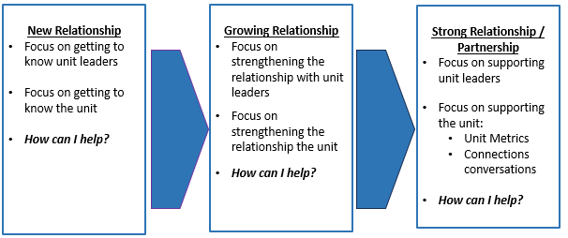
Relationship Drives Partnership
No Relationship = No Partnership
Notes:
Relationship drives Partnership
Building partnerships with unit leaders will increase a commissioner's trust and effectiveness when working with a unit. This graphic outlines the steps in moving from establishing a relationship to growing that into a partnership with a continual message of "How Can I Help? " The focus should always be on understanding the unit's needs, resulting in how to best support them.

Slide 4
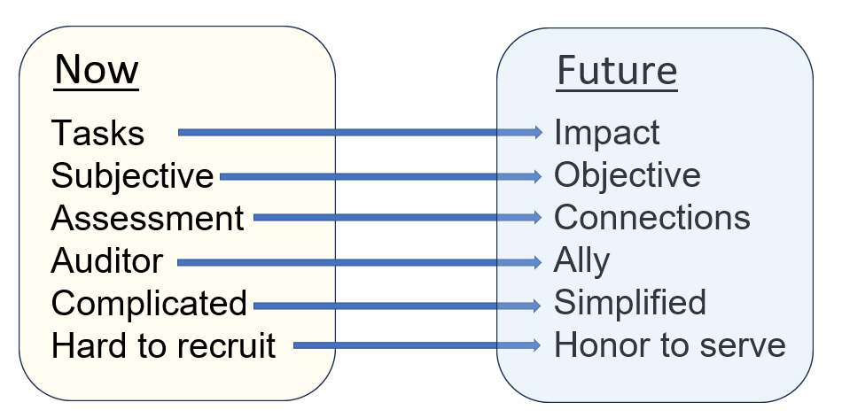
What’s Changing?
Notes:
What’s Changing?
This slide shows how commissioners have managed their role in the past compared to the expectations for how they will handle them in the future.
Commissioners need to be less focused on tasks and move towards making an impact. Subjective scores generated through Assessments will no longer be required, with objective unit data now available for commissioners to guide them when engaged with the new unit connection process. This will simplify the commissioner's work and aid in building a stronger relationship with the unit leaders.
Recruiting commissioners can be a challenge, but when the volunteer views the role as an honor to serve as a commissioner, it's expected inviting commissioners to serve will be different.

Slide 5
What’s the Reason for Change?
New approach will encourage commissioners to work more closely with unit leaders, creating a partnership
Ensures a better Scouting experience for youth and volunteers
Listening to unit leader needs will help commissioners be the Single Best Resource
Unit metrics are more objective
Changing the way commissioners work with unit leaders is a foundational component of commissioner culture
Notes:
Why are we changing?
It has been observed that the current approach is not driving consistent desired commissioner behavior. Unit leaders have not received assessments well; consequently, meaningful assistance suffers. Unit scoring is inconsistent, and documented contact information is not always useful. Stronger active units ensure a great Scouting Experience for youth and adults.
Effective communication and partnerships are essential to our success. Commissioners should help units by listening to the needs of unit leaders and serving as the single, best resource.
Everything commissioners do starts with effective communication: building relationships, strengthening units, serving youth, and encouraging membership growth.
A relationship is the way two or more people behave toward each other. Partnership sets a higher standard: people working as partners listen to each other, understand one another, and work together to accomplish a common goal. Teamwork is effective. Our success is dependent upon partnerships.
Combining effective communication and partnership enables impact.

Slide 6
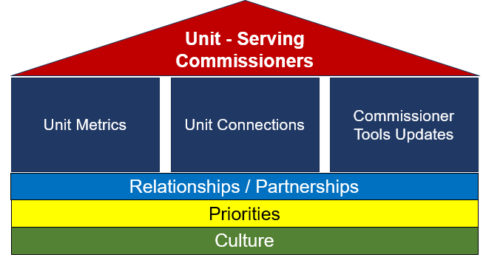
Unit Service Concept
Notes:
Unit Service Concept
There are three components to the concept of Unit Service.
The first is Unit Metrics. Unit Metrics introduce objective data and eliminate the assessing and scoring of units. The metrics can be a starting point for conversations and may suggest areas of conversation to understand how the unit operates and how commissioners can engage. They are NOT measures of success or failure.
The second is Unit Connections, a new method and tool that will help commissioners develop partnerships with unit volunteers and guide conversations toward areas where commissioners can impact.
The third component is the Commissioner Tools Updates, which involve integrating Unit Connections and key metrics into our current Tools system.
The Metrics, Connections, and Tools are all built on the foundation of commissioner culture, our priorities, and the relationships we build with unit leaders and others in the district/council.

Slide 7
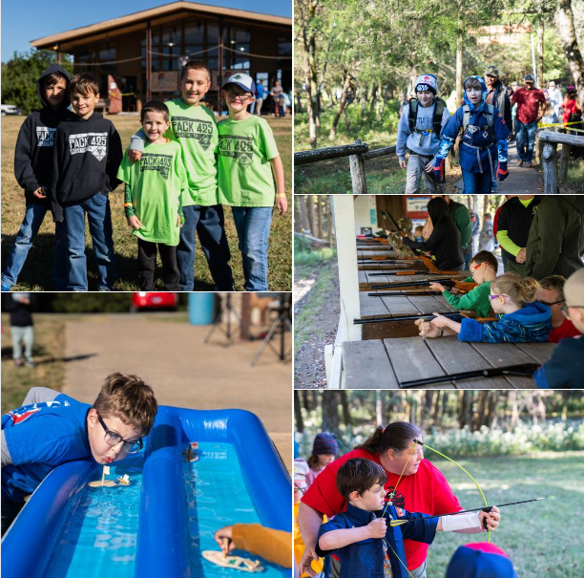
Review of Unit Metrics (Objective)
Key Leaders Trained
Unit Size
Membership Growth
Advancement/Youth Leaders
Outdoor Activities
Youth Retention
Notes:
Unit Metrics are simple, objective indicators of a unit’s status. They are a starting point for discussions and are not intended to compare one unit to another. Instead, they provide insight into a unit’s overall status so you and unit Scouters can work together to improve their ability to deliver the promise of Scouting. The unit metrics that have been chosen provide an objective and useful means of identifying how a unit is doing and enable commissioners a convenient method to provide focused help where needed. Objective metrics are determined using thresholds established for average expectations. Variation from these thresholds is not necessarily ‘good’ or ‘bad.’ Metrics are not ‘scores.’ They identify opportunities to ‘connect’ with unit leaders and understand how best to provide useful guidance where needed. Discussing only one or two metrics with a unit leader to explore where help might be needed, could be very beneficial.
Key Metrics are objective and help commissioners identify potential areas to help unit leaders.
An advantage of this approach is that metrics are not a barrier to building a relationship with unit leaders – unlike our current approach of scoring and assessing, which can be intimidating for unit leaders.
However, focusing solely on Key Metrics keeps us focused only on data. We need to look beyond metrics to understand how commissioners can interact effectively with units to make sure that youth who join Scouting don’t drop out because of disorganization or lack of understanding on the part of unit leaders
Caution: The danger comes from presuming units ought to do it one way or that there is only one way to define success.
Metrics are not intended to be a tool for us to use to tell unit leaders what they are doing wrong or point out where they don’t succeed.
Metrics can help us determine which units might need help and which commissioners might be the best fit to help them.

Slide 8
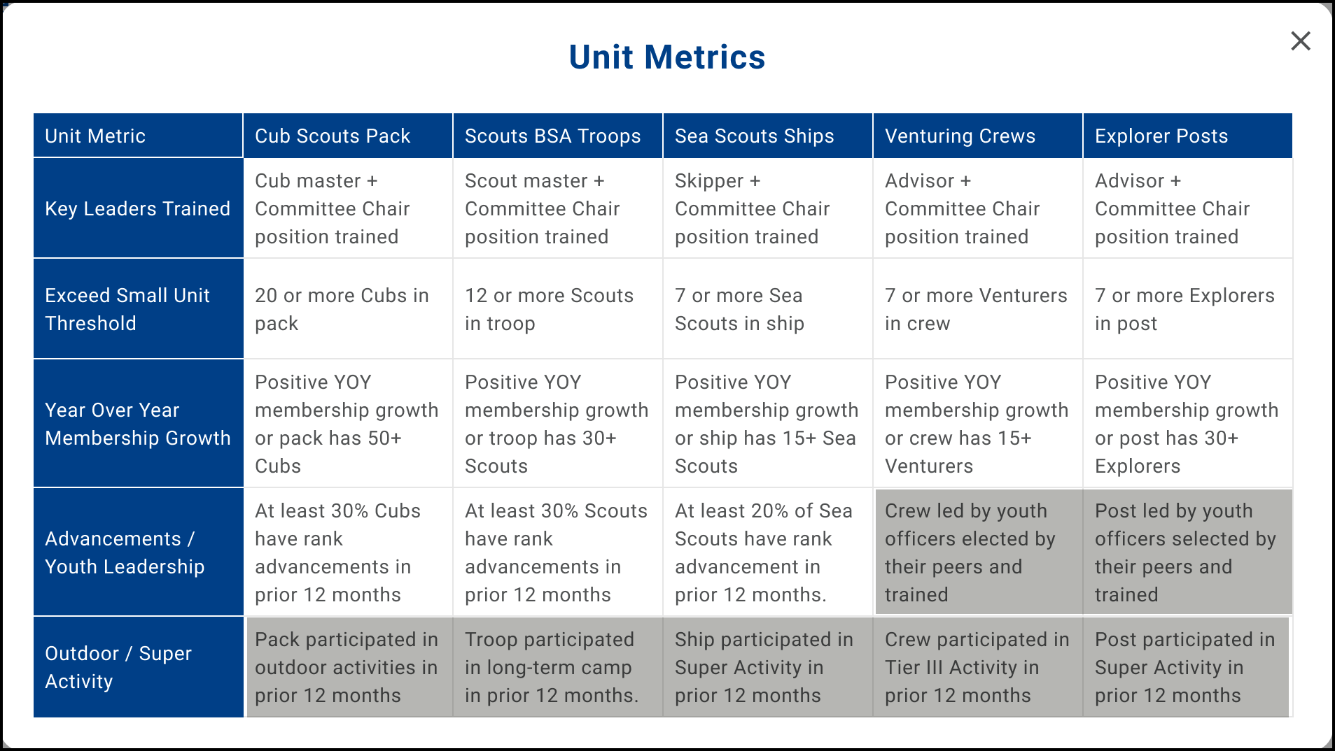
Notes:
Objective metrics are determined using thresholds established for average expectations. This chart displays six metrics, covering each of the five Scouting America programs, and describes thresholds based on average expectations. Each metric and threshold was established based on a relationship with unit renewal.
Note, for example, the unit size for Cub Scouts. The threshold is set at 20, which interestingly is far below the national average of pack sizes. However, during the development of this new process, units that fell below this threshold were less likely to complete a unit renewal. It also helps to establish a typical den unit for each grade level with at least 3-4 youth in each den. Similarly, for Troops, a threshold of 12 accommodates two patrols of 5 youth and still enables the opportunity for youth leadership’s SPL and ASPL, which is fundamental in the Scouts BSA Program.
Data is available through Scoutbook Plus and other Scouting America systems. The shaded metrics, Leadership for Crews and Posts, and Outdoor Activity for all programs, are dependent on what is entered at the unit level. Our technology systems have been updated to make it easy for unit leaders to enter only a date for when the activity occurred via My.Scouting or Scoutbook Plus.

Slide 9
Benefits of Unit Connections:
Build Relationships
Enhance Conversations
Drive Collaboration & Innovation
Foster Support
Create & Grow Partnerships
Change Lives
Notes:
Benefits of Unit Connections
Unit Connections is a Tool for commissioners to assist in meaningful conversations with the unit.
Building Relationships: Connections facilitate establishing strong relationships based on trust, respect, and shared goals. These relationships form the backbone of successful teamwork and collaboration.
Enhancing Conversations: Strong connections begin with knowledge to enable open communication channels. When individuals feel connected, they are more likely to express their thoughts, concerns, and ideas freely, leading to better understanding and problem-solving.
Driving Collaboration: Connected individuals and groups are more inclined to collaborate effectively towards common objectives. They leverage each other's strengths, resources, and expertise to achieve shared outcomes that benefit everyone involved.
Fostering Support: Connections create a support network where individuals can seek help, guidance, and encouragement from one another.
Create & Grow Partnerships: Connections lay the groundwork for establishing and nurturing partnerships. These partnerships, built on mutual trust and shared interests, can lead to new opportunities, innovative solutions, and long-term success.
Change Lives: Connections have the power to transform lives by providing access to new resources, perspectives, and opportunities. Through meaningful interactions and relationships, individuals can achieve personal growth, overcome challenges, and reach their full potential.

Slide 10
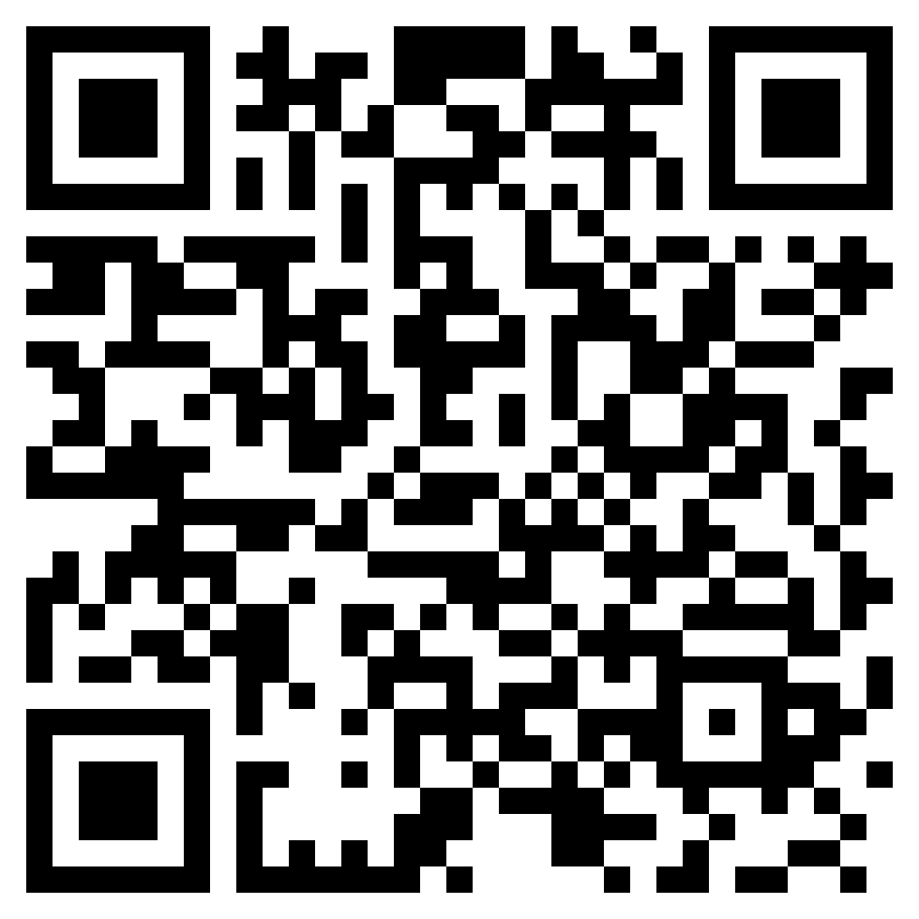
https://shorturl.at/5qRpd
Notes:
Connection Guides
A new tool available is a set of Connection Guides to aid new and experienced commissioners in facilitating a conversation with unit leaders. These new guides were created following feedback received directly from commissioners across the country. There are guides for each of the six metrics, and more will be developed in the future. All guides will be accessible from the updated unit and district dashboards, and each follows a similar pattern of offering several leading questions to help guide a unit-level conversation.
Scanning this QR code will also enable direct access to the library of connection guides.

Slide 11
Pre-Connection Preparation
Review Unit Data
Identify Potential Topics
Schedule Connection
Questions/Discussion Points
Notes:
The unit dashboard and unit connection guides are readily available to prepare to connect with your units. Here are a few ideas to guide you in getting ready to connect with unit leaders:
Review Unit Data: Utilize available resources (e.g., unit dashboards, unit metrics, membership records, advancement reports, activity calendars) to identify potential areas for discussion and improvement. Look for trends, gaps, and areas where the unit might need assistance.
Identify Key Topics: Based on the data review, determine the most pressing issues to address with the unit leadership. Prioritize based on impact and urgency. (Examples: low membership, stagnant advancement, lack of outdoor activities, training gaps).
Schedule Unit Connection: Contact the unit leader to schedule a connection at a convenient time and location. Be clear about the purpose of the connection.
Prepare Questions/Discussion Points: Outline specific questions to ask and topics to discuss. Using the Connection Guides, consider potential solutions and resources you can offer.

Slide 12
Making the Connection
Review Data Together
Facilitate Discussion
Brainstorm Solutions
Focus on Action
Share Resources
Next Steps
Schedule Follow-up
Notes:
Here are some ideas on how to guide the connection now that you are together:
Review Data Together: Conversationally share your reviewed data with the unit leader. Ensure they understand the trends and potential concerns. This collaborative review helps ensure everyone is on the same page.
Facilitate Discussion: Ask open-ended questions to encourage the unit leader and other leaders to share their perspectives on the challenges and potential solutions. Actively listen to their input. (Examples: "What do you think is contributing to the low membership?", "What are some barriers to getting Scouts to camp?" "What resources would be most helpful?")
Brainstorm Solutions: Work together to brainstorm potential outreach activities, program enhancements, or other strategies to address the identified issues. Encourage creative thinking and explore various options. Offer examples from other successful units, but avoid being prescriptive.
Focus on Actionable Steps: Encourage and guide the unit leaders to identify goals and action steps. Who will do what by when?
Resource Sharing: Provide information about relevant training courses, program resources, funding opportunities, or other support available from the council or district.
Confirm Next Steps: Summarize the agreed-upon action steps and assign responsibilities. Ensure the unit leader understands what they are expected to do.
Schedule Follow-up: Schedule a follow-up connection to review progress on the action items and offer further support.

Slide 13
After the Connection
Document
Follow-up
Support
Notes:
Once you have finished meeting with the unit leaders, It’s time to summarize your conversations.
Focus on Strengths: While addressing challenges, also acknowledge and celebrate the unit's strengths and successes.
Empower Unit Leaders: The commissioner's role is to facilitate and support, not to take over. Empower the unit leaders to develop and implement their own solutions and guide them in goal setting as needed.
Be Patient: Change takes time. Be patient and persistent in your efforts to support the unit's growth and improvement.
Maintain Confidentiality: Respect the confidentiality of information shared during unit visits.

Slide 14
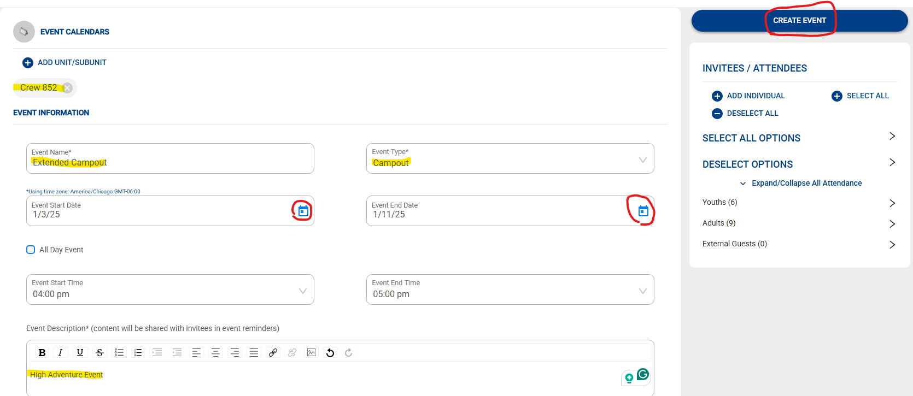
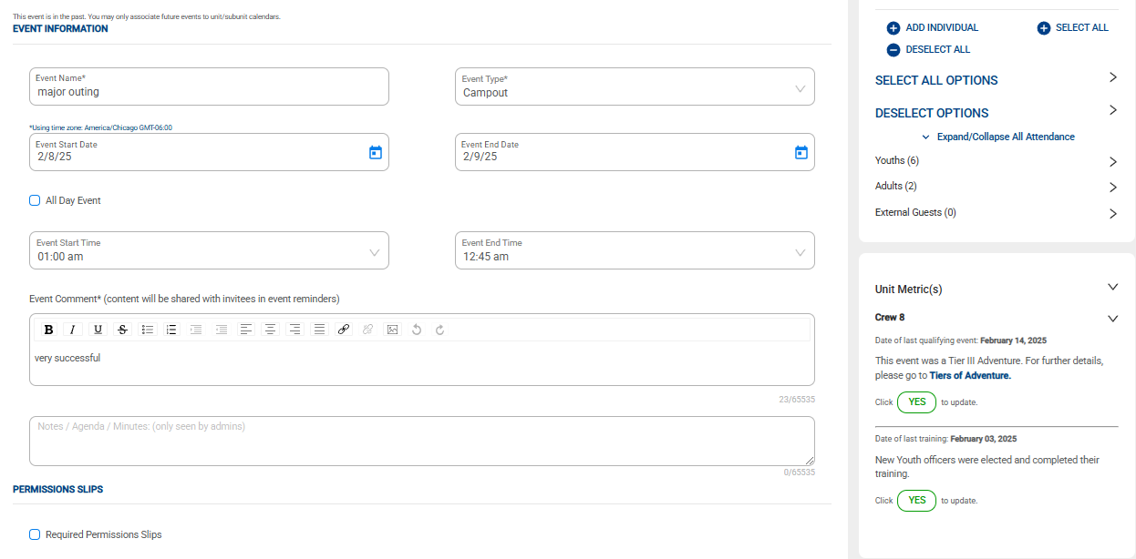
Data Entries in Scoutbook+
After entering SB+, Create Event, then Complete Unit Metric Entry w/ Date
Notes:
All units are requested to enter data for the Outdoor Adventure. This can be done using two methods: Scoutbook+ or my scouting in Organization Manager. Crews and Posts will also need to make an entry for electing new youth leaders and completing leadership training.
This example shows how data is entered in Scoutbook+. After completing an event entry in Calendar, click on Unit Metrics and enter the completion date. The date will be good for a full year or until a new date is entered. This process works for all Scouting programs, and the definitions of those requirements are noted specifically for whichever program is making the entry. This example is for a Crew.

Slide 15
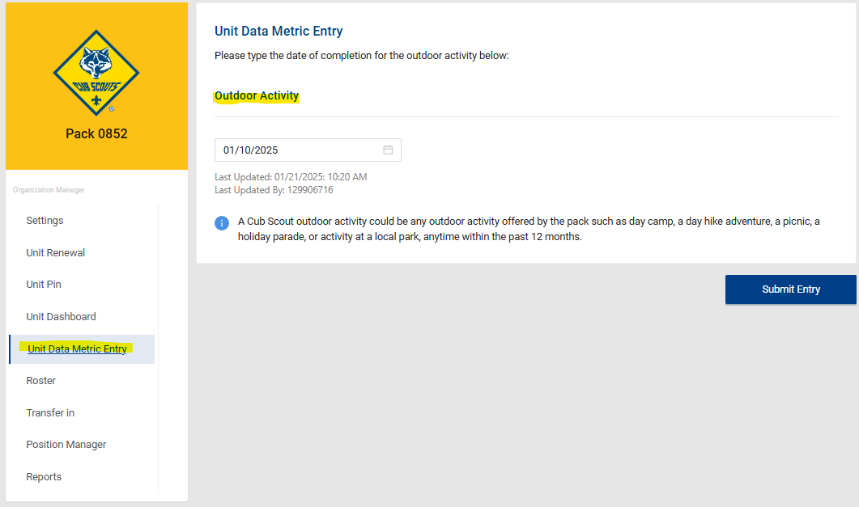
Data Entries in My.Scouting for Outdoor Activity for Packs, Troops, Ships
After entering My.scouting, Click on Unit Data Metrics Entry and enter completion date
Notes:
Another method of entering the Outdoor Adventure for packs, troops, and ships is in My.Scouting under Organization Manager. From the unit’s main menu, click on Unit Data Metric Entry, enter the completion date, and click on Submit Entry.

Slide 16
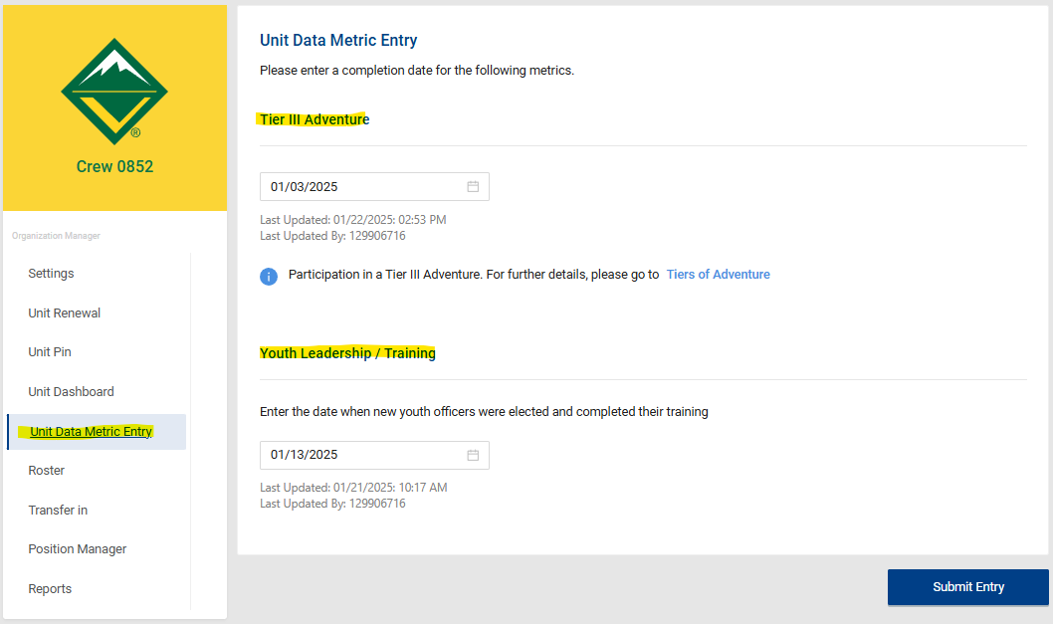
Data Entries in My.Scouting for Tier III Adventure & Leadership for Crews & Posts
Notes:
The process is the same for crew and posts. You can enter either the Tier III Adventure or Leadership/Training dates. Remember to click Submit Entry.

Slide 17
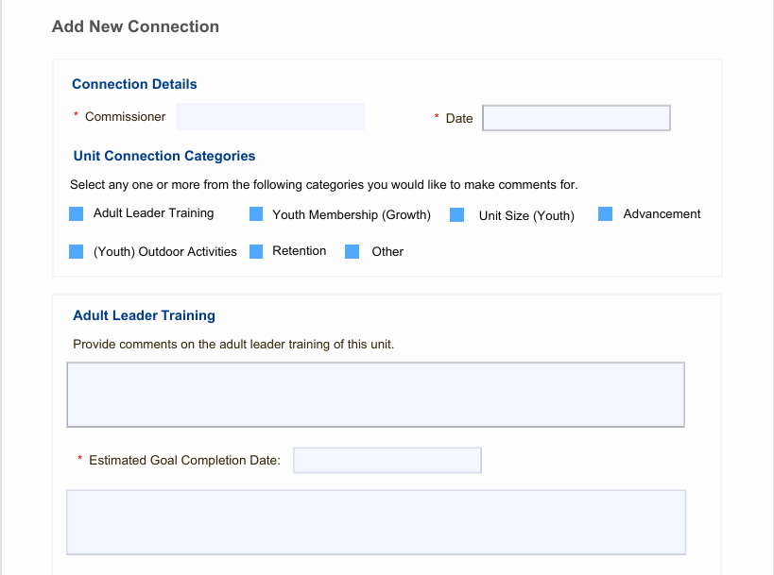
Unit Connection Form
Each category is optional, and multiple can be selected
Notes:
The new Unit Connection process has been simplified and replaces the Simple and Detailed Assessment process. It consists of only one form, whereas the previous assessment process required entries in several categories.
The categories for discussion points consist of each unit metric plus an Other category. Each category is optional, and only one or more need be selected for each ‘connection’.
Replacing the Unit Service Plan is an optional goal-setting process. The unit leader owns the goal, with the commissioner’s assistance in documenting the goal plus an estimated completion date.

Slide 18
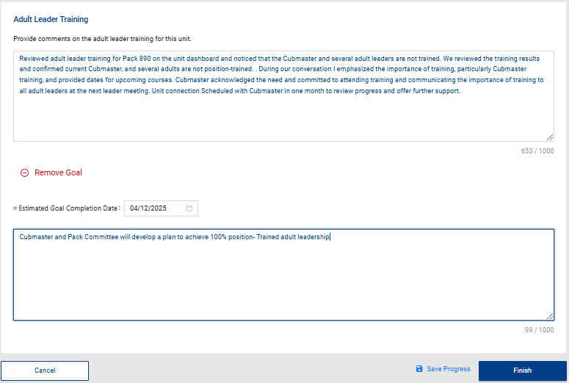
A Unit Connection
Notes:
The entry shown in this example provides guidance for what to include when making an entry in a unit connection. You will note how it covers details such as what was discussed during the meeting, what action was taken, and establishing a follow-up plan.
This print is small, so here is what the entry says:
Reviewed adult leader training for Pack 890 on the unit dashboard and noticed that the Cubmaster and several adult leaders are not trained. I reviewed the training results with the cubmaster and confirmed that the current Cubmaster and several adult leaders are not position-trained. During our conversation, I emphasized the importance of training, particularly Cubmaster Training and provided dates for upcoming courses and information on training on-line. Cubmaster acknowledged the need and committed to attend training and communicate the importance of training to all adult leaders at the next meeting. Scheduled another unit connection in one month to review progress and offer further support.

Slide 19
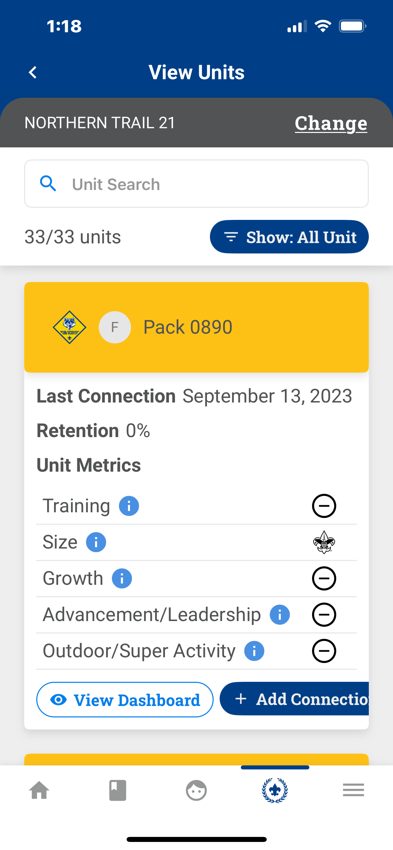
My.scouting Mobile Application
Notes:
The mobile app provides another resource for entering a unit connection. It also has many other resources that are familiar to those found in the web version of Commissioner Tools, making it very handy for commissioners working in the field and away from home.

Slide 20
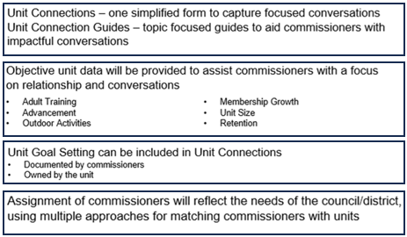
Commissioner Tools Summary
Notes:
Commissioner Tools has been updated to deliver the Future of Unit Service. These new features will enable commissioners to build solid relationships and increase their knowledge about the units they serve to deliver impactful results.

Slide 21
Summary
Notes:
This version of commissioner tools puts district and unit information on dashboards so that the information a commissioner needs to support units is in one easily accessible location.

