Slide 1
Navigating Commissioner Tools for Administrative Commissioners

Slide 2
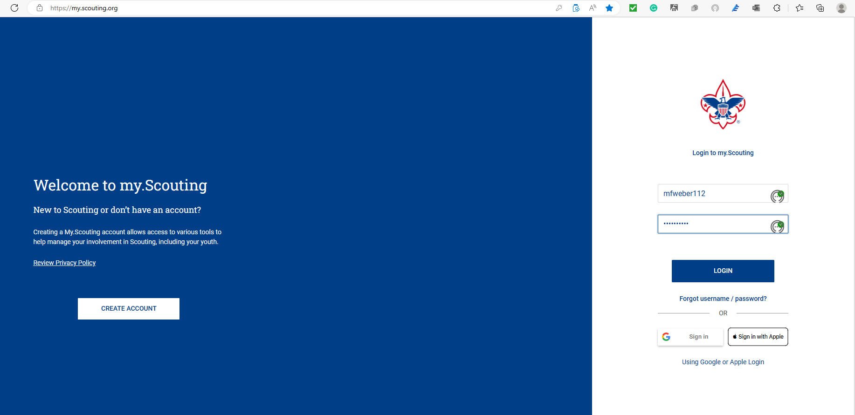
Notes:
Everything begins by logging in to My.Scouting.

Slide 3
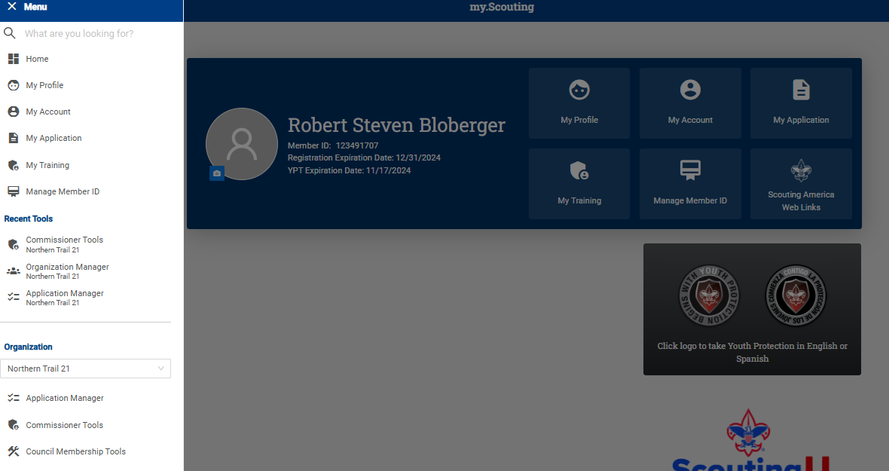
Notes:
Once logged in, click Menu in the upper left corner, and scroll down to your district as indicated in the red box. Then select Commissioner Tools.

Slide 4
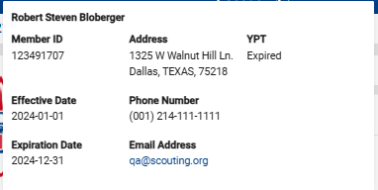
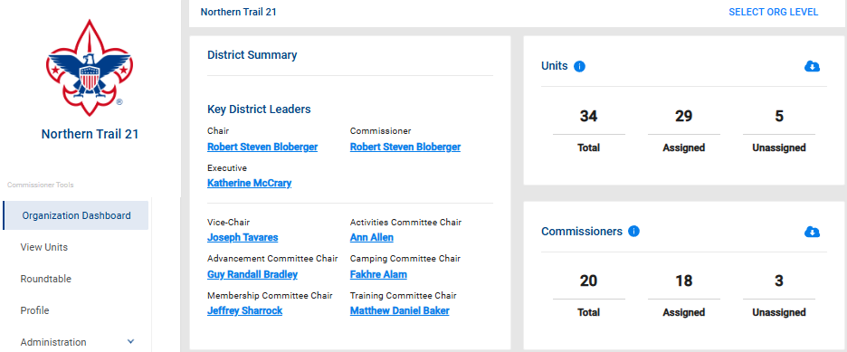
Notes:
This is a view of a district dashboard. It will appear after entering Commissioner Tools and selecting Organization Dashboard. This will be a common process whether using the web or mobile versions. At the top, you will see a list of key district leaders. Notice their names are all in blue. The names are hyperlinks that provide contact information for each person. The top right section shows the number of units in the district and how many have a commissioner assigned. The Commissioner section shows how many commissioners are registered in the district and how many are assigned to a unit(s).

Slide 5
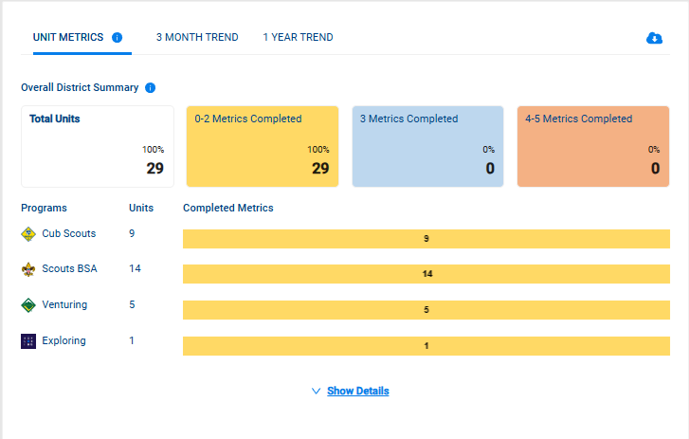
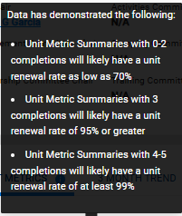
Notes:
This section summarizes the unit metrics across the district and the number of units that have met each threshold. It can be viewed in its current state or by toggling the 3-month and 1-year trends to identify how that data has changed over time. Below is a breakdown of each program by the level of completed metrics.
To understand each of the metrics and thresholds, click on the blue icon by the Unit Metrics title. To understand the significance of how the metrics can be used for helping units, click on the blue icon by the Overall District Summary title. In each case, a pop-up message will appear.
When clicking on the Show Details at the bottom of this slide, more information is available as shown on the next slide.

Slide 6
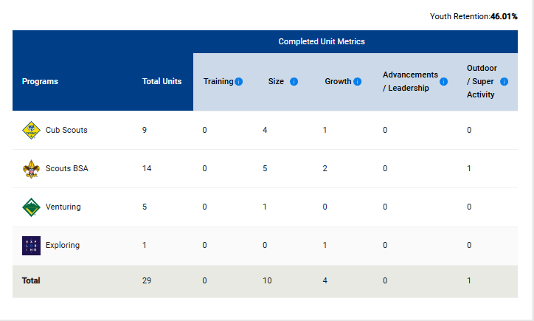
Notes:
This page breaks down each metric by the individual Scouting America programs. This is a useful chart to identify trends across programs and by metric. District committees can use this information to apply help to different groups or topics where needed.

Slide 7
Notes:
Immediately below the metric summary data are Unit Connection Guides. Details of Unit Connection Guides are covered in another training module, but these individual guides, by topic as noted, can assist a commissioner in having a meaningful and helpful discussion with unit leaders.

Slide 8
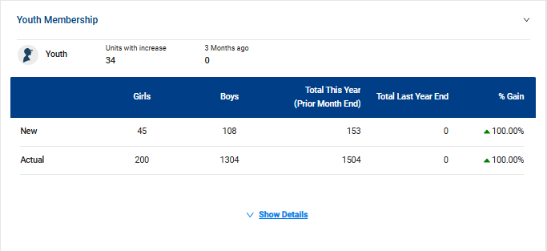
Notes:
The next several sections that follow the Unit Connection Guides provide summaries of each of the Unit Metrics. The first is Youth Membership, which provides an overall snapshot of a district’s youth membership. When clicking on the Show Details link, more detail is available, showing membership by each program area. See the next slide for an example.

Slide 9
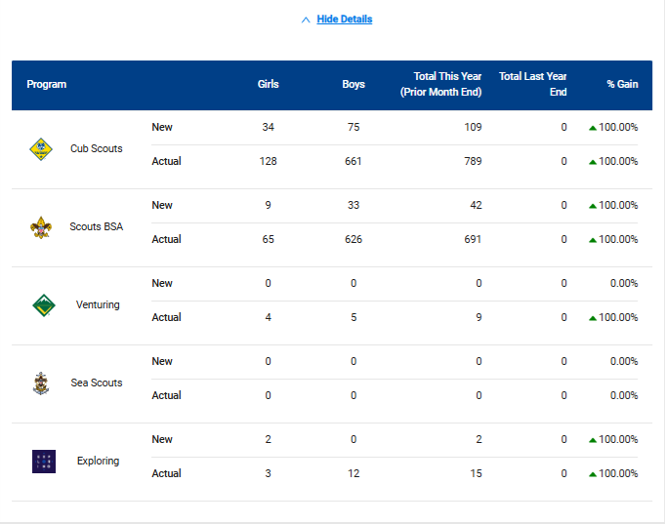
Notes:
Expanding the details displays specific numbers by program and gender. Membership year-over-year changes are also shown.

Slide 10
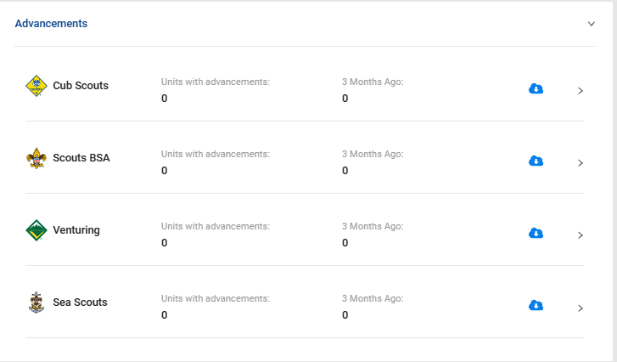
Notes:
Advancement data follows the Membership data. Expanding the Advancement section displays information by program showing trends of how the youth in the district are advancing. You can download detailed reports for each program by selecting the download report arrow.

Slide 11
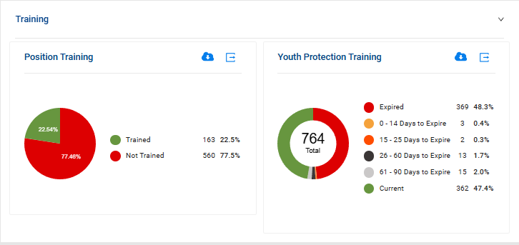
Notes:
Further down the dashboard, you see Volunteer Leadership. This section highlights how many adults are registered, followed by training information. At a glance, the district staff can see if units need leaders to complete the necessary training, particularly YPT. There is a quick synopsis of those members who have expired or are soon to be expiring Youth Protection Training to aid in follow-up. To view the details of the training that leaders are missing, click on the Download Report. These two reports can be printed for use during an upcoming unit leader visit for helpful discussion.

Slide 12
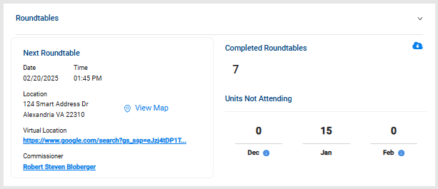
Notes:
Further down the dashboard is the Roundtable information. At the top of this section is attendance over the past three months. If details are needed for that, click on the Download Report.
It is important to know if units are participating in roundtable. If leaders are not attending the roundtable, this would be an excellent conversation to have with the units that are not attending. By having at least one person attend a roundtable meeting each month, useful information can be brought back to the unit to help strengthen the unit’s program for their youth.
In this section, you’ll also note when the Next Roundtable meeting is, where it’s held, a single click to view a map of the location, a virtual meeting link if the district uses that option, and even who the Roundtable commissioner is, whom you can contact simply by clicking on their name for any necessary information.

Slide 13
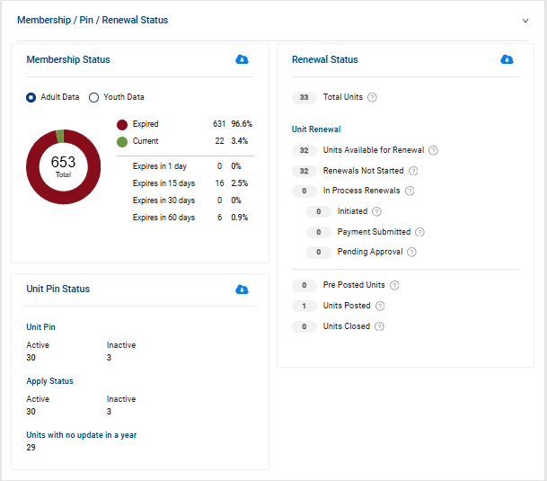
Notes:
Towards the bottom of the dashboard are the Membership, Unit Pin, and Unit Renewal Status of units in the district. Toggle back and forth between adult and youth data to see the number of expired or soon-to-be expired members. The circle chart also notes the number of members with a current registration. Unit Renewal information is also summarized in this section. This section provides unit pin status along with the last update.

Slide 14
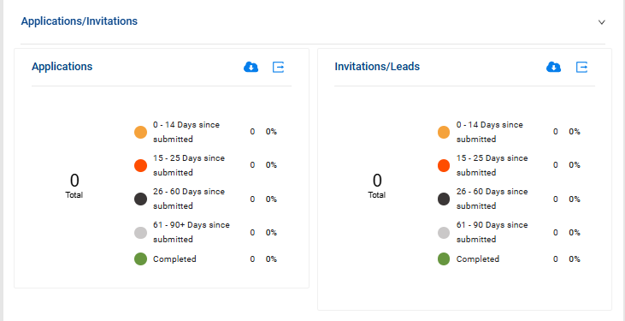
Notes:
The final section of the district dashboard shows the status of applications and invitations in the district. Detailed reports can be obtained by clicking on the download report arrow for each category. The boxed arrows in each of these two sections will direct you to the Application and Invitation Manager apps.

Slide 15
Summary
Notes:
This version of Commissioner Tools puts district and unit information on a dashboard so that the information a commissioner needs to support units is in one easily accessible location.

