Slide 1
Navigating Commissioner Tools for Unit Commissioners

Slide 2
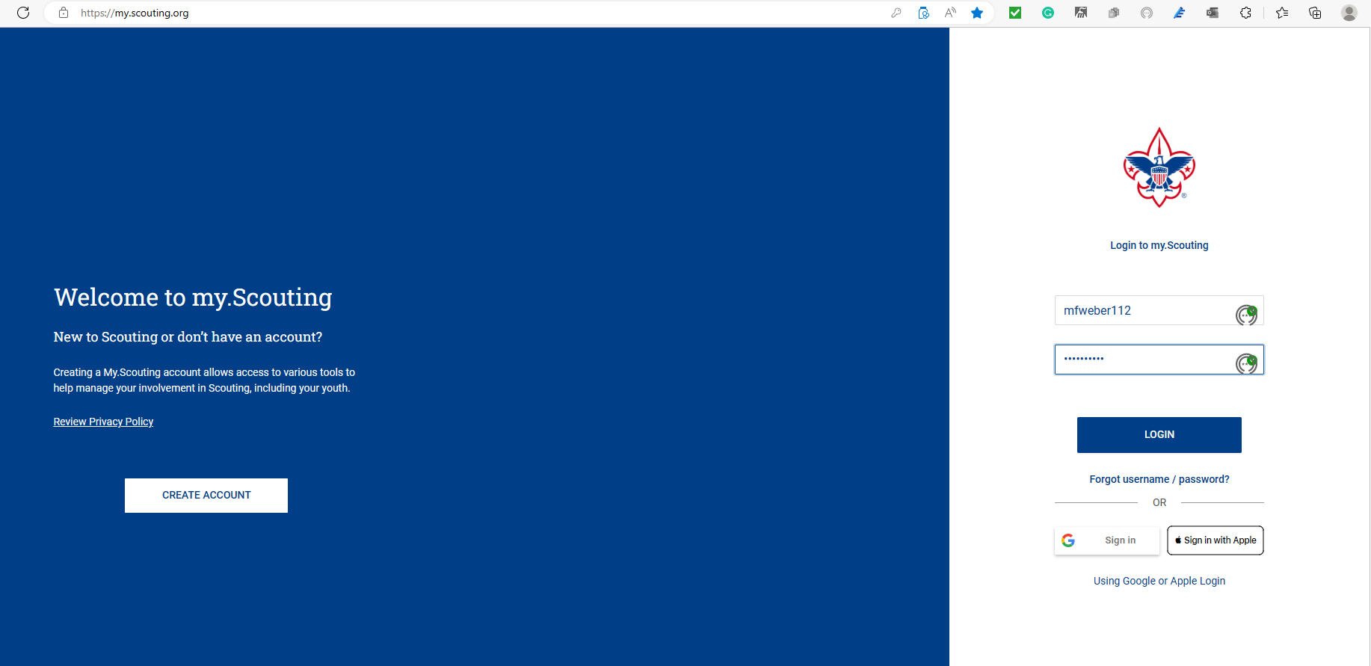
Notes:
Everything begins by logging in to My.Scouting.

Slide 3
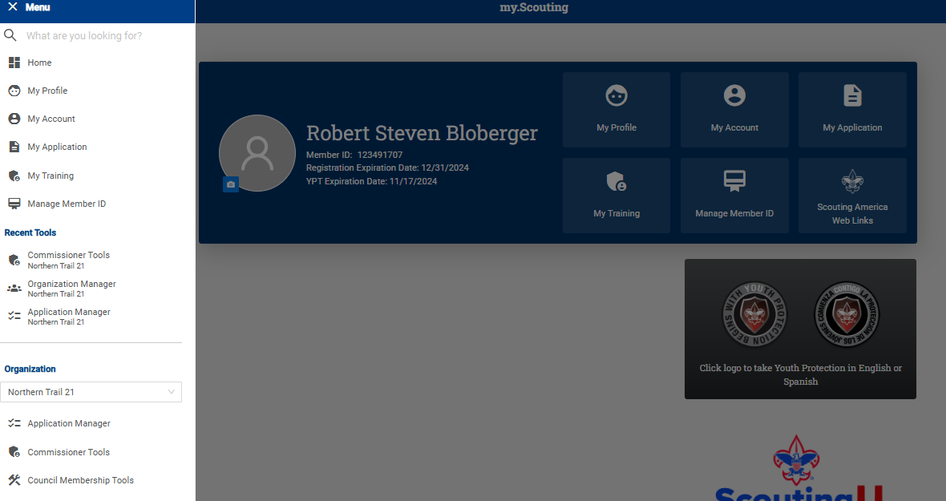
Notes:
Once logged in, click on Menu in the upper left corner, scroll down to your district, as indicated in the red box, and select Commissioner Tools.

Slide 4
Notes:
Connection guides have been created to aid in facilitating the Unit Connection process. Click on each of them, and you will see the complete document for each metric. These guides enable commissioners to focus on meaningful conversations about topics that are crucial to each unit’s success. Keep in mind that each unit’s view of success may be different. The guides are there to facilitate discussion and will not work for every unit in every situation.

Slide 5
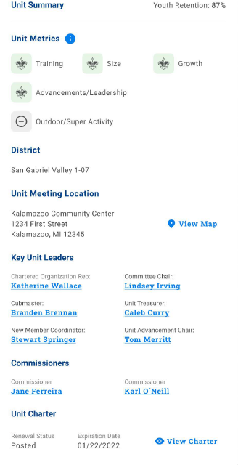
Unit Dashboard
Notes:
This is an example of the updated unit dashboard. At the top of the section, you’ll see the unit metrics. The metric summary indicates which metric has met the threshold with a fleur de lis icon vs. a circle with a dash indicating it has not been met.
The district meeting location can be viewed by clicking on View Map.
The Key Unit Leaders heading provides the names of the unit's leaders, including the name of the assigned unit commissioner. Unit leaders will have similar information on their unit dashboard.
Note that the name of each key leader is highlighted in blue. These hot links provide contact information such as phone number and email.
Last in this section is information related to the Unit Charter, including whether the charter has been posted and the unit's Expiration Date. If a copy of the charter is needed, clicking on View Charter will enable a printable copy.
The Unit Summary provides valuable information that commissioners can use when working with units.

Slide 6
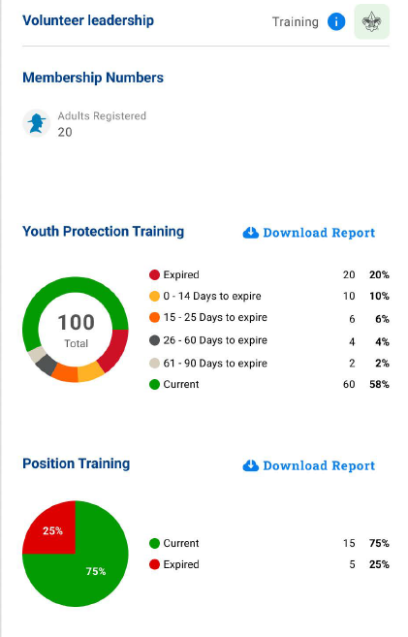
Unit Dashboard
Notes:
The Volunteer Leadership section highlights the total number of adults registered, followed by training information. The unit commissioner can see which unit leaders have completed training, including mandatory Youth Protection Training. To view detailed information, click on the Download Report. These two reports can be printed.

Slide 7
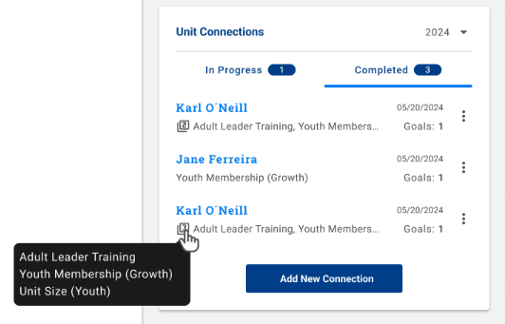
Unit Dashboard
The Unit Connections section shows the selected category’s title. If more than one, you can hover over the number to view the categories.
Goals field to display count if the connection has any goals.
Notes:
This slide covers the details related to Unit Connections. At the top right is a year date. Clicking the dropdown arrow will display three years, which allows a commissioner to view past connections.
The dashboard indicates how many connections are in process and how many have been completed.
The main body of this section contains the most recent connections, including the name of the commissioner who completed that connection and the date it was completed. Immediately below each person's name is the topic(s) covered in that connection. If the unit established a goal related to the connection, it will be indicated to the right.
To add a new connection, click on the blue tab at the bottom. This process is similar to the one used to log contacts in the previous versions of Commissioner Tools.

Slide 8
Notes:
When entering a new unit connection, the page will display this screen.
Each unit metric is listed for providing comments, but any (1 or more) can be optionally selected, as required. Commissioners can select any number or combination of these topics to include an “Other” category if the connection does not involve a discussion of any of the primary unit metrics.

Slide 9
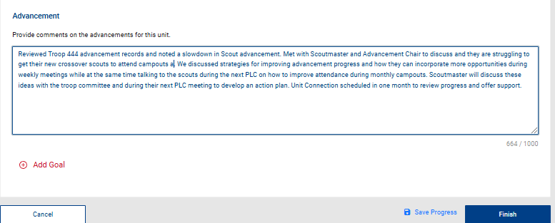
Notes:
Once a category has been selected, a new comment box will open for commissioners to enter their discussion points.
To add a goal that the unit has set, click on the Add Goal symbol.

Slide 10
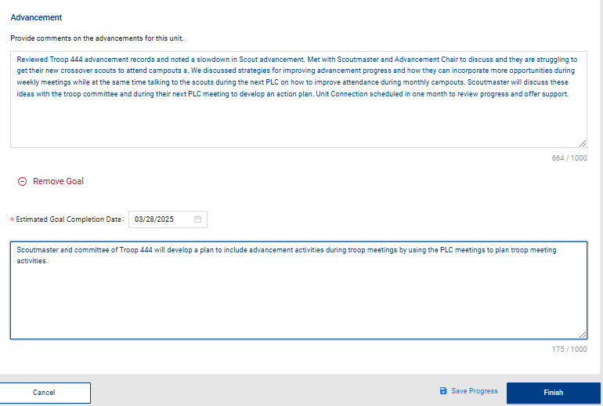
Notes:
The unit maintains complete autonomy in determining goals. The unit may choose to have them or not. Commissioners are available to assist them throughout the process.
Unit Conversations may lead to opportunities for the formulation of unit goals.
Commissioners can help by recognizing and documenting achievements and aiding the unit in pinpointing areas for enhancement.
Establishing goals can be pivotal in planning and enhancing thriving units. Commissioners might be asked to participate in the goal-setting process.

Slide 11
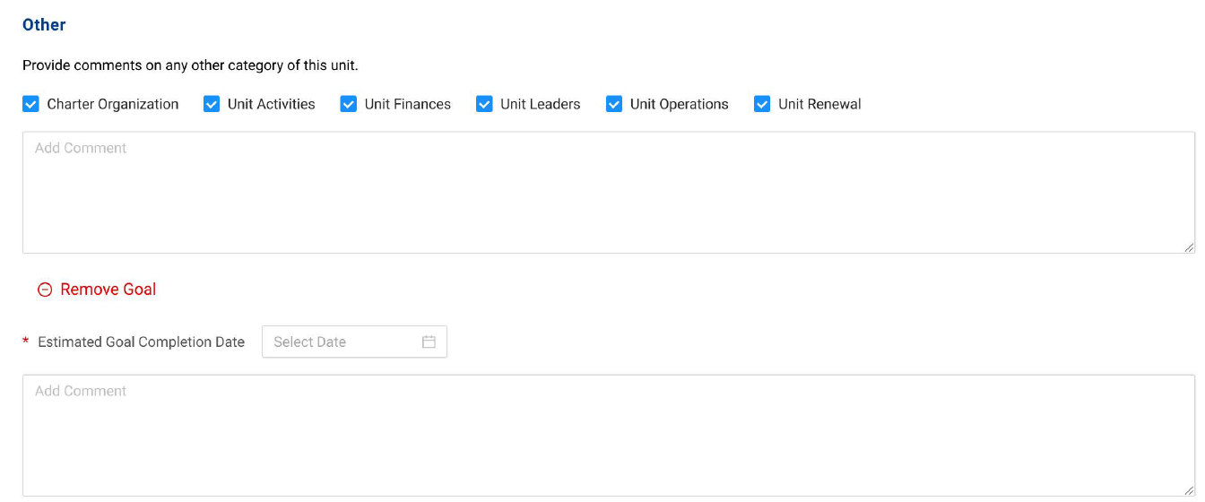
Notes:
If the “Other” category is selected, it provides options other than the primary unit metrics, including a goal-setting option.

Slide 12
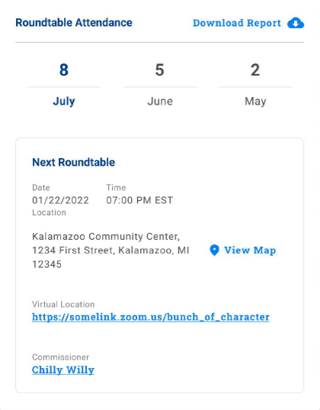
Notes:
Further down the dashboard is the Roundtable information. At the top of this section is attendance over the past three months. If you need details for that, click on the Download Report.
As a unit commissioner, it is essential to know if a unit is participating in roundtable. If leaders are not attending the roundtable, this would be an excellent conversation to have with the unit. By having at least one person attend a roundtable meeting each month, useful information can be brought back to the unit to help strengthen the unit’s program for its youth.
In this section, you’ll also note when the Next Roundtable meeting is, where it’s held, a single click to view a map of the location, a virtual meeting link if the district uses that option, and even who the RT commissioner is, whom you can contact simply by clicking on their name for any necessary information.

Slide 13
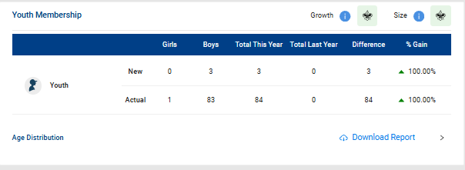
Notes:
As you progress down the dashboard, you will see a summary of Youth Membership. It shows the number of new youth who have joined over the past year, as well as the total unit membership. This is handy to see if the unit is growing, declining, or just holding its own. An explanation of the metric is available by clicking the information icon in the upper right corner. To obtain a youth member age report, click on the download report arrow, as shown in the red box.

Slide 14
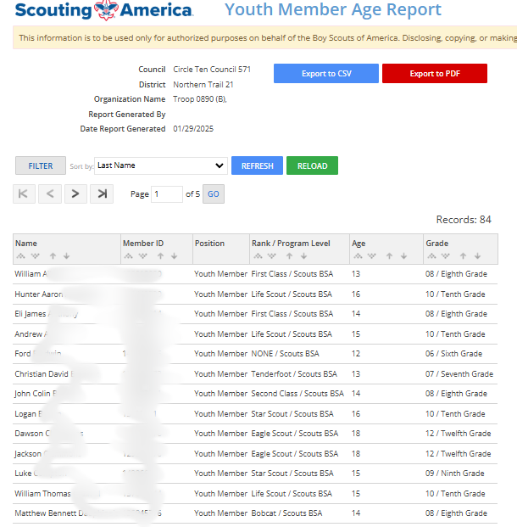
Notes:
The Age Distribution will also indicate if there are potential risks in the unit within different age groups. You can imagine how vital information of this nature could be during a conversation with the unit leader regarding either recruiting or identifying other aspects of youth membership to address.

Slide 15
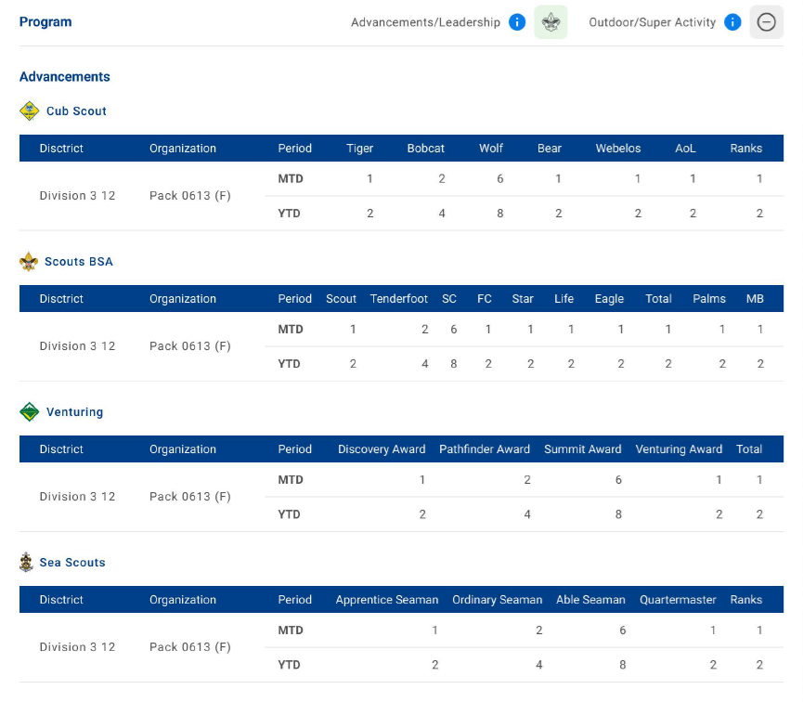
Notes:
Unit Advancement follows Youth Membership. You can view unit advancement information. Most units will need to enter advancement information in either Scoutbook or Internet Advancement to receive their awards. A unit with a solid program will, by its very nature, have advancement activity. If not, then it is time for a meaningful discussion.

Slide 16
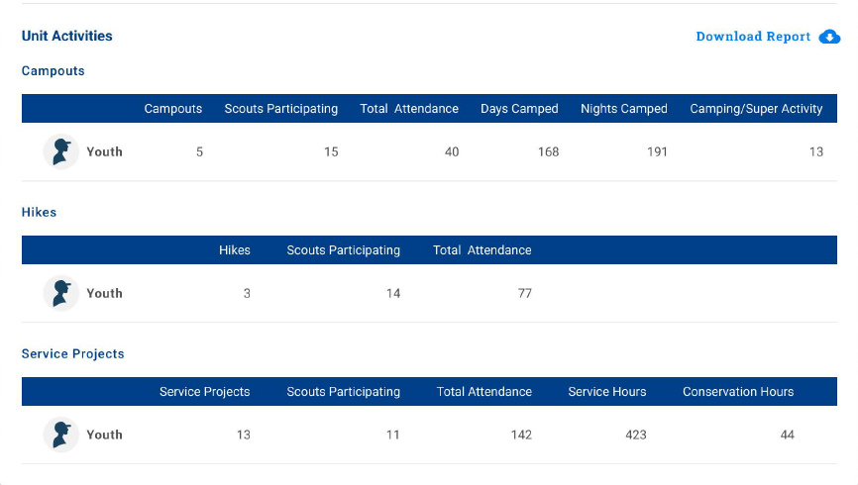
Notes:
The final section is Unit Activities. If no information is listed in the Unit Activities, that can mean one of two things: Either no activities are taking place or no data is being entered. Again, this is an excellent conversation topic to have with unit leaders. If there are no advancement or unit activities, the youth are likely either already dropping or will shortly.

Slide 17
Summary
Notes:
This version of Commissioner Tools puts unit information on dashboards so that the information a commissioner needs to support units is in one easily accessible location.

