Slide 1
National Lion Pilot
The Boy Scouts of America’s pilot program
for kindergarten-age boys
What’s New for 2017-2018?
What we learned from those in the field...and modifications made.
Notes:
Updated 2017-08-18

Slide 2
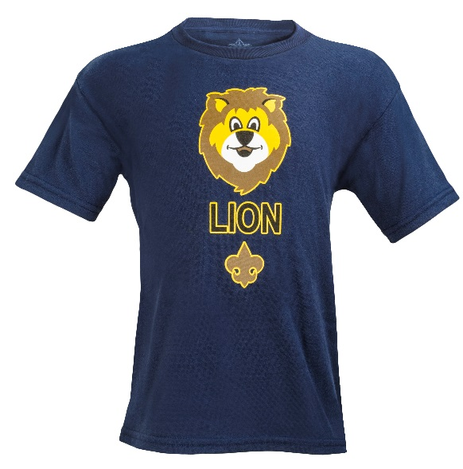
Lion Pilot Changes
New wording for joining
A boy must be 5 years old or the year before first grade.
New Recruitment brochure available at www.scouting.org/lion
Uniforms
The Lion T-shirt is still very popular and is the required uniform with optional cap. Families may also buy official blue Cub Scout button down or pants as desired for special occasions and Pack ceremonies.
The changes in this Powerpoint will only be made online and word of mouth for 2017-2018. The printed material and Lion merchandise is already available for Scout Shops. So changes to the printed material will take place in 2018-2019.
Notes:
Your evaluation is needed to provide feedback for program continuation or expansion. To support the feedback, it is important to deliver the program as designed.
Reproduction or distribution without written consent is not authorized.

Slide 3
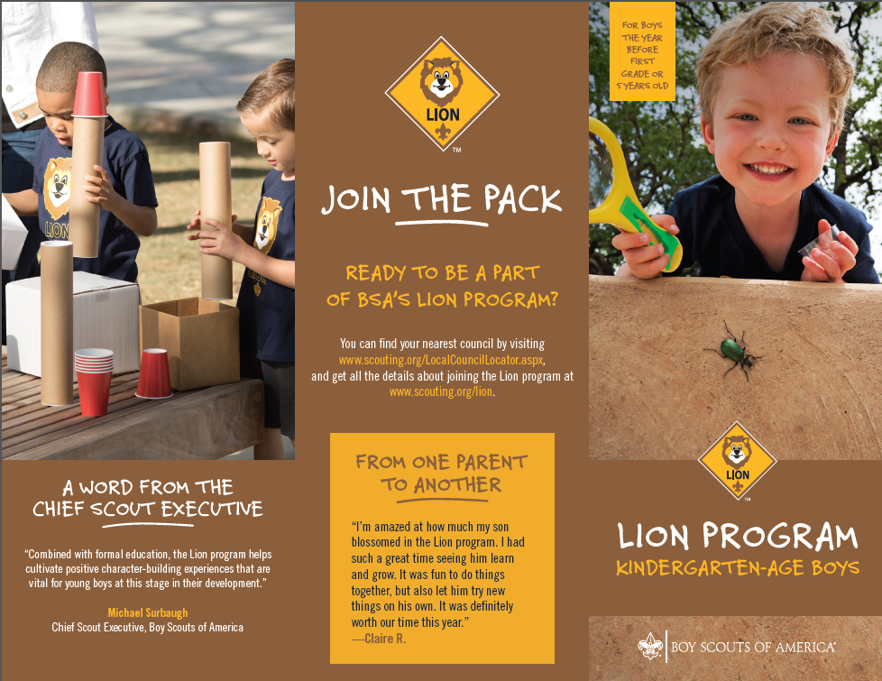
New Lion Recruitment Brochure
Available at
www.scouting.org/lion

Slide 4
Lion Changes for 2017-2018
Pack meeting and activities—Now Lion families may individually decide to participate in more (than the 2-3 required meetings) as desired. Packs should look for ways to actively involve the Lions and include them in program, skits, etc. Lions want more Pack involvement.
Pinewood Derby—This is now a Pack decision, it can be open to Lions if the Pack chooses. Three options are recommended.
1) Integrate Lions into Pack with Cub Scouts as Pack decides.
2) Use the wedge car from the Scout Shop to eliminate cutting.
3) Have Lions do a Veggie Car Derby—information on website.
Fundraising—This is now a family option. Fundraising and mandatory levels are not required. Some parents do want to have the individual option to fundraise. If popcorn is sold by Lions then Show and Sell with older boys and parents would be the preference, door to door selling needs the parents at the Lions’ side.
Spring Fundraising is the better selection.

Slide 5
Highlights
61% of Lion parents indicate they have no other child in Scouting.
This means we are reaching our intended audience of recruiting new families to Scouting as well as serving siblings of our existing Scouts.
91% of parents say their Lion will be moving to Tigers and 82% of Lion Guides say most will become Tigers.
Satisfaction is very high 90%.
For the T-shirt, shared leadership, age appropriate activities, youth Adventure book and immediate recognition stickers. Also pleased with the meeting duration, frequency and content. Leader Guidebook was not intimidating and was simple and easy for new parents to follow for effective meetings. Adventures were engaging for the boys.
Parents say developing character is the #1 reason to join Scouting.

Slide 6
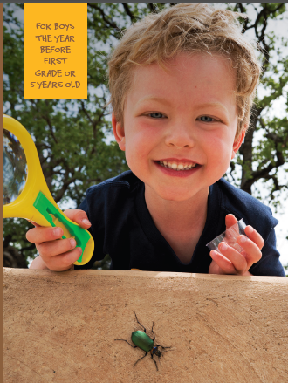
Membership
Expansion in 2017-2018 is even bigger
Existing councils expanding their units
New councils joining
Expecting more youth, units, and councils to join
204 Councils were Lion approved for 2016-2017!
Councils took a conservative approach usually
limiting the units that could do Lions.
Over 30,000 youth were Lions.
4,373 Packs had Lion Dens
out of the
Total BSA 37,757 Cub Packs

Slide 7
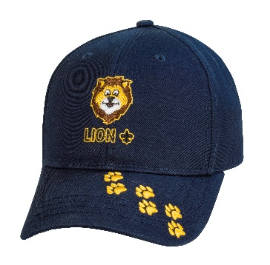
Feedback from Focus Groups and surveys
“The program content is really good. It’s the right length and hits the sweet spot of this age group very well.”
Parents appreciate the cost factor to be able to participate in Lions for lower cost of the T-shirt verses higher priced shirt.
“Overall, the Lion Cub program was a big hit with our Pack. In my opinion, this is the best idea the BSA has come up with, next to allowing girls to join Venturing.”

Slide 8
Lessons Learned for Councils
Tailor pack meetings to engage Lions.
Continue what’s working—Many said they got the training, orientations and support they needed. They had support from council and district volunteers they needed to be successful.
A key consideration in our success was starting the recruiting in the summer, and not waiting until September, when the crush of 'new school' activities are upon the parents in their first year of school. I found it extremely easy to recruit boys in the Spring. It was also easier to recruit kindergartners in the spring, than it is to get Tigers to sign up in the fall.
We offered multiple times to join. The first few weeks of school is just overwhelming for many families. So we continued to recruit in September and October and later in the year with great success.
Many dens meet on the same night as pack meeting to establish the night as routine early on.

Slide 9
Recommendations for National
Provide an advancement device for Lion recognition at Pack meetings.
National and Supply are working on this.
Provide Lion Guides more direction and resources for working with kindergartners.
This will be evaluated as to what more can be added than already exists in the guidebook.
Move stickers to the Parent and Lion Guidebook.
To be done in 2018 since materials are already printed and in stores.

Slide 10
Benefits of Lion Implementation
Allows youth to join at an earlier age.
Allows for extended retention.
Helps reach goal of providing character and leadership to youth.
Creates a stronger feeder program for Tigers.
Some families fill their activity schedules by kindergarten and if Cub Scouting is not offered we may not engage them after this age.
Allows the ability to “preview” adults for future leadership.

Slide 11
Pilot Evaluation
Lion Parents were included in Voice of the Scout survey.
Each of the 4 regions held May Focus Groups which included: Lion Guides, Parents and Youth.
24,000 online surveys were sent to all emails that were in the registration system. Survey dates 5/11- 19 sent to:
Parents
Lion guides
Feedback has been extremely positive.
Several modifications were made based on input: Pinewood Derby, Pack meetings, and Fundraising.

Slide 12
Lessons Learned 2016-2017
Many councils year 1 limited the rollout to selective units.
Often councils set up an application process to ensure units had good leadership capacity and financial stability.
The consistent feedback has been that the councils will be expanding their Lion units dramatically for 2017-2018.
The key is to get those good Experienced Den Leaders. Then include and support the Lion units.

Slide 13
Critical Success Factors
Experienced Den Leader recruited as Lion Guide.
Leader energy with youth and hands on activities.
Leader communication and support of parents.
For the pilot to be valid, it is important to deliver the curriculum and program as written.
Parent involvement—Lion Guide provides consistency and coordination.
Parents are instrumental in rotating leadership of Den meetings.
Serves to engage families, and create an ownership of the program.
Provides opportunity to watch potential leaders in action for future years.

Slide 14
Why is Shared Leadership Important?
Engages the families and helps create ownership of
program by families.
Creates a stronger loyalty and connection to the
den, families, and Scouting.
Provides an opportunity to watch potential leaders in
action—as a unit or pack considers future leaders.
The boys love watching their “parents be the leader!”
Millennial parents want to try things out before
committing. They prefer to commit to small roles first.

Slide 15
Appendix

Slide 16
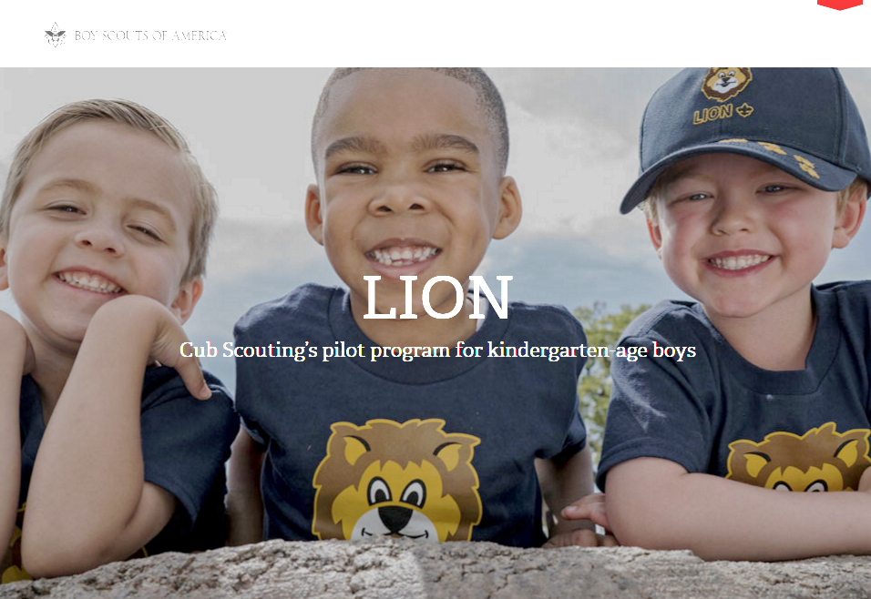
Online Resource
Lion web page:
www.scouting.org/lion
Check here for the most
up-to-date Lion information.
One-stop shop for resources--Councils, parents, leaders
FAQs
All program and orientation resources
Recruiting materials—fliers, promotional video, etc.
Need help? Contact Member Care at
972-580-2489 or MyScouting@Scouting.org

Slide 17
Lion Recruitment
Councils participating in the Lion pilot are expected to actively recruit new members, not implement it solely as a sibling program.
“Build an Adventure”–themed Lion recruitment materials are available on the website at www.scouting.org/lion
English, Spanish, and bilingual versions
Assets will include:
Fliers
Yard signs
Email blast templates
Social media artwork
Promotional video (sharable on social media channels)
Special Lion stock photos are available for council use, but vendor and licensing rules still apply.

Slide 18
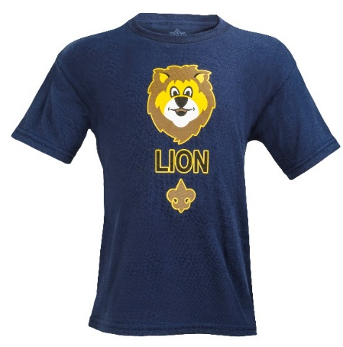
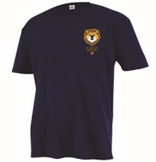
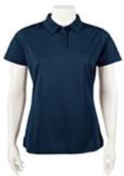
Lion Adult Apparel
Available through NDC Customer Service by calling 800.323.0736.
Lion logo is embroidered on left sleeve of Ladies Polo
Adult Graphic Tee
Sizes S-3XL
SKUs #636420-25
$14.99
Adult Tee (Small Graphic)
Sizes S-3XL
SKUs #636465-70
$14.99
Ladies Polo
Sizes S-2XL
SKUs #636744-8
$29.99
Prices subject to change without notice. Contact NDC Customer Service for latest pricing.

Slide 19
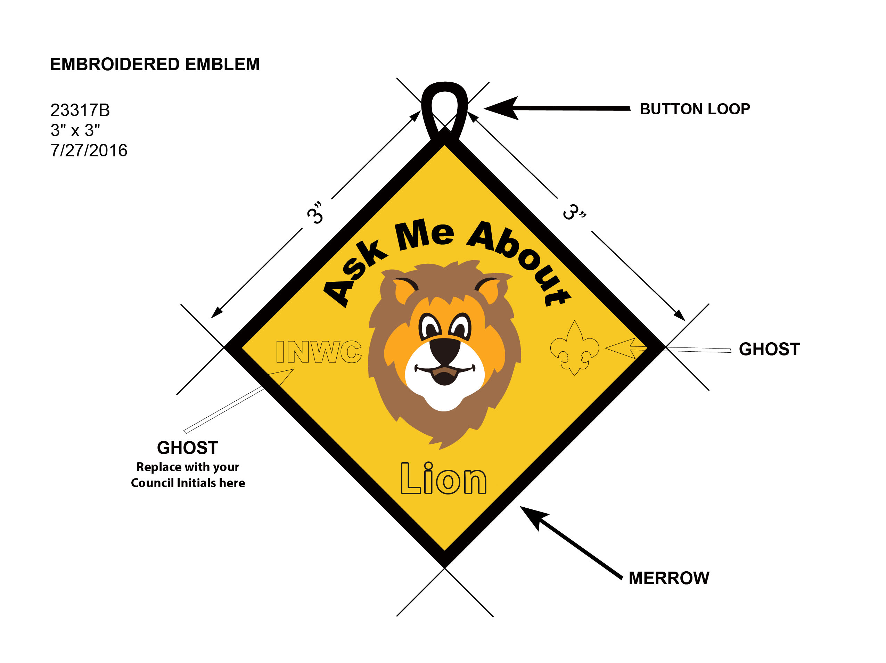
Lion Recruiter Patch
Councils may order custom Lion program recruiting patches directly through the BSA National Supply Group at NDCSpecialty.Products@scouting.org or through an authorized BSA Licensee at http://licensingbsa.org/bsa-licensee-list/.
Production time and pricing depends on quantity and various other factors.

Slide 20
Custom Lion Merchandise
Councils may order custom designed Lion merchandise directly through the BSA National Supply Group at NDCSpecialty.Products@scouting.org or through an authorized BSA Licensee at http://licensingbsa.org/bsa-licensee-list/.
Examples of custom designed Lion merchandise might include:
Pens/Pencils
String Bags
Cups/Mugs
Emblems
Production time and pricing depends on quantity and various other factors.

Slide 21
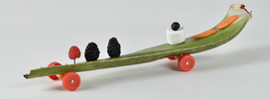
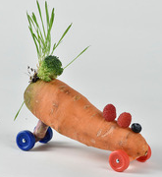
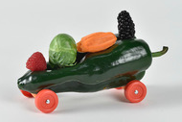
Pinewood Derby
It’s fun! Do a Veggie car race.
Doesn’t take much prep.
Fun for All ages!
Lions can easily be included.
Can also be done as a Den meeting activity.
More at www.scouting.org/lion
Your pack may also integrate Lions into a regular Pinewood Derby too.
Wheels available at Scout Shops

Slide 22
Flier available at www.scouting.org/lion
Consider making this a Den Meeting activity for some special fun.
It would work well especially before they make their Pinewood Derby car and compete in the Pack event.
Helpful Hint: Many grocery stores throw out their almost old veggies often. This may be something you could ask if your Lions could have some and therefore save additional cost of buying it.
Make a racing ramp from a big piece of cardboard.
Remember have lots of FUN!!

