Slide 1
NATIONAL PROGRAM UPDATE
Notes:
Slide of Anthony, Garfield and Owen. Check with April McMillan.

Slide 3
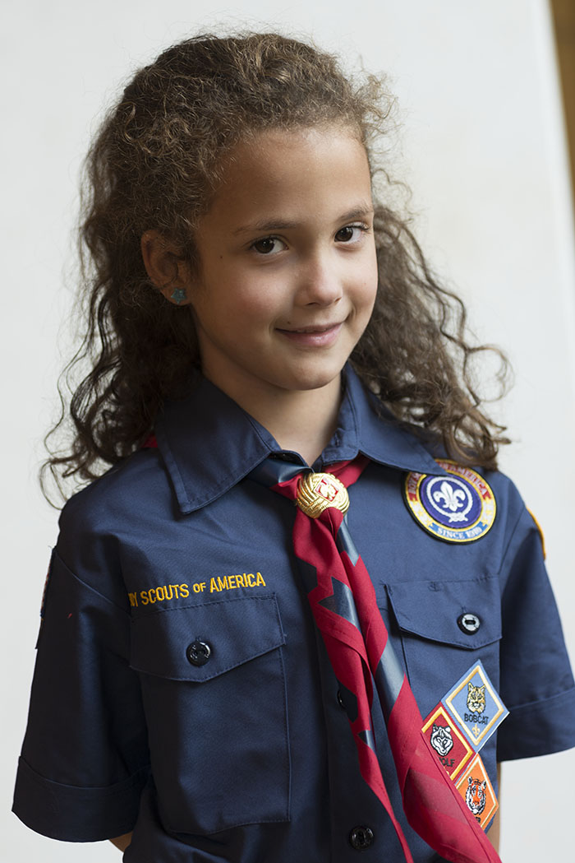
CUB SCOUT GIRLS

Slide 4
Two Deep Leadership Requirements
For All Boy Dens
For all Girl Dens
No Change
One registered adult leader and one other adult, one of which must be 21 years old.
One registered adult leader and one other adult, one of which must be 21 years old, and a Youth Protection trained adult female must be present.

Slide 5
Camping and Overnight Activities
Cub Scout overnight activities are designed to be family events where the parent(s) or legal guardian participates with the Cub Scout.
Pack and Webelos Den Overnighters
Male and female adult leaders must be present for all overnight Scouting trips and outings, even those including parent and child, unless all youth and adults are the same gender. Both male and female adult leaders must be 21 years of age or older and currently Youth Protection trained, and at least one must be a registered member of the BSA.
No Change
A minimum of two registered adult leaders, or one registered leader and a participating Scout’s parent or another adult is required for all trips and outings. One of these adults must be 21 years of age or older.
If all boy Den or Pack all adult leadership may be male.
If all girl Den or Pack all adult leadership may be female.

Slide 6
No adult may share a tent with the opposite sex unless he or she is that adult’s spouse.
No youth may share a tent with an adult or a person of the opposite sex other than a family member or guardian. Assigning youth members more than two years apart in age to sleep in the same tent should be avoided unless the youth are relatives.

Slide 7
Whenever possible, separate shower and latrine facilities should be provided for male/female adults and youth. If separate facilities are not available, separate shower times must be scheduled and clearly posted.

Slide 8
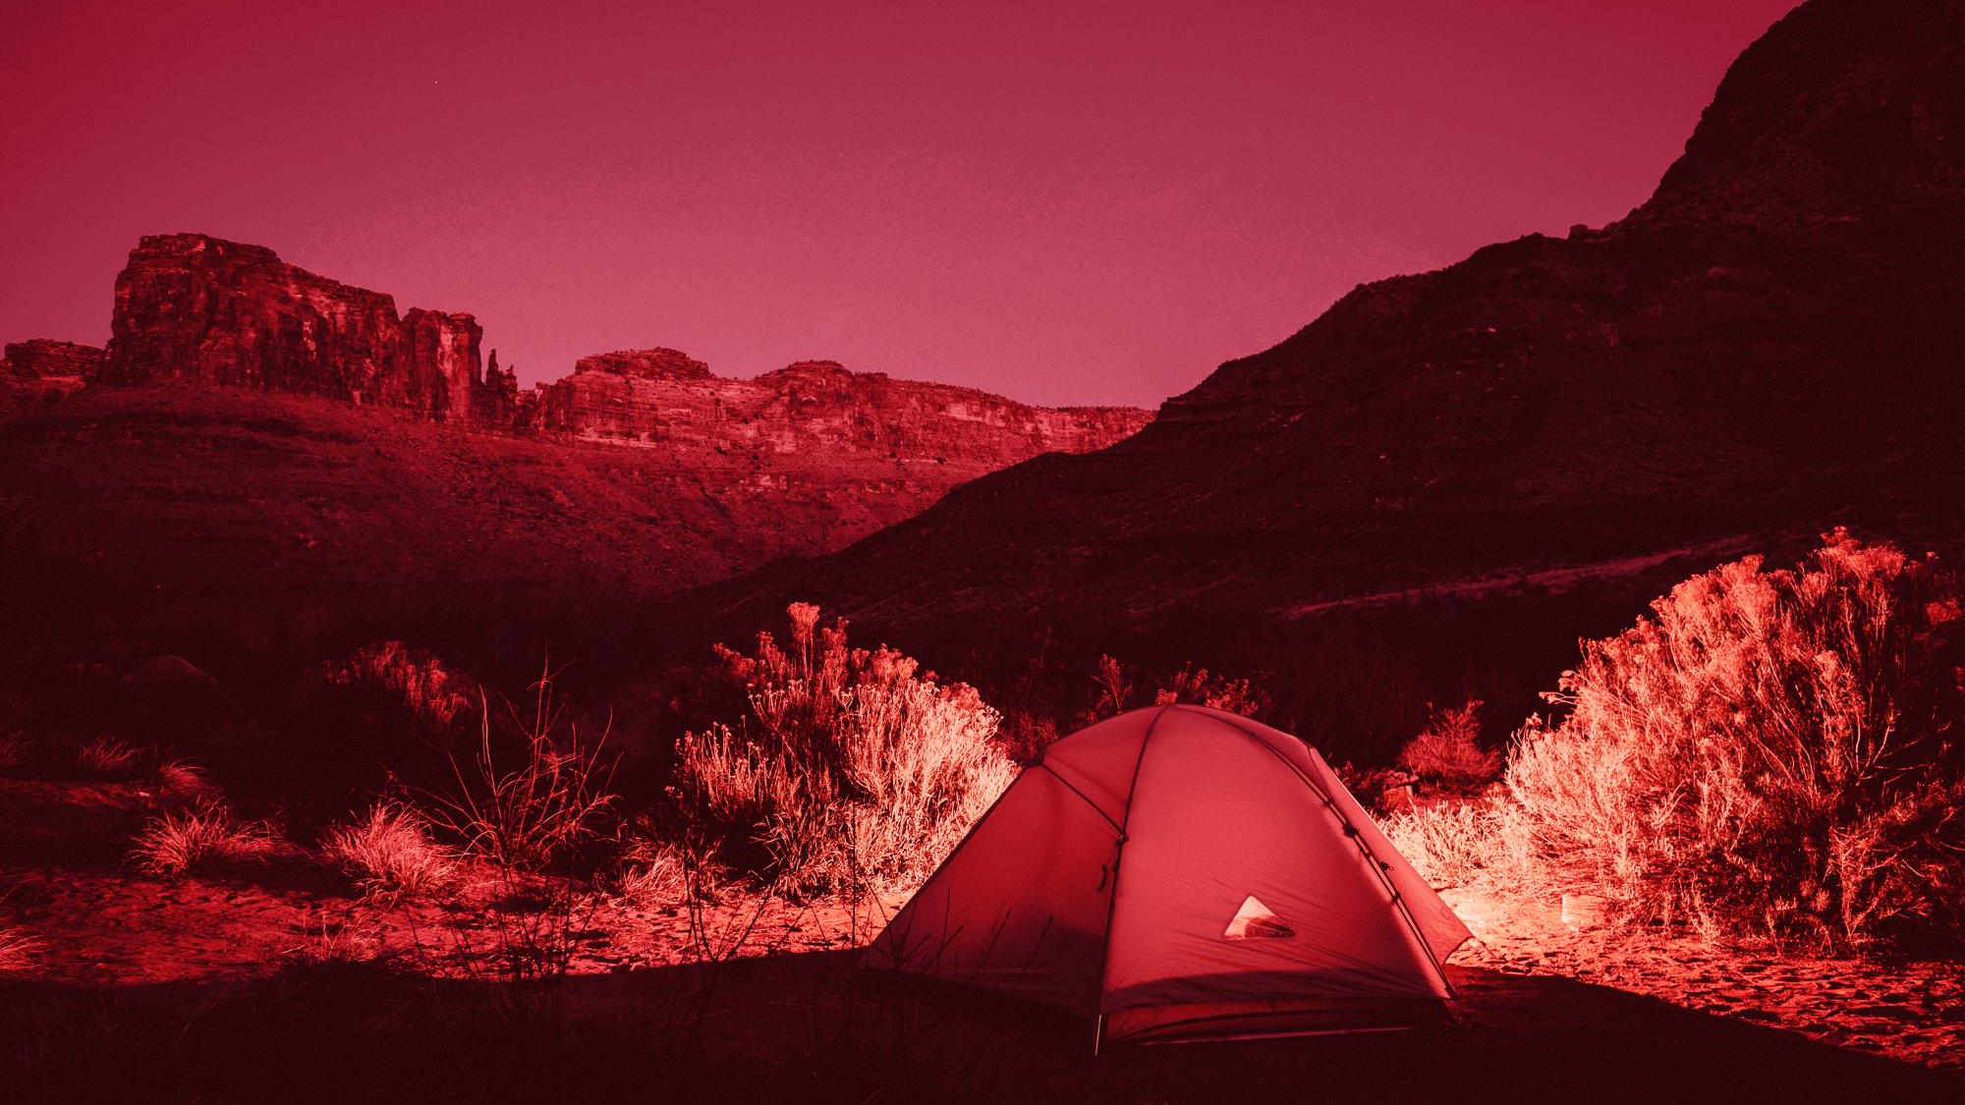

Slide 9
COUNCIL DECIDES WHETHER THEY WANT TO PARTICIPATE IN EARLY ADOPTER PROGRAM BY FEBRUARY 15, 2018

Slide 10
COUNCIL APPROVES THE PACK IS IN GOOD STANDING AND HAS THE CAPACITY (LEADERSHIP, FACILITIES, ETC.) TO PARTICIPATE

Slide 11
CHARTERED PARTNER AND PACK COMMITTEE ADOPTS USE OF THE FAMILY PACK MODEL

Slide 12
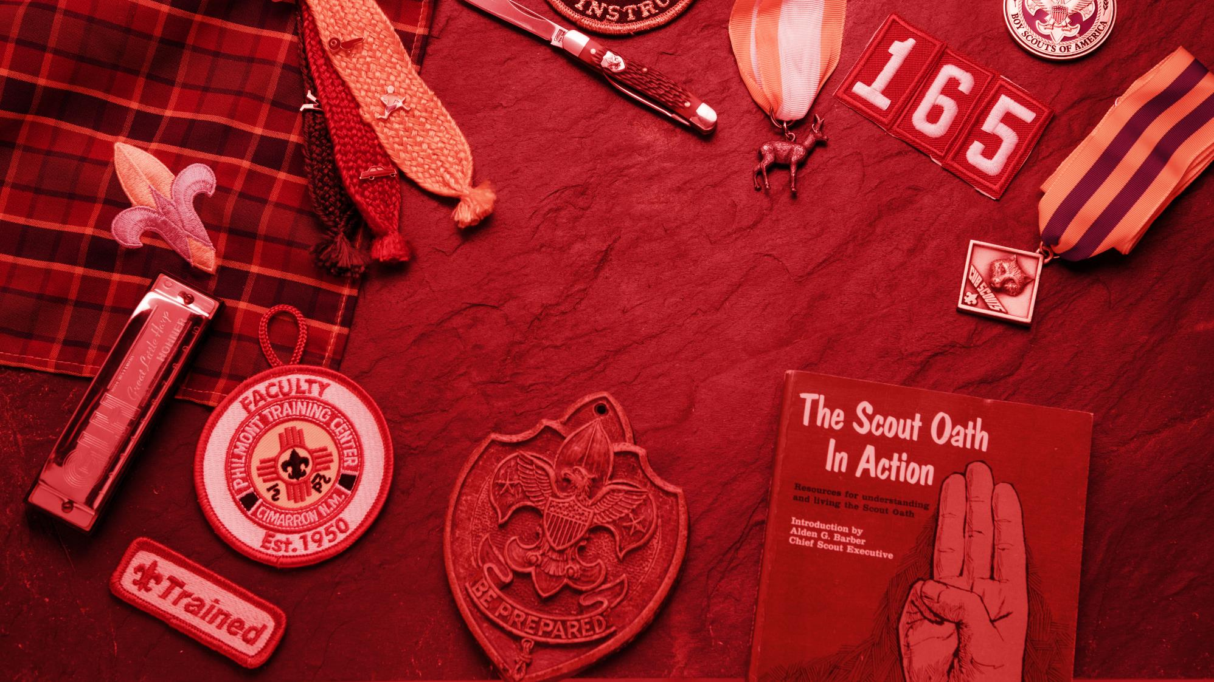
LEADERS IN THE PACK ARE TRAINED IN THEIR POSITIONS

Slide 13
Program Plan developed with a timeline to accomplish all rank requirements by May 31, 2018

Slide 14
EARLY ADOPTERS AGREE TO:
Register a minimum of 4 girls into an existing pack in an all-girl den
Use the Current Cub Scouting program and resources
Uphold membership policies and follow the guidelines in the Unit Performance Guide
Provide data and statistics on their activities and experiences to help improve the formal rollout; this information may also be used in marketing material and earned media.
Early adopters may participate in Pack overnighters, Family Camping, Council-Organized Family Camps, Day Camps, and Resident Camp.

Slide 15
FAMILY.SCOUTING@SCOUTING.ORG

