Slide 1
The Latest Research: Evaluation of Prevention Programs
Lisa M. Jones
Crimes Against Children Research Center--University of New Hampshire
National Youth Protection Symposium
November 1-2, 2012 Atlanta, GA

Slide 2


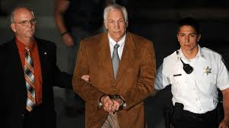




Slide 3

Sexual abuse prevention research…

Slide 4
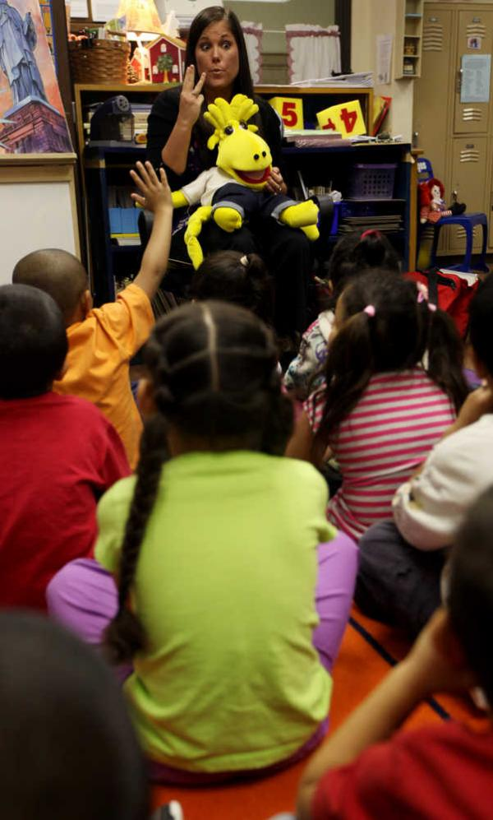
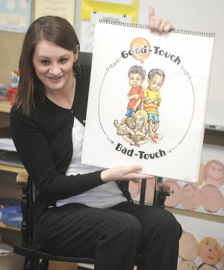

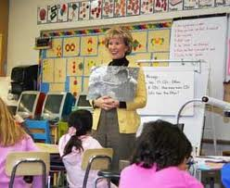

Slide 5

Presentation
What can research tell us about effective child sexual abuse youth prevention?
What information do we still lack?
Based on this:
What are your best bets for improving safety?
What do we need to avoid?
How can we measure success?
What next-step learning is important for the field?

Slide 6
Important elements of agency CSA prevention
Agency Policy
Protection
Response
Youth Education
CSA specific
Social emotional skills
Staff Training
Protection
Response

Slide 7
Agency-level prevention policies
Screening
  Interviews, reference checks, criminal background checks
Creating a safe physical environment and establishing policies on staff-youth interactions
  Physical contact, boundaries, reduced one-on-one interactions, structured monitoring and supervision, no closed-door policies, limiting contact outside the organization
  Boys and Girls Club of America (BGCA) are implementing a Situational Prevention Model (SPM) that they are adapting from safe housing and crime prevention (Kaufman, Tews, Schuett, & Kaufman, 2012)—focus on local input and sustainability. They are hoping to evaluate.

Slide 8
Staff training
Arguably one of the most important elements of safety
Few packaged training programs
Very little research or evaluation
Research on Stewards of Children training program (Darkness to Light)
  RCT: trained child care workers showed increased knowledge and behaviors at 3-month follow-up assessment (Rheingold, et al., 2012)
  Web-based training acceptable and feasible, but research suggested some benefits to in-person training around support and communication.

Slide 9
Classroom-based or group-based youth education
Recognize: helps them identify dangerous situations and boundary violations
Resist: Gives them permission and skills to break off unwanted contact
Report: Adults aren’t able to prevent everything—youth should be encouraged to report and provided with language to do so
Provides messages to those who have experienced abuse that they are not at fault
Increases social-emotional skills: Recognizing and naming feelings, self-assertiveness skills—there are situations that youth can handle on their own or help each other handle

Slide 10
Are youth education programs effective?
Evidence suggests that youth-education CSA prevention programs are effective.
Several meta-analyses, plus two carefully done reviews conclude that:
  Youth show increased knowledge about CSA and maintain over time
  Youth demonstrate understanding that children are not at fault for abuse
  Evidence that children can learn and use self-protection strategies
  Evidence that programs provide youth with opportunity and language to report

Slide 11
Concerns about CSA education programs
Are the programs upsetting to children?
Is education on sexual abuse appropriate for children?
Are the programs too complicated for young children to learn?
Is a focus on youth education unfair-shouldn’t the focus be on the adults to protect them?
How and where do we take the time to provide youth with this education?

Slide 12
CSA prevention programs with research support:
Talking about Touching by the Committee for Children
Speak Up, Be Safe (Good Touch/Bad Touch) by Childhelp
Child Assault Prevention Programs (CAPP)—”Safe, Strong and Free”
Care for Kids—Prevent Child Abuse Vermont
➔Other ones: Who Do You Tell, Body Safety Training, Feeling Yes, Feeling No, ?

Slide 13
Elements of effective youth prevention education
Multiple sessions
Focus on skills
Active learning, ideally physically and verbally involved in learning process
Practice and rehearsal ideally with role-plays

Slide 14
Best bets for youth serving organizations
Make youth protection as comprehensive as possible
A combination of policy, ongoing training, and youth education is ideal
Saul J, Audage NC. Preventing Child Sexual Abuse Within Youth-serving Organizations: Getting Started on Policies and Procedures. Atlanta (GA): Centers for Disease Control and Prevention, National Center for Injury Prevention and Control; 2007.
Standards for Child Protection. By Keeping Children Safe. http://www.un.org/en/pseataskforce/docs/keeping_children_safe_standards_for_child_protection_tool.pdf

Slide 15
Build and share resources
Share policies and staff training resources
Clearinghouse is critical
Need to build more organizational checklists, self-auditing tools, packaged programs

Slide 16
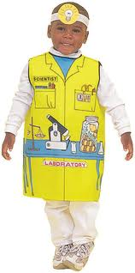
Find your inner researcher!
Protecting children means learning cross-disciplinary skills—including research
  Know the research on CSA
  Describe the research behind your prevention efforts
  Participate in data collection/self-assessment, M&E
  Demand evaluation, participate in it if you can
  Promote child sexual abuse prevention as a public health issue

Slide 17
Quick lesson on evaluation
Gold Standard: Randomized Controlled Trial (RCT)
Adequate: Quasi-experimental
(Developmental evaluation, Process evaluation, Innovation evaluation)
Meta-analyses are helpful in understanding where a field of prevention (or intervention) stands
Less acceptable: Anecdotes, Pre-Post tests, Consumer satisfaction surveys

Slide 18
What can we do if evidence-based programs are not available?
Ask about evaluation-what did it find? Is it ongoing?
Have trusted CSA experts been involved in the development?
Ask how the program logic or theory is supported by research?
Does it include components of effective education/prevention?
Does it avoid things that we know DON’T work?

Slide 19
What do we need to avoid?
Quick fixes-prevention education that is “easy”—assemblies, poster contests, etc.
Being distracted by dramatic stories of “new” problems
Intervention/prevention/education models that do not have evidence-supported logic models
  Teaching children physical self-defense
  Most Internet safety messages

Slide 20
Popular yet problematic Internet safety messages
“Don’t give out personal information.”
“Don’t talk to strangers online.”
“Don’t use a sexy screen name.”
“Think before you click.”
No research support
Based on stereotype of Internet predator
No understanding of causal factors or youth at-risk
“Don’t do it” messages never effective with youth

Slide 21
CSA rates declining
Rate per 10,000 Children (<18)
Year

Slide 22
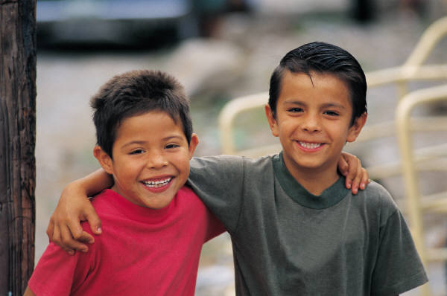
Final suggestions: Think broadly about child safety
We need approaches to child safety that are broader than just CSA (or bullying or rape prevention)

Slide 23
Social Emotional Learning (SEL)
Implement a social emotional learning program (see CASEL.org) in addition to a CSA prevention strategy—Many evidence-based
Focus attention on generic skills that improve online and offline decision-making, health and safety
  Emotion management
  Risk assessment
  Impulse control
  Perspective taking
  Refusal skills
  Bystander skills
  Help-seeking

Slide 24
Final suggestions: Support offender-level protection efforts
Law enforcement/criminal justice response and sanctions
Treatment
Prevention

Slide 25
"The test of a first-rate intelligence is the ability to hold two opposing ideas in mind at the same time and still retain the ability to function."
F. Scott Fitzgerald

Slide 26
Good Resources
Finkelhor, D. (2009). The prevention of childhood sexual abuse. The Future of Children, 20 (20), 169-194.
Wurtele, S.K. (2009). Preventing sexual abuse of children in the twenty-first century: Preparing for challenges and opportunities. Journal of Child Sexual Abuse, 18 (1), 1-18.
Wurtele, S.K. (2012). Preventing the sexual exploitation of minors in youth-serving organizations. Children and Youth Services Review, doi: 10.1016/j.childyouth.2012.09.009.
http://www.nsvrc.org/sites/default/files/Publications_NSVRC_Guide_Child-Sexual-Abuse-Prevention-programs-for-adults.pdf
http://www.nsvrc.org/sites/default/files/Publications_NSVRC_Guide_Child-Sexual-Abuse-Prevention-programs-for-children.pdf
NSVRC, Stop It Now

