Slide 2
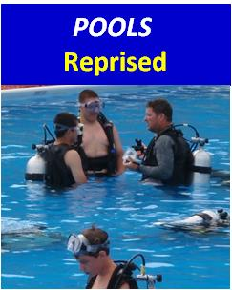
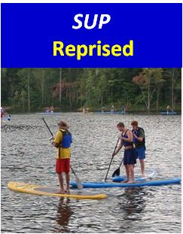
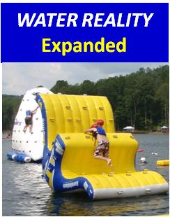
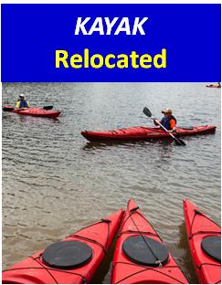
Like the water?
There’s a place for YOU in Aquatic Sports !
With or without experience.
Revised
Revised
Scouts experience basic scuba skills in large above ground pools.
Stand up paddle board basics and games.
A water obstacle course of large inflatables – fun, plus great team building.
Kayak basics and beyond.
On flat water.

Slide 3
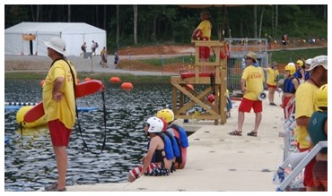
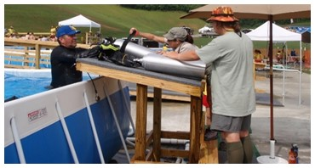
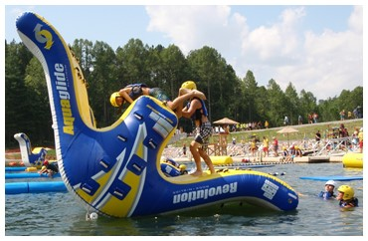
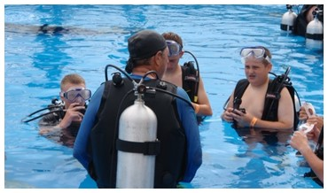
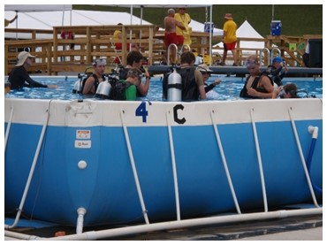
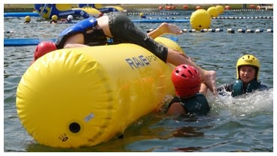
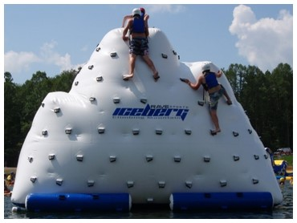
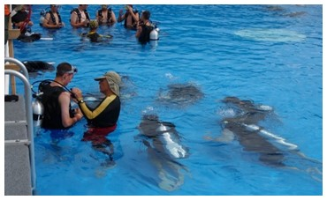
IN-WATER TEAMS: OPTIONS & NEEDS
SCUBA
Certified Instructors
Divemasters
Repair Technicians
Certified lifeguards
Support Personnel (Manage participant flow, transport tanks, etc. Scuba experience useful, but no training required.)
WATER REALITY
Aquatic Instructor, BSA
Certified lifeguards
Support Personnel (Manage participant flow, issue lifejackets & helmets, time events, etc. Camp waterfront experience useful, but no training required.)

Slide 4
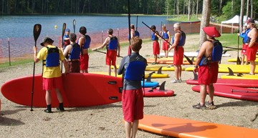
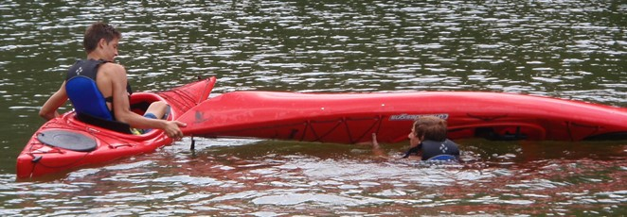
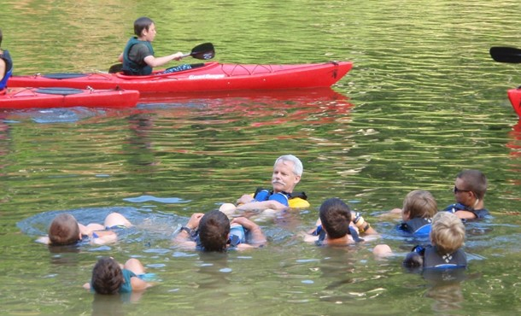
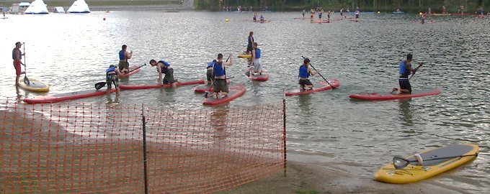
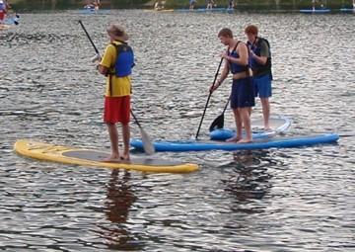
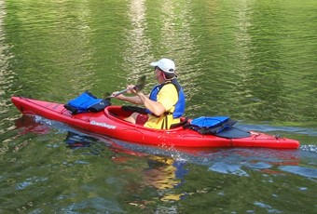
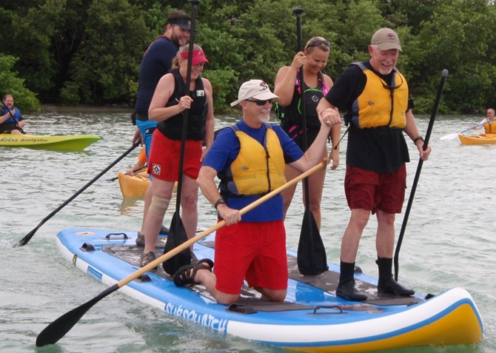
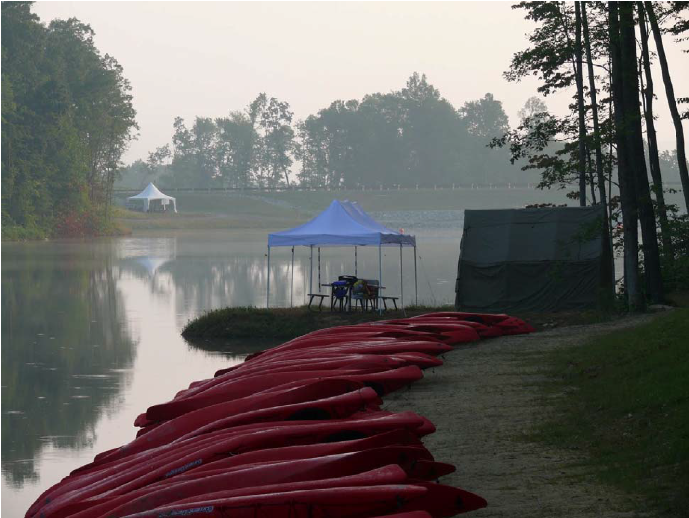
ON-WATER TEAMS: OPTIONS & NEEDS
KAYAK
Experienced Instructors (Aquatics Instructor BSA, ACA credentials, merit badge counselors, summer camp staff)
Experienced kayakers
Support Personnel (Manage participant flow, issue lifejackets, etc. No training required.)
SUP
Experienced Instructors (Aquatics Instructor BSA, ACA credentials, summer camp staff)
SUP experience
Support Personnel (Manage participant flow, issue lifejackets, etc. No training required.)

Slide 5
New / Improved:
Expanded Staff Transportation
More Time Off
Better Communications
Lunch Options
Tent Mate Choice
Enhanced Staff Village
Heated Showers
Staff Photos
PADI back!

Slide 6
Dates & Fees:
Staff Session 1 – July 15-29, 2017 (full jamboree)
Staff 26 and – $850
Staff 16-25 – $425
Staff Session 2 – July 15-22, 2017 (half jamboree) – $425 (regardless of age)
Staff Session 3 – July 22-29, 2017 (half jamboree) – $425 (regardless of age)

Slide 7
Staffing Levels:
AQUATICS 435
320
20%
40%
60%
80%
100%
ALL AREAS 9195
2013: 226 Total Aquatics Staff, ~ 200 Full Time Equivalents
(data for Sept 2016)
Notes:
Data for September 2016

