Slide 2
“In Council” Cub Scout Day Camp Administration - 2025
National Camping School
Local councils: Please use this PowerPoint and the associated student workbook to facilitate your Local Council NCS Training Sessions

Slide 3
Facilitator Instructions
Each participant should bring to council training:
Completed online NCS workbook
Certificate of completion of online NCS training (available on my.scouting.org)
Council supplies each participant with:
In-Council NCS Workbook
Council Specific Documents (see list on next slide)
Job Description for Camp Director and Program Director
NCAP Circulars that apply to the upcoming camping season

Slide 4

Items you should have at this training
NCAP Standards (2025 version)
First Aid Logbook sample
Previous year’s NCS Camp Book
Documents Referenced in Slide 26 and 82 (or use camp book for reference)
Staff Employment Documents
Previous Staff Manual
Sample Staff Development Guide (sample may be found at https://www.scouting.org/outdoor-programs/camping/cub-day-camp/)
Previous and current year day camp budgets
Previous promotion/marketing examples
Guide to Safe Scouting (available online at https://www.scouting.org/health-and-safety/gss/toc/)
Council’s Risk Management Policy
Council’s Insurance Information
Council’s Emergency Procedure Plans
Council’s Emergency/Crisis Plan
Council’s Emergency Contact List
Other council specific documents that will assist in preparing your day camp directors and program directors.
You will be prompted on the slide when it’s time to hand out some of these materials.

Slide 5
Important Changes to NCAP Standards
Please reference NCAP Circulars 20, 21 and 22 to confirm upcoming changes to the 2025 camping season.*
*This is not intended to be a complete list of changes to the NCAP Standards that apply to Day Camp. Please review all applicable Day Camp Standards prior to holding your camp.

Slide 6

CUB SCOUT
OUTDOOR
DAY CAMP
IN-COUNCIL TRAINING
________________________ Council

Slide 7
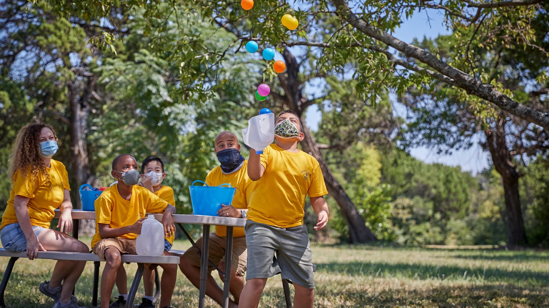
Introduction
Notes:
Remind all participants they must have:
— Be Registered member of Scouting America
— Current Youth Protection certificate
— Completion of any Cub Scout leader-specific training on my.scouting.org
— Current Hazardous Weather training certificate
• Course Work
— Online training, sent via NCS registration confirmation email

Slide 8
Introduction
This is part 2 of the Cub Scout Day Camp Administration National Camping School training.
Online and all pre-requisites should be completed at this point.

Slide 9
Pre-Requisites for National Camping School
YPT (and are a Registered leader)
Any Cub Leader specific training from my.scouting.org
Cub Scout Day Camp Administration Online Training – Available online at my.scouting.org (SCO_14001)
Cub Scout Day Camp Administration in Council (CS 63) (this training).
Be sure to print proof of all completions and bring to the National Camping School session. NO CERTIFICATION will be presented until pre-reqs have been completed.

Slide 10

WHO DOES WHAT?

Slide 11
Who Does What?
LEARNING OBJECTIVES
Explain the overall structure of a day camp staff organization
Explain the roles of Day Camp Advisor, Day Camp Director, and Day Camp Program Director
List the specific duties of these positions: camp advisor, camp director, and program director.
Understand the importance of the partnership between the professionals and volunteers

Slide 12
Who Does What?
What is the biggest difference between the day camp staff advisor, the camp director, and the program director?
CAMP STAFF ADVISOR – usually a professional, serves as a resource, and supports the directors
CAMP DIRECTOR – in charge of admin duties
PROGRAM DIRECTOR – Program and program staff

Slide 13
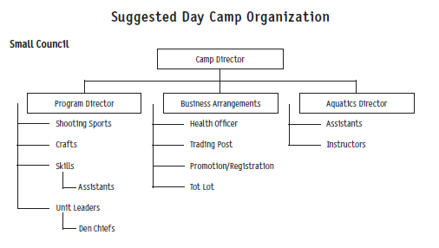
Staff Organization
Discuss your local Day Camp organization chart

Slide 14
Day Camp Director
Is responsible to the day camp advisor
Supervises personnel and camp operations
Recruits, interviews, and trains day camp staff
Maintains the national standards
With the camp advisor, is responsible for national accreditation
With the camp advisor, is responsible for camp budget
Creates staff organization chart
With the camp advisor, is responsible for the emergency plan
Implements the risk-management plan and the camper security plan
Implements the program and supervises staff and program activities in accordance with approved policies during camp. (NCAP standard PD-112)
Creates the menu and determines food costs
Prepares the promotion plan
Prepares the staff manual
Develops check-in and orientation procedures
Supervises the trading post and its staff
Recognizes the staff and campers
Prepares the evaluation at the end of camp

Slide 15
Day Camp Staff Advisor
Maintains the national standards at camp
Maintains proper budget control
Usually determines dates of operation
Determines the staff salary chart and payroll
Assists in creating and approves the camp staff organization chart
Is aware of the emergency procedure plan
Advises camp directors and program directors; communicates council-specific information to them
With the camp director, is responsible for national accreditation
Manages risk management and camper security plans
Assists with camp problems
Is responsible to the council for equipment and property
Assists with the evaluation at the end of camp

Slide 16
Day Camp Program Director
Is responsible to the camp director
Assists with promotion of the camp
With the camp director, recruits, interviews, and trains program staff
Creates the program staff organization chart
Prepares schedules, including den formations and rotation schedules
Prepares the program budget
Understands and supports the emergency plan
Maintains inventories of program supplies
Provides program stations and activities
Develops the theme for the camp
Provides ceremonies, campfire, and mealtime programs
Evaluates program effectiveness

Slide 17
The Partnership
Some duties overlap across all positions – you cannot be Camp Director and Program Director at the same time. Why?
Each camp is unique, each council/district will decide their structure
Work together to provide a camping program that meets POLICIES of Scouting America, budget of the council, and a POSITIVE EXPERIENCE for Cub Scouts and Leaders!

Slide 18
Volunteer-Professional Relationship
Preparation – Do your assigned work, follow through on your responsibilities, on time, and as agreed to.
Accessibility – Accessible to each other – cells, email, whatever works – must talk frequently!
Time Efficiency – Appreciate each other’s time. Be efficient, don’t overload with tasks, respect each other in work, family, and health commitments
Communication – Key to successful interaction. Keep each other informed of progress in your area. Communicate status, successes, and PROBLEMS!

Slide 19
Standards
PD-112
SQ-401
SQ-403
RP-462
RP-851

Slide 20

NCAP
NATIONAL CAMP ACCREDITATION PROGRAM
Notes:
Paper informs – people inspire.

Slide 21
National Camp Accreditation Program - NCAP
LEARNING OBJECTIVES
Describe where and when day camp happens.
Describe the importance of national standards and the accreditation process.
Identify the national standards and reason for their existence.
Define the key components of the national accreditation process:
  Site Appraisal Form
  Local Council Authorization and Assessment Declaration Form
  Precamp/postcamp inspection
  On-site assessment, scoring, and recording.
Understand what an assessment team does.

Slide 22
Where do we hold camp?
City, County, State Parks
Churchyards
School Grounds
Council Camps
Open Fields
Where the Scouts are!!
Accessible by the population we are serving.

Slide 23
When / how long do we hold day camp?
2 or more days
Duration may affect sign ups, depending on parent’s need for daycare
Doesn’t have to be in the summer
No overnights

Slide 24
National Standards
Ensure the health, safety, and well-being of every camper, visitor, and staff member while on camp property.
Ensure that the council takes pride in the high quality of its day camp, including the program staff, facilities, and equipment.

Slide 25

National Standards
Guide to be sure tasks are completed on time
Your true source for the day camp process
Scout Executive is responsible for ensuring the camp is accredited
Scout Executive is responsible to see that standards are maintained, with help from your council’s committees such as camping, Health & Safety, Risk Management, and others as needed
Can be volunteers and professionals

Slide 26
National Standards
● SA-0xx - Standards Applicability
● PD 1xx – Program Design & Recommended Practices
● PS 2xx – Program Specific & Recommended Practices
● SQ 4xx – Staff Qualification & Training & Recommended Practices
● HS 5xx – Health & Safety
● FS 6xx – Food Service
● FA 7xx – Facilities & Recommended Practices
● AO 8xx – Administration & Operational

Slide 27
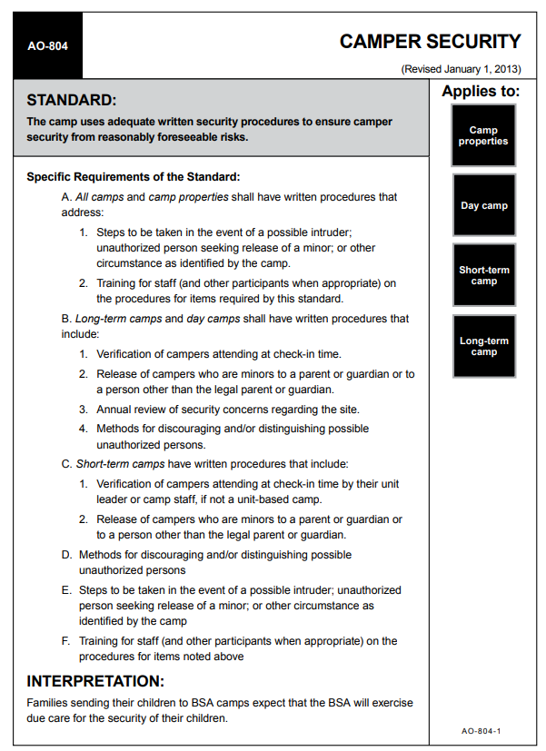
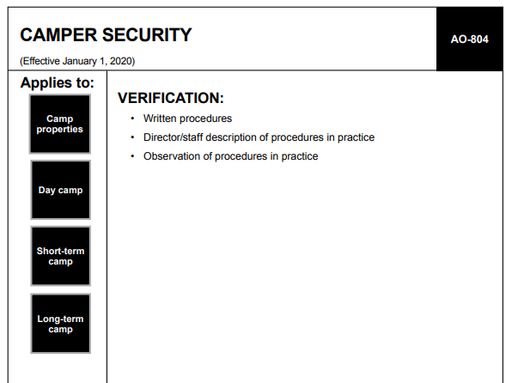

National Standards
Standard or RP #
Standard or RP Title
Revision Date
Specific Requirements
Type of verification required
Type of Camp Standard or RP Applies to
Interpretation

Slide 28
NCAP – Paperwork Reminders
Step 1: Site selection – NCAP Site Appraisal Form
Step 2: Council authorizes day camp “NCAP Local Council Authorization and Assessment form- Part A”
Step 3: Camp planned in accordance with standards
Step 4: On site assessment - “NCAP Local Council Authorization and Assessment form- Part B”
Step 5: All paperwork is submitted

Slide 29
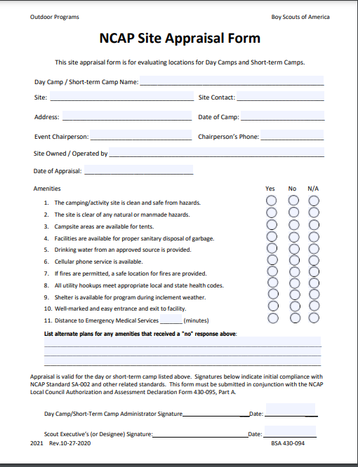
NCAP Site Appraisal Form
430-094

Slide 30
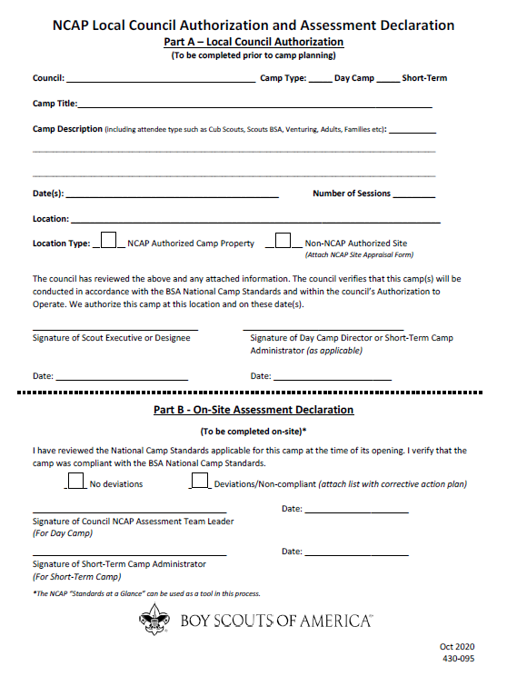
Part A and Part B
Local Council Assessment

Slide 31
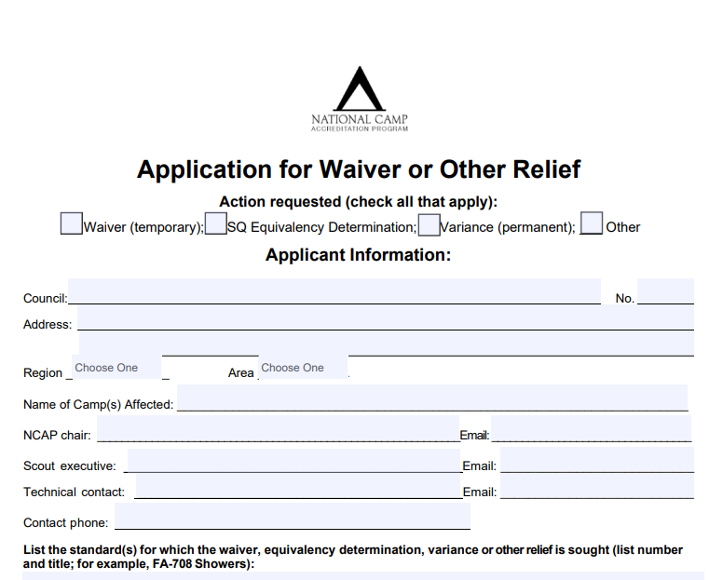
Waivers and Variances

Slide 32
NCAP Assessment Team
Visit camps, review practices, activities, and site to see that standards are being maintained
Provide suggestions for the camp administration and program best practices
Can shut sections, or entire camp down if discrepancies exist

Slide 33
Standards
FA-701
A0-801
AO-802
AO-808
AO-811
AO-812
SA-001
SA-002
SA-003
SA-004
SA-005
SA-006

Slide 34

RISK MANAGEMENT

Slide 35
Risk Management
Learning Objectives
Learn what risk management is, who reviews it, and how it relates to camps.
Identify who we are responsible for in our camps
Identify potential emergency situations at camp
Describe the 8 parts of an emergency plan.
Learn the importance of communicating emergency plans to staff & participants.
Become familiar with Scouting America resources focused on camp risk management.

Slide 36

Risk Management
Everyone’s Job at camp!
It’s not “RISK ELIMINATION”, it’s “RISK MANAGEMENT”
Minimize risk, and establish procedures to handle the risk
Guide to Safe Scouting is the reference. Day Camp – NCAP process.
SAFE Checklist (Supervision-Assessment-Fitness and Skill-Equipment and Environment)
Pre-camp Inspection – evaluate for any risk, evaluated by Risk Management Committee of Council
We are responsible for campers, leaders, parents, visitors, staff – everyone!

Slide 37
Daily Safety Moment
RP-552 states “The camp includes a safety moment as part of its daily program to help foster safety awareness and a culture of safety.”
Take a few moments each day to share a safety moment with your camp.
Focusing on all aspects of safety each day will go a long way toward managing risks.
Example safety moments may be found at:
www.scouting.org/health-and-safety/safety-moments

Slide 38
Our Risk Management Policies
Discuss and Distribute the material to be covered pertinent to YOUR council procedures!!

Slide 39
Emergency Plan
Review last year’s plan and update as necessary
An Emergency Plan contains 8 parts
Discuss and Distribute the material covered on this slide pertinent to YOUR council procedures!!

Slide 40
#1 – Warning or Emergency Signal
What will it be? Keep it simple, functional!
Can it be heard everywhere in camp? Do we need runners to remote locations?
Practice! Part of opening session
What do we do when we hear it?
Who is responsible for whom?
What is the procedure for head counts and reporting?

Slide 41
#2 – Central Location to Meet
Use common sense
Is it accessible from all locations?
Easily identifiable
Can campers sit comfortably?
Adequate shelter? (FA - 714)
What if a group can’t get there? Is there an alternative?

Slide 42
#3 – Buddy System
HS-511
Part of everyday life in camp
No exceptions
Practice!

Slide 43
#4 – Leadership Plan
All leaders know their roles. Review it with them (AO–805)
Each group has a leader assigned
First Aid responders are designated
When moving, there should be a leader in front and back
Telephones or other communication systems must be available to designated staff members. (AO-807)
Information and procedures are in place for communication with Responders and medical, Scout Executive, parents and campers
Media spokesperson is designated
All staff members are trained in the plan

Slide 44
#5 – Emergency Vehicles
All vehicles are in good repair and operated in a safe and legal manner.
Policies are in place to address motor vehicle use (at council facility)
Vehicles are parked in a designated area
Roads are restricted to camp vehicles ( if possible)
One “emergency vehicle” is always designated and available. Not for emergency victims
Access to ambulance is available. Staff will not transport.
Is entry to camp easy to find and travel?
How will we evacuate if necessary? Inform emergency agencies.
See FA-711

Slide 45
#6 – Emergency Phone Numbers
See AO-807
Posted in more than one location
Numbers are current and correct (what are our emergency numbers?)
Who will call?
Who will call the Scout Executive?
Discuss and Distribute the material covered on this slide pertinent to YOUR council procedures!!

Slide 46
#7 – Emergency Shelter
What do we use for a shelter?
Consider appropriateness for rain, wind, and other possible conditions
Is the size adequate, or will be have to divide the group? What is the plan?
FA-714

Slide 47
#8 – Evacuation Plan
Evacuation is a real possibility
Determine leadership - who makes the decision to evacuate?
Be sure the council is involved and informed
Do we need to shut off utilities (council properties)?
Communication with authorities?
Communication with families?
FA-705, AO-805, AO-807

Slide 48
Incident Reporting
Report all incidents per Scouting America protocol (AO 808)
Review the Scouting America incident reporting website: www.scouting.org/health-and-safety/incident-report/
NEW: As part of AO 808, the Camp Director, the Program Director and the Camp Advisor must review the incident reporting site/documents and sign a certification statement 60 days prior to start of camp.
Fatality or catastrophic injury or illness the Camp Director is in charge, supported by the camp health officer.
What are the council protocols for these incidents? (HS-507)
What are the council emergency policies and procedures? (AO 805)
Discuss and Distribute the material covered on this slide pertinent to YOUR council procedures!!

Slide 49
Summary
Through the years, Scouting America has developed a plan for safe camping.
The NCAP standards have been put in place for the safety of youth, staff, and leaders.
Risk management means managing the environment to minimize risks to everyone’s safety and well-being while allowing for a fun learning experience to take place.

Slide 50
Standards
PD-108
PD-112
HS-511
FA-703
FA-705
FA-711
FA-714
AO-805
AO-807
AO-808
AO-812
RP-552

Slide 51

ORIENTATION & OPENING FUNCTIONS

Slide 52
Orientation & Opening Functions
LEARNING OBJECTIVES
Explain potential opening functions that need to be completed prior to opening camp
Recognize the importance of communication, proper training, and orientation of parents and leaders
Describe a typical orientation for adult leaders
Review appropriate check-in procedures
Explain the importance of efficient record keeping

Slide 53
Opening & Closing Procedures
Plan or manual with written procedures for the following:
  Review of evals from current session
  Review of checkout reports from staff
  Physical setup and takedown requirements
  Inventory, condition, and location of equipment & supplies
  Design and layout of program areas
  End of season maintenance (RP-855)
  Equipment & Supply needs for next year

Slide 54
Pre-Camp Orientation
Leaders & Parents need to know what to expect and how to plan so they can arrive prepared
Brochures, flyers, websites
  Dates, Times, Locations, Fees
  Special information
  Lunches, Tours, trips, special activities
2-3 weeks before camp

Slide 55
Pre-Camp Orientation
Key Staff Members - discuss program and answer questions
Tour of the camp, if possible
Review procedures for check-in, registration, emergencies, camper security
Provide instructions on leader and parent expectations
Review schedule of activities
Discuss the theme
Medical Forms
T-shirt distribution
Promote trading post items

Slide 56
Pre-Camp Orientation
Medical Checks – process for collecting & securing medical info
Daily Sign-in. What about no-shows?
Authorization for removal from camp – who can do it, how will you track it?

Slide 57
Arrival in Camp – Check In Procedures
ONE CHANCE TO MAKE A GOOD FIRST IMPRESSION!
Positive & Inviting Appearance on arrival
Greeted with a smile by a uniformed staff member?
Area free of litter and organized? Is the grass cut?
Sufficient signage for drop off, parking, access from main roads?
Greeted enthusiastically by staff they encounter?
Restrooms? Directions, signs, etc?
Parents feel safe about leaving their Cub Scout here?
Can they recognize the theme?

Slide 58
Arrival in Camp – Check In Procedures
Divide the process into stations:
  Paperwork and Fee Clearance
  Medical Check (must retain confidentiality)
  T-shirts for those who missed orientation
  Den Assignment – meet the den leader/chief
  Wristband / name tag / ID tag creation or distribution
  Pre-opening activity
  Allow for good flow, smoothly moving from one to the next

Slide 59
Council Paperwork & Fees
Application forms for unregistered youth
Registration forms for walk-ins
Permission Slips, if necessary
Updating roster for walk-ins and no-shows
Collection of fees (council policy on handling funds?)
Receipt book

Slide 60
Summary
Create high morale and minimize stress with a well-defined and organized opening process. Be sure your staff knows each job, and their part of it as well.
Signage
Start out happy!
Smooth, fun, fast – no bottlenecks!
The first day should be fun and exciting for youth, leaders, and STAFF!!

Slide 61
Standards
PD-108
RP-855

Slide 62

CAMPER SECURITY

Slide 63
Camper Security
Learning Objectives:
Identify camper security information that should be communicated to unit leaders and parents prior to camp and at registration
Identify transportation security measures (FA-711, PS-216)
Explain procedures for:
Camper security check-in
Camp contract personnel, if used, and visitors
Handling unwanted visitors
Handling media
Handling early checkout
Identify areas in camp that pose potential security issues

Slide 64
Transportation Issues
Monitor parking and drop-off areas
Watch when near busy streets, avoid if possible
If providing transportation, do so in a safe fashion
All passengers should be secured by seat belts when in passenger vehicles – and according to local law
Consider using law enforcement to help direct traffic
Consider “back-in” parking to facilitate leaving the area
Communicate safe rules to pedestrians and drivers
Council vehicles must be maintained properly
Time evening events to arrive at home at a reasonable hour

Slide 65
Routing and Accounting For
Path to check-in is well-marked. Provide maps as needed.
Identify everyone in camp: (AO-804)
  campers
  leaders
  staff
  Visitors
Daily verification of no-shows

Slide 66
Identification Methods
T-shirts
  Campers
  Staff, leaders
Wrist Bands
Bolos, necklaces
Hats
Logbook and hang tag for visitors
Make sure staff and campers are aware of it!

Slide 67
Unauthorized Visitors
Written procedure for intruders or unauthorized visitors
  Campers and Staff are coached in procedure (AO-804)
Possible Steps
  Report presence to the Camp Director or staff advisor.
  Camp Director approaches unwanted guest to determine why they are in camp.
  Ask them to leave the area/property. Keep them in sight until they are gone.
  Contact law enforcement if they refuse to leave or return.

Slide 68
Media or Government Agencies
What is the Council Policy?
The Council Scout Executive/CEO is the official spokesman for the camp. The day camp staff adviser should facilitate that contact, if needed.
Be friendly, ask them to check-in, provide badging according to your plan.
Escort at all times.
Be cautious.
Photographs may only be taken with parent’s release form.
Discuss and Distribute the material covered on this slide pertinent to YOUR council procedures!!

Slide 69
Outside Providers of Program (PD-109)
Who is authorized to sign contracts for the council? Do we have/use any?
This standard applies if a council uses public or private outside (non-Scouting America) providers of programs or activities. The council must have a written agreement with each provider that outlines the responsibilities of both parties.
The council requires staff to accompany campers participating in outside programs and ensures that these staff members are well-informed of their responsibilities for camper supervision.

Slide 70
Outside Providers of Program (PD-109)
Specific Requirements of the Standard
The council selects only providers who:
Present programming in keeping with Scouting America standards.
Provide an adequate number of instructors/guides with verified qualifications.
Use equipment that is safe, age-appropriate, and in good repair.
Provide evidence that they meet or exceed Scouting America insurance requirements.
Meet or exceed the requirements outlined in the Guide to Safe Scouting.

Slide 71
Outside Providers of Program (PD-109)
Daily off-site providers providing service at a place of public accommodation (e.g., general public swimming pool, public beach) should meet as many of these policies as is reasonably possible and accompanying staff should always ensure maintenance of Youth Protection policies.
Where compliance with the standard as written cannot be achieved due to unusual circumstances, the council should propose how it intends to demonstrate compliance in the application, and approval will be provided in the Authorization to Operate.

Slide 72
On-Site Contract Personnel Background Check (RP-852)
As a recommended practice, camps employing outside food service contractors or other vendors whose function requires that their personnel are regularly on-site should request certification that criminal background checks have been conducted.

Slide 73
Early Check Out Procedures
It may be necessary, either expectedly or unexpectedly, for a camper to leave camp before the scheduled end of the camp session. Written procedures are in place regarding release of campers who are minors to a parent or to people other than the legal parent or guardian. (NCAP standard AO-804)
What are our procedures?
Discuss and Distribute the material covered on this slide pertinent to YOUR council procedures!!

Slide 74
Identifying Areas in Camp for Potential Security Problems
Each camp has areas with potential security problems.
You will need to take extra steps to minimize risks of abuse or abduction in the following:
Physical Layout – any blind spots?
Public access to the camp area?
Swimming pool & changing areas
Behind buildings
Busy Roads
Congested registration areas

Slide 75
Identifying Areas in Camp for Potential Security Problems
Train staff to inspect these areas and stress using the buddy system to your campers.
Buddy system drills (simply calling out, “Find your buddy!”) can emphasize in a fun way the importance of being with your buddy at all times.
Grounds should be inspected daily for potential problems.

Slide 76
Communication Systems
Must be reliable
Know who on staff may use
Must be tested prior to and during camp - correct any failures immediately
(AO-807)

Slide 77
Summary
Camper security begins before campers and leaders come to camp.
Carefully considering the areas of security risk and putting procedures into place to deal with them will help ensure that everyone remains safe and secure while they are at camp.

Slide 78
Standards
PD-108
PD-109
PS-216
FA-711
AO-804
AO-807
RP-852

Slide 79

CAMPER HEALTH

Slide 80
Camp Health
Learning Objectives:
Define roles of camp medical personnel
Define the role of accident & sickness insurance
Define a properly equipped medical care area
Identify proper procedures to dispense meds at camp
Understand written policy for medical care while at camp
List the purposes that health forms and first aid logs fulfill at camp.

Slide 81
Introduction
Creating a healthy and safe environment for your campers, leaders, and staff takes planning. There are two stages of planning that are necessary:
  Pre-camp health and safety steps
  On-site health and safety steps

Slide 82
Before Camp Begins
All necessary and required permits, certificates, licenses, and agreements secured for lawfully operating a camp at the location.
Appropriate on-site medical supervision secured.
Accident and sickness insurance secured for all campers.
Appropriate equipment secured for the medical care area.
Procedures in place for dispensing and securely storing medications.

Slide 83
Before Camp Begins
All written policies for medical-care services approved annually by the council’s health supervisor in conjunction with the risk management committee.
First-aid kits for all on-site program areas secured with adequate supplies and equipment.

Slide 84
Required Permits, Certificates, Licenses and Procedures
Advisor and Director work together in the following areas:
Drinking Water Certification
General Health procedures
Accident prevention
Major Emergency procedures
Site Concerns

Slide 85
Medical Personnel
Council Health Supervisor – Oversees council affairs for health services and is a licensed physician medicine in the applicable state.
Camp health officer - Trained professional, who is on hand at camp. At least 18 years of age. Conducts a daily safety inspection of camp, emphasizing sanitation. Review SQ-405 for specific training requirements based on camp location.
Camp health officer has completed the training “Camp Health Officer Training for Day Camp & Short-Term Camps” per SQ-405 located at https://www.scouting.org/health-and-safety/training/

Slide 86
Insurance
All camps must have current accident and sickness insurance in effect for all campers and staff as specified by the council and state and local government agencies. This insurance should be secured by the council, and the camp director will need written confirmation that can be viewed by the assessment team.
Where is that confirmation?
Discuss and Distribute the material covered on this slide pertinent to YOUR council procedures!!

Slide 87
Medical Care Area
Clearly Marked
Lockable medical storage system (dry and cold)
Available toilets, washing water, and drinking water
Space for medical treatment
Protection from elements
Staff continuously on call to meet routine and special needs per council written procedures and to maintain health and medication logs

Slide 88
Medication Handling (HS-508)
The camp requires that all prescription and over-the-counter (OTC) medications be stored under lock (including those requiring refrigeration), except when in the control of medical-care staff or other adult leader responsible for administration and/or dispensing medications.
An exception may be made for a limited amount of medication to be carried by a camper, leader, parent, or staff member for life-threatening conditions, including epinephrine injector, heart medication, and inhalers, or for a limited amount of medication approved for use in a first-aid kit.

Slide 89
Medication Handling (HS-508)
Medications must be:
— Kept in their original containers; or
— Labeled and maintained in a fashion approved by the council health supervisor.

Slide 90
Medication Handling (HS-508)
For prescription medications, in accordance with the prescribing medical-care provider’s directions or a parent/guardian’s signed summary thereof.
For OTC medications, in accordance with the original label, except as otherwise provided by the council’s health supervisor, or a prescribing medical-care provider’s directions, or a parent/guardian’s signed summary thereof.
Camp-supplied medications must be administered and/or dispensed in accordance with pre-approved medical procedures approved by the council’s health supervisor.

Slide 91
Medication Handling (HS-508)
All administration or dispensing of medication must be recorded in accordance with the council’s written policies.

Slide 92
Medical Policies
Written policies for medical-care services must be approved annually by the council’s health supervisor in conjunction with the risk management committee. Specific written policies required by NCAP standard HS-506 include:
  Camp Health Operations
  Camp Treatment Procedures (Standing Orders)
  EMS Services
  Authority, limits, required experience and training of the camp health officer
  Leadership and expectation of non-medical camp staff to provide medical care – first aid
Discuss and Distribute the material covered on this slide pertinent to YOUR council procedures!!

Slide 93
Medical Policies
  Equipment and supplies needed for camp
  Health screenings as needed
  Medication management
  Sanitation of health facilities with procedures for dealing with contaminated waste, sharps
  Medical record keeping
  Selection and maintenance of camp first-aid kits

Slide 94
First Aid Kits (HS-510)
The camp supplies or ensures that adequate first-aid kits are available.
The camp supplies first-aid kits to all on-site program areas.
All first-aid kits provided by the camp have adequate supplies and equipment.
All camp first-aid kits are kept in easily identifiable, accessible containers and locations.

Slide 95
Health Forms
A current (within 12 months) health history is required of all campers, leaders, and staff members. (Note that state law will supersede Scouting America health form requirements).
The information is reviewed at the beginning of camp and is kept on file during the camping period as recommended by the council. Health forms are returned at the end of camp. Cub Scout campers use the Annual Health and Medical Record, No. 680-001, sections A and B.

Slide 96
First Aid Log (No. 680-127)
Daily record of all first aid and medical treatments is kept.
Staff records are kept in separate log from campers.
Camp Director and Health Officer should review and sign off daily.
All injuries, illnesses, and incidents requiring the intervention of a medical provider beyond basic Scout-rendered first aid are reported promptly, following Scouting America guidelines.
Procedures are in the First Aid Log and will be followed for these incidents.

Slide 97
First Aid Log (No. 680-127)
Close of Camp – logs are reviewed by Risk Management committee and are stored in a secure fashion for 18 years or as required by local law.
HS-507 Verification Item
During camp, a plan is in place for observation of the medical log(s) and spot-check of completeness, without excessive intrusion into the privacy of an individual.

Slide 98
Other Items to Consider
(as needed by your camp situation)
Water—Adequate access to safe drinking water is provided to all participants. Drinking water is from an approved public water system source or is tested regularly during the season for bacteriological quality and meets governmental health standards. In the absence of an applicable health code, piped or provided water supplies are tested at least once a year at the start of camp.

Slide 99
Other Items to Consider
(as needed by your camp situation)
Food Storage and Handling—Proper food storage is necessary. Make sure the camp refrigeration units are clean, sanitary, and able to achieve required temperatures. If handling food, staff needs to be neat, wear clean clothing, have no health concerns, and comply with all state and local laws. Dishes, silverware, cookware, and cooking utensils are properly cleaned and sanitized in accordance with state and local regulations. Provided meals should be dietitian-approved and nutritionally balanced.

Slide 100
Other Items to Consider
(as needed by your camp situation)
All equipment and surfaces used in the preparation and serving of food are clean and sanitary. Dining hall tables, benches, and serving facilities are clean and in good repair. The dining hall has good ventilation and adequate room to walk freely between tables.

Slide 101
Other Items to Consider
(as needed by your camp situation)
Possible food allergies should be kept in mind as meals and snacks are planned, as well as how the transportation, storage, and “use by” date requirements are met. Review with the head of food services to assess understanding of the guidelines and how they are followed.
Possible food and other allergies should be addressed during the registration process. Also be cautious about cross-contamination of foods.

Slide 102
Other Items to Consider
(as needed by your camp situation)
Smoking is not allowed in the dining hall, nor is it permitted in the kitchen. A smoking zone away from any food preparation, serving, dining, and camping areas may be designated if local ordinances permit.
Sanitation—Disposing of garbage properly can control the spread of germs. Trash needs to be picked up in a timely manner and must meet local or state regulations. Disposal of garbage, refuse, and sewage meets the demand of those in attendance.

Slide 103
Other Items to Consider
(as needed by your camp situation)
Toilets and Latrines—Toilets and latrines are clean, well-ventilated, in good repair with adequate insect and pest control, and located throughout camp and/or in each campsite.
Procedures for separate use of restroom facilities by males and females and by youth and adults are in effect.
Procedures are in place to include periodic checks to ensure that safety, sanitation, and privacy of participants is maintained.
Handwashing—Proper hand washing before and after eating, before food preparation and after disposing of garbage, as well as after using restroom facilities, can prevent the spread of many germs. Make sure staff and campers have access to facilities throughout the camp.

Slide 104
Other Items to Consider
(as needed by your camp situation)
Bulk flammable storage: Bulk containers of flammable liquids are properly located, vented, secured, and connected according to the supplier’s recommendation or local codes. Fuel pumps are locked; all flammable fuels are safely stored in approved containers that are locked or located in a locker area or facility.
Signage: “Danger—No Smoking” signs are posted at fuel storage locations where required by code or established by council policy.

Slide 105
Summary
By following these pre-camp and on-site steps, Cub Scout day camp standards will be in place to provide a healthier and safer camping experience for campers and staff.

Slide 106
Standards
SQ–405
RP–453
HS–503, 504, 505, 506, 507, 508,
HS–509, 510
FS–601, 602, 603
FA–702, 703, 705, 706, 707, 709, 710, 712, 713
AO–801, 803, 808, 812

Slide 107

STAFF SELECTION AND TRAINING

Slide 108
Staff Selection & Training
Learning Objectives:
List the different roles and general responsibilities of staff members at Cub Scout day camp.
List the factors that determine the number of staff members for a camp.
Describe how camp staff are found and recruited.
List the critical fundamentals in camp staff applications, position descriptions, and letters of agreement.
Explain why staff training is critical in executing a great program.
List some key subjects that should be covered in staff development.
Understand how a staff manual should be used to communicate camp expectations to staff members
Understand Youth Protection policies at camp.
Explain that staff training is a continual process and does not end when camp training is finished.
Describe how to avoid unlawful harassment in camp.
Describe the purpose of a code of conduct.

Slide 109
Introduction
“The principal mission of the camp staff is to ensure a quality program of adventure that will meet the high expectations of every participating camper.”
Each staff member MUST be a team member who sets an example by applying the 12 points of the Scout Law in thought and action.

Slide 110
Staff Members-
Roles & Responsibilities
Support Unit leaders in making their year-round programs effective
Instruct campers in skills such as aquatics, personal fitness, sportsmanship, craftsmanship, crafts, and sports
Assist with safety procedures and YPT policies of the camp
Give leadership to programs, campfires, and ceremonies
By example and personal effort, help youth and leaders have a happy, worthwhile experience.

Slide 111
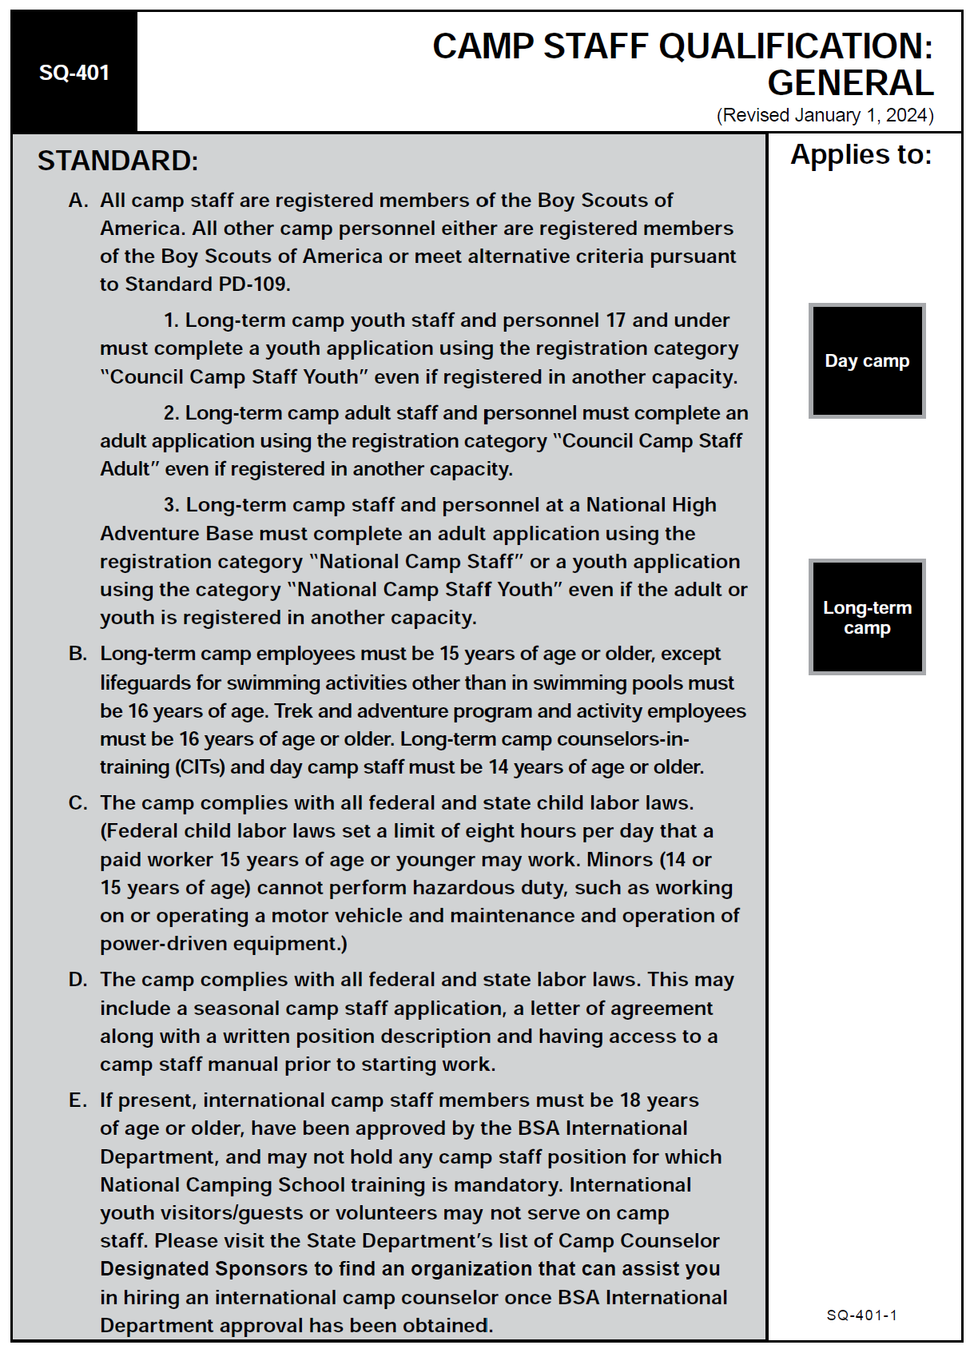
Who is considered staff?
(SQ-401)

Slide 112
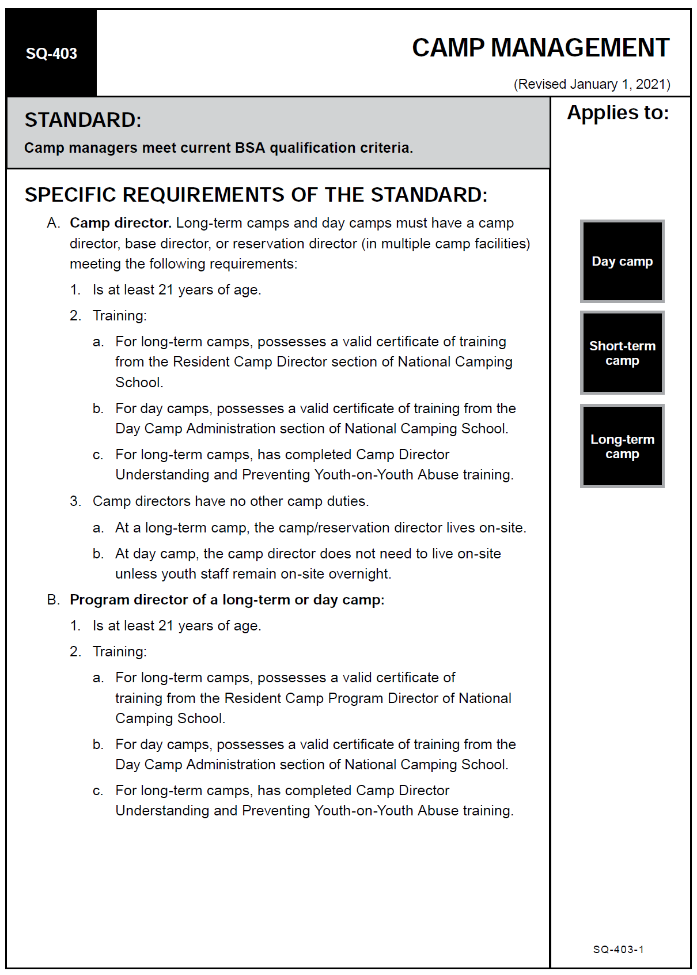
Staff Ages
(SQ-403, RP-451, 457, 459)

Slide 113
Staff Size Factors
Number of campers expected
Site characteristics
Length of camp (days)
Programming activities
Specialized activities
Type of Food Service
Maintenance
Participation of leaders
Special Needs
Staff Ages
Tot Lot?

Slide 114
Potential Staff Positions
  Business and Physical Arrangements Manager
  Health Officer
  Crafts Director
  Aquatics Director
  Shooting Sports Director
  Station Instructors
  Walking Den Leaders
  Tot Lot leaders
  Den Chiefs
  Food Service Staff
  Trading Post Staff
  Quartermaster

Slide 115
Where do we find them?
Previous Day Camp staff
Pack unit leaders
Parents
Scout Troops / Venture Crews
Eagle Scouts / NESA
Order of the Arrow
Council / district Scouters
Community special interests
RSVP / SRDA

Slide 116
Where do we find them?
Military Groups
Hospital staff
Medical schools
Paramedics / Ambulance companies
USA Archery
NRA
Conservation groups
Teachers
Instructors

Slide 117
Applications, Job Descriptions, Letters of Agreement
Apply to all – Volunteer or Paid
Council Policies
Employment laws do not apply to volunteers, but all should be treated with the same respect.
Documents are to be in “The Book”, or filed in the council electronic system!

Slide 118
Selection of Camp Staff
#1 - Must be registered members of Scouting America (SQ-401A)
  Recommendation – 50% in leadership positions have 3 years camp experience, or a degree in a related field (RP-458)
  On site leadership – Orientation, written summary of their duties and responsibilities, and be supervised by a key staff member
  All staff must be over 14 (SQ-401B), must comply with all labor laws (SQ-401C).
    Federal Child labor laws may apply
    No hazardous duty

Slide 119
Selection of Camp Staff
#2 - An Application is submitted (SQ-401C.3)
#3 – Application is reviewed
#4 – Face to face interview
#5 – Letter of Employment is issued, including Job Description
(SQ-401C.3)
#6 – Other necessary forms are completed

Slide 120
Staff Training
Should begin as soon as staff is recruited and confirmed
Should continue thru camp duration
Code of Conduct – review and sign (see workbook)
Behavior – referenced to Scout Oath & Law

Slide 121
Staff Development Guide
Review sample (or actual if present)
Welcome and Personal Info
Camp Site and Staff Organization
Staff Policies and Guidelines
Written Emergency Procedures
Special Activities
Discuss and Distribute the material covered on this slide pertinent to YOUR council procedures!!

Slide 122
Staff Manual
Used and Referenced at all staff meetings
Emergency Procedures
Security Plans
Wildlife Hazards
YPT at Camp
Uniform / Costuming
Rules for electronics, punctuality, manners, grooming and language
Staff Use of Program Areas
Trading Post guidelines
Autos & Bikes in camp

Slide 123
Staff Manual
Kitchen policy
Things to bring and not bring to camp
Map of camp – stations and facilities
Objectives and philosophy of CS Day Camp
Organization Chart
Staff Roster
Schedule
Theme – related material
Approved songs and skits
Procedures
Staff Rules & Regs

Slide 124
Staff Manual
Phone policy
Position responsibilities and duties
Personnel policy
Records to be kept
Outlines of reports to be made
Keep it simple and portable!

Slide 125
Unlawful Harassment
Review Scouting America policy.
Positive and productive work environment
Prohibiting unlawful harassment
Promptly addressing reports of harassment
Any form of harassment is forbidden:
  Including but not limited to – race, gender, religion, color, sexual orientation, national origin, ancestry, citizenship status, uniformed service member status, marital status, pregnancy, age, medical condition, physical or emotional disability
Action can include discipline and discharge
Important – all staff understand the definition of harassment

Slide 126
Unlawful Harassment
The term harassment includes but is not limited to slurs and any other offensive remarks, jokes, or other verbal, graphic, or physical conduct.
Here are some examples of inappropriate behavior that may meet the definition of unlawful harassment:
Unwelcome sexual advances
Offering an employment benefit (such as a raise or promotion or assistance with one’s career) in exchange for sexual favors, or threatening an employment detriment (such as termination, demotion, or disciplinary action) for an employee’s failure to engage in sexual activity
Visual conduct, such as leering, making sexual gestures, or displaying sexually suggestive objects or pictures
Verbal abuse
Derogatory or offensive jokes, emails, or comments about race, ethnic origin, age, disability, religion, or gender

Slide 127
Harassment by Non-Employees
Any harassment will not be tolerated
Harassment of an employee by a non-employee must be reported using the same procedure
Appropriate action will be taken

Slide 128
Reporting Harassment Policy
Council Policy discussion
It is an employee’s responsibility to report
If not comfortable with supervisor level report, elevate to the next level – camp director, Scout Executive
Reporting is done in good faith and is protected against adverse action or retaliation
False reporting is also subject to action
Reports should be investigated promptly and thoroughly, and action taken when warranted, as confidentially as possible

Slide 129
Standards
PS-215
SQ-401, 402, 403, 405
HS-501, 505
RP-451, 457, 458, 459
AO-805

Slide 130

BUDGETS

Slide 131
Camp Budgets
Learning Objectives:
Understand the elements of budget preparation
Identify income and expenditures related to a camp budget.
Understand how budgets are impacted by variables such as attendance, fees, and other sources of income.
Recognize the importance of tracking income and expenses and accurate reporting
Address specific business items to arrange with advisor before camp
Conduct an inventory of equipment and condition of program tools to determine need to add to future budgets

Slide 132
Introduction
Budgets are often the toughest part of day camp
Advisor, director, and program director will need to work together before, during, and after to ensure the process is smooth and accurate
Being responsible for and with finances is critical for the success of your camp, and future activities!

Slide 133
Budget Responsibility
Every camp’s budget is part of the council’s larger overall budget. The council annually prepares a budget that should include any long or short term, year-round, and day camps.
Budget building often includes an annual analysis based on year-round data on all camp operations and properties. (AO-806)
Understand that the income of the camp is part of the council’s larger budget, not a specific camp’s money. Any debts of the camp will be paid by the council. Any surplus funds after the season must go back to the council.

Slide 134
Budget Responsibility
Don’t shortchange the program. Campers should receive value to match their fees.
Crafts and projects that the campers make and take home should be keepsakes that will foster memories. These things will remind campers and their families of day camp long after the camp is over.
It should be more than orange juice lids and toilet paper rolls!

Slide 135
Budget Development
Last year’s information
  Leftover inventory
  Attendance projection
Income
  Camp Fees
  Trading Post income
  Donations
  Gifts-in-kind
Expenses
  Supplies, rent, port-a-potties
  Contingency Funds
  Council administration
Discuss and Distribute the material covered on this slide pertinent to YOUR council procedures!!

Slide 136
Budget Development
Two methods
  A) Camp key 3 develop complete budget and submit to council for consideration. All expenses, income, contingencies, variable costs are figured in.
  B) Camp key 3 is given a “Program cost” budget, basically how much can be spent on program supplies per scout. All other costs are not a concern of the camp staff but are managed by the council.
  Our council uses Method ____

Slide 137
Budget Development
Purchasing
  Bulk ordering of T-shirts, crafts, program supplies across all camps?
  Who can order material? What is the approval procedure? Do you use purchase orders, or is reimbursement approved?
  How is the trading post inventory purchased, tracked, and reconciled?
Record Keeping
  Track year-to-year expenses and income
  Includes: registration, supply orders and expenses, post-season inventory of supplies and donations

Slide 138
Budget Development
And Finally –
Final Reports To the Council Once Camp Is Over
  Financial report of income and expenses
  Itemized inventory of all program supplies, trading post stock, and other items.

Slide 139
General Expenses
Fees / rentals
Insurance
Council Contingency
Council Operating Fund
Salaries
Promotion & Marketing
Training (NCS, 1st Aid, CPR)
Medical Supplies
Staff ID (T-shirts, hats, etc.)
Office Supplies
Telephones / Radios
Food / catering
Sanitation / Fuel
Maintenance / repair
Recognition items
Travel / transportation
Security
Program

Slide 140
Program Expenses
Leatherwork / crafts
Ceremony / campfire
Special programs
Shooting Sports
Awards & Prizes
Program Staff Training Costs
Costumes
Equipment replacement / depreciation
Will you be sharing with other camps?

Slide 141
Variables
May change right up to the day of camp
Number of campers / staff
Unforeseen costs
Replacement of tools or equipment
What Else?

Slide 142
Council Financial Procedures
Handling Cash
Credit Card, checks
Purchase Orders
Reimbursement
Petty Cash
Ordering Supplies
Processing payments / refunds
Trading Post
Program Budgets
Inventory of Supplies
Vendor Contracts
Donations
Gifts-In-Kind
Payroll

Slide 143
Summary
It’s essential that the camp advisor, camp director, and program director communicate and work together on the camp budget
Communicate any budget constraints to directors to avoid surprises
Maintain control! Each and every financial decision made affects your program

Slide 144
Standards
RP-445, 854
AO-806

Slide 145

PROMOTION AND MARKETING

Slide 146
Promotion and Marketing
Learning Objectives:
Describe the 7 elements in successful Cub Scout camp promotions and how the council will be assisting
Explain why marketing materials should be directed to adult leaders, parents, and guardians, and what should be directed at youth
Describe how to use the different tools used by your council for camp promotion
Determine ways to overcome any negative reaction from last years camp
Explain how a camp survey can be helpful to the future of the camp.

Slide 147
Introduction
How will the council assist with promotion of your day camp?
Remember that promotion is essential to having good participation at camp
Who will be in charge of each method of promotion?

Slide 148
Last Year’s Reputation
Next years promotion starts the first day of this year’s camp!
The experience campers and leaders have this year will affect their desire to return next year.
Will your promotion focus on some of the great things from last year, or will you be promoting the changes you made so camp will be even more fantastic?
What were last year’s negatives? What’s the plan to correct them?
AO-809 states “The camp surveys its customers to assess satisfaction.” What are your plans to conduct the survey?

Slide 149
Camp Plan
It’s hard to promote when you don’t know what’s happening
Having a solid camp plan makes promotion easier. You don’t need every day planned, but you should have the overall plan in hand for promotions.
Competence inspires confidence. Promote your camp as the greatest camp ever, be sure, and be proud!

Slide 150
Promotion Plan
When will the promotion plan start? (not a few weeks before camp)
Where will the plan be delivered? Pack Meetings? Roundtables, Cub Events?
What materials do we need to promote?
Can the council help, or will it be up to the Camp directors and staff?
If social media used - who develops information?

Slide 151
Promotion Team
Recruit volunteers to help, including camp staff!
Theme – related costumes, quick craft items
Camp rap, song or skit to be performed at events and meetings
Social Media
  Council
  District
  Camp
Who is reviewing material?

Slide 152
The Right Audience
Oriented towards adults
  Make decisions for their Scouts
  Flyers and other material geared towards adults
  Include critical info
    Place, Dates, Cost, Special events, etc.
    Contact Info
Built-In audience at Pack meetings
  Don’t assume pack leadership is promoting
  Promote strongly at larger packs and those who have supported in the past.
Scout level as well
  Games, activities to show how much fun camp is!

Slide 153
Promotional Material
Promotion Team
Websites
Social Media
Eblast/email
Fliers, brochures
Posters
Place Mats
Mailers
Registration Packets
Videos
Pack Visits
Newsletters
Open House
Cub Events
Local Service center

Slide 154
Stand Up Display Board
All necessary information
“On the Road” for promotion, take to meetings, events, etc.
Nice to be able to see information in addition to hearing it.
Humans need to be told more than once before they “hear” the information – multiple methods are needed to promote good communication.

Slide 155
Communication!
WHO can come?
WHAT will you do?
WHEN is the camp?
WHERE is the camp?
WHY should they attend?
HOW to the sign up?
HOW can parents/leaders help?
Accurate, Interesting – they can’t register if they don’t know about it!
Consider using QR codes to register.

Slide 156
Summary
How will the Council help promote?
What information is needed?
Who will build the promotional information?
What is our timeline?

Slide 157
Standards
RP-151
AO-809

Slide 158

TRADING POSTS AT DAY CAMP

Slide 159
Trading Posts at Day Camp
Learning Objectives:
Illustrate the fiscal impact on the camp and council from a successful camp trading post
Explain that a trading post is a service, and parents, leaders, campers, visitors, and staff expect to have the opportunity to purchase camp-related items there.
Show how the trading post can be used as a mechanism to help deliver the camp theme.
Identify procedures to order, price, display, and sell merchandise

Slide 160
Trading Posts at Day Camp
Learning Objectives Continued:
Determine what to order, how much, and from where
Establish procedures for handling cash and credit cards
Explain managing and maintaining inventories in compliance with Scouting America guidelines.

Slide 161
Introduction
Who is running our Trading Post?
  Council personnel?
  Day Camp advisor?
  Specified Individual?

Slide 162
Why Should We Have One?
Positive fiscal impact. A well-planned and well-managed trading post can be the difference between a camp making and losing money for the season.
Program support. A trading post can support the camp theme by decorating and by providing theme-related items for purchase.

Slide 163
Why Should We Have One?
Service to customers. By offering items such as cold drinks, candy and snacks, camping supplies, books, and program support items, a service is being provided to our customers. Customers include campers, leaders, parents, visitors, and staff.
A trading post gives them an opportunity to purchase memorabilia and souvenirs with your camp name. Having items available such as T-shirts, sweatshirts, hats, patches, water bottles, Frisbees, mugs, pocket knives, flashlights, etc., will satisfy that need and provide free promotion for your camp throughout the communities you serve.

Slide 164
Administration & Management
A very important part of camp.
Really operates as a separate retail establishment operating within your camp.
Much care should be given to operation and administration.
Scouting America has specific guidelines for operation, work with Day Camp advisor to ensure policies are defined and adhered to.
Day Camp Advisor should approve all material purchases.

Slide 165
Trading Post Administration
One person is responsible
Post hours of operation
Cash and Carry only – no credit!
Conduct regular inventories. Restock as needed
Follow all cash-handling procedures diligently
Have processes in place for customer security when dealing with credit or debit cards, personal checks

Slide 166
Prior to Camp
Include the trading post in advertising so parents know it’s OK to send money.
Order merchandise. Use last year’s trading post records to help determine what and how much to buy.
Work with vendors and suppliers to establish a business relationship. Know what their policies are for reorders, returns, payment, and turnaround. There should be no surprises once you’ve agreed to conduct business with them.

Slide 167
Prior to Camp
Meet with your National Supply Group representative to determine your needs.
Determine council policy on requesting cash for a cash drawer.

Slide 168
Opening Your Trading Post
Ready and open before anyone else arrives.
Check opening inventory.
Check suppliers’ invoices thoroughly, one at a time. Call them immediately if there are discrepancies.
Display items in an organized and efficient manner. Have items located for easy viewing, without customers having to dig around to see what’s available.
Develop and adhere to practices for checking in new merchandise.
Properly store reserve inventory.

Slide 169
Stock Control
Determine if you will try to restock certain items, or only sell what was available at the start.
Know the timelines available to restock, if possible
Regular inventories are a necessity (AO-806C)

Slide 170
Tips for Handling Money
A predetermined amount of cash is used to start each day.
The trading post account should be balanced at the close of each day.
Cash should be kept in a locked, secure place at the close of operation each day.
Do not allow credit for campers or staff.

Slide 171
Tips for Handling Money
Receipts for all purchases must be made available immediately upon request.
Credit and debit card information, as well as personal checks, need to be kept secure and away from access by anyone other than the store manager.
Deposits should be made regularly to avoid having large amounts of cash on hand.
Money should be counted by two people for accuracy.
Proper procedures are essential!!

Slide 172
End of Camp
Efficient shutdown of a trading post will have a positive effect on how easily and effectively the trading post will open next year. All returnable items should be returned.
Held-over items should be inventoried and stored. Record keeping is very important since those records will be used to determine trading post plans for next year.

Slide 173
Odds and Ends
Litter control. Have receptacles for wrappers, etc. Encourage their use!
Bags for purchases help with loss prevention.
If they can’t see it, you can’t sell it!
Involve the staff to sell “cool” stuff!
Age appropriate items are essential.
Don’t forget the adults.
Theme-oriented items will be popular.
Cover a variety of price levels.

Slide 174
What sells?
What do we want to sell?
What was hot last year?
T-shirts, patches, branded items
Candy, snacks, soft drinks, popcorn
Cub Scout items
Multiple price levels
Magic tricks, games, puzzles
Closeout from previous years on “sale”
Healthy alternatives

Slide 175
Summary
The trading post in a Cub Scout camp can be a great asset to the program. It can add to the theme atmosphere, be a social gathering place and an information station, and help provide additional income for the camp and council.
It can be a hive of activity with resources for leaders, parents, and campers.

Slide 176
Standards
RP-159
AO-806 C

Slide 177

NEED IDEAS?
If you are stumped for a great Day Camp theme idea, visit our Cub Scout Day Camp resource page at
https://www.scouting.org/outdoor-programs/camping/cub-day-camp/
This resource page has the current national Day Camp Theme Resource Book full of great ideas for activities, songs, skits, clip art for promotion and much more!
The resource page also has resources and theme ideas from past years.

Slide 178

CONGRATULATIONS!

Slide 179
Congratulations
You’ve completed the In-Council portion of NCS for Day Camp Administration!
Be sure your council adds “SCO_14001” and “CS 63” to your training record!

Slide 180
Next Steps
Be sure to bring your workbooks, and proof of all prerequisite completion to the In-person portion of National Camping School.
See you at National Camping School!!

