Slide 1
Special Needs and Disabilities Roundtable Will begin at 6:30pm Central Time
1
Notes:
1

Slide 2
Special Needs and Disabilities Roundtable May 22, 2023
2
Notes:
2

Slide 3
Homesickness
BSA Safety Moment
Notes:
SUMMARY
Many of us can feel a bit out of sorts when away from familiar surroundings, and Scouts are no different. Many Scouts experience some symptoms of homesickness during campouts, and identifying these symptoms early and addressing them can help make the event a great experience for everyone.

Slide 4
Homesickness Risk Factors
Symptoms of homesickness include:
a disturbed sleeping pattern.
feeling angry, nauseous, nervous or sad.
feeling isolated, lonely or withdrawn.
feeling overwhelmed, insecure, anxious or panicky.
feelings of low self-esteem or self-worth.
headaches.
a lack of appetite or concentration.
Notes:
According to the American Camp Association, most campers report at least some homesick feelings during one day of their camp stay. Common symptoms include mild depression, anxiety, withdrawn behavior, somatic—or physical—complaints, and misbehavior.
Younger Scouts usually are those affected the most. Those who experience homesickness typically have little experience with separation, are anxious or depressed before camp, and may feel they have little control over their situation. They may have no camping experience, feel forced to attend, have insecurities at home, or have overheard their parents express anxiety about them leaving.

Slide 5
Helpful Pre-Camp and Camp Strategies
Take campers for a visit prior to camp starting.
Make sure all Scouts are included in the planning phase, and discuss what camp life will be like.
Address any fears of hazing or bullying.
Make everyone feel a part of the group.
Notes:
Helpful Pre-Camp and Camp Strategies Adult leaders can mitigate many of the potential problems of homesickness by planning ahead and taking the following steps:
Take campers for a visit prior to camp starting. If not possible, show them material from the camp so that they can become more familiar. All BSA Camps should provide a leader’s guide that will have all the information you need. Also, utilize Google Maps and look at the camp sites.
Make sure all Scouts are included in the planning phase, and discuss what camp life will be like.
Address any fears of hazing or bullying.
Make everyone feel a part of the group.

Slide 6
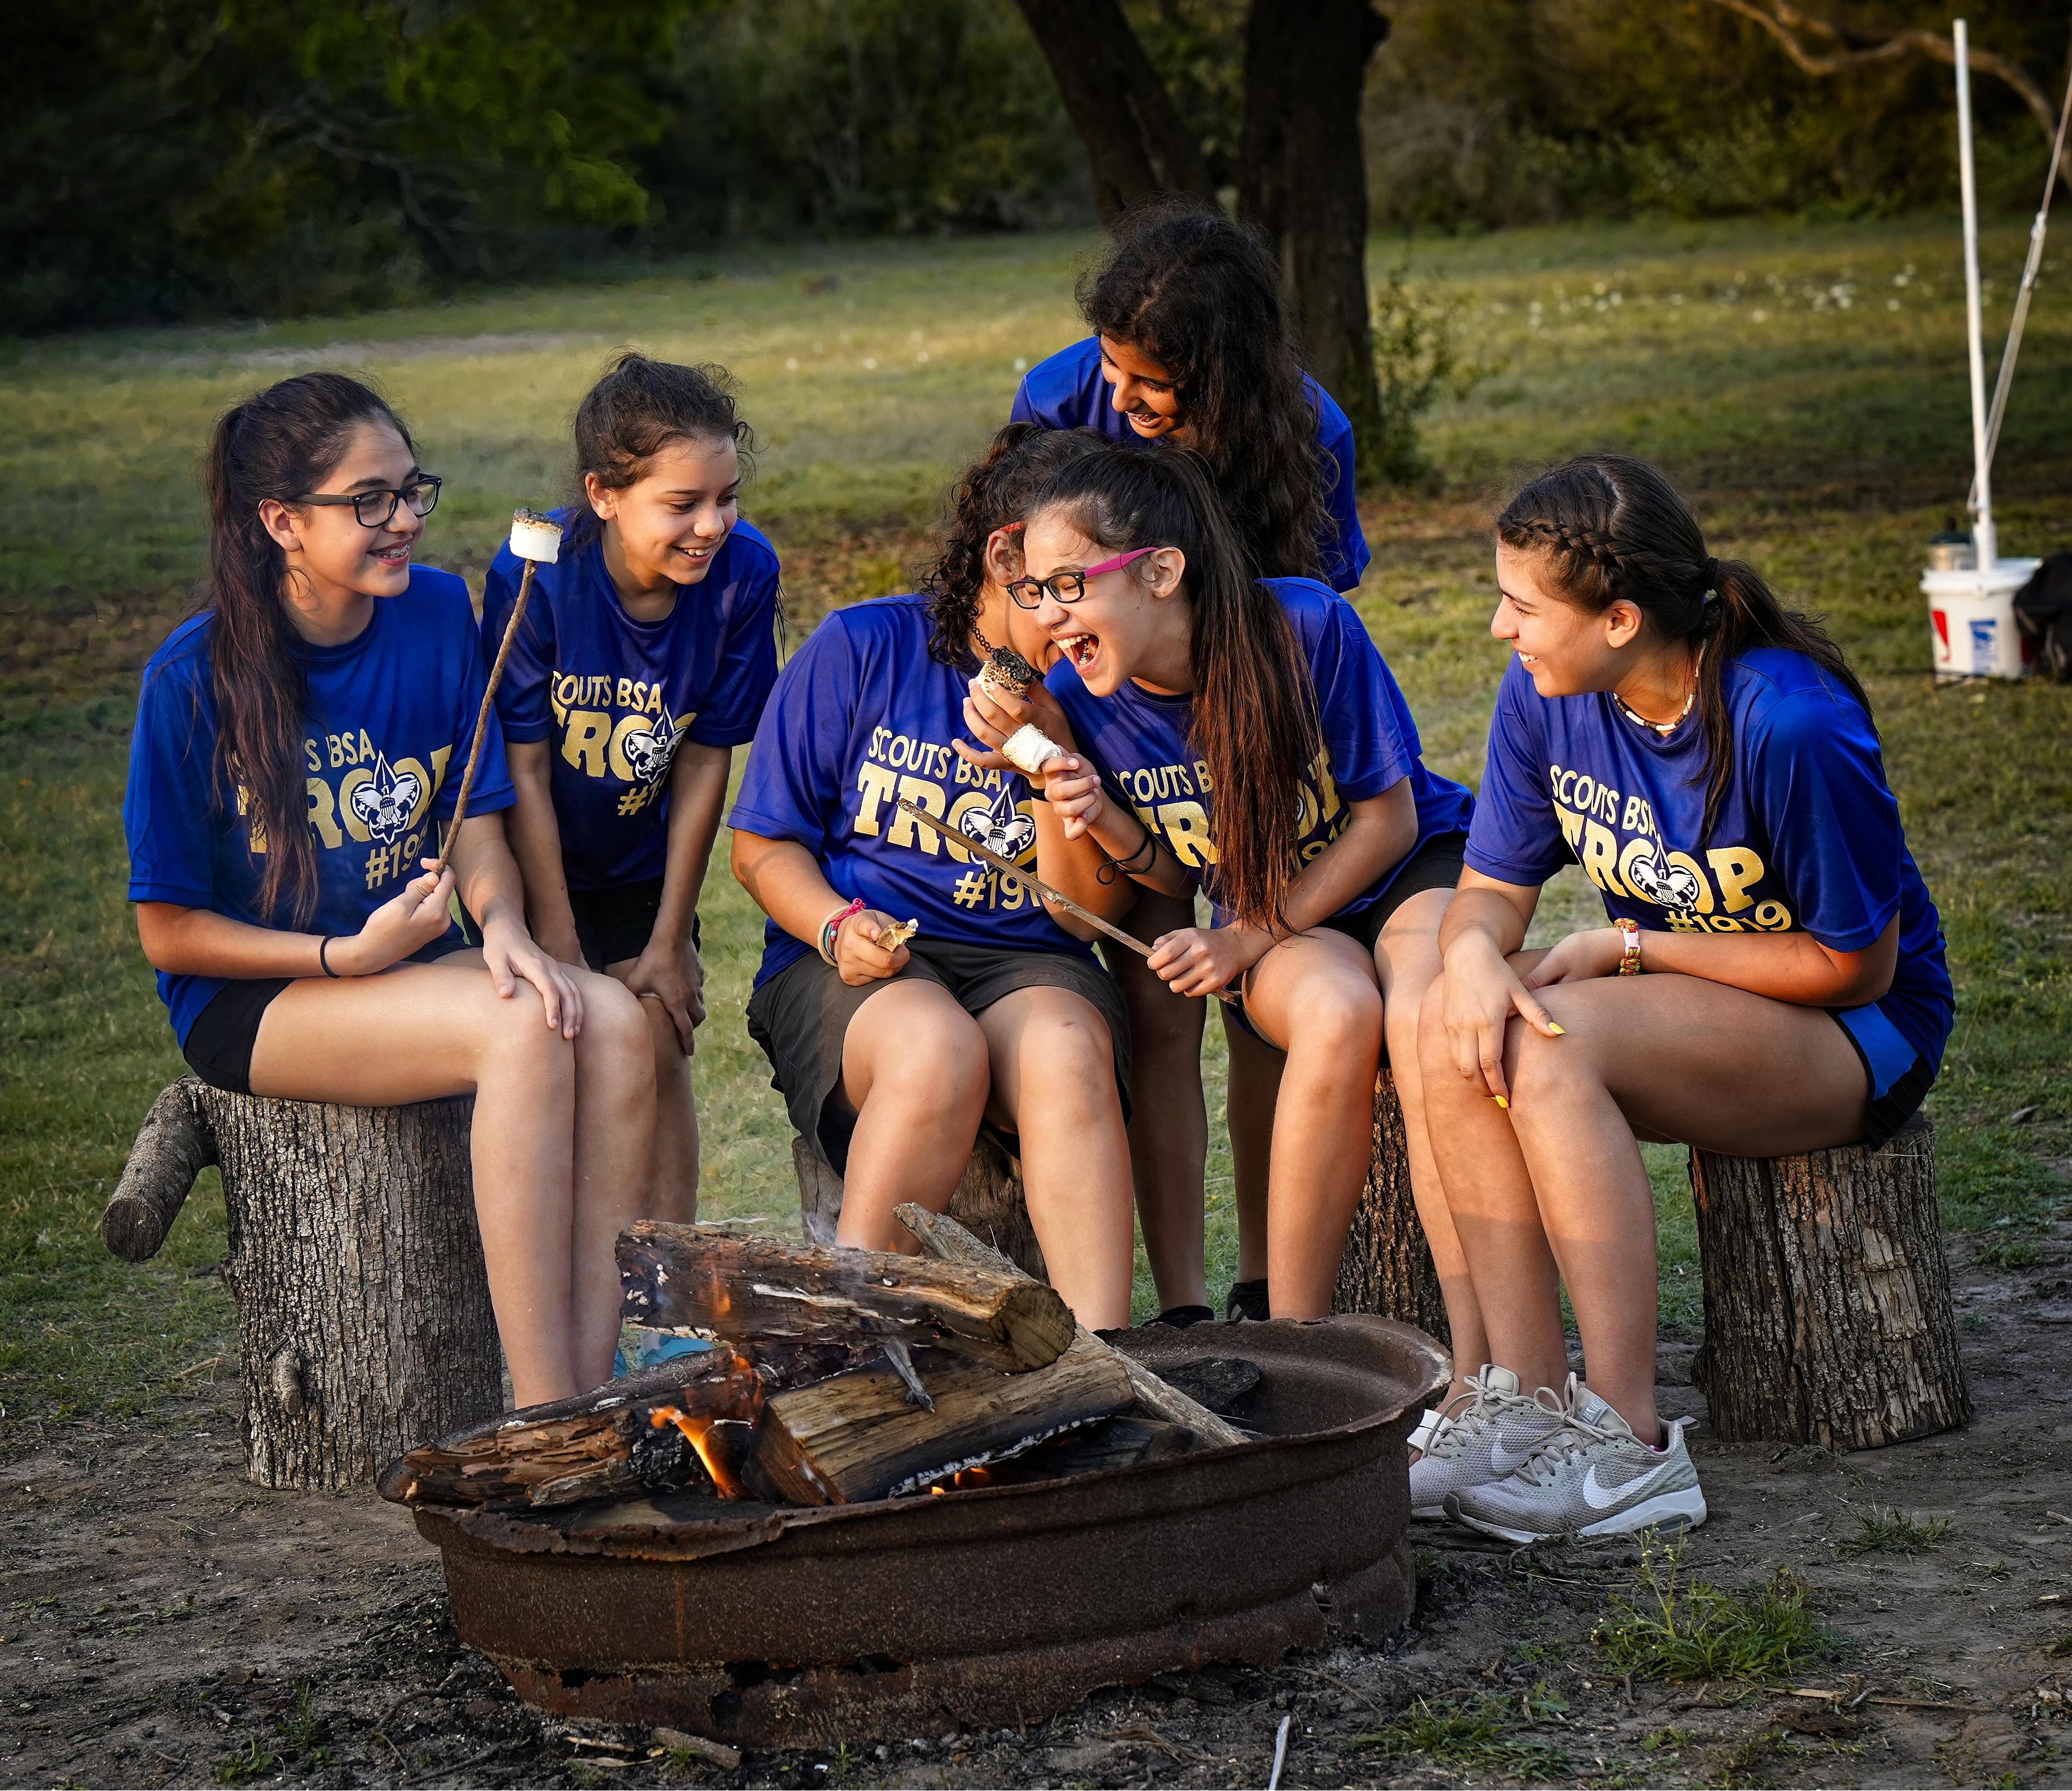
Additional Steps Once at Camp
Immediately integrate into the camp routine & inform them of what to expect.
Provide social support
Promote an appropriate connection with home
Assess the Scouts’ needs and provide positive coping outlets.
Encourage them and follow up regularly.
Notes:
Once everyone is in camp, there are additional steps that can help minimize feelings of homesickness:
Immediately get everyone integrated into the camp routine and inform them of what to expect.
Provide social support to normalize their experience, e.g., asking an older Scout to help mentor a younger Scout who exhibits homesickness and to empathize with their feelings.
Promote an appropriate connection with home, e.g., have them write a letter home.
Assess the Scouts’ needs and provide positive coping outlets. Some of these strategies might be to get them involved in fun activities, encouraging them to talk with other Scouts or a leader about their feelings, reminding them of the fun things that they have done or will do at camp, and providing special fun tasks to do each day. Using a Tranquility Base can assist with this.
Encourage them and follow up regularly.

Slide 7
Additional Information
https://www.scouting.org/health-and-safety/safety-moments/homesickness/
https://drchristhurber.com/
https://www.acacamps.org/parents-families/planning-camp/coping-homesickness-camp

Slide 8
CALLING ALL VOLUNTEERS
WE NEED YOU!
Looking for a rewarding experience?
Registration for JST (Staff) closes on May 31, 2023
Come join us as a National Jamboree volunteer at the Special Needs & Disabilities Challenge. Help others learn about Special Needs.
JULY 19-28, 2023
Positions available for half week or full week
Contact Tony Mei tonymei.novato@gmail.com
or Warren Wenner specialneedschair@scouting.org

Slide 9
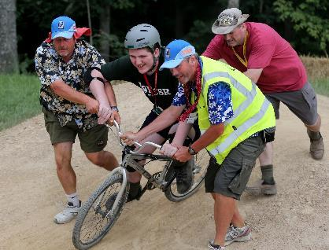
2023 National Jamboree Quick Facts
Jamboree is the best of Scouting all in one place
Since 1937, national jamborees have brought tens of thousands of Scouts together to share the bond of Scouting
July 19-28, 2023 at Summit Bechtel Reserve in West Virginia
Registration closes on May 31, 2023
$1,285 national fee for youth and leaders (council fees extra)
Scholarships available up to full amount!
Service Team (staff) fees:
Age 16-33: $400 (half) or $675 (full)
Age 34+: $700 (half) or $1200 (full)
Special Needs & Disabilities Challenge is looking for JST (staff)
Jamboree is committed to accessibility
Jamboree.Scouting.org

Slide 10
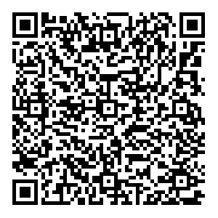
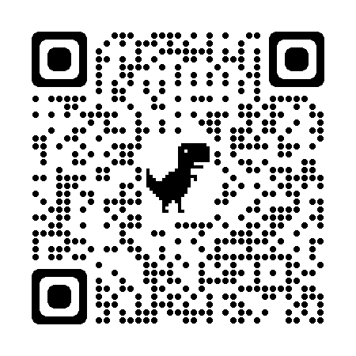
Inclusion Toolbox for Specials Needs & Disabilities
SUPERCEDES
BSA 34059
2007 EDITION
DOWNLOADABLE WEB-BASED AT
November 2022 AbleScouts.Org
Edition

Slide 11
LEARNING OPPORTUNITIES

Slide 12
June 25 - July 1 Zia Experience and Adaptive Special Needs Conference @ Philmont
July 19 - July 28 National Jamboree “Tent of Possibilities”
September 27 - October 1 National Outdoor Conference
National BSA Special Needs Accessible Camps (w/ National Properties Strategic Analysis Committee)
Disabilities Awareness in Scouts BSA Camps
Building an Outdoor Program for the Intellectually Disabled Scout
Creating a Blueprint for an Exceptional Camp Program for the Challenged Scout
Using the Inclusion Toolbox
Supporting Mental Health in Scouting
DATES TO REMEMBER

Slide 13
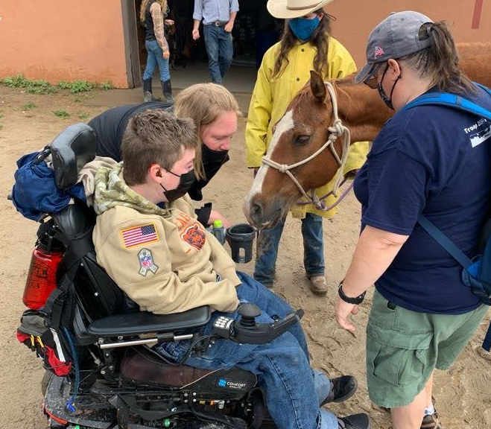
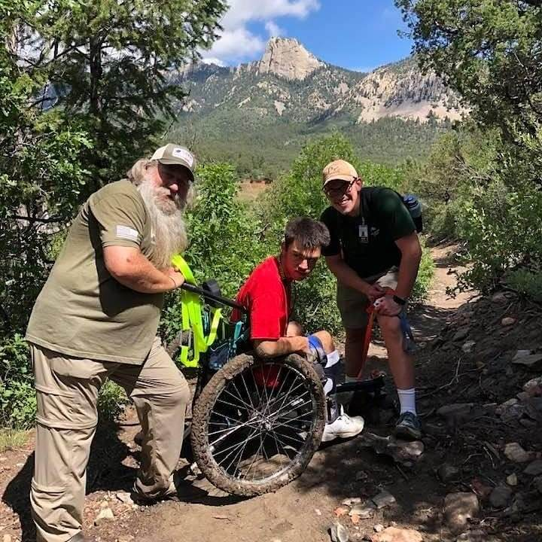
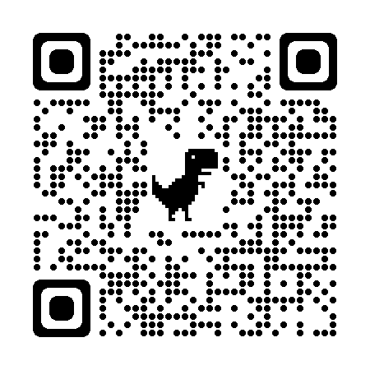
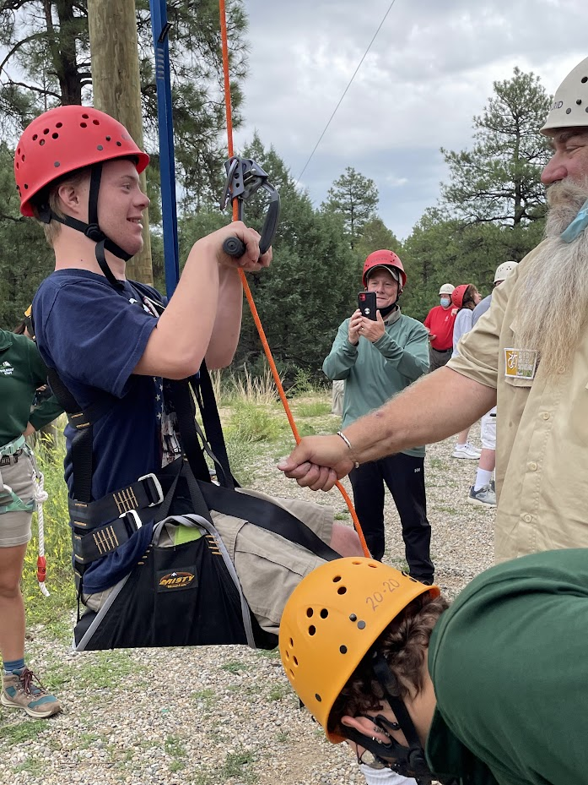
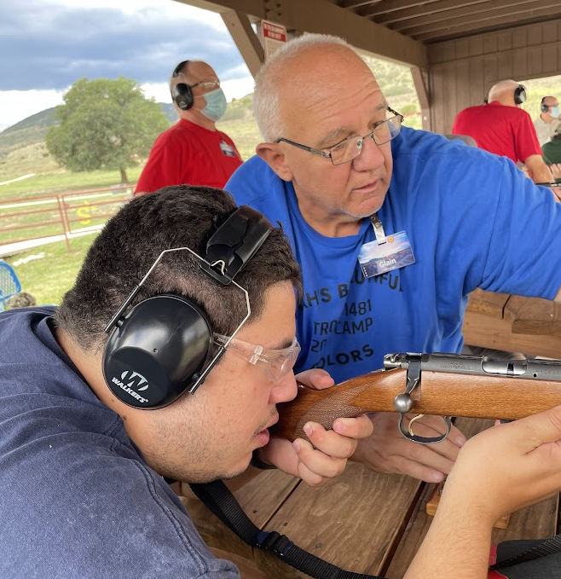
June 25-July 1, 2023
The Zia Experience
Adaptive Special Needs Conference
Adaptive Philmont Adventure for Scouts with Special Needs
https://www.philmontscoutranch.org/ptc/ptc-conferences/

Slide 14
NATIONAL WEEKEND WORKSHOPS

Slide 15
SAVE THE DATE
A MINI CONFERENCE ON SPECIAL NEEDS & DISABILITIES
COMMUNICATIONS, INCLUSIVITY & SCOUTS WITH SND
Presented by:
BOY SCOUTS of AMERICA
NATIONAL SPECIAL NEEDS AND DISABILITIES COMMITTEE
20-21 October 2023
Hosted by GOLDEN GATE AREA COUNCIL
Pleasanton, CA
Conference designed for:
Adult Leadership
Camp Leadership
Professional BSA Staff
Volunteer BSA Staff
Parents
Caregivers
Anyone Interested
Topics to be discussed:
How Scouts with SND communicate
How we communicate with them
Impact of multiple SND
How we communicate beyond Scouting
Registration information coming soon

Slide 16
M.E.S.H in Scouting
Mental, Emotional, Social Health
Notes:
May is Mental Health Awareness Month
The mission of the Boy Scouts of America is in its simplest form – to prepare young people for life. So how can we help prepare Scouts mentally for the challenges they face now and in the future?
According to data gathered by the American Camp Association, youth mental health incidents at accredited camps have increased substantially over the last decade. Youth at BSA camps are not immune from this trend. BSA believes that MESH is an important and evolving issue.
It may not seem like mental health concerns share much with other kinds of special needs and disabilities, but many neurodiverse diagnoses, such as autism, also have co-occurring mental health issues. In addition, techniques for supporting a Scout with a mental health concerns are also useful in other situations.

Slide 17
IF YOU OR SOMEONE YOU CARE ABOUT IS PRESENTLY EXPERIENCING THOUGHTS OF SUICIDE, SELF-HARM, OR HARM TO OTHERS
STOP NOW AND CALL
LOCAL EMERGENCY SERVICES (911)
OR IF MORE APPROPRIATE, SUICIDE & CRISIS LIFELINE (988)
Notes:
Anxiety, depression, and other mental health[2] disorders affect both youth and adults. At the outset, we need to recognize that Scouting volunteers generally lack the expertise to work youth with these conditions. Also, We are not here to diagnose or provide treatment.
One in six U.S. youth aged 6-17 experience a mental health disorder each year.
Half of all lifetime mental illness begins by age 14, and 75% by age 24.

Slide 18
What is Mental Health?
A state of mental well-being
Cope with stress
Make decisions
Realize abilities
Learn and work well
Contribute to community
Experienced differently, and in varying degrees
https://www.who.int/news-room/fact-sheets/detail/mental-health-strengthening-our-response
Notes:
The World Health Organization defines Mental health as a state of mental well-being that enables people to cope with the stresses of life, realize their abilities, learn well and work well, and contribute to their community. It is an integral component of health and well-being that underpins our individual and collective abilities to make decisions, build relationships and shape the world we live in. Mental health is crucial to personal, community and socio-economic development.
Mental health is more than the absence of mental disorders. It exists on a complex continuum, which is experienced differently from one person to the next, with varying degrees of difficulty and distress and potentially very different social and clinical outcomes.
Mental health conditions include mental disorders and psychosocial disabilities as well as other mental states associated with significant distress, impairment in functioning, or risk of self-harm. People with mental health conditions are more likely to experience lower levels of mental well-being, but this is not always or necessarily the case.

Slide 19
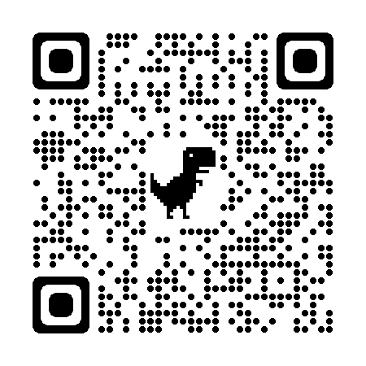
Mental Health Concerns
J: Understanding Anxiety, Depression, and Other Mental Health Concerns
Anxiety
Depression
Obsessive Compulsive Disorder
Bipolar Disorder
Eating Disorders
Substance Abuse
Psychosis
Notes:
For a more in-depth overview specific to anxiety and depressions and other mental health concerns, please refer to Module J of the Inclusion Toolbox.
The primary purpose of this module is to help recognize when a Scout may be struggling, how you can support the Scout, and when these struggles are a cause for concern. That way you know when to turn to family members and professionals to assist the Scout with his or her immediate needs.

Slide 20
How To Improve Mental Health
Value yourself and your body
Surround yourself with good people
Give of yourself
Deal with stress
Quiet your mind
Set SMART goals
Break up the monotony
Avoid alcohol or drugs
Get help
*Adapted from the National Mental Health Association/National Council for Community Behavioral Healthcare
Notes:
Try these tips to keep your balance, or re-balance yourself.*
1. Value yourself:
Treat yourself with kindness and respect, and avoid self-criticism. Make time for your hobbies and favorite projects, or broaden your horizons. Do a daily crossword puzzle, plant a garden, take dance lessons, learn to play an instrument or become fluent in another language.
2. Take care of your body:
Taking care of yourself physically can improve your mental health. Be sure to:
Eat nutritious meals
Avoid smoking and vaping
Drink plenty of water
Exercise, which helps decrease depression and anxiety and improve moods
Get enough sleep. Researchers believe that lack of sleep contributes to a high rate of depression in college students.
3. Surround yourself with good people:
People with strong family or social connections are generally healthier than those who lack a support network. Make plans with supportive family members and friends, or seek out activities where you can meet new people, such as a club, class or support group.
4. Give yourself:
Volunteer your time and energy to help someone else. You'll feel good about doing something tangible to help someone in need — and it's a great way to meet new people.
5. Learn how to deal with stress:
Like it or not, stress is a part of life. Practice good coping skills: Try One-Minute Stress Strategies, do Tai Chi, exercise, take a nature walk, play with your pet or try journal writing as a stress reducer. Also, remember to smile and see the humor in life. Research shows that laughter can boost your immune system, ease pain, relax your body and reduce stress.
6. Quiet your mind:
Try meditating, Mindfulness and/or prayer. Relaxation exercises and prayer can improve your state of mind and outlook on life. In fact, research shows that meditation may help you feel calm and enhance the effects of therapy.
7. Set realistic goals: SMART goals (Specific, Measurable, Attainable, Relevant and Timely)
Decide what you want to achieve academically, professionally and personally, and write down the steps you need to realize your goals. Aim high, but be realistic and don't over-schedule. You'll enjoy a tremendous sense of accomplishment and self-worth as you progress toward your goal.
8. Break up the monotony:
Although our routines make us more efficient and enhance our feelings of security and safety, a little change of pace can perk up a tedious schedule. Alter your jogging route, plan a road-trip, take a walk in a different park, hang some new pictures or try a new restaurant.
9. Avoid alcohol and other drugs:
Keep alcohol use to a minimum and avoid other drugs. Sometimes people use alcohol and other drugs to "self-medicate" but in reality, alcohol and other drugs only aggravate problems.
10. Get help when you need it:
Seeking help is a sign of strength — not a weakness. And it is important to remember that treatment is effective. People who get appropriate care can recover from mental illness and addiction and lead full, rewarding lives.
*Adapted from the National Mental Health Association/National Council for Community Behavioral Healthcare

Slide 21
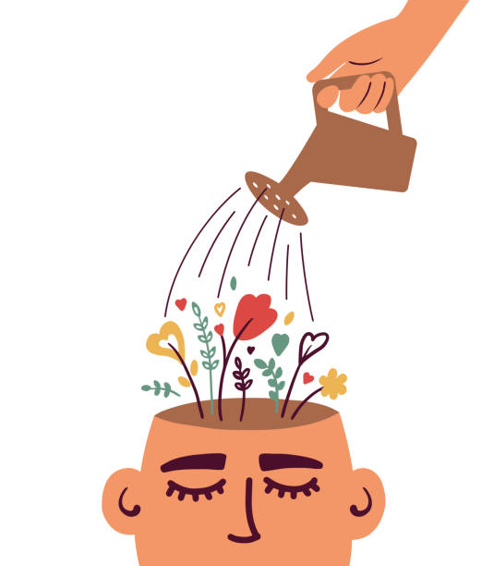
What is Emotional Health?
Being aware of your emotions
Accepting your feelings
Processing and managing those feelings
Expressing your feelings
Appropriately doing all of the above.
https://www.talkspace.com/blog/emotional-health-definition/
Notes:
Emotional health is about how we feel about ourselves, how we handle difficult situations, and how we acknowledge both our own and other people’s feelings.
The definition of emotional health is pretty much the same as the definition of emotional well-being. It’s what helps you not just survive but also heal when you’re faced with difficult times in life and thrive overall. Emotional wellness or health is an essential component if you want your everyday life to feel whole and balanced.
Emotional health is a person’s ability to accept and manage feelings through challenge and change. Someone who is emotionally healthy can allow their emotions to be digestible. The mundane hassles of daily life offer opportunities to practice responses, rather than reactions to allow emotional health to flourish.
Emotional health includes both emotional intelligence and emotional regulation.

Slide 22
Emotional Health Checklist
Build resilience
Reduce stress
Get quality sleep
Strengthen social connections
Cope with loss
Be mindful
https://www.nih.gov/health-information/emotional-wellness-toolkit
Notes:
Resilience: People who are emotionally well, experts say, have fewer negative emotions and can bounce back from difficulties faster. This quality is called resilience. Learning healthy ways to cope and how to draw from resources in your community can help you build resilience.
Stress: Everyone feels stressed from time to time. Stress can give you a rush of energy when it’s needed most. But if stress lasts a long time—a condition known as chronic stress—those “high-alert” changes become harmful rather than helpful. Learning healthy ways to cope with stress can also boost your resilience.
Sleep: To fit in everything we want to do in our day, we often sacrifice sleep. But sleep affects both mental and physical health. It’s vital to your well-being. When you’re tired, you can’t function at your best. Sleep helps you think more clearly, have quicker reflexes, and focus better. Take steps to make sure you regularly get a good night’s sleep.
Social Connections: Social connections might help protect health and lengthen life. Scientists are finding that our links to others can have powerful effects on our health—both emotionally and physically. Whether with romantic partners, family, friends, neighbors, or others, social connections can influence our biology and well-being.
Cope with loss When someone you love dies, your world changes. There is no right or wrong way to mourn. Although the death of a loved one can feel overwhelming, most people can make it through the grieving process with the support of family and friends. Learn healthy ways to help you through difficult times.
Mindfulness: The concept of mindfulness is simple. This ancient practice is about being completely aware of what’s happening in the present—of all that’s going on inside and all that’s happening around you. It means not living your life on “autopilot.” Becoming a more mindful person requires commitment and practice. You can find some tips to help you get started on our resource slide sited as emotional wellness.
https://www.nih.gov/sites/default/files/health-info/wellness-toolkits/emotional-wellness-checklist-2022-7.pdf

Slide 23
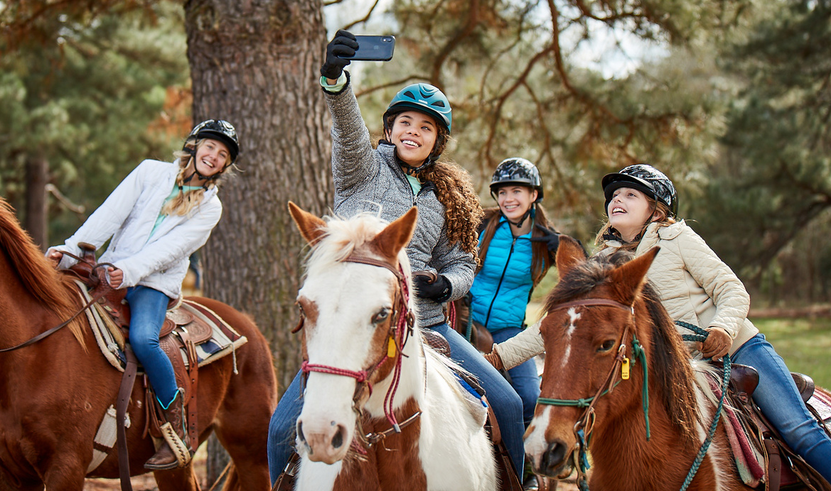
What is Social Health?
Connection
Community
Belonging
Relationships
Family
Friends
Feeling supported, valued and loved.
https://www.psychologytoday.com/us/blog/social-health/202302/what-is-social-health
Notes:
Social health is the aspect of overall well-being that stems from connection and community. It’s about having close bonds with family and friends, enjoying a sense of belonging to groups, and feeling supported, valued, and loved.
It’s different from mental health, which encompasses psychological and emotional well-being and relates to our thoughts and feelings. Social health can both contribute to and be affected by mental health.

Slide 24
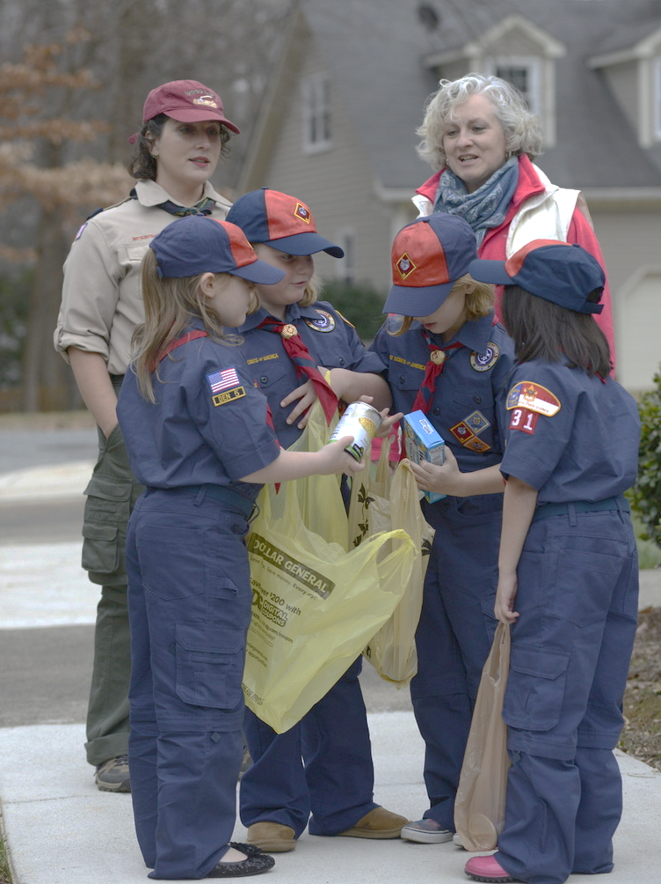
How to work on Social Health
Connect with five people each week
Talk on the phone for 10 minutes
Do a good turn
Keep a couple close friends
Get involved
https://www.psychologytoday.com/us/blog/social-health/202108/how-strengthen-your-social-muscles
Notes:
According to Psychology Today they recommend:
1. Connect with five people each week.
Studies have found that people who connected with at least five people each week were more likely to be happy. This was true for family members and friends, but also coworkers, indicating that meaningful connection can come from a variety of sources. The form of these interactions can vary too; the survey reported that happier people call, text, video chat, write letters, have loved ones over, or go out for a walk or meal with others at least a few times a week.
2. Talk on the phone for 10 minutes.
While it’s wonderful to spend time with others in person, even brief interactions from far apart can make a meaningful difference. Talking on the phone for 10 minutes 2 to 5 times a week significantly lowered people’s levels of loneliness, depression, and anxiety. Importantly, the phone calls centered around empathic communication, with the callers listening actively and asking questions about the other person’s life.
3. Do a small act of kindness or “Do a Good Turn”
Giving kindness may be as beneficial as receiving kindness. For instance, doing thoughtful gestures for neighbors—such as checking in on them, providing helpful information, bringing in their garbage cans, or mowing their lawns—the likelihood of feeling lonely decreases and the sense of neighborhood unity increases.
4. Keep three friends close.
People who had fewer or no close friends, and previous research has shown that friendship positively influences health and even longevity. People often leave interactions with close friends feeling loved, supported, and happy, and the qualities that are most important in these relationships are honesty and authenticity.
5. Get involved locally.
One-on-one connection is an important driver of social health, but so is a broader sense of community and camaraderie
Similar to physical and mental health, social health takes sustained effort and consistent habits to keep strong. But just like you don’t need to run a marathon to stay physically fit, you can do simple actions each day or each week to enjoy greater social wellness. Try these recommendations and see what works for you.

Slide 25
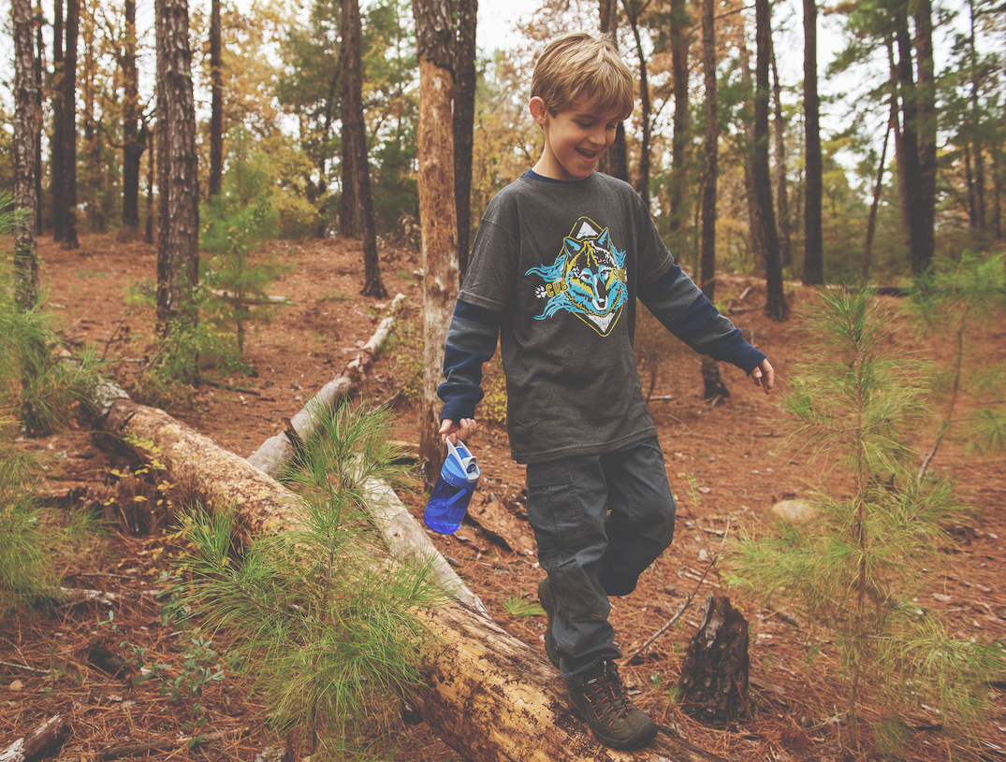
Warning Signs for Younger Children
Frequent tantrums or irritability
Often talk of fears or worries
Frequent stomach or head aches
Sleep too much, or too little
Not interested in connecting with peers
Struggle with school or decline in grades
Repeatedly check things many times out of fear
Notes:
It can be tough to tell if troubling behavior in a child is just part of growing up or a problem that should be discussed with a health professional. But if there are behavioral signs and symptoms that last weeks or months, and if these issues interfere with the child’s daily life at home and at school, or with friends, you should contact a health professional.
As Scout leaders, it is important to understand that we may not spend enough time with the Scout to see some of these signs. But if we do, we should demonstrate empathy and support.
Young children may benefit from an evaluation and treatment if they:
Have frequent tantrums or are intensely irritable much of the time
Often talk about fears or worries
Complain about frequent stomachaches or headaches with no known medical cause
Are in constant motion and cannot sit quietly (except when they are watching videos or playing video games)
Sleep too much or too little, have frequent nightmares, or seem sleepy during the day
Are not interested in playing with other children or have difficulty making friends
Struggle academically or have experienced a recent decline in grades
Repeat actions or check things many times out of fear that something bad may happen

Slide 26
Warning Signs for Teens
Lost interest in things they used to enjoy
Low energy
Sleep too much or too little, seem sleepy throughout the day
Spending more time alone
Change in eating habits or dieting/exercise excessively
Engaging in risky or self-harm behaviors
Periods of highly elevated energy
Have thoughts of suicide
Say they can hear or see things others can not
Notes:
Older children and adolescents may benefit from an evaluation if they:
Have lost interest in things that they used to enjoy
Have low energy
Sleep too much or too little, or seem sleepy throughout the day
Spend more and more time alone, and avoid social activities with friends or family
Diet or exercise excessively, or fear gaining weight
Engage in self-harm behaviors (such as cutting or burning their skin)
Smoke, drink alcohol, or use drugs
Engage in risky or destructive behavior alone or with friends
Have thoughts of suicide
Have periods of highly elevated energy and activity, and require much less sleep than usual
Say that they think someone is trying to control their mind or that they hear things that other people cannot hear

Slide 27
Do NOT Make Assumptions
Mental health symptoms can look different from one individual to another
Some behaviors may be developmentally “typical”
Be understanding
Allow for breaks
Communicate with the Scout
Communicate with the Family
Notes:
Mental health and substance use challenges look different for each person affected. No challenge or diagnosis is exactly the same, and some mental health challenges can be difficult to recognize. It can be easy to generalize or make assumptions, but realities vary, and these challenges can impact more than you may think
There are 8 methods to meet the aims of Scouting and through the Method of Association with Adults – Scouts learn a great deal by watching how adults conduct themselves. Scout leaders can be positive role models for the members of their troops. In many cases a Scoutmaster who is willing to listen to the Scouts, encourage them, and take a sincere interest in them can make a profound difference in their lives.
A Scout leader needs to be careful not to make assumptions about a Scout. Mental health symptoms can look different from one individual to another. Some behaviors that look like a mental health symptom may also be age-appropriate or developmentally “typical” behaviors at different ages. Children and adolescents are maturing as they grow, and are learning and developing new skills for regulating their emotions and motivating themselves. For example, a behavior such as a tantrum or emotional meltdown may be age-appropriate behavior rather than a sign of a mental health concern.
If we do see something, communicate your concern with the Scout, if it is age appropriate. Communicate with the family. Offer to be a support. It is NOT our role to diagnose!
Depending on the situation, we may need to be prepared to call for appropriate professional support.
We need to be understanding if a Scout needs to take a break from participation in Scouting. Scouts experiencing severe mental health symptoms may need to step away for a while due to high level needs. Scout leaders should be prepared to support the Scout and family when they re-integrate into the Scout unit and understand that advancement may not be the top priority. Participation in Scouting in general may be an important way for them to get back to their day to day activities and social skill building.
.

Slide 28
How to Respond
Active Listening
Listen Non-Judgmentally
Reassure
Enable Self Care
Enable Help
Notes:
It is important to know how to interact. It is good to develop a few consistent messages to use that will help create a positive MESH environment. In most cases, you should be prepared to sit in silence, listen and not offer advice. Most often people need to feel heard and validated. We are not focused on the fix but rather to be present and available to those sharing their stories. Give the person reassurance, support and information. Encourage the person to seek appropriate professional help if necessary. Encourage the person to seek self-help and other support strategies.
Remember, the BSA mandates that everyone in the organization reports any known or suspected abuse to law enforcement. We need to also report if a Scout may present a safety risk to themselves or others.

Slide 29
What Can We Do To Help at Camp?
Intentional camp schedules
Encourage rest
Emphasize mindfulness
Discuss ways to decrease stress
Assist with social connections and community
Notes:
As leaders:
Intentional Camp Schedules - building in time for rest, clearly sharing expectations whether that's schedules, program requirements etc. Encourage fewer activities at camp so that Scouts have time to relax and have fun. Make sure that parents understand that camp is not school, that it is a time for Scouts to work on other areas besides advancement.
Encourage rest - ensure sleeping areas are adequate. Leverage lights out time frames as necessary
Emphasize mindfulness - take a walk, take deep breaths, Utilize Tranquility Base within the camp site, establishing a safe, quiet zone that can be used to help regulate mood, stress, anxiety. The utilization of Tranquility Bases has really helped reduce the number of unnecessary visits to the health lodge. For more information we have published articles about Tranquility Base can be found in Abilities Digest as well as in the Inclusion Toolbox.
Discuss ways to decrease stress that can build on staff and participants - Set priorities. Decide what must get done and what can wait. Show compassion for yourself. Note what you’ve accomplished at the end of the day, not what you didn’t.
Tap into social connections and community - lean on the troop and patrol structure to ensure connectedness

Slide 30
Tips for Camps
Establish a mental health support network
Provide a positive camp environment
Create a sense of belonging
Educate staff on the symptoms of and help for mental health problems
Establish an incident response team
https://www.acacamps.org/resources/mental-health-resources-tips-camps
Notes:
As Camp leadership
Establish a mental health support network. Build relationships with community mental health resources prior to your camp season. Have professionals in place that you can contact at any time to help you with mental health issues.
Provide a positive camp environment. Feeling safe is critical to a person’s learning and mental health. Promote positive behaviors such as respect, responsibility, and kindness. Prevent negative behaviors such as bullying and harassment. Provide easily understood rules of conduct and fair discipline practices. Teach campers to work together to stand up to a bully, encourage them to reach out to lonely or excluded peers, celebrate acts of kindness, and reinforce the availability of support.
Create a sense of belonging. Feeling connected and welcomed is essential to a child’s positive adjustment, self-identification, and sense of trust in others and themselves. Building strong, positive relationships among campers and staff is important to promoting mental wellness.
Educate staff on the symptoms of and help for mental health problems. Information helps break down the stigma surrounding mental health and enables staff and campers to recognize when to seek help. Your mental health professional network can provide useful information on symptoms of problems like depression or suicide risk. These can include changes in habits, withdrawal, decreased social and academic functioning, erratic or changed behavior, and increased physical complaints like we discussed earlier
Establish an incident response team. Being prepared to respond to an incident is important to safeguarding campers’ physical and mental well-being. Incident response teams should include relevant administrators, staff, and mental health professionals who collaborate with community resources.
We also recommend that Camp create a Tranquility Base, or safe space where a camper can go to help regroup and mentally and emotionally regulate themselves.

Slide 31
NCAP RP-551 Mental, Emotional and Social Health Support
Recommended Practice
Applies to:
Day Camp & Resident Camp
The camp has access to an appropriate support network to assist in responding to staff and camper mental, emotional and social health (MESH) needs. This support network is approved by the council’s health supervisor and reflected in the camp’s on-site treatment procedures.
Notes:
An appropriate network is one that is supervised by a relevant mental health professional with network members operating under supervision. For long-term camps, camp leadership should be able to access the support network as needed, preferably including emergency access. NCAP recommends that councils consider some level of staff training, a protocol for involvement of the MESH support network, and an in-camp response team that is trained to provide immediate support pending further direction from the support network.
To find out what resources your Council has
Touchbase with your Council Health Supervisor. Do they have resources you can access locally that can be shared with your unit leaders? Who do they know in the mental health community who could be on a call list for your camps?
One of the best sources is the American Psychological Association.
Other options include contacting local colleges. Psychology majors (both undergrad and grad school) always need to have internships, volunteer projects, etc. to graduate.
Contact area churches, local hospitals or community health centers. Many have programs in place.
The American Camp Association has a host of “MESH” resources you can access (MESH stands for Mental, Emotional, Social Health). Check those out
The BSA has several excellent safety moments on this topic that you can review here. Talking about mental health is an essential first step.

Slide 32
Self Care
What will I do for self-care?
Whom can I call at any time?
Whom can I reach out to if I need more help?
Intellectual
Emotional
Occupational
Environment
Community
Physical
Financial
Spiritual
https://www.mentalhealthfirstaid.org/2020/07/how-to-create-your-own-self-care-plan/
Notes:
As leaders and volunteers it is important to implement self care. When talking with the Youth Council who visited the mini conference in Houston this past month, they spoke about how important it was for them to see adults practicing self-care. How can we expect our youth to learn healthy mental, emotional and social health if we, ourselves are not modeling it. We should be utilizing the EDGE method in every aspect, not just for teaching Scouting skills. Remember, you can’t help others without taking care of yourself first.
What will I do for self-care? Stick to the basics and add certain self-care activities to your calendar. Some examples are getting enough sleep, exercising as appropriate for your own health, eating healthfully, spending time with loved ones, using relaxation exercises and practicing meditation.
Whom can I call at any time? Identify people in your life who you trust and can talk to about the good and bad that may happen.
Whom can I reach out to if I need more help? Identify who you can call if you are feeling overwhelmed, anxious, or sad. This may include loved ones, a coach or teacher, or mental health professional.
As you start to think about what activities you want to include in your self-care plan, it can be helpful to explore these domains and brainstorm people, programs and activities that are important and feel safe to you within each. You may find that you have things for one domain, a few, or all of them:
Intellectual
Emotional
Occupational
Environment
Community
Physical
Financial
Spiritual
Remember that everyone’s self-care plan will be different — and that’s OK. Equally important, don’t be afraid to ask for help. Reach out to the supportive people in your life and discuss self-care methods that may have helped them and what you’re hoping to achieve. You can also use these tips from Mental Health First Aid to care for yourself. With the right information and tools, you can #BeTheDifference for yourself every day.

Slide 33
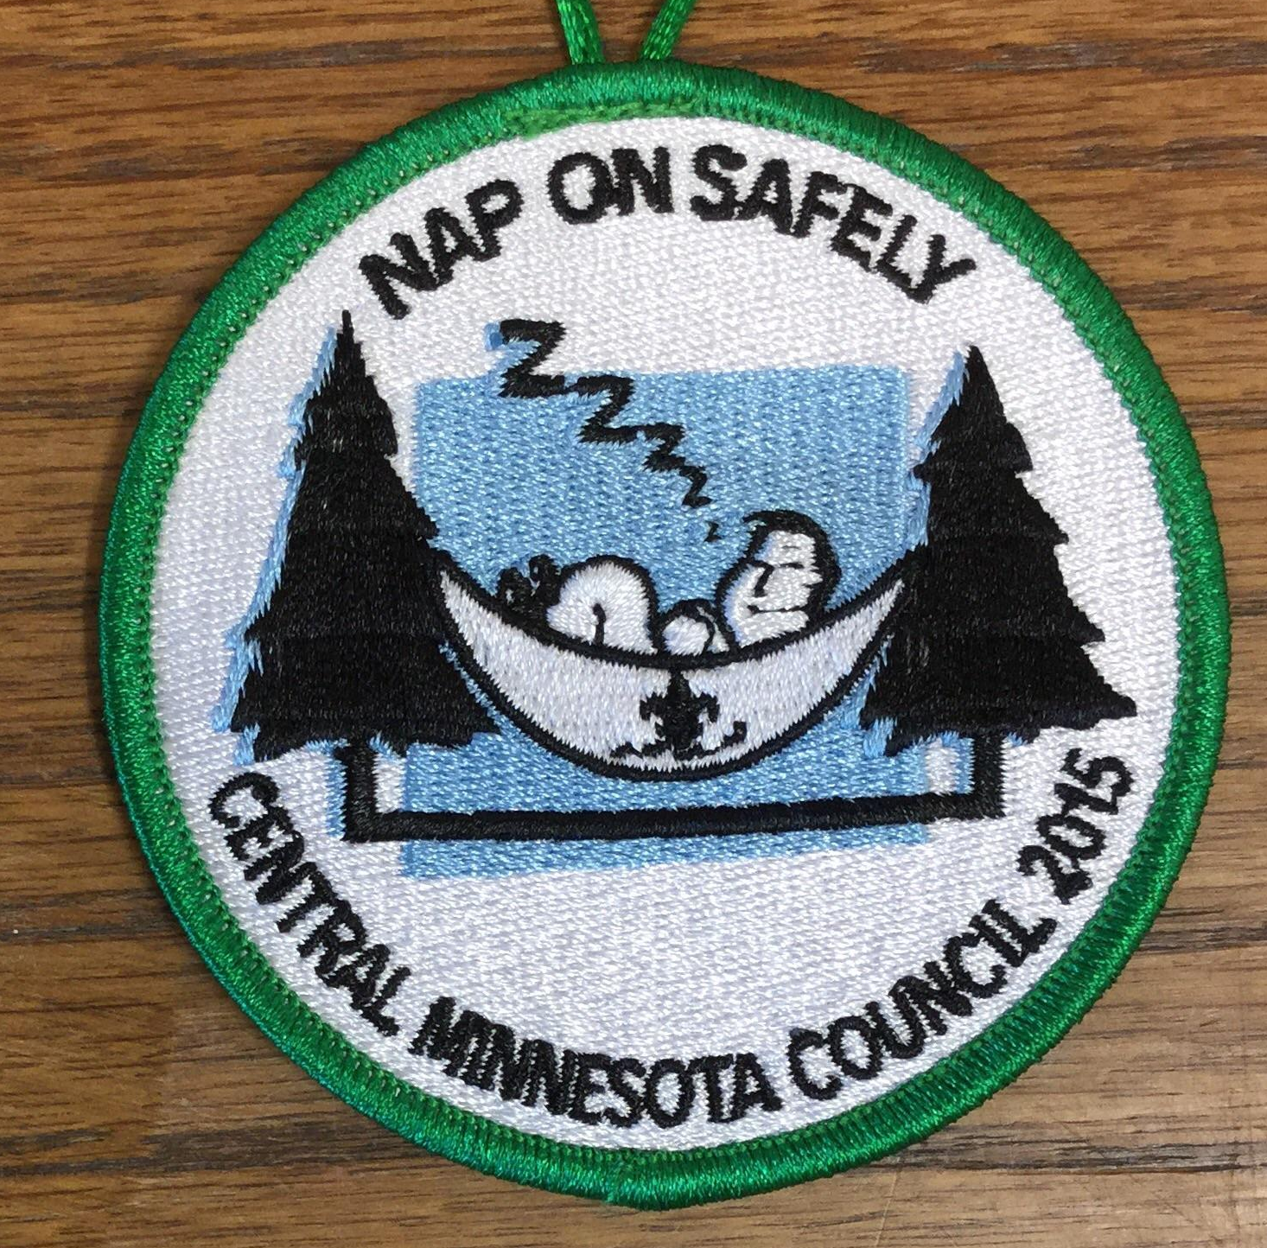
Nap on Safely
1. Nap for the right amount of time
2. Nap at the right time
3. Nap in the right setting
4. Nap with a timer
5. Nap after drinking coffee
Notes:
In a final “safety moment” because we should never underestimate the power of how sleep can effect us and be extremely beneficial for our overall health I am referring to the age old “Scoutmaster Nap on Safely” while
“Nap on Safely” isn’t the only way to nap, but it sure makes napping simple if you follow the plan:
How long do you have to nap?
Six minutes will enhance memory, 10–15 minutes can improve focus and productivity.
The NASA nap (26 minutes) is the optimal time for a performance enhancement of 34 percent and an overall alertness increase of 54 percent.
Extend that nap into the 40–60 minute range, and you will likely be groggy upon awakening as you didn’t finish the sleep cycle. Not good if you are already grumpy.
90 minutes of napping can give you a boost of creativity as you finish a cycle. 90 minutes can also top off the sleep you missed the night before.
Plan to nap between 1:00 and 3:00 p.m. so as to fit the circadian rhythm of most folks. Want everyone to be fresh at your evening campfire? Give them a program break, and schedule naps from 1:00–3:00 at the next campout or camporee.
Make sure you have a safe area and set-up. Make your room darker or cover your eyes (using two pirate patches, an eye mask, or an ostrich pillow). Lie down instead of sitting up. Good news for hammock campers: Hammocks are the best place to nap as the gentle swaying will help you go to sleep.
Set a timer. Remember, 26 minutes is optimal.
Need a super boost for your afternoon? Drink a cup of coffee BEFORE you lie down. Combining caffeinated coffee and a nap will make you feel invincible. (Of course, this is not recommended for youth; the target audience for this tip is the Scoutmaster.)
Napping can’t take the place of getting enough regular sleep. But it certainly may help you through the week at Scout camp or make up for staying up late around the campfire with your crew the night before.
Napping may also help you to
Resist comfort foods and lose some excess weight.
Lower your risk of cardiac disorders. Just knowing your nap is coming may lower your blood pressure!
Reduce the risk of diabetes by lowering insulin and cortisol levels.
Reduce stress and anxiety by lowering cortisol and releasing growth hormones.
Combat driving fatigue on a long trip with an emergency nap.

Slide 34
Resources
https://uhs.umich.edu/tenthings
https://www.who.int/news-room/fact-sheets/detail/mental-health-strengthening-our-response
https://www.nih.gov/health-information/emotional-wellness-toolkit
https://eddinscounseling.com/emotional-health-vs-mental-health/
https://www.psychologytoday.com/us/blog/social-health/202302/what-is-social-health
https://www.psychologytoday.com/us/blog/social-health/202108/how-strengthen-your-social-muscles
https://www.psychologytoday.com/us/blog/social-health/202005/how-s-your-social-health
https://www.acacamps.org/resources/mental-health-resources-tips-camps
https://www.scouting.org/health-and-safety/safety-moments/psychological-first-aid/
https://blog.scoutingmagazine.org/2023/05/02/how-to-help-scouts-who-have-anxiety-about-attending-summer-camp/?utm_source=scoutingwire&utm_campaign=swvolunteer05172023&utm_medium=email&utm_content=

Slide 35
NEXT NSNDC ROUNDTABLE
Topic TBD (submit suggestions to SpecialNeedsChair@scouting.org)
TENTATIVELY: August 22, 2023

