Slide 1
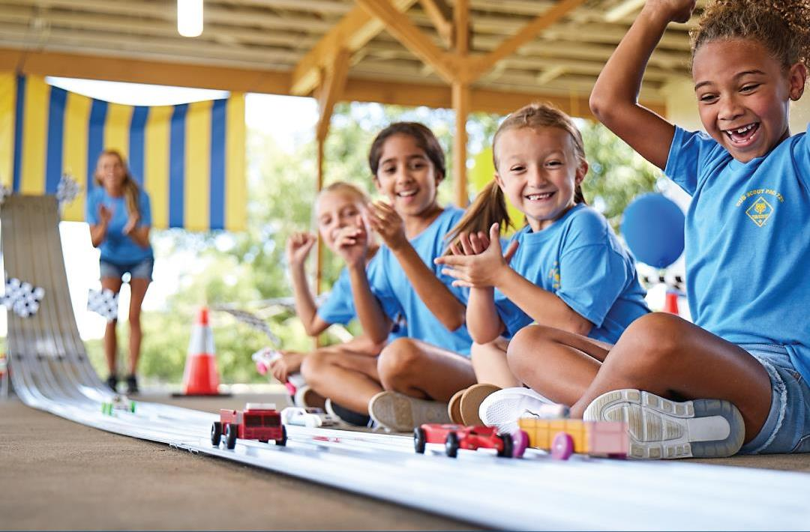
2023 Campaign Kit For Pinewood Derby

Slide 2
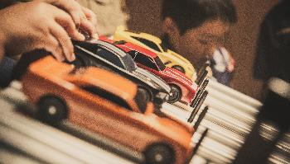
What’s a Pinewood Derby?
Partnered with a parent or guardian, Cub Scouts work together, strengthening bonds and building confidence – and their own custom race cars!
They begin with an official Pinewood Derby Race Car kit, then create a design, then carve it from the wood block provided in the kit.
They detail it with paint, decals and other accessories, and perfect strategies to compete in their pack’s own Pinewood Derby.
It’s a wonderful learning experience centered on teamwork, ingenuity and sportsmanship – all for the thrill of the race and a lifetime of great memories to share with fellow racers young and old.

Slide 3
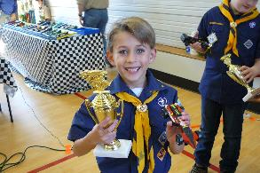
Pinewood Derby is a Great Recruiting Tool!
The Pinewood Derby is one of Scouting’s iconic activities!
Your Pack can use it to attract new members.
Each piece of the PWD process is an opportunity to market your Pack, through social media, yard signage, and other community partnerships.

Slide 4
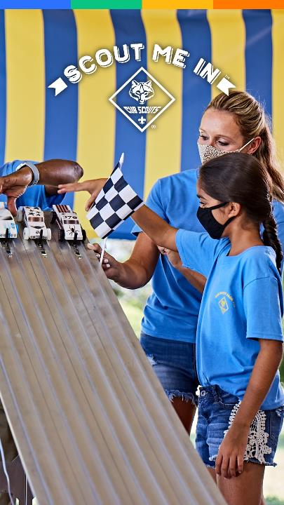
Table of Contents
Welcome to Your Campaign Kit for Pinewood Derby (PWD)
Be Prepared
Know Your Audience: Parents
Plan for Measurement
QR Codes Make it Easier
Update BeAScout.org
Setup Your Facebook Page
Identify Pinewood Derby Partners
Build Your Campaign in 5 Steps
Setup Facebook Calendar Events
Boost Your Facebook Calendar Events
Social Media Campaign
Hyperlocal Marketing: Fliers, Yard Signs and Posters
Spreading the Word: Mobilizing Your Scouting Family
Start Your Campaign: Timelines & Schedule
Resources on BSA Brand Center

Slide 5
Welcome to Your Campaign Kit for Pinewood Derby!
A strong home starts with a solid foundation. The same is true for marketing!
This campaign kit provides step-by-step tips to promote and host a successful Pinewood Derby event.
We’ll also give you ideas on how to use the PWD to recruit new Scouts for your unit.
From planning to promotion to follow up, the kit includes a set of integrated marketing elements designed to work together to help you build the solid foundation needed for a successful Pinewood Derby event.
Are their other things you could do? Yes! But we strongly recommend you start with these key elements and work your way forward. Along with campaign elements, you’ll also find links to helpful how-to’s and marketing resources.
Ready to build a great Pinewood Derby campaign?
Fantastic! Pull right up to the start line and get ready to go!

Slide 6
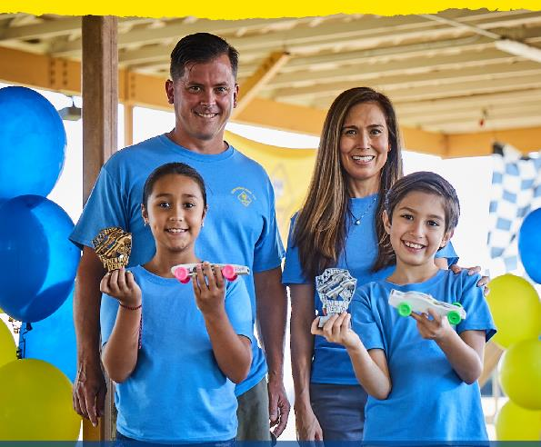
Know Your Audience:
Mom’s and Dads
In marketing and promotion, it’s important to know your audience. For your Pinewood Derby, the target audience are Moms and Dads, alike.
As you develop your campaign, it’s critical you keep parent’s needs in sharp focus to make sure your message is heard by the right audience at the right time.
To help, we’ve combined dozens of data sources to construct a "Persona," a fictional profile of the person you need to reach.
Get to know Parents in the next slide and always make certain your marketing speaks to them as you roll out your campaign!

Slide 7
WHAT PARENT WANTS FOR THEIR KIDS
Safe. Emotionally healthy. Prepared for real life. Life skills and values. Wants to experience activities with their child. Technology is both a blessing and a curse.
Who is your target: Moms & Dads
WHERE DO PARENTS GO FOR INFORMATION?
Online influencers. Taps internet via mobile device. Online 5+ hrs./day on avg. Reads online reviews before making purchase decision. Friends key info source as well. Prefers to be communicated via email. Trusts communication that comes from her child’s school. Facebook still rules.
“We are busy parents who worry about our kids being under pressure and not having time to just be a kid.”
BRAND AFFINITIES
A BIT ABOUT THEM...
A bit skeptical. Question marketing and will search the web and social media to validate info.
Spread thin so make things easy. Have less than an hour a day for themselves.
They’re overwhelmed. Both are working and they’re stressed, tired, rushed and short on quality time with friends and children.
They don’t have a lot of experience using tools or building things
QUESTIONS PARENTS HAVE ABOUT SCOUTING
Will my children be safe – it’s the first and foremost measure to be addressed. Safety is our number one priority. Scouting has the most comprehensive youth protection policies of any youth organization.
Is Scouting relevant anymore? Is it for families like mine? The ideals the Scouting program teaches are timeless. Scouting builds respect for others, character, fitness and leadership and so much more. Scouting helps youth become their best future selves. It prepares them for life!
Will our kids get exposure to new things and opportunities? Scouting is all about trying new things and new experiences. Whether it’s camping or science – you can find it in Scouting. It’s an amazing adventure for the whole family.
Will girls enjoy PWD as much as boys? Absolutely! All youth enjoy the creativity of building their PWD car.
What will it cost (we don’t want to do fundraising!)? It depends on the unit, but most packs/troops/crews find ways to make the Pinewood Derby affordable.

Slide 8
Plan for Measurement
How do you know something works? You measure it!
Measurement is an important part of every campaign. It helps you learn what parts of your campaign worked, which need to be improved and when you’ve reached your campaign goals!
Measuring your campaign’s effectiveness depends on the tactics you’re using. For this campaign, here are some easy things to measure.
Attendance at Pinewood Derby events – How many Scouts picked up a PWD kit? How many attended your “build your car “event? How many scouts signed up for your PWD races?
Social media engagement – Facebook analytics makes it easy to track likes, comments, shares and visits to an event page
Fliers, yard signs or posters – Use QR codes to track click-thru rates.
Emails – Track opens and click-thru rates
What else can you measure related to your event? And how can you improve? Talk about measurement upfront with your leaders and parents.
The best way to get started is to quit talking and begin doing!
-Walt Disney

Slide 9
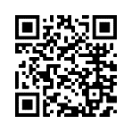
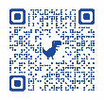
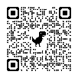
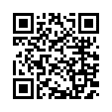
QR Codes Make it Easy!
QR Codes for Online Registration
QR codes make it easy to pull up websites from your phone. Just point your camera and click!
For Scouting, it QR codes are an incredibly valuable way to connect fliers, posters, yard signs and more to your event.
Remember those busy parents we need to reach? QR codes are also widely adopted by busy families as a fast and efficient way to find info they’re interested in.
Here are some helpful links (and QR codes!) to the BSA’s QR codes for online registration, a Google how-to for creating your own QR codes right from Google’s Chrome browser and a handy QR Code Generator.
On BSA’s Online Registration system, you can find a registration URL and QR code specific to your unit. Include this code wherever you want people to be able to register for your unit immediately online.
Create QR Codes for Everything Else!
Create a QR code for any URL using the QR code Creator in Google’s Chrome browser.
QR Code Generator is also a good place to create your own QR codes at no cost!

Slide 10
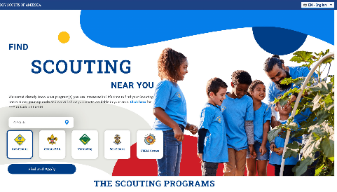
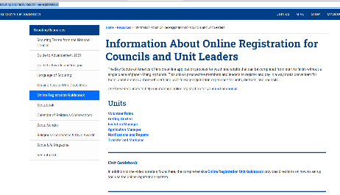
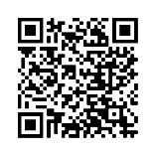
Update BeAScout.org
The Pinewood Derby is a great way to attract new families to your Pack.
Sending interested families to BeAScout.org is the surest way to capture and track potential new Scouts.
Before you begin your PWD campaign, make sure the information on your BeAScout.org pin is up to date!
Find out how to update your pin here BeAScout.org.

Slide 11
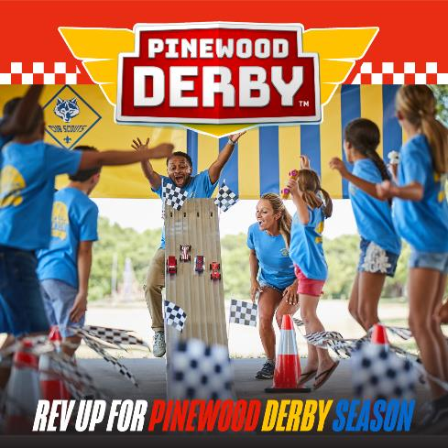
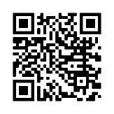
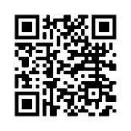
Set Up Your Facebook Page
You probably have a Facebook page for your unit. But make sure to post photos and video from last year’s PWD.
That’ll let families see the fun Scouts have creating and racing their cars.
Learn how to set up your own Facebook page.
Or use Facebook’s handy page creator tool.

Slide 12
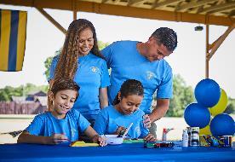
Identify Pinewood Derby Partnerships
Your Pinewood Derby program provides an opportunity for businesses and community partnerships.
Partnerships are a way for your Pack to get in-kind products or services (PWD accessories, materials for your track, yard signs, etc.)
For your partners, it’s a way to support a local community group, build goodwill, and potential customers (discounts for Scouts in uniform, frequent diner cards, store signage, etc.). Packs might even have local partners as “name sponsors” for their PWD program.

Slide 13
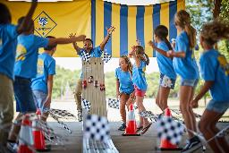
Examples of Pinewood Derby Partners
Local businesses partnerships:
Hardware Stores
Craft and Hobby Stores
Auto Dealerships
Mechanics and Auto Body Repair Shops
Tire Dealers
Local Restaurants
Local community partners:
Schools and School Foundations
Your Chartering Organization
Local Neighborhood Associations
Elks Club, Rotary Club, Kiwanis, etc.

Slide 14
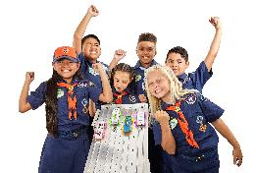
Build Your Pinewood Derby Campaign
Let’s get to work setting up the 5 key elements of your Pinewood Derby promotional plan.
Making the Most of Social Media: Create A Series of Facebook Calendar Events
Boost Facebook Calendar Events
Set up a 2-week social media campaign
Hyperlocal Marketing: Fliers, Yard Signs and Posters – with QR codes!
Spread the Word: Mobilize Your Scouting Family

Slide 15
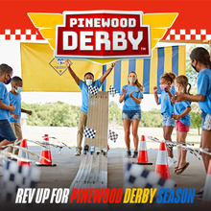
Step 1: Create a Facebook Calendar Event
Every campaign needs a ”landing page” where interested families can be directed to learn more about your event. For Scouting, Facebook Calendar Events are an effective tool for lots of reasons.
A Facebook Calendar Event is a calendar invitation you set up for events like joining nights, meetings and more. Events are easy to create and make it simple to reach people you want to invite to your joining event. Best of all, Parents are familiar with events and very comfortable using them.
Important: To use Facebook calendar events you’ll need an organization page for your Scout unit.

Slide 16
Increase the Impact of Your Facebook Calendar Event
1
2
3
Add a Great Image or Video
A picture or video is worth a thousand words, so be sure to add a photo, logo, or video to your invite. Looking for photos? The BSA Brand Center has everything you need.
Write a Compelling Description.
Tell people why they should attend and any information about your Scouting unit or event.
Include your unit’s registration URL. Make it easy for people can register immediately. Find out more about how to find and use your unit’s registration URL.
Join Cub Scouts!
Join the Adventure of Cub Scouting at our sign-up event (date, time) at (location).
If your son or daughter enjoys camping, hiking and having fun - then join Cub Scout Pack (unit number)! That’s right – Cub Scouting is for boys and girls. It’s fun for the entire family.
Come by our sign up and join the fun! Can’t come to the sign-up event? Join online at (URL)
Learn How to Create a Facebook Calendar Event

Slide 17
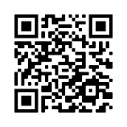
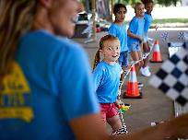
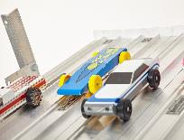
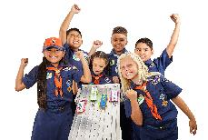
Sample Copy for Your Facebook PWD Event (Customize these for your pack!)
Workshop: Build your Pinewood Derby car!
Time to get your hands dirty and build your Pinewood Derby car! We’ll have all the tools you need - and adults to guide your Scout - to turn that block wood into a fun racing vehicle.
Join us at (date, time) at (location).
Message us or call for more information.
Race your Pinewood Derby car!
Now that you’ve built your car, it’s time to race. We’ll make sure your car is as fast as you want it, and that it passes that all-important pre-race inspection!
Sign up for time to race with your Den (date, time) at (location).
Message us or call for more information.
A Picture is Worth 1,000 Words
Be sure to include a great photo of the Scouts in your unit. Don’t have a photo? Use one from the Brand Center.

Slide 18
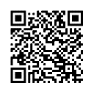
Step 2: Boost the Calendar Event
Once you’ve created your Facebook calendar event, boost the Event so it will be seen by more people.
What is boosting? Boosting is paid advertising and an essential step in promoting your event. For as little as $1 a day, Facebook will promote your event to an audience that is broader than just people who follow or like your page.
This allows you to precisely target who will see your event. For example, you can geotarget parents of elementary school-age youth in a certain geographic such as a zip code or radius around a school or meeting place.
Taking it a step further, you can even geotarget the times and places parents gather - and spend time on their phones! Think Little League games, soccer tournaments or even pick up times at schools.
For tips to selecting the best geotarget settings, review the options on the next slide...
How to Boost a Facebook Event
Here’s how to create an ad to boost your campaign event on Facebook.
Boosting is a powerful, cost-effective marketing tool that’s easy to use!

Slide 19
Choosing the Best Geotargeted Audience
Audience Selections
Geofencing Target: Men & Women age 25-49
Interest Targeting: Parents, Parents of Elementary Age Kids, Parents of 1st Grade, Parents of 2nd Grade, Parents of 3rd Grade, Parents of 4th Grade
Secondary Interest Targeting: Outdoors, Camping, Hiking, STEM
Fence Radius: Generally, 2-4 miles around a joining event location . In dense urban areas, you may fence 0.5 miles. In more rural areas you may fence 10 miles. Use the walk/drive distance as a rule of thumb. Fence only as far out as the reasonable person would drive weekly to attend a Den/Pack Meeting.
Do’s & Don’ts
The more targeting info you enter, the narrower your audience will become. Go too narrow and you’ll quickly cut out most of your audience.
You can hold a joining event at one location but fence around other locations. If you fence around multiple locations, the system will spread your budget across all the locations you fence. In that case, increase the spend so the dollars are not spread too thin to be effective.
Places to consider fencing around?
Anywhere families are visiting. You do not need permission to fence around a location. It is an invisible fence.
Consider schools, family-oriented restaurants, parks, playgrounds, rec centers, grocery stores, stadiums and sports venues, etc. Remember that being local is key. Fence locations that are near the joining event location.

Slide 20
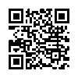
Step 3: Launch Your Social Media Campaign
Launch a two-week social media campaign on Facebook to build awareness of your Pinewood Derby, the pack, and invite families to join. We’ve made it easy!
How to Schedule a Facebook Post
Did you know you can create and schedule your entire set of Facebook posts at once?
Spending some time planning and scheduling posts and they’ll happen automatically!
In the Brand Center you’ll find a sample 4-week schedule of posts to get you started. You can add your own content. The important part is to post regularly to show the fun and adventure youth have in your Cub Scout pack.
Note: Save time by creating your posts in advance in advance, and then use Facebook’s scheduling tool to plan out when they’ll post!

Slide 21
Find a full Pinewood Derby social media calendar on the BSA Brand Center!

Slide 22
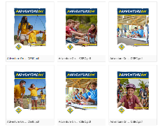
Step 4: Go Hyperlocal with Fliers, Yard Signs and Posters
Because Cub Scout packs are community and neighborhood based, yard signs, fliers and posters are a good way to reach families in your area. Don’t just rely on schools! Distribute join your PWD fliers, posters, and yard signs in and around libraries and friendly businesses.
Ask local business to distribute fliers, for example local hardware stores, craft stores, auto dealerships, and auto repair shops might post and share information..
Place yard signs where families go. Fast-food drive-thrus, where hardware or craft supplies are sold. Don’t forget your own home.
Make sure every flyer, poster or yard sign design includes a QR code to help direct families to your Pinewood Derby event page. You can even create a unique QR code for each design to measure which type performed the best.
BSA Brand Center…
The BSA Brand Center is the place to find videos, fliers, social media images and plans, posters, peer-to-peer cards and so much more!

Slide 23
Step 5: Mobilize Your Scouting Families
“More hands make light work”
Reaching families, inviting them to join and onboarding them can be a lot of work if you go it alone. Make sure you ask every leader and parent in your unit to help.
Explain all of your Pinewood Derby events to your parents and leaders. Break up the tasks and ask people to help.
Ask your families to:
Invite their friends and family to visit meetings – and join
Share posts about the Pinewood Derby and the pack on their social channels
Distribute posters and fliers to local businesses and organizations
Share news of your PWD events to parent teacher association meeting, other and other groups organizations they may be part of.
Drop off fliers to local after-school care centers
Put up fliers and posters on community bulletin boards, hardware stores, auto shops, car dealers, etc.

Slide 24
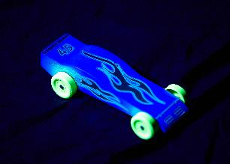
Timelines and Schedules
Sample schedule:
Planning is the key to successful marketing efforts (and almost every other effort, too!)
We highly recommend good old-fashioned backdating. For example, when you’re planning your PWD kit distribution event, grab a calendar and count backwards from the date of that event. Schedule out all your marketing activities!
For example:
Note the event date
Start posting on your Facebook page 4 weeks prior to your event
Set up and boost your calendar event 2 weeks prior to your event
Distribute fliers in schools 10 days to 2 weeks prior to your event
Place yard signs at school 1 week prior to your event
… and more…
Don’t skip this step! Map it all out… then meet with other leaders and parents to decide who can help cover all your marketing tactics.
Dec. 1 - Announcement of Your Pinewood Derby
Dec. 10 - Distribution of Pinewood Derby Car Kits
January 10 - Car Building Workshop
January 15 - Feb. 5 - Races (you might have preliminary races and then finals)
March - Awards (these might be distributed at a regular Pack meeting or a special “Blue & Gold” dinner.
Every one of these events can be a social media post, recruitment opportunity, and more!

Slide 25
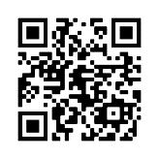
Resources
Find all your #AdventureOn marketing assets on the BSA Brand Center.
Adventure-Themed
Deliver brand promise through outdoor imagery
Dozens of digital and print assets available
Available on the BSA Brand Center

Slide 26
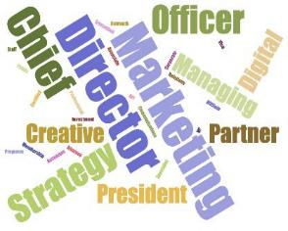
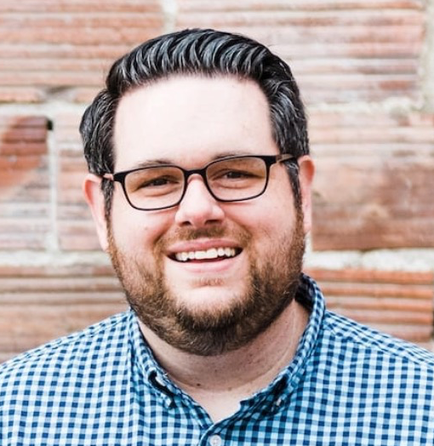
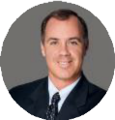
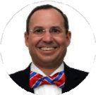
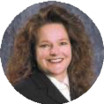
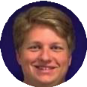
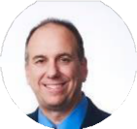
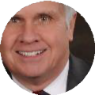
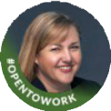
Got Questions? If you have questions about marketing, your NST Marketing Leads are standing by to assist!
Matthew Lundh, NST 1
Bruce Dooley, NST 2
Joshua Gilliland, NST 3
Sharon Sodor, NST 4
Ron Clary, NST 5
NST Marketing Leads are are each highly skilled professional marketers and ready to help!
If you have questions about your campaigns, email your lead for assistance. You’ll be glad you did!
Steve Piehl, NST 6
David Rollins, NST 7
John Hearrell, NST 8
Rich Gargas, NST 9
Brad VanAuken, NST 10
Bob Brown, NST 11
Robbie DiBiagio, NST 12
Gordon Andrew, NST 13
Beth Stockner, NST 14
Mike Matzinger, NST 15
Pat Noack, NST 16

Slide 27
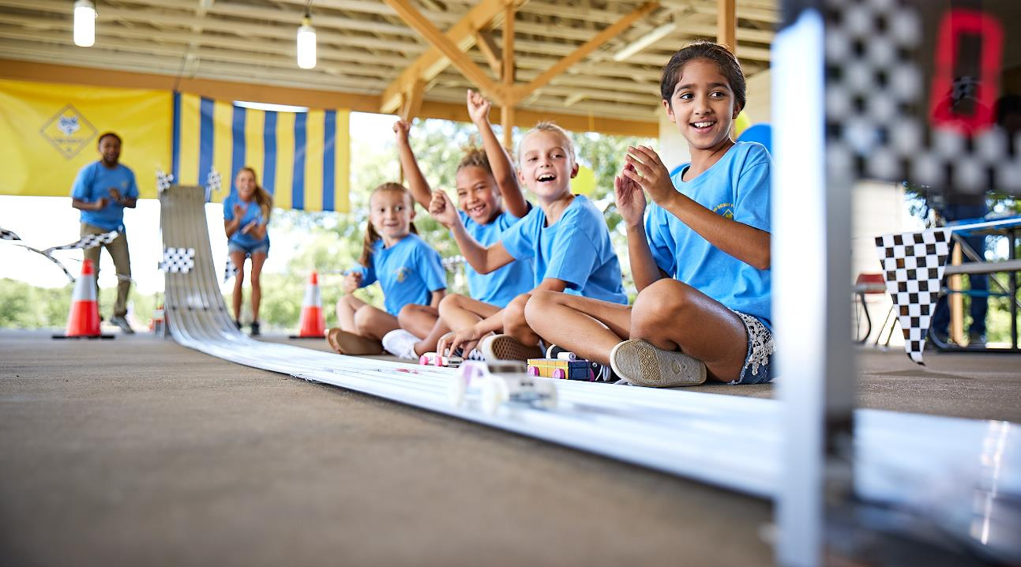
Good Luck!

