Slide 2
Welcome to the
national fall kickoff!
Ken Gordon
Chair, National Membership Engagement Committee

Slide 3
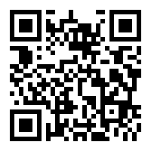
Are you recording this?
Yes!
www.scouting.org/recruitment

Slide 4
Tonight’s topics
A Message from our National Chair
A Message from our Chief Scout Executive
Fall Media in Support of Recruitment
Best Practices and Recruiting Tips
Following Your Council’s Membership Plan
A Message from our National Commissioner

Slide 6
Safety moment
Sean Magennis
EVP, Membership Engagement

Slide 7
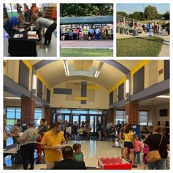
SAFETY MOMENT
Take Care of Yourself First — So We Can Serve Others Well
Sleep
Aim for 7–8 hours
Fatigue affects judgment
Hydrate
Drink water throughout the day
Fuel
Eat regular meals
Healthy snacks
Drive Safely
No texting
Allow extra time
Weather
Dress for conditions
Use sunscreen
Teamwork
Check in with teammates
Ask for help
Breaks
Take short breaks
Know your limits
“Our most important asset isn't our marketing, our flyers, or our events.
It's our people. Let's make sure every volunteer and professional gets home safely each day.”

Slide 9
Our collective objective
228 Councils, 35,403 units, One Brand, One Movement!
Ken Gordon
Chair, National Membership Engagement Committee

Slide 10

Scouting America
Our Collective New Youth Objective
284,000
260,723 New Youth in 2025
223,190 To Go
Councils submitted new youth forecast for 2026 totaling – 287,284
Updated July 15, 2026– Council Membership Tools

Slide 12
A message from the chair
Ricky Mason
National Chair, Scouting America

Slide 14
A message from the chief scout executive
Roger Krone
CSE, President and CEO, Scouting America

Slide 16
Scouting America Brand
Michael Ramsey
SVP and Chief Marketing Officer, Scouting America

Slide 17

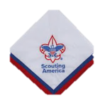

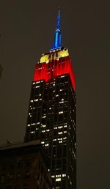
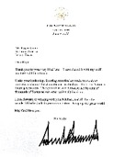

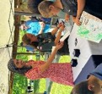

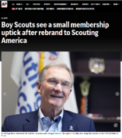


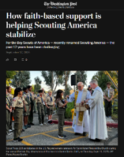




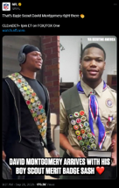
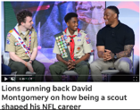
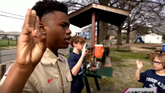
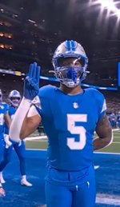

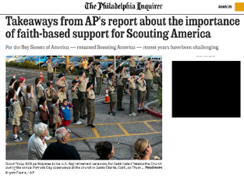
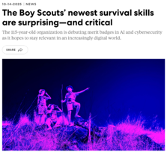
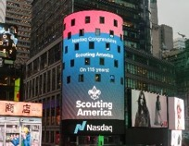
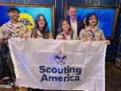


A Record Year for PR
David
Montgomery

Slide 18
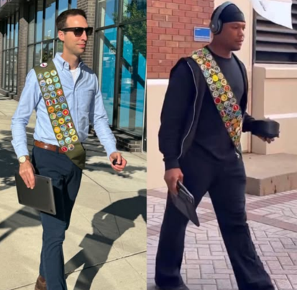



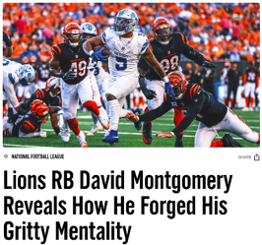




David Montgomery
Sash
  50M
  impressions

Slide 19
The Marketing is
Always On!

Slide 20
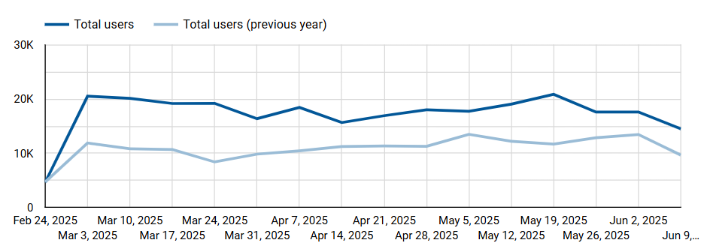
Interest in Scouting is High!
BeAScout Traffic Up 28% March - June (YOY)
Notes:
56% attributable to paid search (32%) and social(14.4%)

Slide 21













2026 Fall Membership Channels:
Retargeting Ads
PR/Earned Media
Website Display Ads
Influencer Content
Google Search
Social Media Ads
Video Pre-Roll Ads
Streaming TV
Content Integration

Slide 22
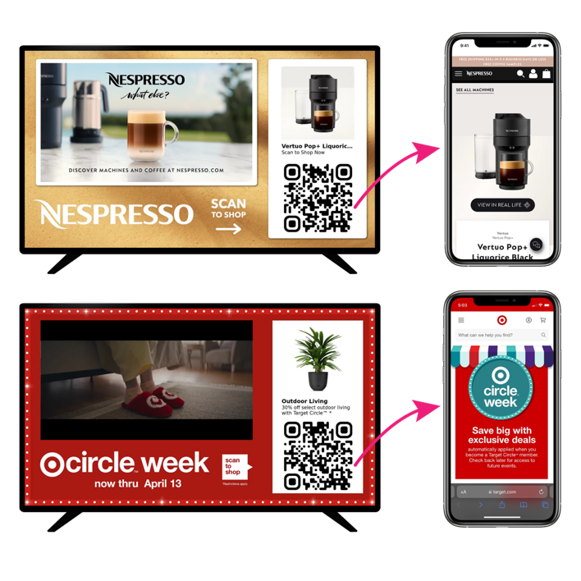

Slide 23

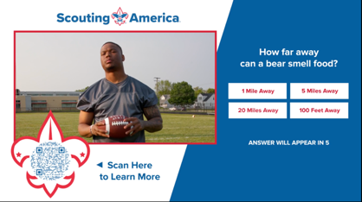
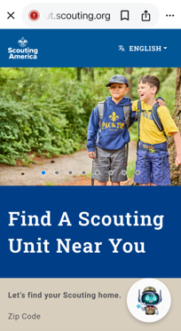
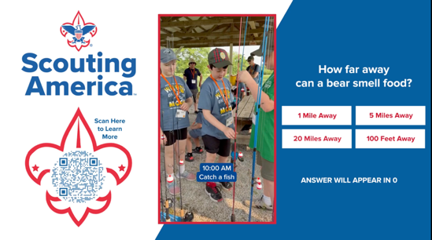
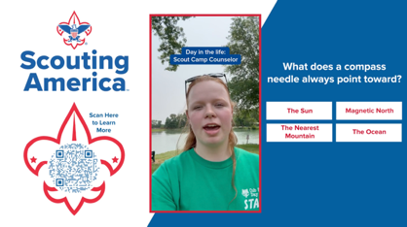
Disney Interactive

Slide 24


Slide 25


Slide 26


Slide 27


Slide 28


Slide 29


Slide 30


Slide 31



2026 AI-Driven Channel Mix
AI is allowing us to be much more precise in reaching Parents.
Streaming TV – Disney+, Hulu, ESPN+, YouTube TV, NFL Network
Streaming Audio – Spotify (music & podcasts) NEW!
Social Media Ads – Facebook, Instagram, TikTok, Reddit
Influencer Content – TikTok, LinkedIn
PR/Earned Media –Local / National Release
Retargeting Ads – Facebook, Instagram, TikTok
Google Search Ads - Google
Video Pre-Roll Ads - YouTube
Content Integration – Disney Interactive, Nat Geo

Slide 32


An essential part of the Scouting experience
Encourages and reinforces Scouting skills and values in between meetings and events
Shows the relevancy of Scouting in everyday life
80% PARENTS WHO SAY IT HELPS SCOUTS SUCCEED | 73% PARENTS WHO SAY IT HELPS SCOUTS SUCCEED | 10 ISSUES PER YEAR | $1.50 PER ISSUE

Slide 33

Mini Mags are
Back!

Slide 34

Use your Scout Life mini-mags as recruitment tools.
Pass them out at recruitment events.
Encourage current Scouts to share with potential new members.
Keep a stash in the office to use
throughout the year.
NEED MORE THAN YOU PRE-ORDERED? MISSED THE DEADLINE? | Download more! scoutlife.org/minimag | Coming soon: New ordering opportunity!

Slide 35

Update Your Info on BeAScout.org!

Slide 37
Best Practices and Recruiting tips
Martez Moore
Deputy Scout Executive, St. Louis
Chris Crowley
Central North Carolina, Scout Executive
Ben Buckelew
VP, Membership Engagement
Otto Goedhart
Manager, Membership Growth

Slide 38
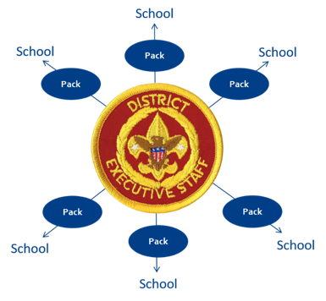

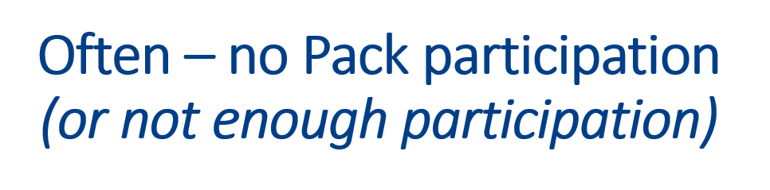

Old Way...
A Better Way!

Slide 39
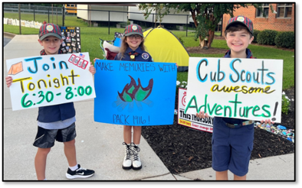
Volunteer/Staff Partnership
Stronger staff/volunteer partnership
Increased retention: Families who meet the pack leadership are more likely to stay with Scouting
Increased % of parents stepping up as volunteers
Lower closing rate – Needs training
Higher second chance/residuals

Slide 40
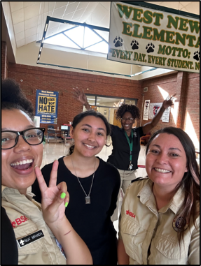
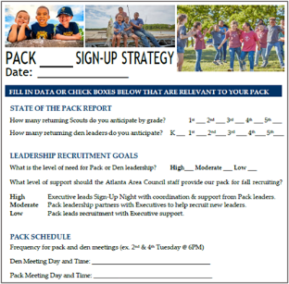
Volunteer and Staff Collaboration
Work together to:
  Assess leadership needs
  Review assigned schools
  Establish recruiting capacity/goal
  Sign-up logistics
  Share resources for youth & adults
  Identify parent/school Relationships
“New families that meet a unit leader (volunteer) the night of the signup are more likely to come to the first meeting and stay in Scouting."​

Slide 41

Results – Volunteer Led
Stronger staff/volunteer partnership
Increased retention: Families who meet the pack leadership are more likely to stay with Scouting
Increased % of parents stepping up as volunteers
Lower closing rate – Needs training
Higher second chance/residuals

Slide 42
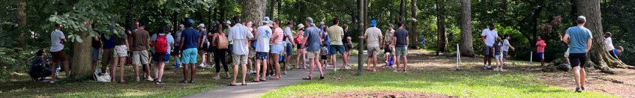
Traditional Recruitment
Back to the Pack Event - Summer
Fun Location ​Fun Event to Welcome back existing leaders and Scouts​
​
School Open House – At The School ​
Meet Your Teacher/Registration Day​
​
Sign-Up Event – At The School ​
Objective Is To Register New Families​
Fun Pack Event - At Charter Partner
Fun First Event For New And Existing Families: Reptile, Magician, Pool Party​​
​​
New Scout Family Event/Parent Orientation Practical Location, Onboarding Session for New Parents – Every Parent Helps​

Slide 43
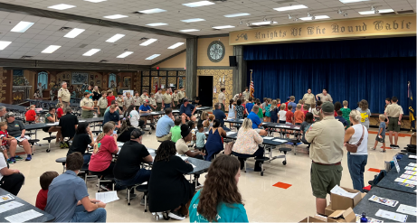
Signup Night 101 – Helpful Tips
Preferred days: Tuesday, Wednesday and Thursday
Sign-up night vs. parent orientation night
Location of signup night: at school
Signup night – keep it brief (not a Pack Meeting)
_____________________________________________________________________________________
Yard signs and posters everywhere
Flyers sent home with students
In-classroom rallies

Slide 44

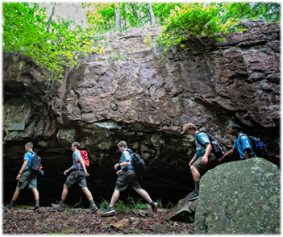
Volunteer/Staff recruitment collaboration
Provide and educate families with:
Onboarding messaging
Instructions (leadership)
Resources
Training
Council/District level program
“How to Engage the Parent in the Back of the Room”

Slide 46
Non-Traditional Recruiting
Sign-ups held outside of the school – Marketing is key
Promote joining Cub Scouts during the car rider line at either the sign-up night if there is one or at upcoming pack, even if there’s no school access
In geographical areas where school access is difficult, or in some cases not allowed…in all cases we want to get the flyers in the hands of youth and ultimately parents
Peer-to-peer recruitment
Social Media
Chris Crowley
Scout Executive
Central North Carolina Council
Martez Moore
Deputy Scout Executive
Greater St. Louis Area Council

Slide 47
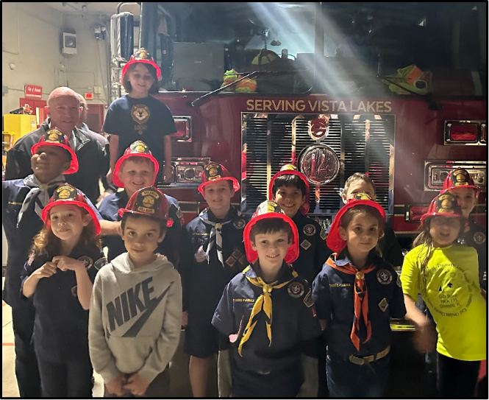
Promote joining
Cub Scouts during the car rider line at either the sign-up night, if there is one, or at an upcoming pack event... even if there’s no school access
Chris Crowley
Scout Executive
Central North Carolina Council

Slide 48
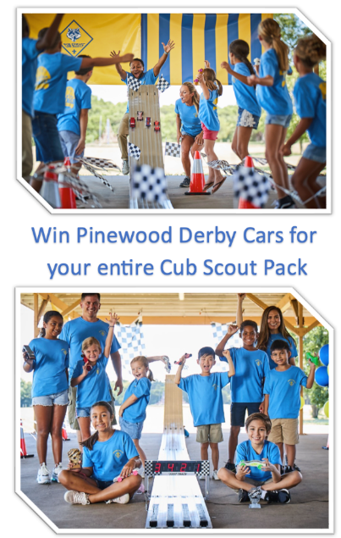
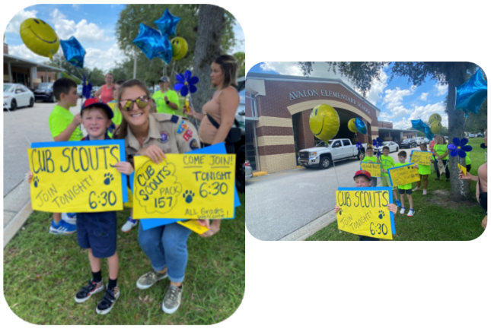
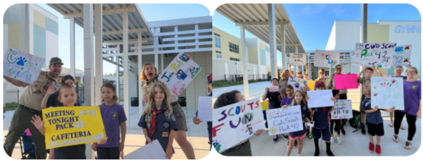

Slide 50
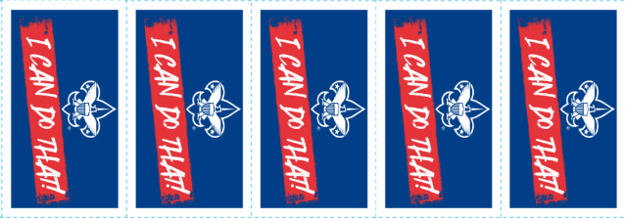
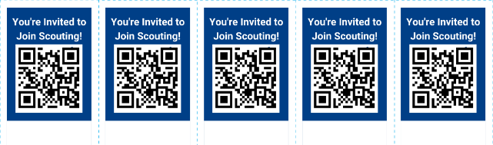
PEER TO PEER Recruitment
Martez Moore
Deputy Scout Executive
Greater St. Louis Area Council

Slide 52
Social Media
Social Media Marketing
within Facebook (Meta)
with Geofencing
Local Unit Influencer

Slide 53
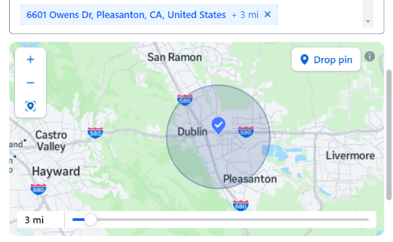
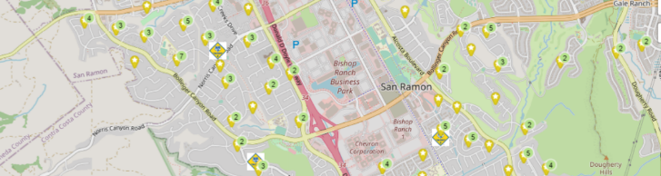
Geofencing on Facebook (meta)
What is Geofencing?
  Geofencing is a way to make a targeted ad through social media or on the web, Here we will focus on Facebook or what is now known as Meta. This includes Instagram. The idea being you take an event and make an ad to be marketed with geographic borders and age demographics in the social media ad algorithm. (Examples being; Addresses, zip codes, age range, parents, interests, etc.)

Slide 54
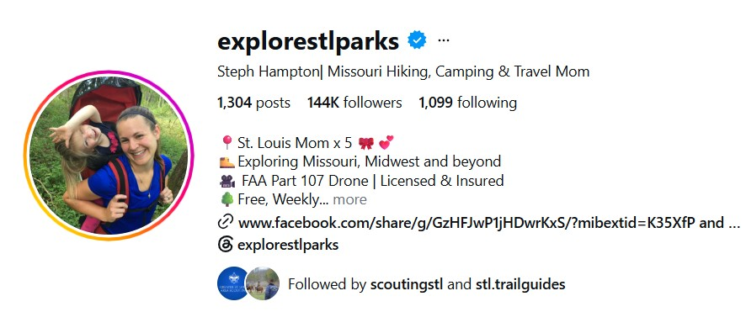
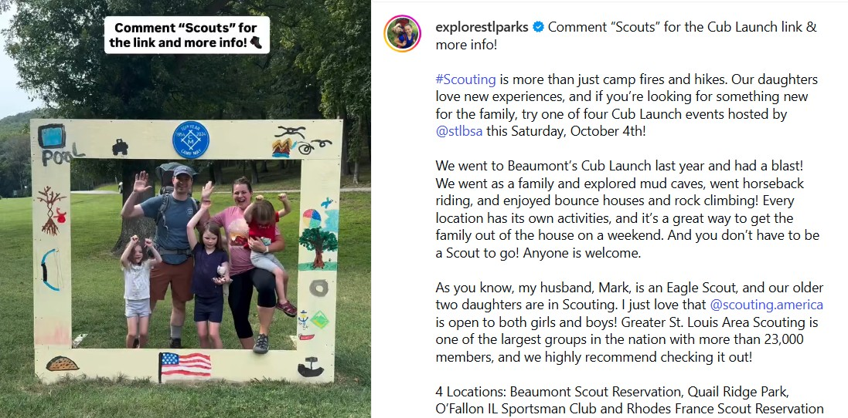
The Local Influencer

Slide 56
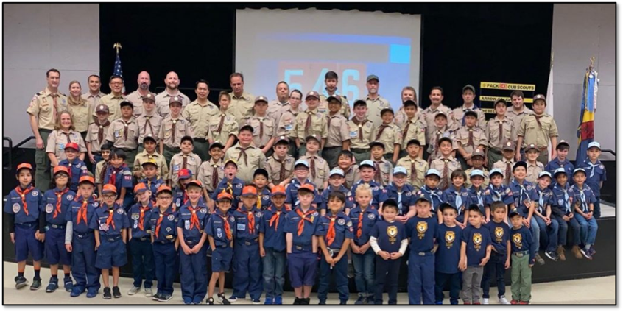
New Packs
Should We Recruit 70 Scouts To A Pack with 5 Leaders?

Slide 57

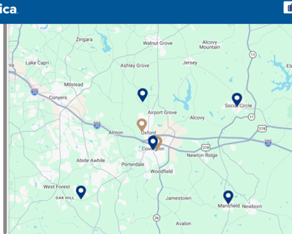
Pack/school ratio – desired ratio is 1/1.
No more than 1/3
Pack/troop ratio – every pack needs a troop
Large 5th grade girl dens without a troop
Private Schools
Martez Moore
Deputy Scout Executive
Greater St. Louis Area Council

Slide 59
Beascout enhancements
Answering the most common questions up front
August 3, 2026 – updated look and feel
Estimated cost to join
Unit meeting days and times
Whether the unit charges additional dues
Total Charge per Member (National and Council)
Otto Goedhart
Manager, Membership Growth

Slide 60
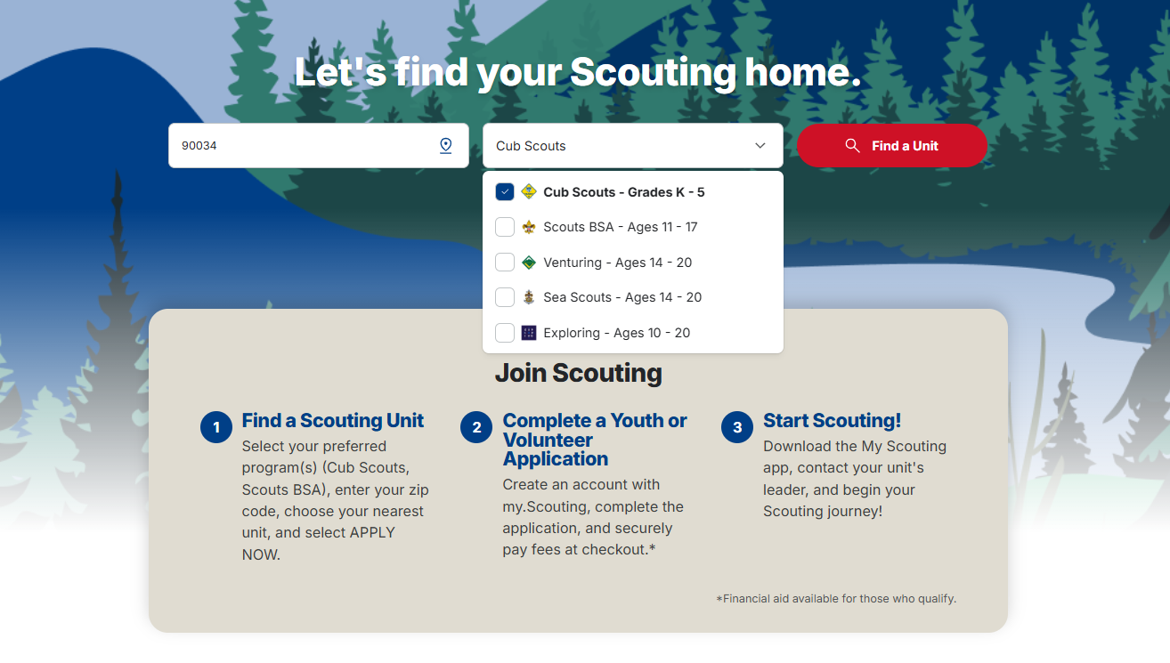
Beascout New Look!

Slide 61
*To support these improvements, new fields added to the Unit Pin page in Organization Manager:
Fundraising helps cover costs
Trial Visit Encouraged
Unit fees
Meeting Schedule: Frequency, Meeting Day, Start/End Time
*July 9, 2026 - Unit leaders can begin updating these fields. Changes in effect August 3, 2026

Slide 62
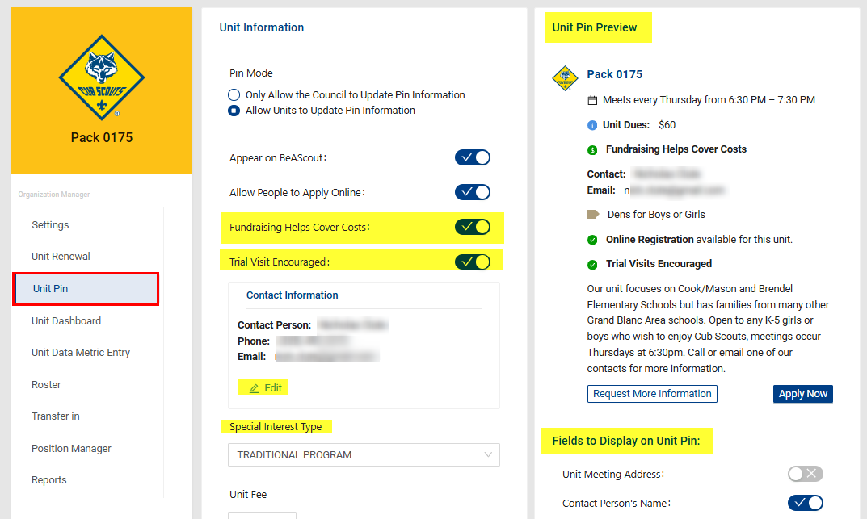
BeAScout Enhancements – Pin Settings

Slide 63
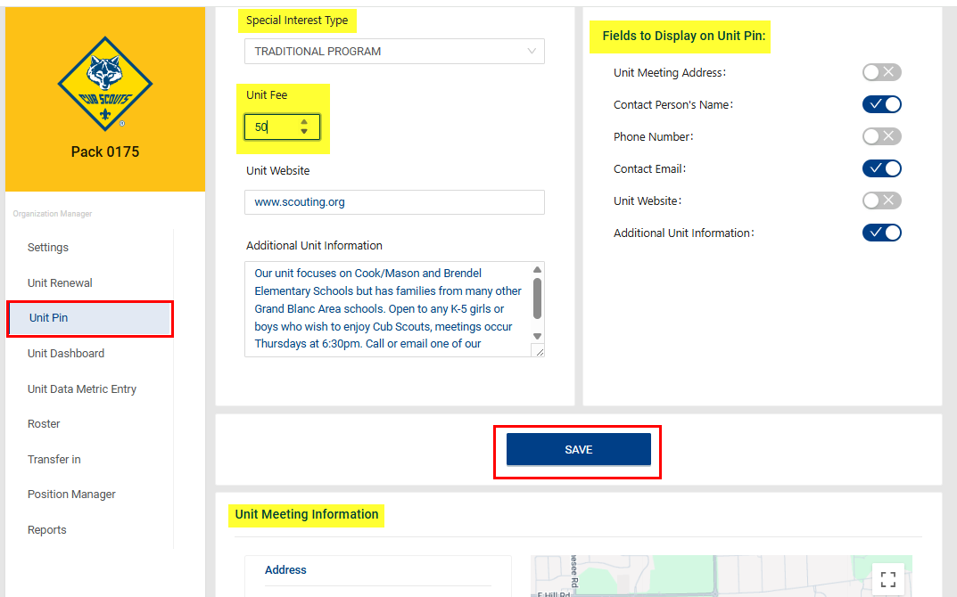
BeAScout Enhancements – Pin Settings

Slide 64
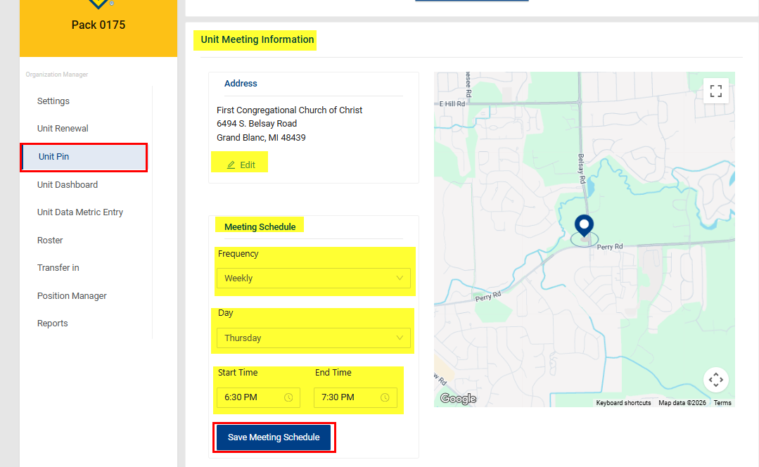
BeAScout Enhancements – Pin Settings
Please Note:
The enhanced details will not show in the current BeAScout; this additional information will be displayed in the new BeAScout released in August.

Slide 65
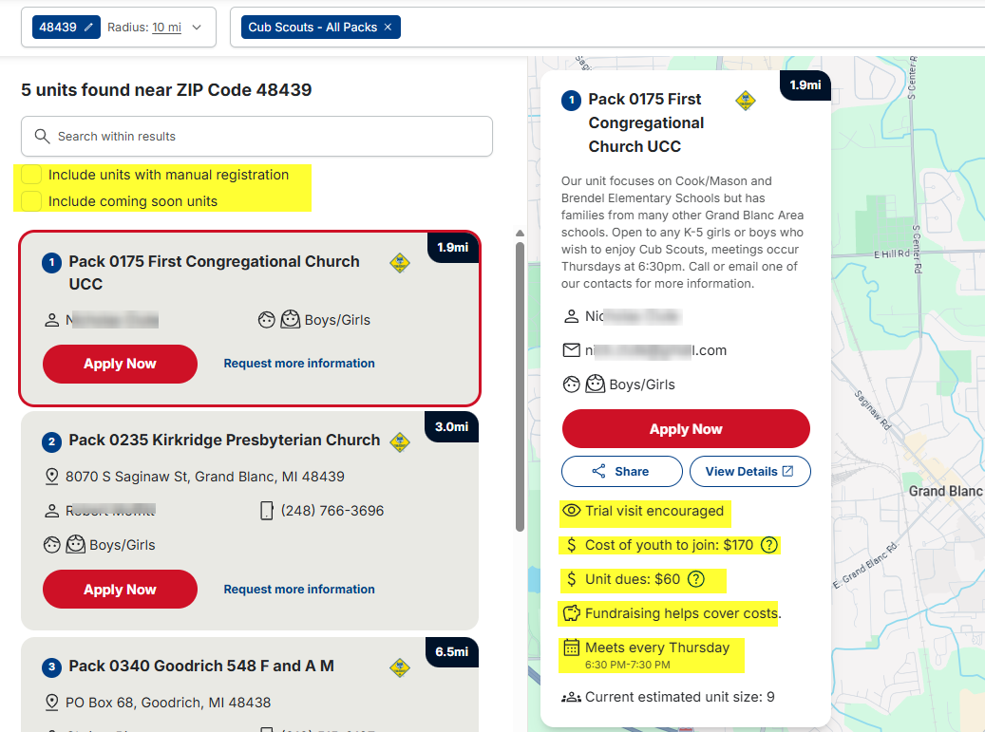
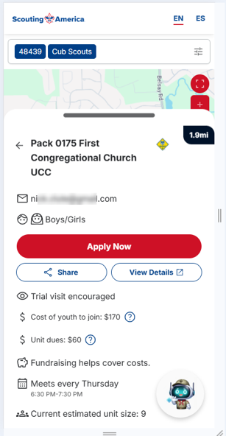
BeAScout Enhancements

Slide 67
Following your council’s membership plan
Chuck Brasfeild
EVP, Council Operations

Slide 68


Slide 70
Closing Thoughts
Devang Desai
National Commissioner, Scouting America

