Slide 2
Welcome to the
National Fall Scouts BSA kickoff
Ken Gordon
Chair, National Membership Engagement Committee

Slide 3
Tonight’s topics
A Message from our National Chair
A Message from our Chief Scout Executive
Scouting America Brand
Best Practices and Recruiting Tips
Following Your Council’s Membership Plan
A Message from our National Commissioner

Slide 4
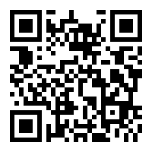
Are you recording this?
Yes!
www.scouting.org/recruitment

Slide 5
Safety moment
Ben Buckelew
VP, Membership Engagement

Slide 6
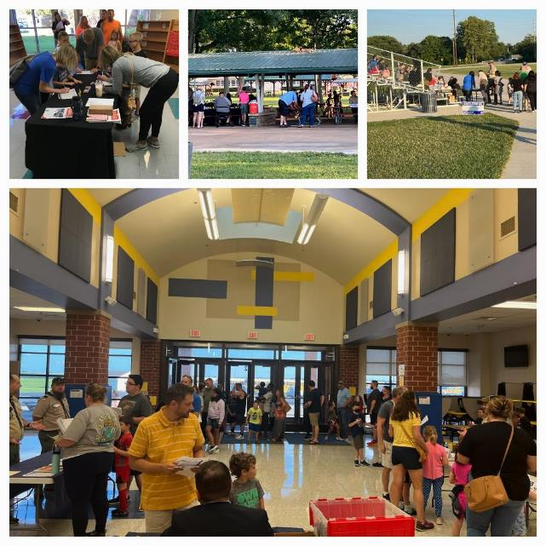
SAFETY MOMENT
Take Care of Yourself First — So We Can Serve Others Well
Sleep
Aim for 7–8 hours
Fatigue affects judgment
Hydrate
Drink water throughout the day
Fuel
Eat regular meals
Healthy snacks
Drive Safely
No texting
Allow extra time
Weather
Dress for conditions
Use sunscreen
Teamwork
Check in with teammates
Ask for help
Breaks
Take short breaks
Know your limits
“Our most important asset isn't our marketing, our flyers, or our events.
It's our people. Let's make sure every volunteer and professional gets home safely each day.”

Slide 7
Our collective objective
228 Councils, 35,439 units, One Brand, One Movement!
Ken Gordon
Chair, National Membership Engagement Committee

Slide 8

Scouting America
Our Collective New Youth Objective
284,000
260,723 New Youth in 2025
221,373 To Go
Councils submitted new youth forecast for 2026 totaling – 287,284
Updated July 22, 2026– Council Membership Tools

Slide 10
A message from the Chair
Ricky Mason
National Chair, Scouting America

Slide 11
A message from the chief scout executive
Roger Krone
CSE, President and CEO, Scouting America

Slide 12
Scouting America Brand
Michael Ramsey
SVP and Chief Marketing Officer, Scouting America

Slide 13
The Marketing is
Always On!

Slide 14

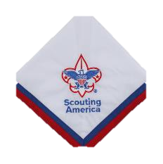

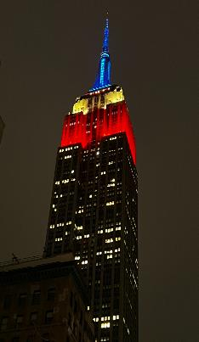
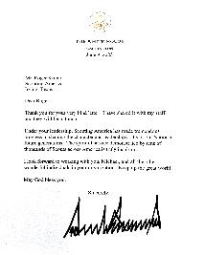


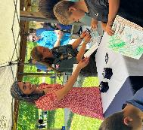

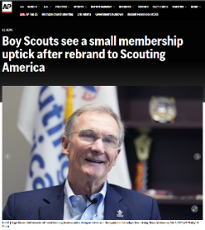


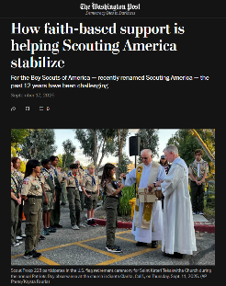





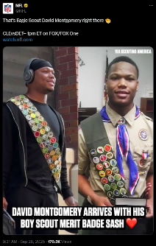
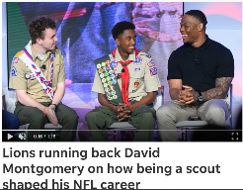
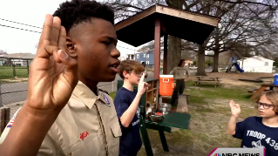
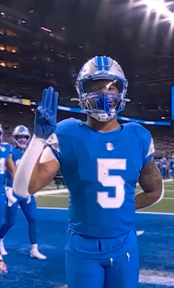

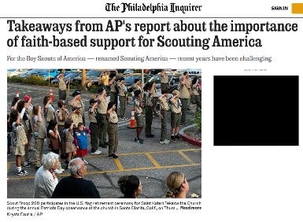
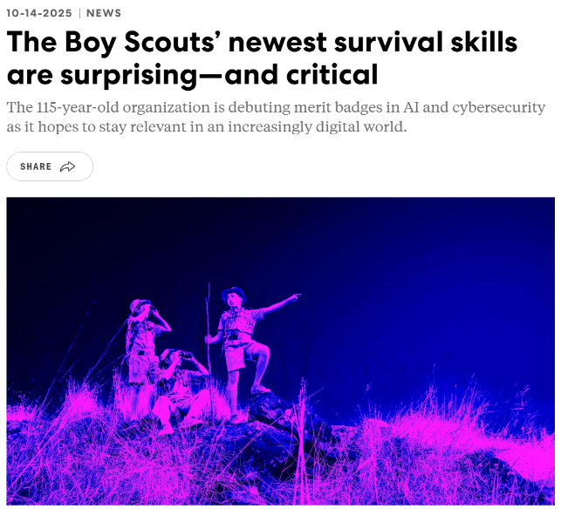
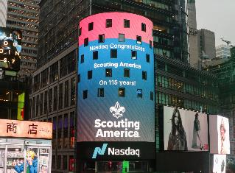
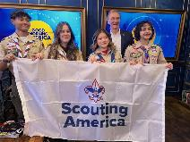


A Record Year for PR
David
Montgomery

Slide 15

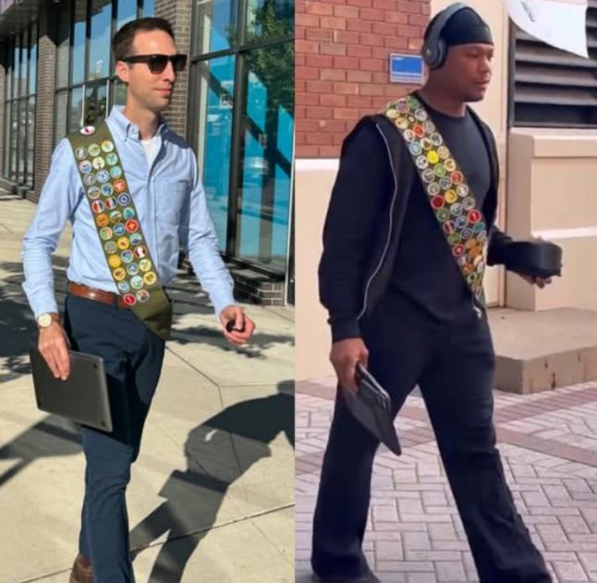


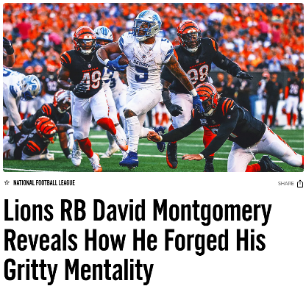



David Montgomery
Sash
  50M
  impressions

Slide 16
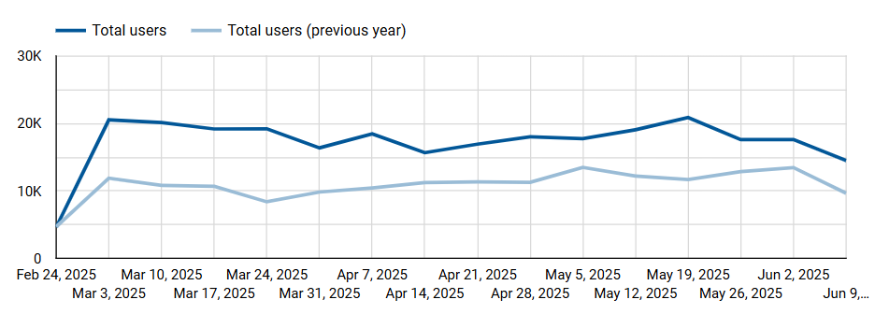
Interest in Scouting is High!
BeAScout Traffic Up 28% March - June (YOY)
Notes:
56% attributable to paid search (32%) and social(14.4%)

Slide 17













2026 Fall Membership Channels:
Retargeting Ads
PR/Earned Media
Website Display Ads
Influencer Content
Google Search
Social Media Ads
Video Pre-Roll Ads
Streaming TV
Content Integration

Slide 18
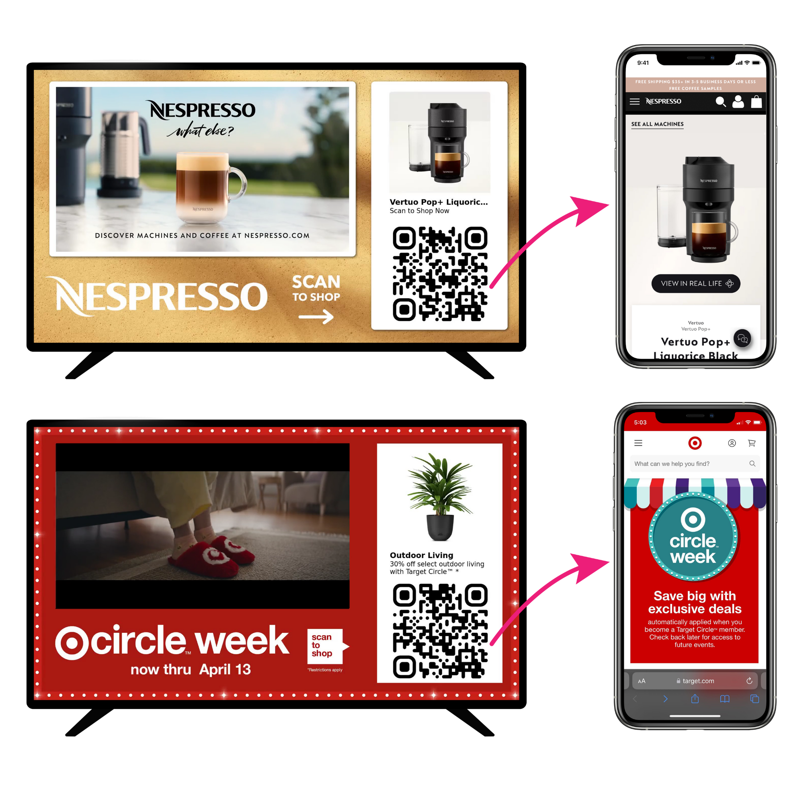

Slide 19
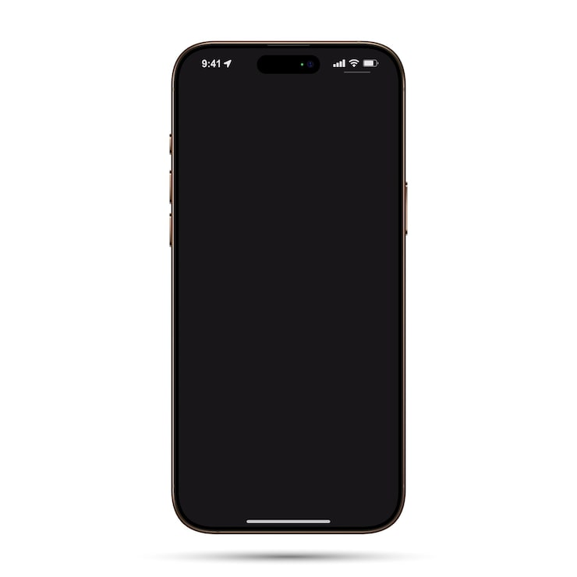
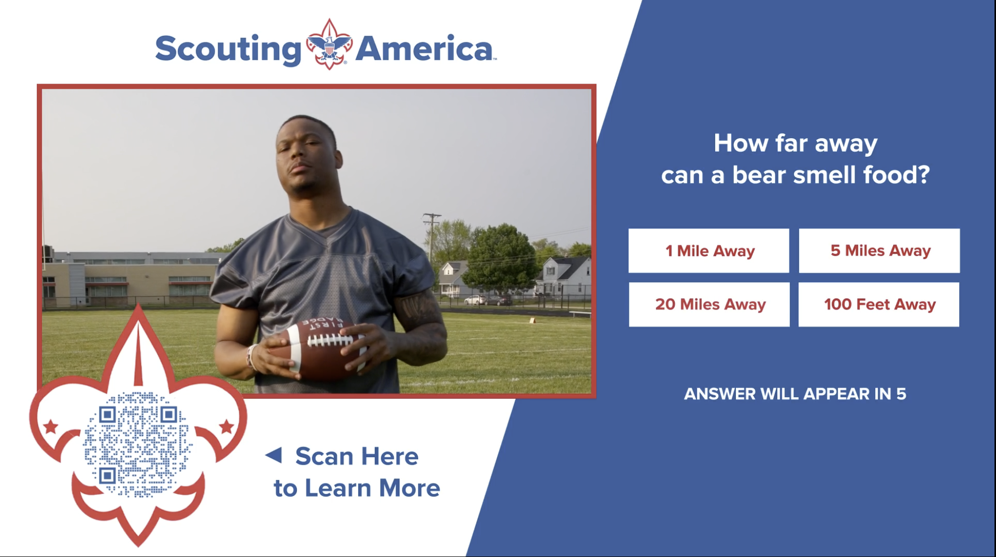
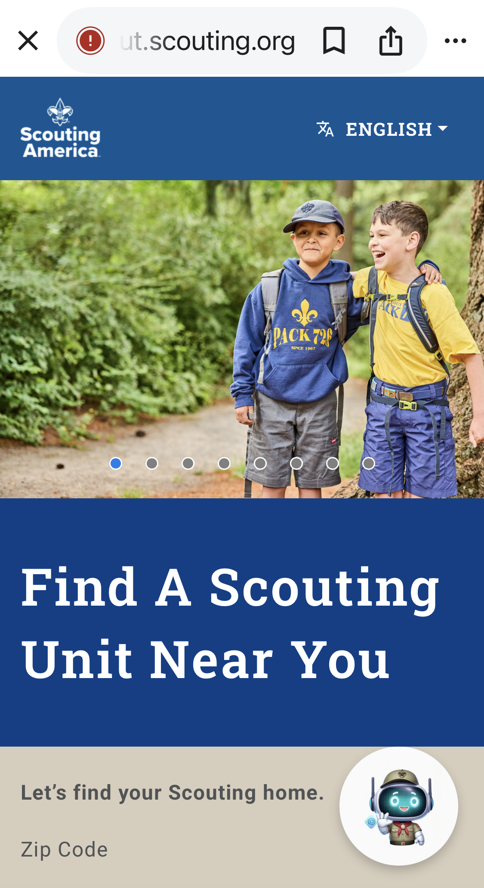
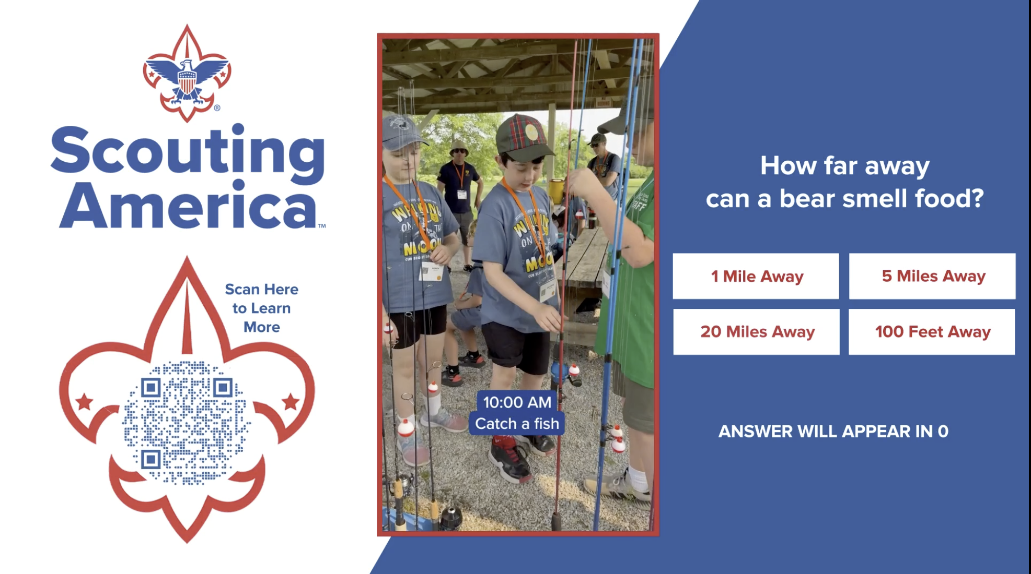
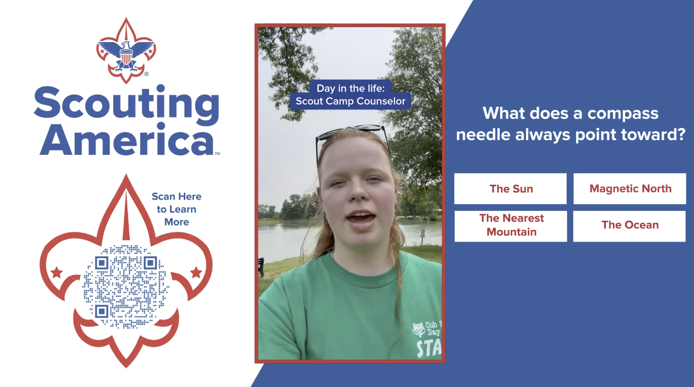
Disney Interactive

Slide 20


Slide 21


Slide 22


Slide 23


Slide 24


Slide 25


Slide 27
2026 AI-Driven Channel Mix
AI is allowing us to be much more precise in reaching Parents.
Streaming TV – Disney+, Hulu, ESPN+, YouTube TV, NFL Network
Streaming Audio – Spotify (music & podcasts) NEW!
Social Media Ads – Facebook, Instagram, TikTok, Reddit
Influencer Content – TikTok, LinkedIn
PR/Earned Media –Local / National Release
Retargeting Ads – Facebook, Instagram, TikTok
Google Search Ads - Google
Video Pre-Roll Ads - YouTube
Content Integration – Disney Interactive, Nat Geo

Slide 28


An essential part of the Scouting experience
Encourages and reinforces Scouting skills and values in between meetings and events
Shows the relevancy of Scouting in everyday life
80% PARENTS WHO SAY IT HELPS SCOUTS SUCCEED | 73% PARENTS WHO SAY IT HELPS SCOUTS SUCCEED | 10 ISSUES PER YEAR | $1.50 PER ISSUE

Slide 29

Mini Mags are
Back!

Slide 30
Use your Scout Life mini-mags as recruitment tools.
Pass them out at recruitment events.
Encourage current Scouts to share with potential new members.
Keep a stash in the office to use
throughout the year.
NEED MORE THAN YOU PRE-ORDERED? MISSED THE DEADLINE? | Download more! scoutlife.org/minimag | Coming soon: New ordering opportunity!

Slide 31

Update Your Info on BeAScout.org!

Slide 33
Best Practices and Recruiting tips
Chris Crowley
Central North Carolina, Scout Executive
Ben Buckelew
VP, Membership Engagement
Ty Washington
Growth and Retention Director
Otto Goedhart
Manager, Membership Growth

Slide 34
Troop and Pack partnership
Ben Buckelew
VP, Membership Engagement

Slide 35

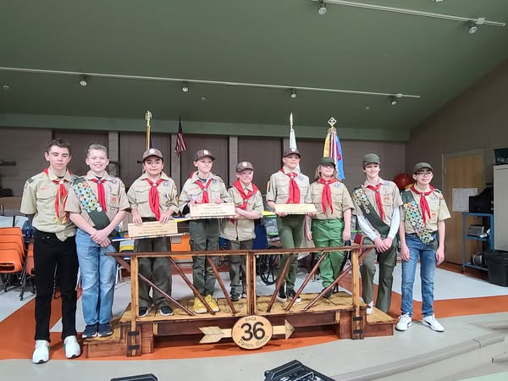
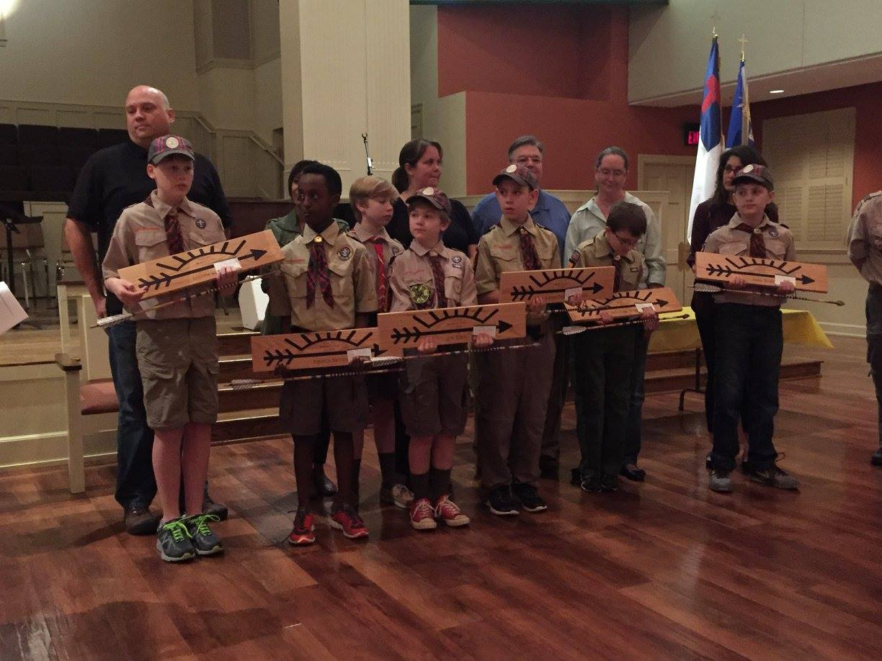
Troop and Pack partnership

Slide 36
Pack/Troop Partnerships
Strategies That Promote Pack/Troop Partnerships
Cubmaster(CM)/Scoutmaster(SM) serve on each committee
CS/SM play a small role at Pack Meeting and Court of Honors
Delegate a Pack/Troop adult to be the liaison between units
Utilize Den Chief Program
Troop to help with Fall Sign-up events
Most Scouts BSA members are from crossovers

Slide 37
Scouts BSA middle school recruitment
Chris Crowley
Scout Executive
Central North Carolina

Slide 38


Middle School Recruitment

Slide 39

Setting the Stage

Slide 40

School Relationships

Slide 41
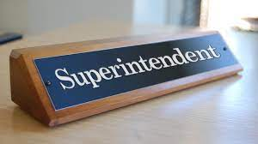
Superintendent Visits

Slide 42
Principal Visits

Slide 43
Scoutmaster Visits

Slide 44
The in-school rally

Slide 45
The in-school rally setup
Mock campsite setup with tents, hiking backpacks, kayak, high adventure items, etc.
  Area setup to test the fire starter
Each period social study classes come (class by class) to visit the campsite to listen and interact for 12-15 minutes.

Slide 46
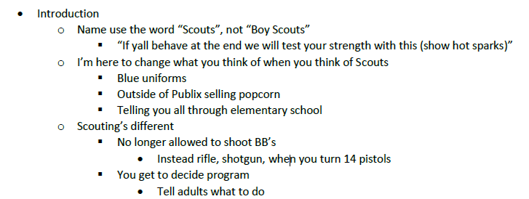
The rally itself

Slide 47
The rally itself

Slide 48
The rally itself

Slide 49
The rally itself

Slide 50
The rally itself

Slide 51
The rally itself

Slide 52

The rally itself

Slide 53
The rally itself
Tomorrow’s meeting
  Time, location, bring a parent
Who thinks they are tough and wants to test their strength
  Pick a volunteer to try to start a fire using the fire starter
  Show after the volunteer
Give out flyers to take home…

Slide 54

Flyer
Takes middle schooler or parent to website to gain more information and register online

Slide 55
www.JoinScoutsFL.com
Website

Slide 56
School Night
Mechanics

Slide 57
Items to Bring
2 Presenters (One District Executive, One Lead Volunteer
from District Membership Team)
Junior Leaders (SPL’s and ASPL’s) and Adult Leaders from
Area Troops
Each Troop will setup a Display Board to highlight their strengths
Youth Applications
Change for registration fee
Popcorn Family Guides
Orlando Magic Ticket Vouchers

Slide 58
School Night Agenda

Slide 59
School Night Agenda
6:20pm: Arrive with Lead Volunteer from District Membership Team.
6:30pm: Junior Leaders and Adult Leaders from Area Troops arrive and begin to setup Display Boards.
6:35pm: Meet with all Scouts and Scouters and go over Middle School Night plan for evening.
6:45pm: Junior Leaders are stationed at entrances and doors of Middle School to welcome new families. When families arrive they “check in” and receive youth application and popcorn family guide.
7:00pm: Open the evening with Opening Ceremony lead by Junior Leaders.
7:02pm: Lead Volunteer from District Membership Team gives overview of Scouting.

Slide 60
www.JoinScoutsFL.com
School Night Agenda
7:12pm: Junior Leaders give short overview / highlights of their Troop
7:25pm: New families visit Troops at their displays and are instructed once they are ready to complete electronic application or fill out youth application and submit at “check out” area. At this
point, once youth application is received at “check out” new
Scout will receive Orlando Magic Basketball Ticket Voucher
and hot spark.
7:45pm: Lead Volunteer from District Membership Team, District
Executive and Adult Leaders from Area Troops meet to
debrief and develop action plans for new Scouts
8:00pm: School Night Ends

Slide 61
Some Middle School Nights get 50-60 new Scouts in one night

Slide 62
Scouts BSA 5th & 6th Grade Youth Talk
Ty Washington
Growth and Retention Director

Slide 71
Know your audience:
Find age-appropriate activities that interest them

Slide 72
Beascout enhancements
Answering the most common questions up front
August 3, 2026 – updated look and feel
Estimated cost to join
Unit meeting days and times
Whether the unit charges additional dues
Total Charge per Member (National and Council)
Otto Goedhart
Manager, Membership Growth

Slide 73
Beascout New Look!

Slide 74
*To support these improvements, new fields added to the Unit Pin page in Organization Manager:
Fundraising helps cover costs
Trial Visit Encouraged
Unit fees
Meeting Schedule: Frequency, Meeting Day, Start/End Time
*July 9, 2026 - Unit leaders can begin updating these fields. Changes in effect August 3, 2026

Slide 75
BeAScout Enhancements – Pin Settings

Slide 76
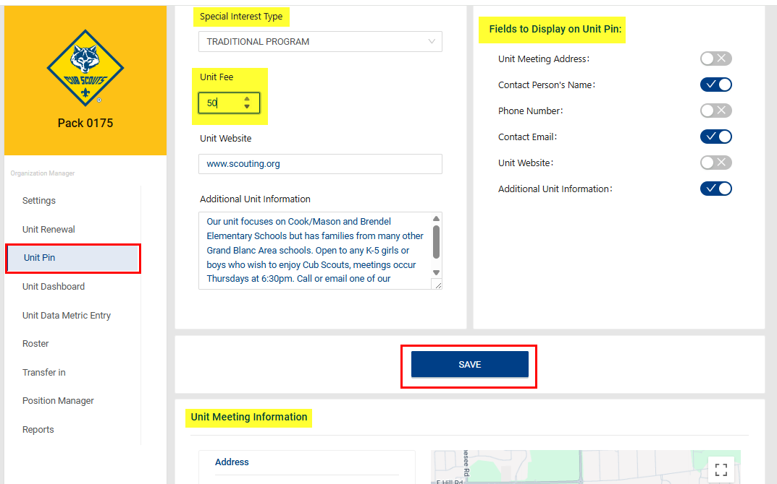
BeAScout Enhancements – Pin Settings

Slide 77
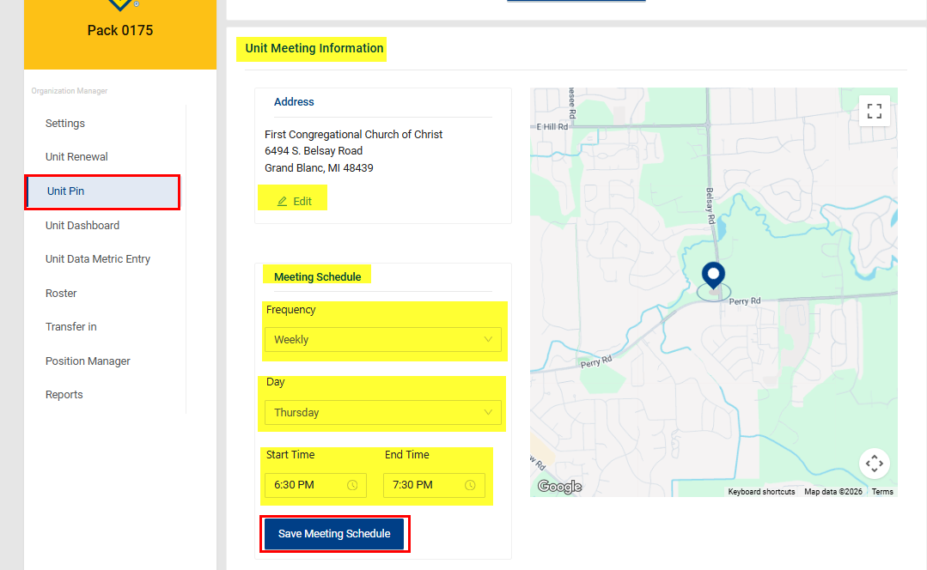
BeAScout Enhancements – Pin Settings
Please Note:
The enhanced details will not show in the current BeAScout; this additional information will be displayed in the new BeAScout released in August.

Slide 78
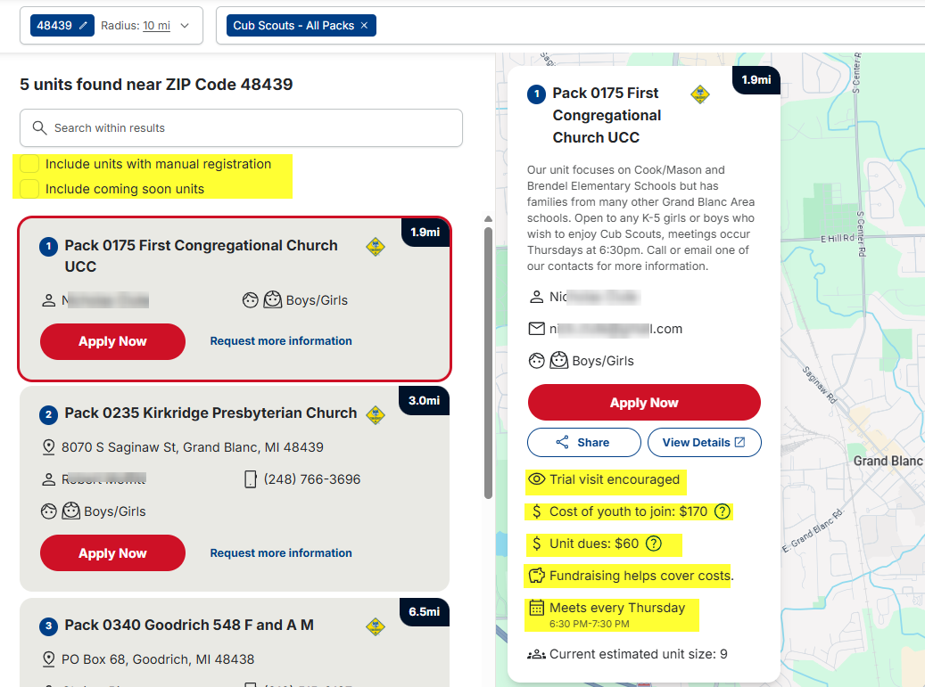
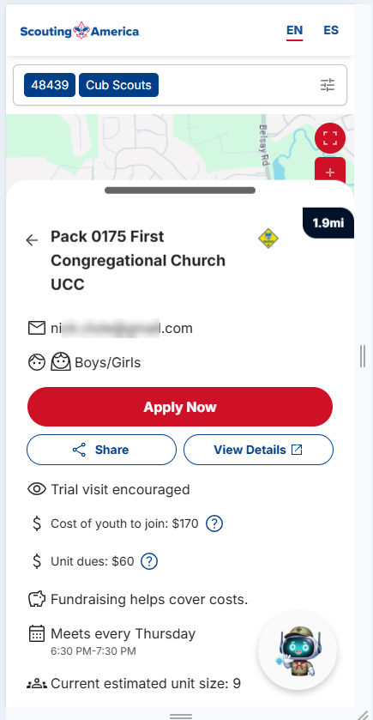
BeAScout Enhancements

Slide 79
Following your council’s membership plan
Chuck Brasfeild
EVP, Council Operations

Slide 80
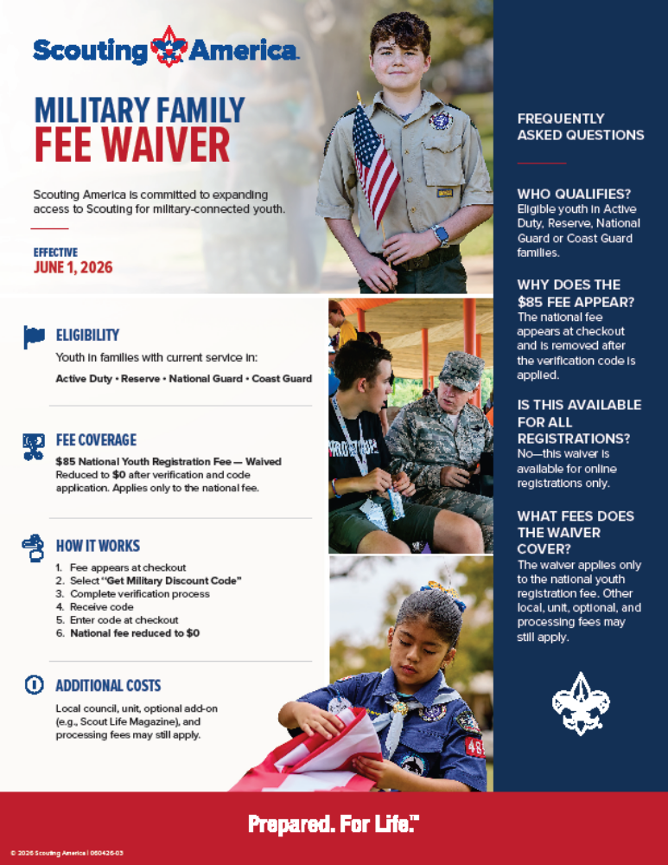

Slide 81
Closing Thoughts
Devang Desai
National Commissioner, Scouting America

