Slide 1
Campaign Kit Scouting for Food

Slide 2
Table of Contents
Welcome to Scouting for Food
Plan for Measurement
Scouting for Food and Recruitment
Update BeAScout.org
Set Up Your Facebook Page
QR Codes
Build Your Campaign in 5 Steps
Identify a corporate community partner/sponsor
Identify a large food distribution partner
Write and distribute a press release/Follow up
Shout it out to your units with email
Create Facebook Event & Social Posts
Measure and Track Success
Build your Campaign Easily – Units
Suggested Timeline & Schedule
Resources
Local Expertise: Marketing NSTs

Slide 3
Welcome to Scouting for Food
Scouting for Food is a program with a rich history and tradition. Whether you are planning a council-wide event or a local drive, this kit includes tools for both. From Facebook posts to sponsorship partnerships, there is bound to be something that you can utilize to help you promote the Scouting for Food program in your markets.

Slide 4
Why Scouting for Food?
According to the USDA, more than 34 million people, including 9 million children, in the United States are food insecure.
The pandemic has increased food insecurity among families with children and communities of color, who already faced hunger at much higher rates before the pandemic.
Many households that experience food insecurity do not qualify for federal nutrition programs and visit their local food banks and other food programs for extra support.
Scouting Can Help
It’s a great way make a difference in the community.
Scouting for Food teaches youth valuable lessons about service.
A great way for kids to give back to the communities in which they live and attend school.
By partnering with the right organizations, councils can help the success of the grassroots efforts while also sharing the ‘good works’ of Scouts.

Slide 5
Welcome to Your Campaign Kit for Recruiting!
Step-by-Step Marketing for Scouting for Food
This campaign kit provides step-by-step tips to promote your event. From planning to promotion to follow up, the kit includes a set of integrated marketing elements designed to work together to help you build the solid foundation needed for a successful event.
Are their other things you could do? Yes! But we strongly recommend you start with these key elements and work your way forward. Along with campaign elements, you’ll also find links to helpful how-to’s and marketing resources.
Ready to build a great campaign? Fantastic! So, grab your tools and let’s get to work!

Slide 6
Plan for Measurement
Measurement is an important part of every campaign. It helps you learn what parts of your campaign worked, which need to be improved and when you’ve reached your campaign goals!
Measuring your campaign’s effectiveness depends on the tactics you’re using. For this campaign, here are some easy things to measure.
Social media engagement – Facebook analytics makes it easy to track likes, comments, shares and visits to an event page
Fliers, yard signs or posters - Use QR codes to track click-thru rates.
Emails – Track opens and click-thru rates
Attendance at events - How many people stopped by the event? How many new scouts signed up?
What else can you measure related to your event? And how can you improve? Talk about measurement upfront with your leaders and parents.
Remember: Progress is made where progress is measured!

Slide 7
Welcome to Your Campaign Kit for Recruiting!
Scouting for Food is also a great way to support recruiting.
How do people learn about Scouting? They see Scouts doing good turns in their neighborhood recruitmentds. Scouting for Food can help support efforts by raising the profile of Scouting in the community.

Slide 8
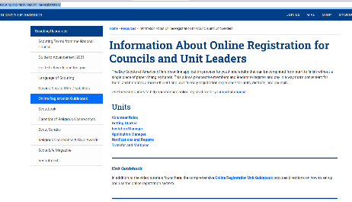
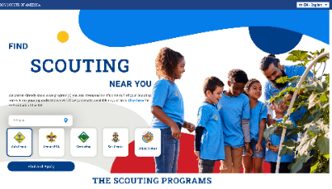
Use Scouting for Food to Support Recruiting Update BeAScout.org
Community initiatives like Scouting for Food are a great way to recruit more families to scouting. When using the various marketing initiatives in this tool kit, don’t forget to include the BeAScout.org website. A simple message:
“To join scouting and be a part of your community, go to https://www.BeAScout.org to find the scouting program near you!”
Example Council Landing Page https://www.cflscouting.org/scouting-for-food/

Slide 9
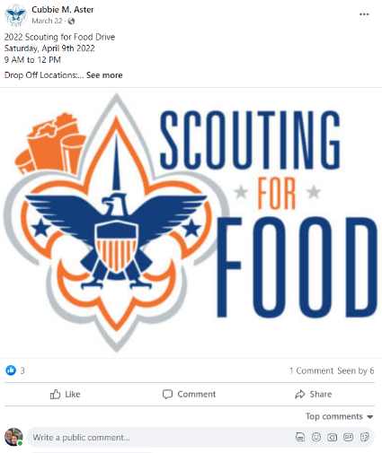
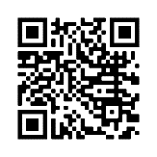
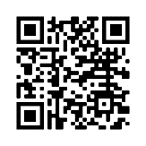
Set Up Your Facebook Page
Make sure you have a Facebook page for your unit. Post photos and video so people can see the fun Scouts have in your unit.
Learn how to set up your own Facebook page.
Or use Facebook’s handy page creator tool.

Slide 10
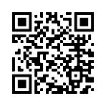
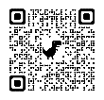
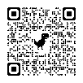
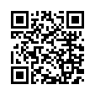
QR Codes Make it Easy!
QR Codes for Online Registration
QR codes make it easy to pull up web sites from your phone. Just point your camera and click!
For Scouting , it QR codes are an incredibly valuable way to connect fliers, posters, yard signs and more to your event.
Remember those busy Mom’s we need to reach? QR codes are also widely adopted by busy families as a fast and efficient way to find info they’re interested in.
Here are some helpful links (and QR codes!) to the BSA’s QR codes for online registration, a Google how-to for creating your own QR codes right from Google’s Chrome browser and a handy QR Code Generator.
On BSA’s Online Registration system, you can find a registration URL and QR code specific to your unit. Include this code wherever you want people to be able to register for your unit immediately online.
Create QR Codes for Everything Else!
Create a QR code for any URL using the QR code Creator in Google’s Chrome browser.
QR Code Generator is also a good place to create your own QR codes at no cost!

Slide 11
Build Your Campaign in 5 Steps

Slide 12
1. Identify a Corporate/ Community Partner
Partnering with an organization can make your campaign more successful.
Corporate partners may support by cash donation to underwrite any associated costs such as the collection bags; these sponsors can also act as collection centers for the units – a great way to contribute to one of the most important community opportunities – food insecurity within our own communities. Options could include a grocery store, bank; hospital, etc.
Media partners can support by promoting the program via their communication channel – getting the community engaged and ready to support a worthy cause. Options include radio stations, web sites, news organizations, etc.
What could a Partnership Package include?
Press Release - Partners should be included on all press material
Collection Bags - Logos on all collection bags (be sure and list how many)
Social channels – Include mentions on all of your social channels
Partners also should share the Scouting for Food initiative on their web and social channels

Slide 13
2. Identify Food Distribution Partners
For Large-scale Drives
If you are conducting a drive on a large scale, partnering with a larger food pantry or distribution center will lend the effort credibility and help with resources
The top food banks include Feeding America, Second Harvest, Feeding Children Everywhere, Loaves and Fishes
Identify the program contact, connect and request that they partner with the Scouting for Food program – sharing how much food is collected will likely excite them
Include their logo on the collection bags, on the press release, the website and on all social media posts
For Smaller Drives
If you’re in a smaller market, identify various churches or local food pantries that may want to partner
Promotional Possibilities
Food distribution partners should also share Scouting for Food on their social channels
No matter the size of drive, be sure to include partner and organization logos on the collection bags, fliers, on the press release, the website and on all social media posts.

Slide 14
3. Distribute A Press Release & Follow Up
Identify someone within the Council who can speak to the press about Scouting for Food and be the main contact included on the press release.
For the purposes of Scouting for Food, Macro-distribution – When a press release is dispensed to a high volume of recipients
Release should be addressed to a specific recipient on your media contact database whenever possible
Search and identify online publications and specific reports that cover community and local event; television/radio station newsrooms; search google for mom and community bloggers/influencers in your specific markets. Message them and/or email them the release
Use a free or paid service to help distribute your release. Options include: https://prlog.com; https://www.pr.com; https://www.eznewswire.com; or pay a small amount to help distribute to a wider group
When do I distribute my release?
Send at an unconventional time, such as 10:15am
Avoid the late hours
Distribute during the week, Tuesday thru Thursday – these are the most opportune, less busy news times
Follow Up
Allow 2 days, then send an email or message follow up
If they choose not cover, politely ask why so that you can learn for future
A phone call or voicemail, if you have a number is also an option
Even after this release, continue to reach out with other story ideas so that you can continue to build relationships. Perhaps send them a collection bag for the initiative so they can first-hand-see what you’re doing

Slide 15
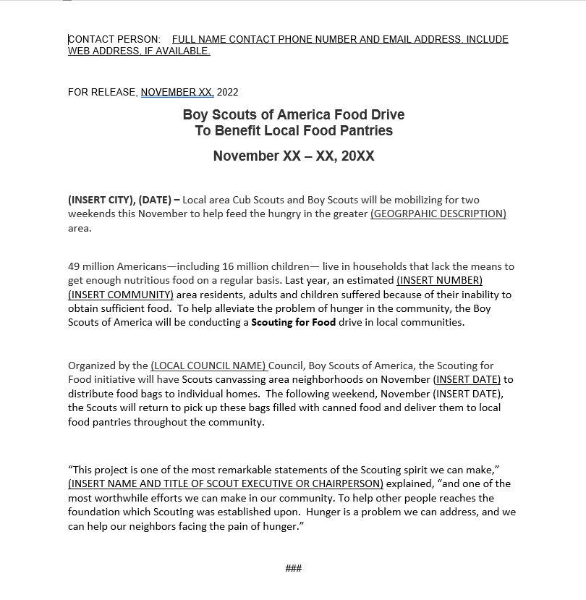
Provide contact information in case the media outlet has a question
The headline should be short, and clear.
Be sure to include the date of the event (s)
The first paragraph (the lead) should cover the who, what, when, where and why. (The 5 W’s)
The following paragraphs define the opportunity and how Scouts are helping.
If you have local or community statistics on food insecurity, include them. Check your local food pantry or food bank web sites for these statistics.
Consider including a quote from the event chair, Scout executive, unit leader, etc.
The three “###” (number signs)indicate the end of the release.

Slide 16
4. Shout it Out to Units with Email
Have the email list of all of your scout leaders and units? Let’s share the news.
If you don’t have an email platform that you use, you can easily register to use one for free
https://mailchimp.com is a great option. The free version allows for 500 contacts and 2,500 email sends; for only $11 per months, the system allows for 50k contacts and 5k monthly email sends
Full creative suite that is easy to use
Audience management and tracking
Marketing automation
Insights and Analytics
Once you choose a platform, it will allow you to upload your contacts and will allow you to choose from several templates. These templates allow for logo uploads and text messaging
Take the online tutorial and get the sign-up email out to your units and scout leaders
Email is also a great way to inform the community about the event, assist your units in getting the word out about Scouting for Food
If you want to start an email database, MailChimp will allow you to include a sign-up link on BeAScout.org to make it easy

Slide 17
5. Facebook Event Page & Social Posts

Slide 18
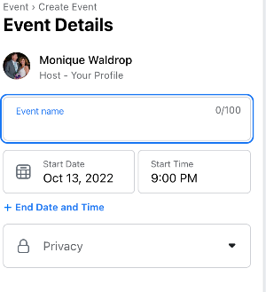
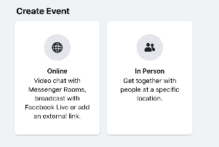
Create a Facebook Event Page
Creating a Facebook Event Page is free and easy. Why do you want to do this?
Make it easy for people to find information about Scouting for Food. Use Facebook Events to help you set up an event, reach your audience and increase participation in Scouting for Food. Follow these easy steps:
- From your newsfeed, click page in the left menu
Go to your page
Click events, then Create New Event
Click Online or In-Person
Add event details, then click Create Event
Be sure and make it Public!

Slide 19
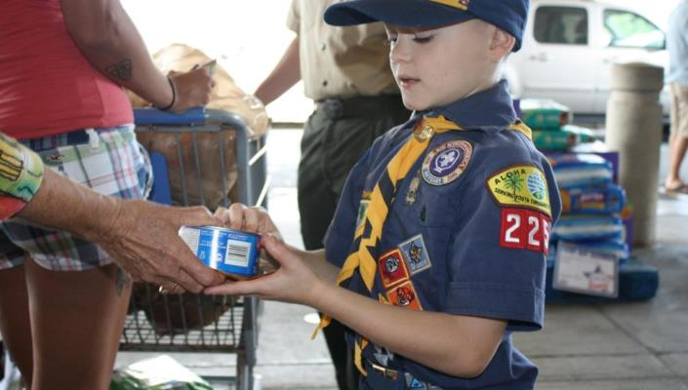
Sample Social Posts you can share 1-2 times per week.
An estimated 1-in-7 Floridians did not have enough to eat. Help us ease the pain of hunger by supporting Troop XXX’s Scouting for Food Campaign. Get all the details here (link to Facebook Event page) #ScoutingForFood

Slide 20
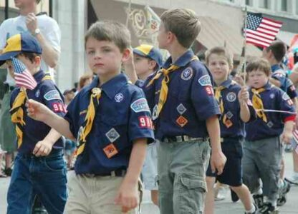
Sample Social Posts
There are over 2.5 million people in Florida who face daily hunger. With your support, Troop 123’s Scouting for Food campaign can aid in alleviating this immense need for food. #ScoutingForFood For more info visit (url)

Slide 21
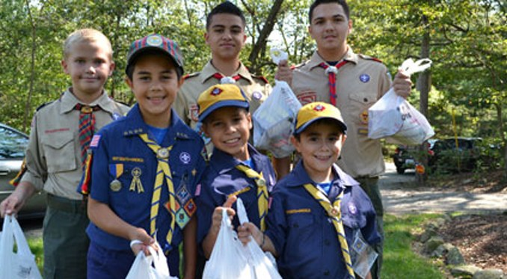
Sample Social Posts
More than 191,000 individuals in Orange County face the struggle of food insecurity. Troop XXX’s Scouting for Food campaign could use your help in reducing these unfortunate statistics. #ScoutingForFood
Find more at (url)

Slide 22
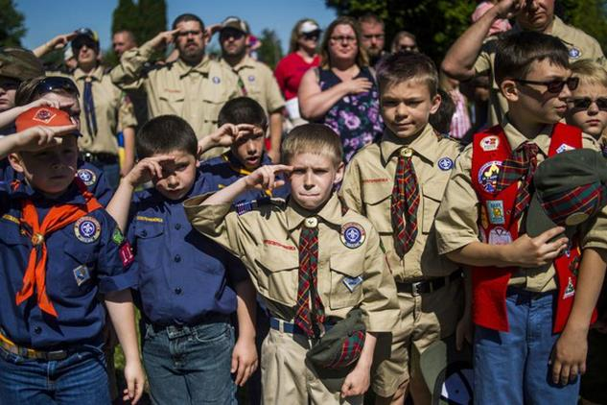
Sample Social Posts
Millions of people are unable to afford nutritious food for themselves or their families. Troop 123 is aiding these individuals with their Scouting for Food Campaign. . #ScoutingForFood Find out how to help at:

Slide 23
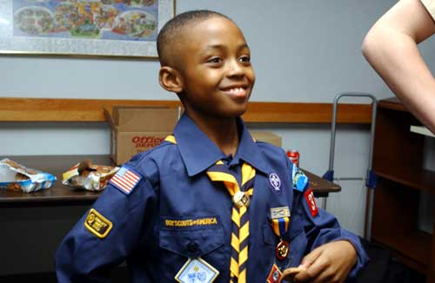
Sample Social Posts
Many people do not have the privilege of eating a warm meal. Troop 123’s Scouting for Food campaign involves initiatives to help fight hunger. #ScoutingForFood
Check out (Link) for more on how to help

Slide 24
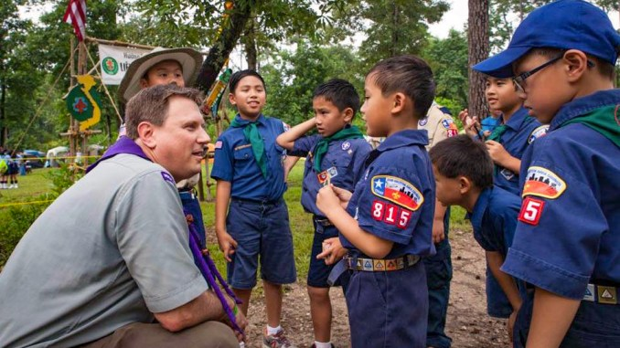
Sample Social Posts
Around 95 million meals are needed in order to fill the hunger gap in our community. With your help, Troop 123’s Scouting for Food campaign will aid these community members in getting nutritious meals. #ScoutingForFood Find out more details on how to get involved at (url)

Slide 25
Measure & Track Success
Measurement is an important part of every campaign. It helps you learn what parts of your campaign worked, which need to be improved and when you’ve reached your campaign goals!
If this is your first-year measuring results for the activities promoting this program, use the results for this year as a baseline for future years. For this year, set goals to measure against and track.
Examples of potential goals are as follows:
Drive 100 units to sign up for Scouting for Food in your community
Identify 3 bloggers to partner with that have a collective following base of 10k people; then monitor their blogs and engagement
Identify and receive coverage of the program from one major television station;
Distribute press release to 20 online outlets, television and radio stations in the market and monitor coverage
Set a goal of how much food collectively will be donated – look at last year’s numbers and increase it by a percentage and gauge your results
How much media coverage was received from the press release? If you don’t have a Public Relations firm or formal way of tracking coverage, utilize the following free tools:
You can set up your google alerts to capture any media mentions by clicking here
Use https://www.mention.com to gauge any coverage from social media – the free version allows for the following:
One brand
3 social accounts
1 user
1000 mentions
If you had any television or radio partners, request that they provide the value and recordings of coverage
Distribute a press release AFTER the program as well to share the results!

Slide 26
Start Your Campaign
Suggested Timeline
90 Days
Develop partnership opportunities
Identify and secure, grocery store, corporate and/ or food bank partners
60 Days
Order bags, door hangers, etc., with all partner logos included
30 Days:
Distributed Press releases 30 days out
Begin follow up calls to media and influencers/bloggers 2-3 days after distribution (Note: Follow up 1-2 weeks out for TV stations)
Create Facebook Event
Post on all council social outlets and update web page 30 days out, then at least weekly up to the event.
Communicate to all units with press release, emails and any opportunities for collection opportunities

Slide 27
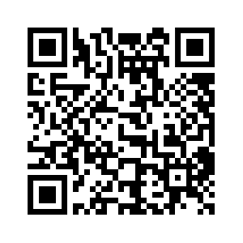
RESOURCES
The BSA Brand Center has multiple Scouting for Food logos and photos available to use for promoting Scouting for Food whenever local councils or units might be conducting their food drive. Be sure to log in to Brand Center to access these materials.

