Slide 2
Welcome to the
national fall kickoff!
Freddy Norton
Chair, National Membership and Relationships Committee

Slide 3
Tonight’s topics
A Message from our National Chair & Chief Scout Executive
The Scouting America Brand
Best Practices and Recruiting Tips
Following Your Council’s Membership Plan
A Message from our National Commissioner

Slide 4
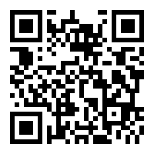
Are you recording this?
Yes!
www.scouting.org/recruitment

Slide 5
Safety Moment
Dr. Amanda Heidemann
Health and Safety Committee, Greater St. Louis Area Council

Slide 6
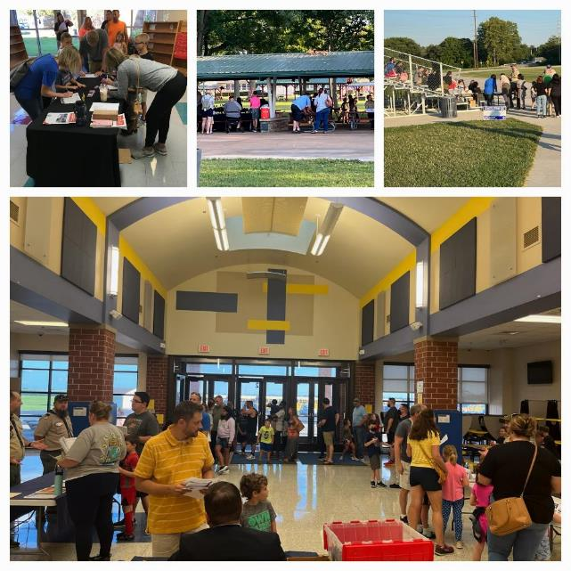
Safety Considerations for Recruitment Events
Parking lot lighting
Parking lot monitors
Safe placement of yard signs
Sign placement for visibility

Slide 7
National Goal
Freddy Norton
Chair, National Membership and Relationships Committee

Slide 8
Scouting America 2024 Year-End Goal 1,050,000
1,015,056 Youth Year-end 2023
211,590 to go
Updated 8/1/2024, July 2024 Month-end – Council Membership Tools

Slide 9
A message from the chair
Brad Tilden
National Chair, Scouting America

Slide 11
A message from the chief scout executive
Roger Krone
CSE, President and CEO, Scouting America

Slide 13
Scouting America Brand
Michael Ramsey
SVP and Chief Marketing Officer, Scouting America

Slide 14
Focus Group Research
Positive impressions - they generally associate Scouting with camping, outdoor adventure, leadership and character.
Willingness to volunteer depended on market but was generally low. But….
Lack of local visibility.
Why had they not joined? They hadn’t been asked!

Slide 15
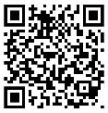

Slide 16
What’s Not Changing!
Scout Oath and Law
Leadership Lessons
Life-Changing Experiences
Gender-Specific Troops
Commitment to Safety
Duty to God
The Name

Slide 17
Fall Campaign
Social / Digital
Sponsored Search
Influencers
Earned Media
... And More
BeAScout.org

Slide 18
New Families are Going to BEAScout.org
Update Your Unit Pins!
Check Those Leads! – A lead means someone wants more info or wants to join!
Respond to them quickly!

Slide 19
National Webinar on August 15 at 7 pm CT
BeAScout.org 101

Slide 20
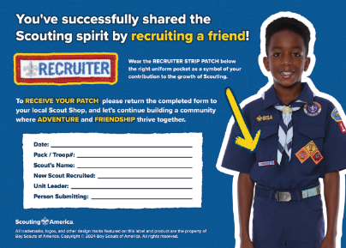
New Cub Scout Welcome Kit
August 1 – October 31

Slide 21
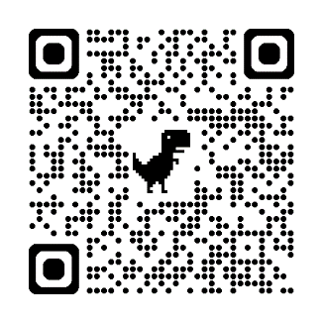
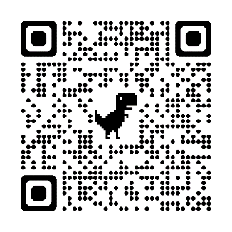
Scouting America Resources
Share: YouTube
Download: Brand Center

Slide 23
Best Practices and Recruiting tips
Ben Buckelew
Director of Field Service
Atlanta Area Council
Chris Crowley
Deputy Scout Executive
Central Florida Council
Martez Moore
Deputy Scout Executive
Greater St. Louis Area Council
Wendy Nelson
Director of Field Service
Greater Alabama Council
Tim Cannard
Marketing Director
Golden Gate Area Council
Ward Bramlett
Director of Field Service
Seneca Waterways Council

Slide 24
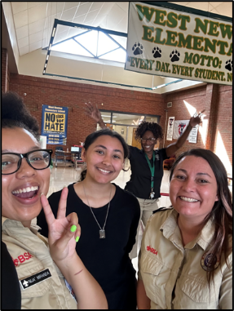
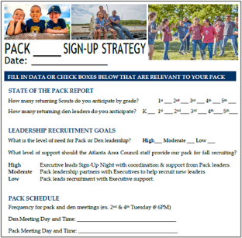
Volunteer and Staff Collaboration
Work together to:
Assess leadership needs
Review assigned schools
Establish recruiting capacity/goal
Sign-up logistics
Share resources for youth & adults
“New families that meet a unit leader (volunteer) the night of the signup are more likely to come to the first meeting and stay in Scouting."​
Ben Buckelew
Director of Field Service
Atlanta Area Council

Slide 25
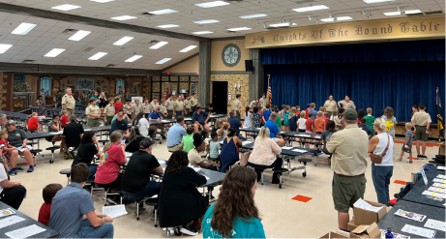
Signup Night 101 – Helpful Tips
Preferred days Tuesday, Wednesday and Thursday
There is a difference between a sign-up night and a parent orientation night
Location of signup night at school
Yard signs and posters
Flyers sent home with students
In-classroom rallies
Signup night – keep it brief (not a Pack Meeting)
Wendy Nelson
Director of Field Service
Greater Alabama Council

Slide 26
Traditional Recruitment
Back to the Pack Event - Fun Location ​
Fun Event to Welcome back existing leaders and Scouts​
​
School Open House – At The School ​
Meet Your Teacher/Registration Day​
​
Sign-Up Event – At The School ​
Objective Is To Register New Families​
Fun Pack Event – Fun Location​​
First Event For New And Existing Families​​
​​
Parent Orientation – Practical Location ​​
Onboarding Session for New Parents – Every Parent Helps​
Ben Buckelew
Director of Field Service
Atlanta Area Council

Slide 27
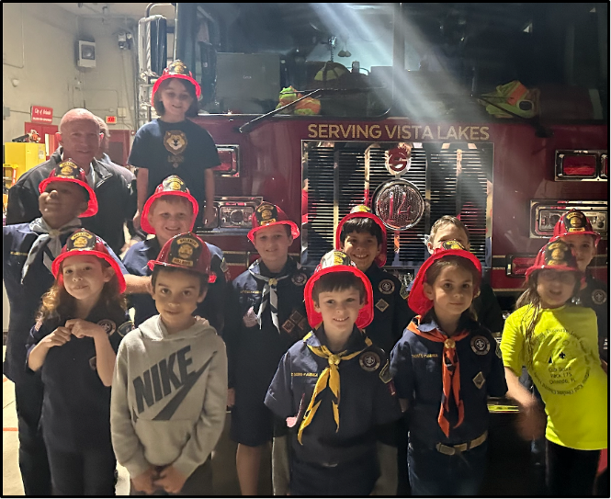
Promote joining Cub Scouts during the car rider line at either the sign-up night, if there is one, or at an upcoming pack event... even if there’s no school access
Chris Crowley
Deputy Scout Executive
Central Florida Council

Slide 28
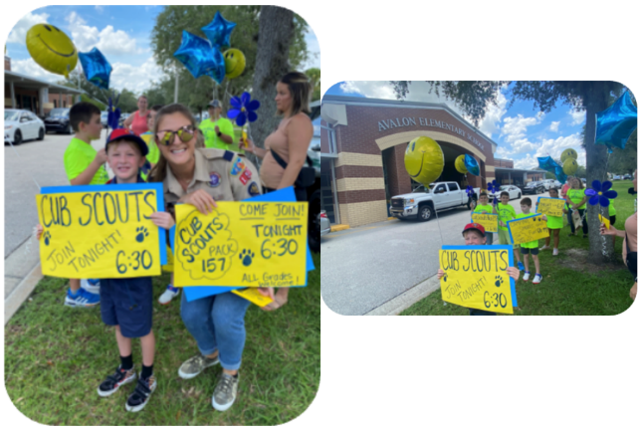
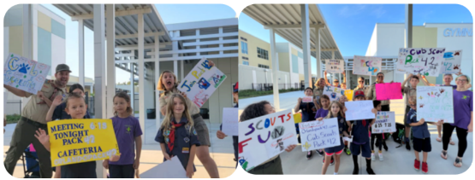

Slide 29
Limited School Access
Flyers, yard signs, posters
Scout talk video announcements
Peer-to-peer recruitment
Social media
Ward Bramlett
Director of Field Service
Seneca Waterways
Martez Moore
Deputy Scout Executive
Greater St. Louis Area
Tim Cannard
Marketing Director
Golden Gate Area

Slide 30
Non-Traditional Recruiting
In geographical areas where school access is difficult, or in some cases not allowed…in all cases we want to get the flyers in the hands of youth and ultimately parents
Ward Bramlett
Director of Field Service
Seneca Waterways Council

Slide 31
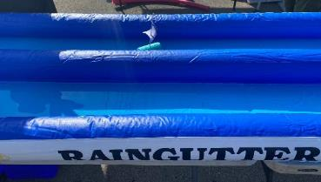
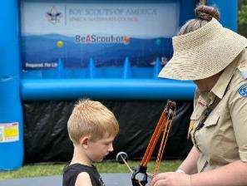
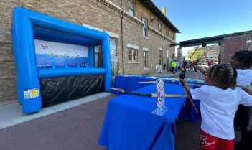
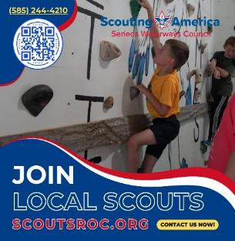
Non-Traditional
Recruiting
Ward Bramlett
Director of Field Service
Seneca Waterways Council

Slide 32
Non-Traditional Best Practices
From Lessons Learned in the Field!
Plan well in advance and recruit your team early!
Multiple shifts to keep enthusiasm high.
Post QR Codes in multiple, easy to access locations.
Bring FLYERS!
Have information available for multiple units.
Offer a discount ticket during the event.
Develop a thoughtful, beginning to end lead management system – Invitation Manager can be your friend!
Follow up with all leads within 24 hours.
Ward Bramlett
Director of Field Service
Seneca Waterways Council

Slide 33
PEER TO PEER Recruitment
Martez Moore
Deputy Scout Executive
Greater St. Louis Area Council

Slide 34
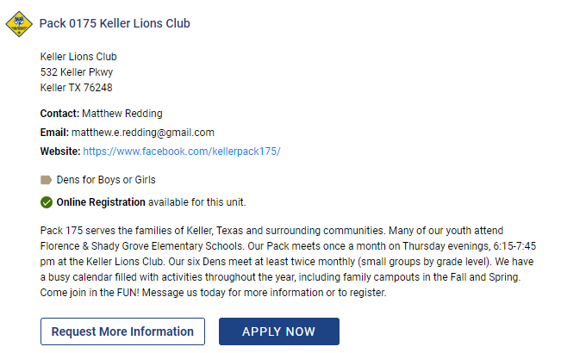
BE A SCOUT . org

Slide 35
SCOUTING FOR EVERYONE

Slide 36
Social Media
Social Media Marketing within Facebook (Meta) with Geofencing
Tim Cannard
Marketing Director
Golden Gate Area Council

Slide 37
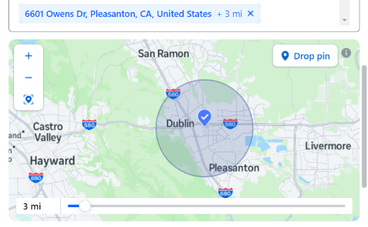
Geofencing on Facebook (meta)
What is Geofencing?
Geofencing is a way to make a targeted ad through social media or on the web, Here we will focus on Facebook or what is now known as Meta. This includes Instagram. The idea being you take an event and make an ad to be marketed with geographic borders and age demographics in the social media ad algorithm. (Examples being; Addresses, zip codes, age range, parents, interests, etc.)

Slide 38
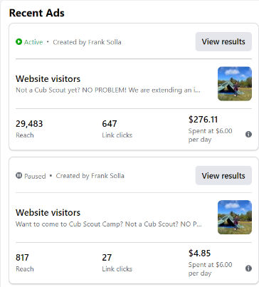
Social Media Best Practices
Follow These Few Steps for Success!
Marketing team should work with Field Staff and Unit Leaders to plan sign up events and promotion on social media in advance. Start ads 10-14 days from sign up date.
Learn or know your audience or local market. Use creatives and language to match them. Make multilingual an option.
Create geofence campaigns within Ads Manager on Facebook (Meta). Use a physical target address so that Meta will allow you to radial geofence down to a 1-mile square radius. If you use City/Zip code radius minimum targeting is 5 miles. A big difference. So, choose wisely.
Set Ads to run throughout the Meta Platform that include Instagram.

Slide 39
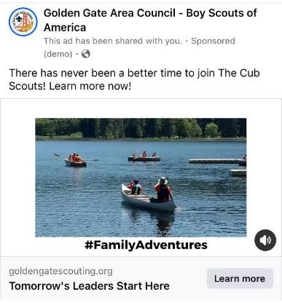
Social Media Best Practices Cont.
Use “Detailed Targeting” within FB Ads Manager. Consider both Demographics and Interest. In addition to common scouting key-words, use REI, Dicks Sporting Goods, Bass Pro Shops, and Outdoor Activities. These key-words help refine the target audience and will generally increase ad performance.
Use a highly detailed membership landing page that focuses on the program you are promoting like Cub Scouting. That way the interested party does not get lost or confused on what to do next. Example: Cubs – Golden Gate Scouting
As an added Bonus, set-Up a Facebook Retargeting Campaign. These traditionally always perform well. As it reinforces your campaigns.

Slide 40
How-to Videos for Social Media
Below are some fantastic how-to YouTube videos that will help set your team up for success.
How to Set Up a Meta Business or Ad Account: https://www.youtube.com/watch?v=EkFkWTiN80g
How to Set up Facebook ads in Facebook Ad Center: https://www.youtube.com/watch?v=YIUrZ69fDOE&t=109s
How to Set Up Targeting: https://www.youtube.com/watch?v=Bts3_LQtJ0M
How to Set Up a Facebook Retargeting Campaign: https://www.youtube.com/watch?v=tejH2CLmCcM

Slide 41
New Units
Pack capacity – avg sized units
Pack to school ratio
Pack to troop ratio
5th grade girls – Do they have a troop?
Ben Buckelew
Director of Field Service
Atlanta Area Council

Slide 42
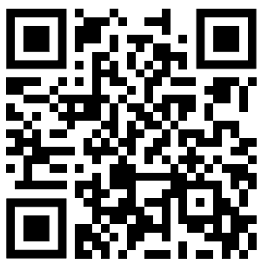
Membership & Unit Renewal Update
Short Video on how to renew your Scouting America membership
Membership and Unit Renewal Landing page
Chris Crowley
Deputy Scout Executive
Central Florida Council

Slide 44
Following your council’s membership plan
Jeff Hunt
Assistant Chief Scout Executive, EVP and Chief Operations Officer

Slide 46
Closing Thoughts
Scott Sorrels
National Commissioner, Scouting America

