Slide 2
Welcome to the scouts bsa membership kickoff
Freddy Norton
Chair, National Membership and Relationships Committee

Slide 3
Tonight’s topics
Fall Media Campaign
Scouts BSA Middle School Recruitment
Scouts BSA Recruiting Girls
Following Your Council’s Membership Plan

Slide 4
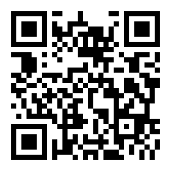
Are you recording this?
Yes!
www.scouting.org/recruitment

Slide 5
Safety moment
Hali Thompson
Scouts BSA Troop Committee Chair, Troop 175

Slide 6
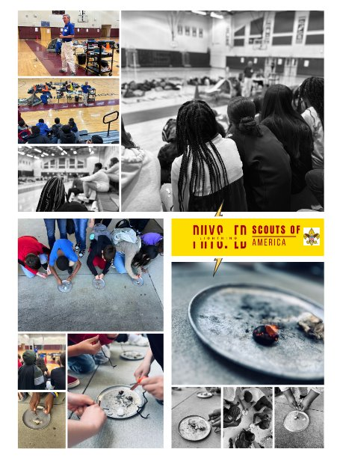
Safety During Recruiting Events
Parking lot lighting
Parking lot monitors
Safe placement of yard signs
Sign placement for visibility

Slide 7
National goal
Freddy Norton

Slide 8
Scouting America 2024 Year-End Goal 1,050,000
1,015,056 Youth Year-end 2023
179,788 to go
Updated 9/1/2024, August 2024 Month-end – Council Membership Tools

Slide 9
Fall Recruitment
Michael Ramsey
SVP and Chief Marketing Officer, Scouting America

Slide 10
INSIGHTS
Focus Group Research
Positive impressions - they generally associate Scouting with camping, outdoor adventure, leadership and character.
Willingness to volunteer depended on market but was generally low. But….
Lack of local visibility.
Why had they not joined? They hadn’t been asked!

Slide 11
Fall Campaign
Social / Digital
Sponsored Search
Influencers
Earned Media
... And More
BeAScout.org

Slide 12
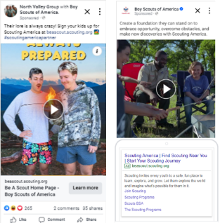
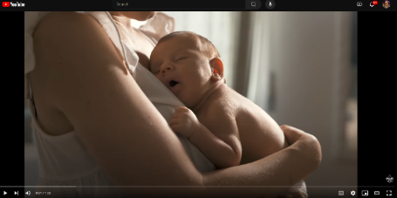
SOCIAL & DIGITAL MEDIA It’s all about awareness!
3.4 Million Impressions
650K+ Video Views
18% Engagement Rate
45,000 Clicks to BAS.org

Slide 13
RETARGETING
Activated Last Week.
Metrics to Come.

Slide 14
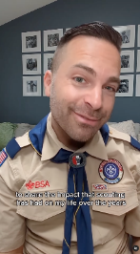
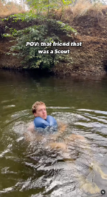
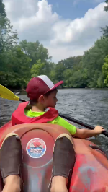
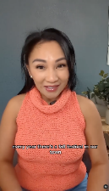
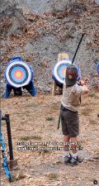
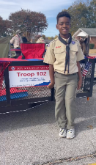
INFLUENCERS

Slide 15
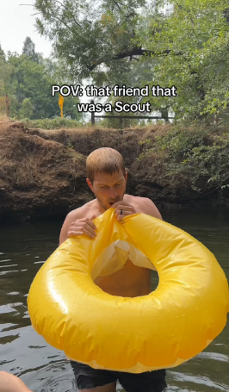
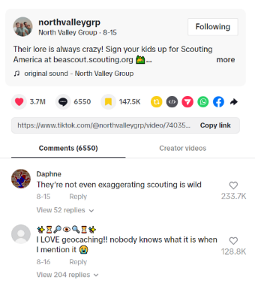
NORTH VALLEY GROUP
TikTok Continues to outperform all social channels. As a result, we’re adding more content.
On one TikTok post alone:
26.8M
views
6,500+ comments
18% engagement rate

Slide 16
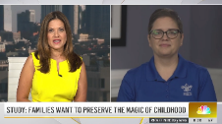
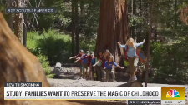
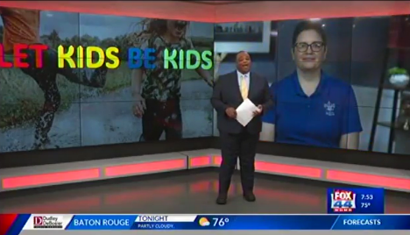
NATIONAL PR
Satellite Media Tour (SMT)
National PR
Experts Speaking to the Value of Scouting for Today’s Parents

Slide 17
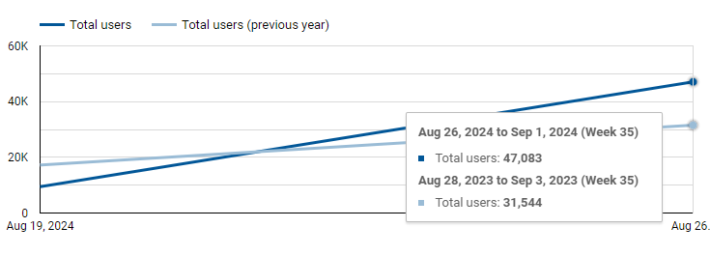
BeAScout.org
49% Increase in Traffic to BeAScout.org Last Week YOY
The week of August 25-31, drove the highest volume of web traffic to beascout.org this year. 275% Increase over July.

Slide 18
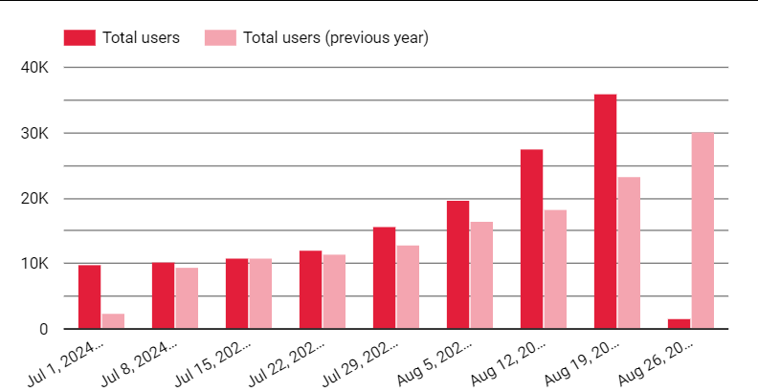
BeAScout.org
20% Increase in Traffic Over the Past 28 Days
34%
54%
31%
19%
21%

Slide 19
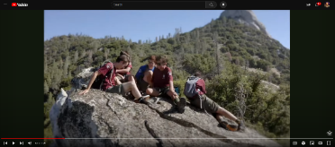
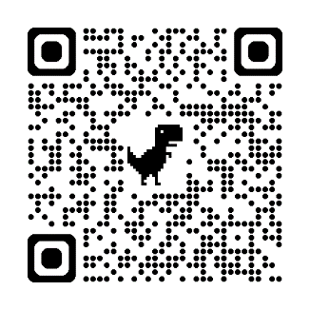
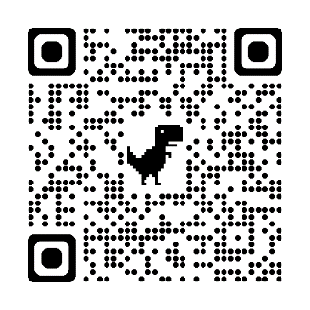
Scouting America Resources
Share: YouTube
Download: Brand Center

Slide 20
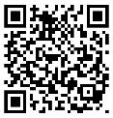

Slide 21
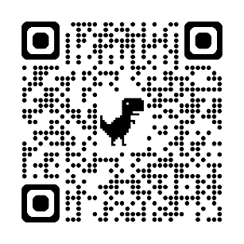
New Families are Going to BEAScout.org
Update Your Unit Pins
Check Those Leads! – A lead means someone wants more info or wants to join! Respond to them quickly!
BeAScout Tutorials

Slide 23
middle school recruitment
Chris Crowley
Deputy Scout Executive, Central Florida Council

Slide 24
Middle School Recruitment

Slide 25
Setting the Stage

Slide 26
School Relationships

Slide 27
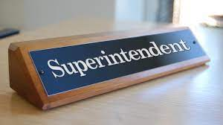
Superintendent Visits

Slide 28
Principal Visits

Slide 29
Scoutmaster Visits

Slide 30
Troop and Pack Partnership
Ben Buckelew
Director of Field Service, Atlanta Area Council

Slide 31
The in-school rally

Slide 32
The in-school rally setup
Mock campsite setup with tents, hiking backpacks, kayak, high adventure items, etc.
Area setup to test the fire starter
Each period social study classes come (class by class) to visit the campsite to listen and interact for 12-15 minutes.

Slide 33
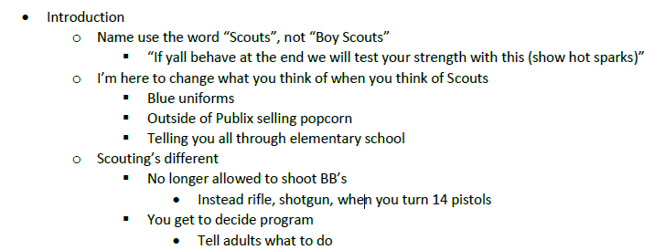
The rally itself

Slide 34
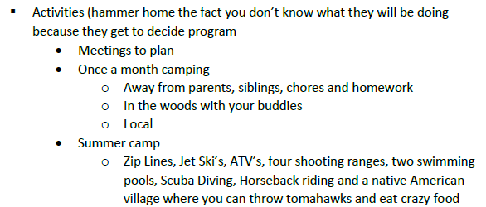
The rally itself

Slide 35
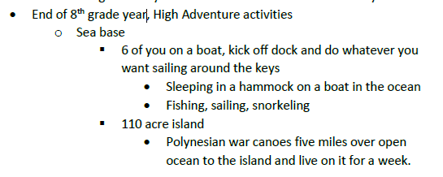
The rally itself

Slide 36
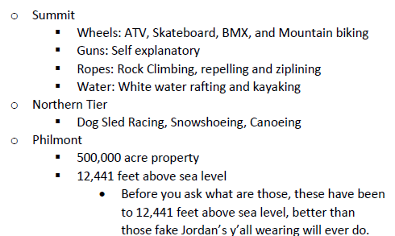
The rally itself

Slide 37
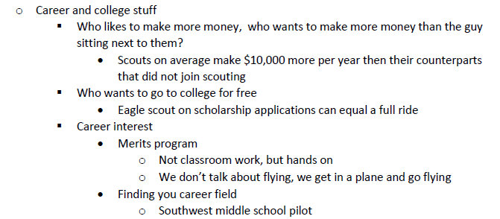
The rally itself

Slide 38
The rally itself

Slide 39
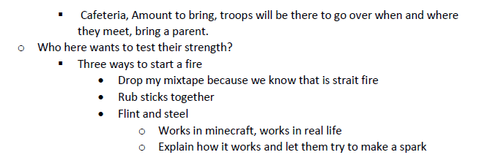
The rally itself

Slide 40
The rally itself
Tomorrow’s meeting
Time, location, bring a parent
Who thinks they are tough and wants to test their strength
Pick a volunteer to try to start a fire using the fire starter
Show after the volunteer
Give out flyers to take home…

Slide 41
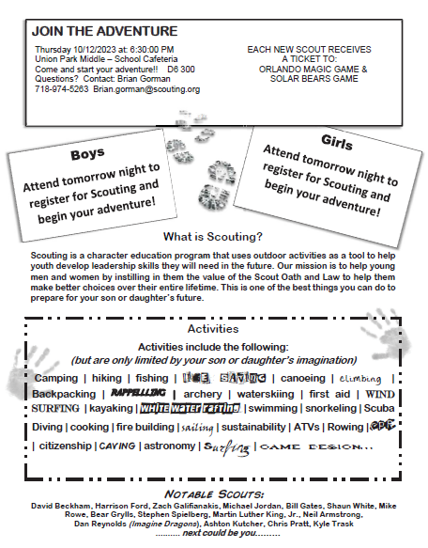
The Flyer
Takes middle schooler or parent to website to gain more information and register online

Slide 42
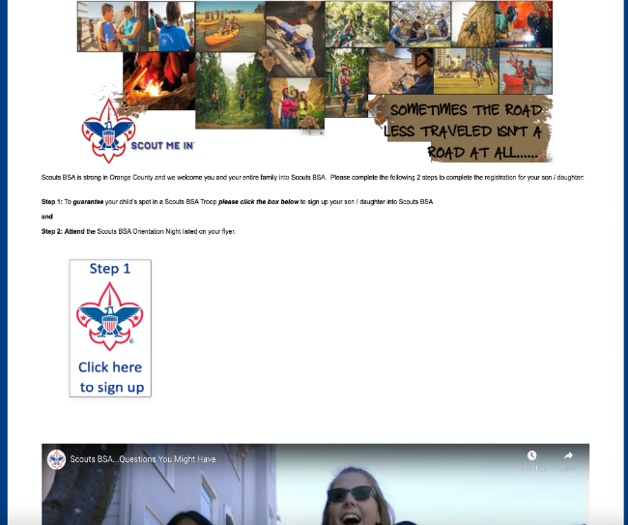
www.JoinScoutsFL.com
Website

Slide 43
School Night Mechanics

Slide 44
Items to Bring
2 Presenters (One District Executive, One Lead Volunteer
from District Membership Team)
Junior Leaders (SPL’s and ASPL’s) and Adult Leaders from
Area Troops
Each Troop will setup a Display Board to highlight their strengths
Youth Applications
Change for registration fee
Popcorn Family Guides
Orlando Magic Ticket Vouchers

Slide 45
School Night Agenda

Slide 46
School Night Agenda
6:20pm: Arrive with Lead Volunteer from District Membership Team.
6:30pm: Junior Leaders and Adult Leaders from Area Troops arrive and begin to setup Display Boards.
6:35pm: Meet with all Scouts and Scouters and go over Middle School Night plan for evening.
6:45pm: Junior Leaders are stationed at entrances and doors of Middle School to welcome new families. When families arrive they “check in” and receive youth application and popcorn family guide.
7:00pm: Open the evening with Opening Ceremony lead by Junior Leaders.
7:02pm: Lead Volunteer from District Membership Team gives overview of Scouting.

Slide 47
www.JoinScoutsFL.com
School Night Agenda
7:12pm: Junior Leaders give short overview / highlights of their Troop.
7:25pm: New families visit Troops at their displays and are instructed once they are ready to complete electronic application or fill out youth application and submit at “check out” area. At this point, once youth application is received at “check out” new Scout will receive Orlando Magic Basketball Ticket Voucher and hot spark.
7:45pm: Lead Volunteer from District Membership Team, District Executive and Adult Leaders from Area Troops meet to debrief and develop action plans for new Scouts.
8:00pm: School Night Ends.

Slide 48
Some Middle School Nights get 50-60 new Scouts in one night!

Slide 49
Growing Scouts BSA Troops for girls with storyshowing
Mike Matzinger
Scoutmaster, Troop 219 / Membership Lead, Council Service Territory 15

Slide 50
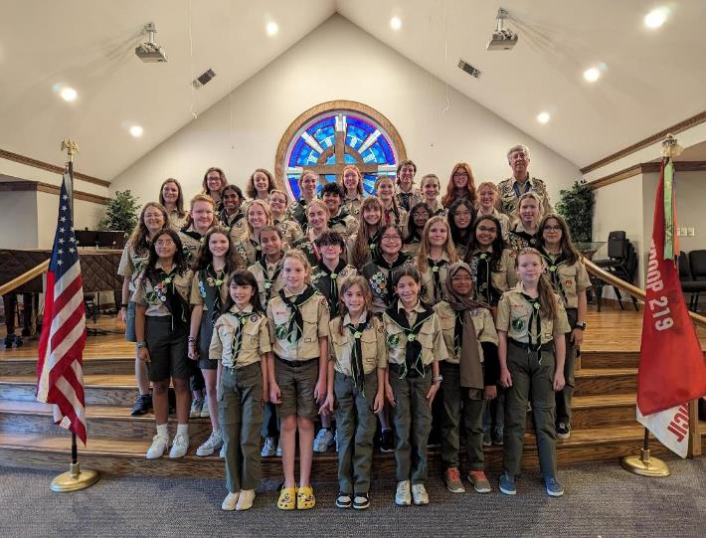
Troop 219
Old North State Council
Greensboro, North Carolina

Slide 51
Every Scout Is A Story
Tens of thousands of Scouts BSA girls = Tens of thousands of stories!
These stories can be fertilizer for membership growth!
The key to using stories to grow membership is “STORYSHOWING™” rather than storytelling

Slide 52
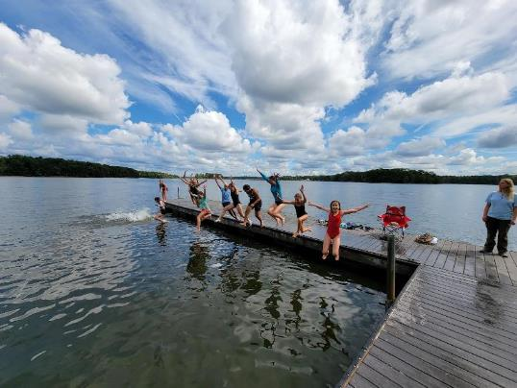
Know The Audience
What do girls want?
FUN
Who do they want to have fun with?
FRIENDS
When do they want to have fun with friends?
NOW

Slide 53
In Showing a story ….
Potential Scouts must see themselves having FUN with FRIENDS NOW!

Slide 54
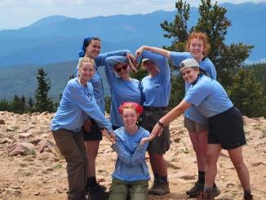
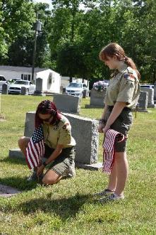
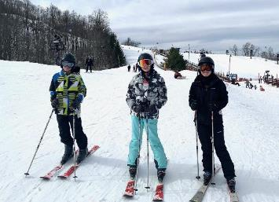
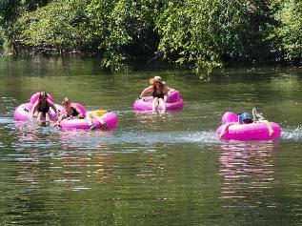
Scouting is a stream of great stories

Slide 55
If you’re short on stories ….
MAKE SOME!
If you promise Fun With Friends Now …
DELIVER
Retention is as necessary as inviting is for membership growth

Slide 56
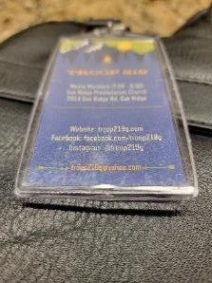
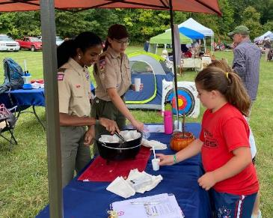
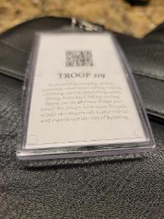
How Do We Show Stories?
Person-to-Person: Scout-to-Scout & Mom-to-Mom

Slide 57
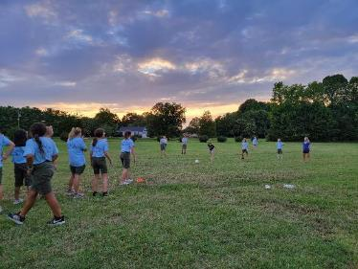
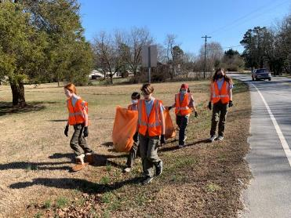
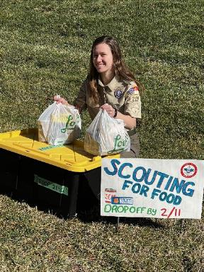
How Do We Show Stories?
Scouting Out Loud

Slide 58
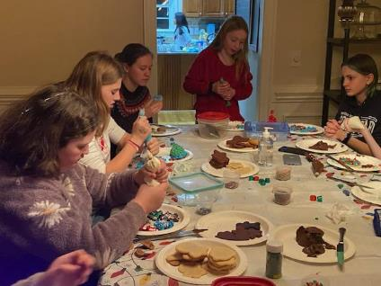
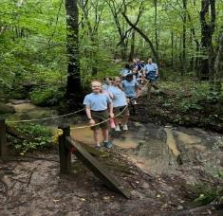
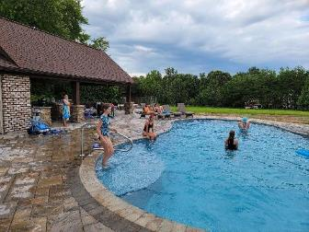
How Do We Show Stories?
Firsthand Experiences
Normal Friend Activities, Scout For A Day, Special Camp-O-Rees

Slide 59
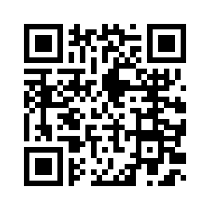
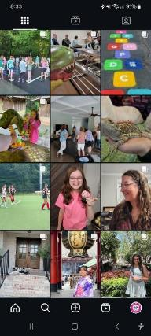
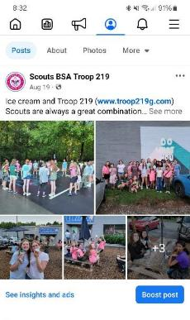
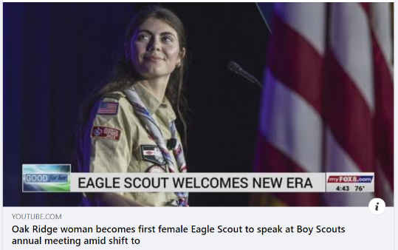
How Do We Show Stories?
Social and Traditional Media
https://www.youtube.com/watch?v=Ul7YARRBBNE

Slide 60
STORYSHOW THE GREAT STORIES OF SCOUTING
Everyone is responsible for growing Scouting
A culture of inviting and retaining must be a focus
More Scouts = more stories
More Stories = more scouts

Slide 61
Following your council’s membership plan
Ron Timmons
Director, Council Services, Scouting America

Slide 62
Closing thoughts
Freddy Norton

