Slide 1
Welcome to the
national fall kickoff!
Freddy Norton
Chair, National Membership and Relationships Committee

Slide 2
Tonight’s topics
A Message from our National Chair
A Message from our Chief Scout Executive
Fall Media in Support of Recruitment
Best Practices and Recruiting Tips
Membership Engagement
Following Your Council’s Membership Plan
A Message from our National Commissioner

Slide 3
Safety Moment
Faye Hammonds
Council Services Territories 14 Membership Lead

Slide 4
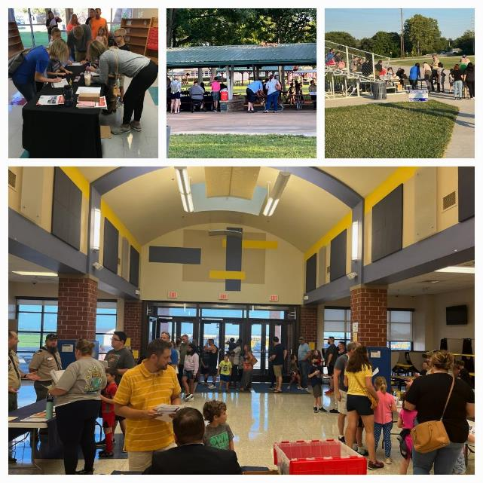
Safety Considerations for Recruitment Events
Parking lot lighting
Parking lot monitors
Safe placement of yard signs
Sign placement for visibility

Slide 5
Our collective objective
235 Councils, 38,407 units, One Brand, One Movement!
Freddy Norton
Chair, National Membership and Relationships Committee

Slide 6

Scouting America
Our Collective Objective
1,075,000
1,030,862 Youth Year-end 2024
287,686 To Go
Updated July 31, 2025– Council Membership Tools

Slide 7
A message from the chair
Brad Tilden
National Chair, Scouting America

Slide 8
A message from the chief scout executive
Roger Krone
CSE, President and CEO, Scouting America

Slide 9
Scouting America Brand
Michael Ramsey
SVP and Chief Marketing Officer, Scouting America

Slide 10


2025 Fall Campaign:
Scouting Surround Sound
Retargeting Ads
PR/Earned Media
Website Display Ads
Influencer Content
Google Search Ads
Social Media Ads
Video Pre-Roll Ads
Streaming TV
Content Integration

Slide 11
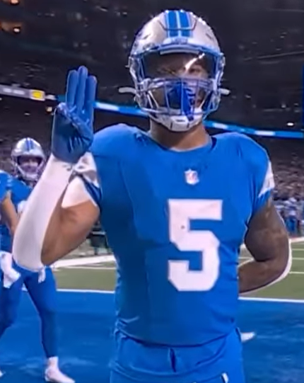
David Montgomery
Fall 2025

Slide 12




…Streaming on National Television

Slide 13






Fall Recruiting Update
Since launch, the paid campaign has delivered:
Live Activations: Paid Search, Cluep, Paid Social, Disney+, Hulu, ESPN & ScaryMommy
3.7M+ Impressions
1.9+M video views
38,000+
visits to beascout.org
40% Increase in Visits to BeAScout.org Since Aug 1, 2024

Slide 14
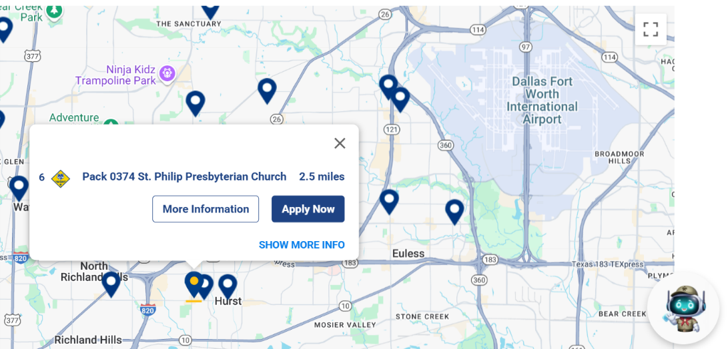
Follow Up on BeAScout!

Slide 15
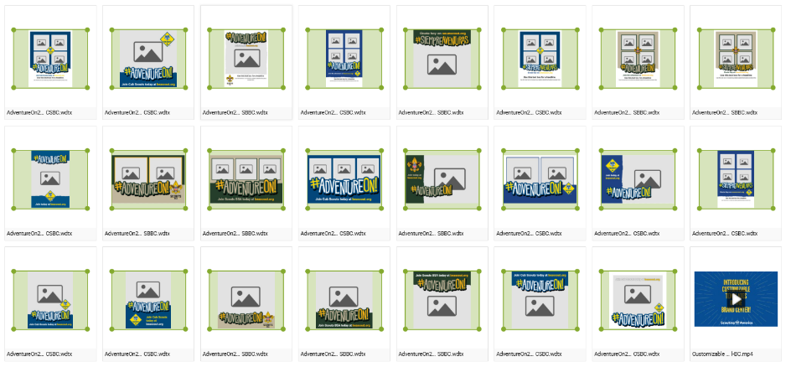
NEW! Customizable Templates

Slide 16
Best Practices and Recruiting tips
Ben Buckelew
Director of Field Service
Atlanta Area Council
Chris Crowley
Deputy Scout Executive
Central Florida Council
Wendy Nelson
Director of Field Service
Greater Alabama Council

Slide 17
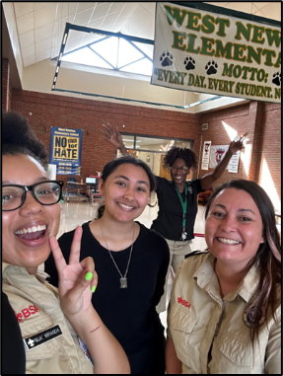
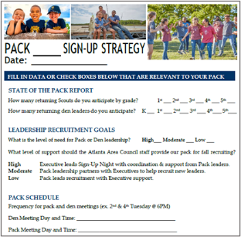
Volunteer and Staff Collaboration
Work together to:
  Assess leadership needs
  Review assigned schools
  Establish recruiting capacity/goal
  Sign-up logistics
  Share resources for youth & adults
“New families that meet a unit leader (volunteer) the night of the signup are more likely to come to the first meeting and stay in Scouting."​
Ben Buckelew
Director of Field Service
Atlanta Area Council

Slide 18
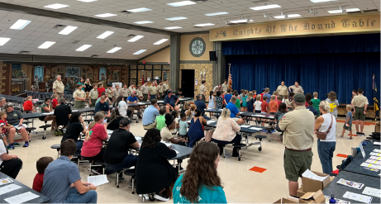
Signup Night 101 – Helpful Tips
Preferred days Tuesday, Wednesday and Thursday
There is a difference between a sign-up night and
a parent orientation night
Location of signup night at school
Yard signs and posters
Flyers sent home with students
In-classroom rallies
Signup night – keep it brief (not a Pack Meeting)
Wendy Nelson
Director of Field Service
Greater Alabama Council

Slide 19
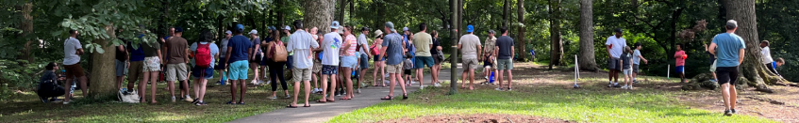
Traditional Recruitment
Back to the Pack Event - Fun Location ​
Fun Event to Welcome back existing leaders
and Scouts​
​
School Open House – At The School ​
Meet Your Teacher/Registration Day​
​
Sign-Up Event – At The School ​
Objective Is To Register New Families​
Fun Pack Event – Fun Location​​
First Event For New And Existing Families​​
​​
Parent Orientation – Practical Location ​​
Onboarding Session for New Parents – Every Parent Helps​
Ben Buckelew
Director of Field Service
Atlanta Area Council

Slide 20
Limited School Access
Flyers, yard signs, posters
Scout talk video announcements
Peer-to-peer recruitment
Social media
Chris Crowley
Deputy Scout Executive
Central Florida Council

Slide 21
Non-Traditional Recruiting
In geographical areas where school access is difficult, or in some cases not allowed…in all cases we want to get the flyers in the hands of youth and ultimately parents

Slide 22
New Member coordinator
New Member Coordinator (NMC)
This individual can be listed as the contact on your BeAScout pin.
They serve as a valuable resource to help new families get connected and feel welcome.
Check Out These Cool Items!
Explore great merchandise available through Outfitters.
All products are made on demand and will ship within a few days.

Slide 23

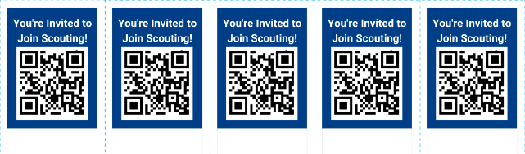
PEER TO PEER Recruitment

Slide 24


SCOUTING FOR EVERYONE

Slide 25
Social Media
Social Media Marketing
within Facebook (Meta)
with Geofencing

Slide 26
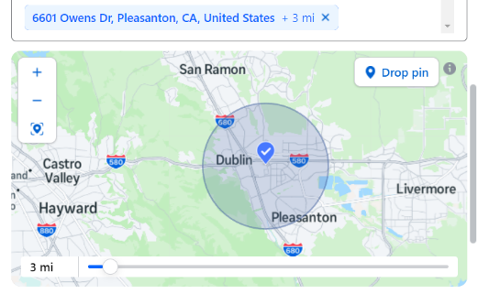
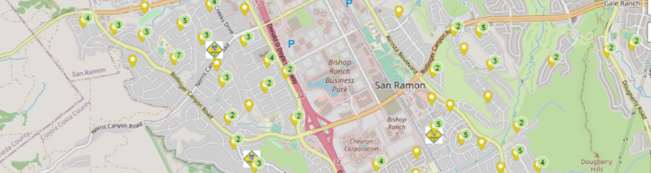
Geofencing on Facebook (meta)
What is Geofencing?
  Geofencing is a way to make a targeted ad through social media or on the web, Here we will focus on Facebook or what is now known as Meta. This includes Instagram. The idea being you take an event and make an ad to be marketed with geographic borders and age demographics in the social media ad algorithm. (Examples being; Addresses, zip codes, age range, parents, interests, etc.)

Slide 27
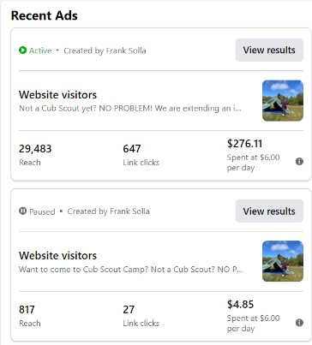
Social Media Best Practices
Follow These Few Steps for Success!
Marketing team should work with Field Staff and Unit Leaders to plan sign up events and promotion on social media in advance. Start ads 10-14 days from sign up date.
Learn or know your audience or local market. Use creatives and language to match them. Make multilingual an option.
Create geofence campaigns within Ads Manager on Facebook (Meta). Use a physical target address so that Meta will allow you to radial geofence down to a 1-mile square radius. If you use City/Zip code radius minimum targeting is 5 miles. A big difference. So, choose wisely.
Set Ads to run throughout the Meta Platform that include Instagram.

Slide 28
New Packs
Pack capacity – avg sized units
Pack to school ratio
Pack to troop ratio
5th grade girls – Do they have a troop?
Ben Buckelew
Director of Field Service
Atlanta Area Council

Slide 29
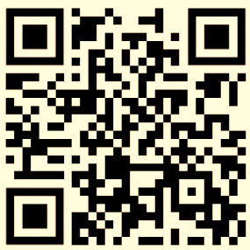
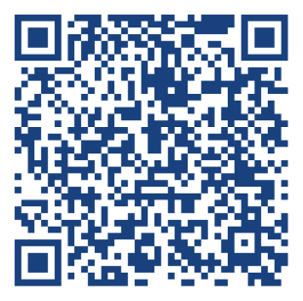
Membership & Unit Renewal Reminder
Short Video on how to renew your Scouting America membership
Membership and Unit Renewal Landing page
Chris Crowley
Deputy Scout Executive
Central Florida Council

Slide 30
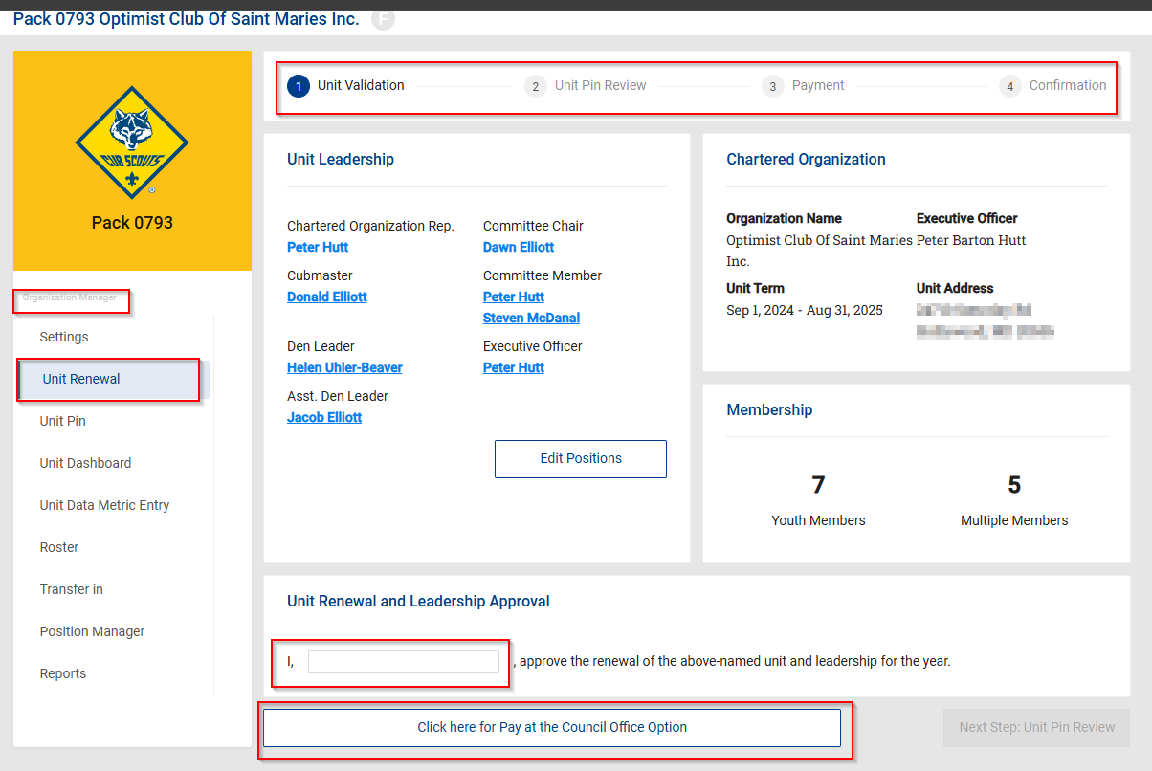
Unit Renewals
30

Slide 31
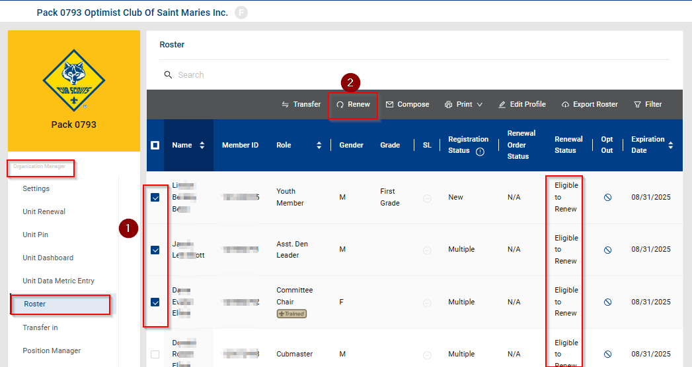
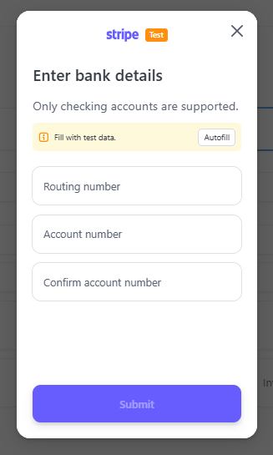
Unit Membership Renewals
31

Slide 32
Membership Engagement
Sean Magennis
EVP, Membership Engagement

Slide 33
Following your council’s membership plan
Chuck Brasfeild
EVP, Council Operations

Slide 34
Closing Thoughts
Devang Desai
National Commissioner, Scouting America

