Slide 2
Welcome to the
scouts bsa membership kickoff
Ken Gordon
Chair, Growing Scouting
National Commissioner Service Team
National Membership Committee

Slide 3
Tonight’s topics
A Message from our Chief Scout Executive
The Scouting America Brand
Troop and Pack Partnership
Scouts BSA Middle School Recruitment
Dynamic Peer-to-Peer Inviting
Following Your Council’s Membership Plan

Slide 4
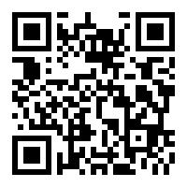
Are you recording this?
Yes!
www.scouting.org/recruitment

Slide 5
Safety moment
Hali Thompson
Troop Committee Chair, Troop 175
Central Florida Council

Slide 6
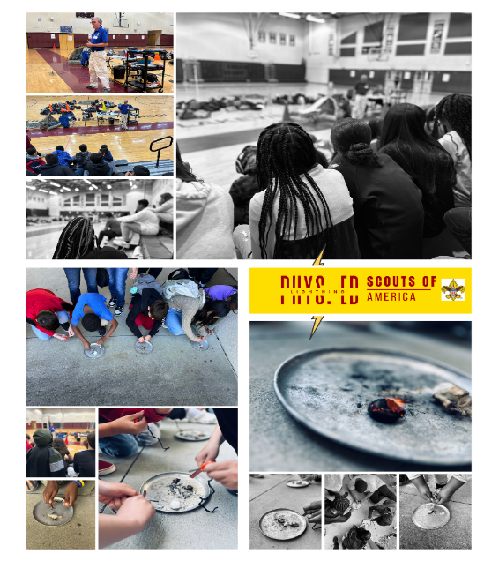
Safety Considerations for Recruitment Events
Parking lot lighting
Parking lot monitors
Safe placement of yard signs
Sign placement for visibility

Slide 7
A message from the chief scout executive
Roger Krone
CSE, President and CEO, Scouting America

Slide 8
Our collective objective
235 Councils, 38,407 units, One Brand, One Movement!
Jerry Case
Vice Chair, National Membership Committee

Slide 9

Scouting America
Our Collective Objective
1,075,000
1,030,862 Youth Year-end 2024
290,969 To Go
Updated August 7, 2025– Council Membership Tools

Slide 10
Fall Media Campaign
Michael Ramsey
SVP and Chief Marketing Officer, Scouting America

Slide 12


2025 Fall Campaign:
Scouting Surround Sound
Retargeting Ads
PR/Earned Media
Website Display Ads
Influencer Content
Google Search Ads
Social Media Ads
Video Pre-Roll Ads
Streaming TV
Content Integration

Slide 13
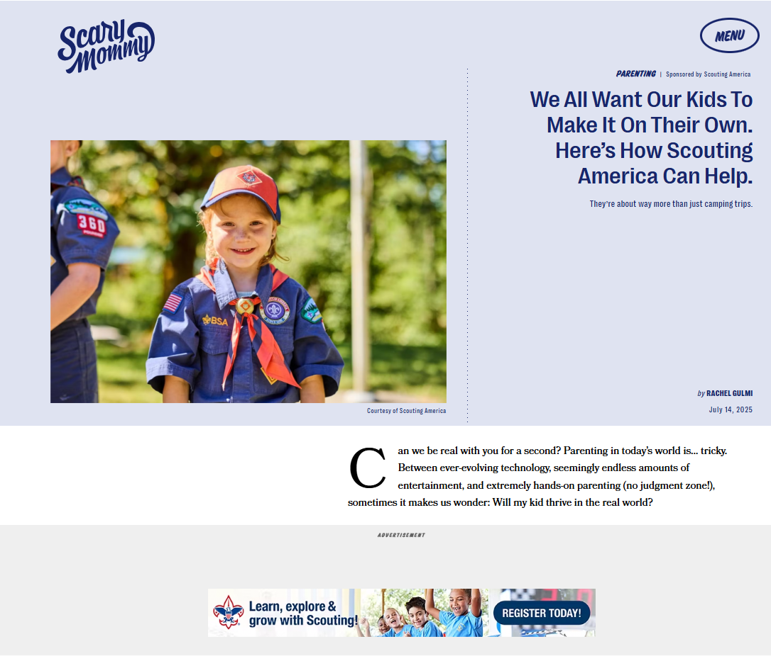
Content Integration
6 Million
Followers

Slide 14
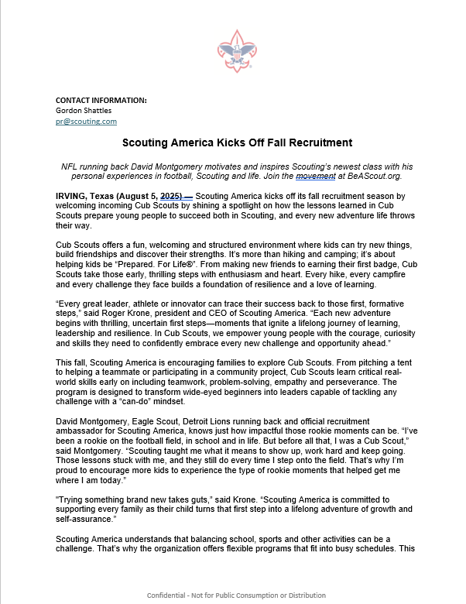




Earned Media

Slide 15
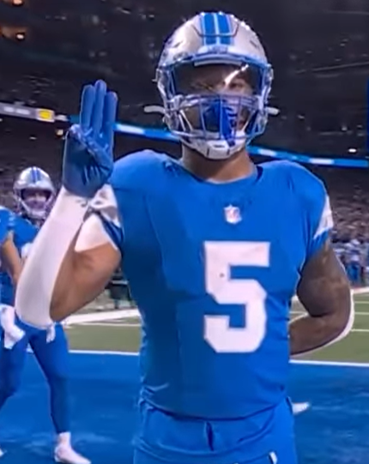
David Montgomery
Fall 2025

Slide 16
And For the First Time…

Slide 17




…Streaming on National Television

Slide 18






Fall Recruiting Update
Since launch, the paid campaign has delivered:
Live Activations: Paid Search, Cluep, Paid Social, Disney+, Hulu, ESPN & ScaryMommy
3.7M+ Impressions
1.9+M video views
38,000+
visits to beascout.org
40% Increase in Visits to BeAScout.org Since Aug 1, 2024

Slide 19
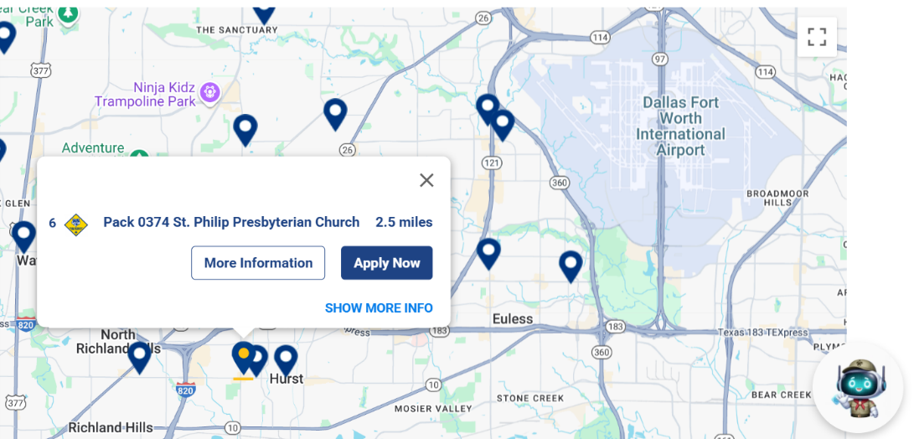
Follow Up on BeAScout!

Slide 20
Leverage the Campaign in Your Community!

Slide 21
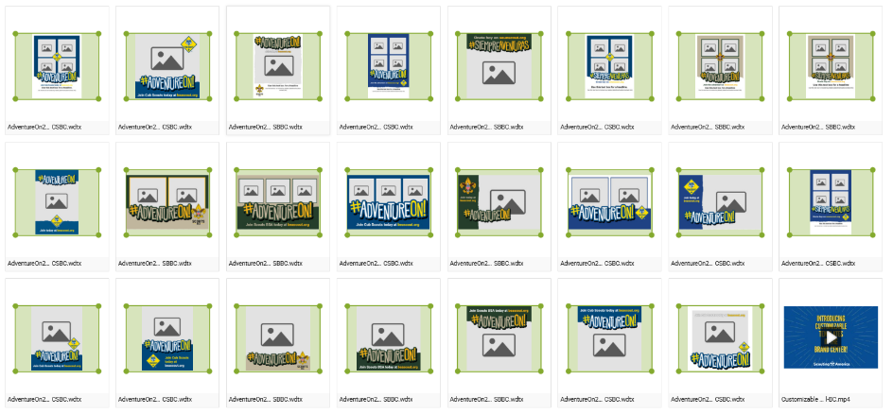
NEW! Customizable Templates

Slide 23
Troop and Pack partnership
Ben Buckelew
Director of Field Service
Atlanta Area Council

Slide 24

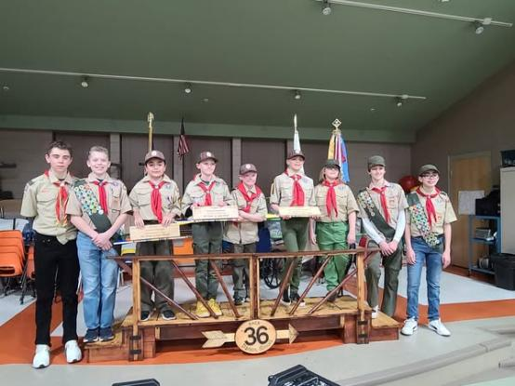
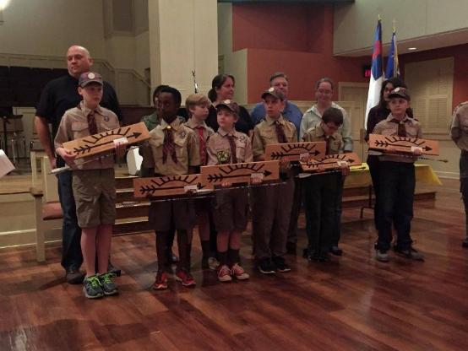

Troop and Pack partnership

Slide 25
Scouts BSA middle school recruitment
Chris Crowley
Deputy Scout Executive
Central Florida Council

Slide 26


Middle School Recruitment

Slide 27



Setting the Stage

Slide 28


School Relationships

Slide 29
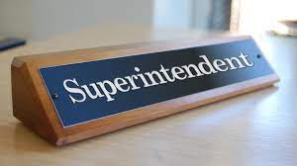

Superintendent Visits

Slide 30

Principal Visits

Slide 31

Scoutmaster Visits

Slide 32
The in-school rally

Slide 33
The in-school rally setup
Mock campsite setup with tents, hiking backpacks, kayak, high adventure items, etc.
  Area setup to test the fire starter
Each period social study classes come (class by class) to visit the campsite to listen and interact for 12-15 minutes.

Slide 34
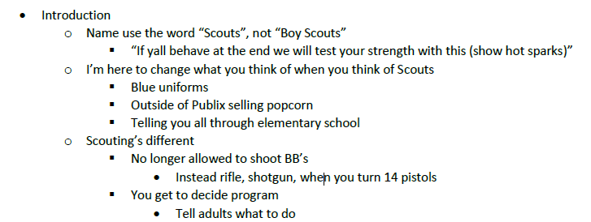
The rally itself

Slide 35
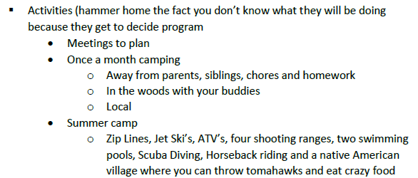
The rally itself

Slide 36
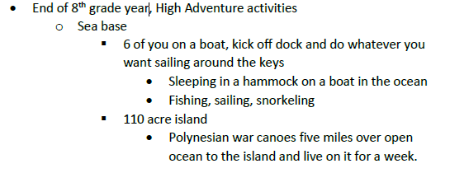
The rally itself

Slide 37
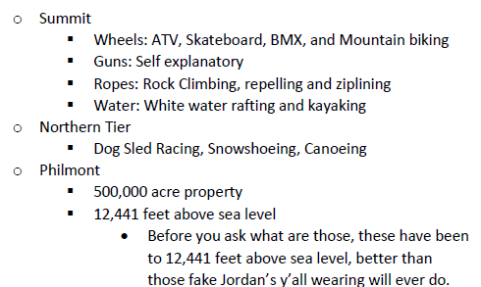
The rally itself

Slide 38
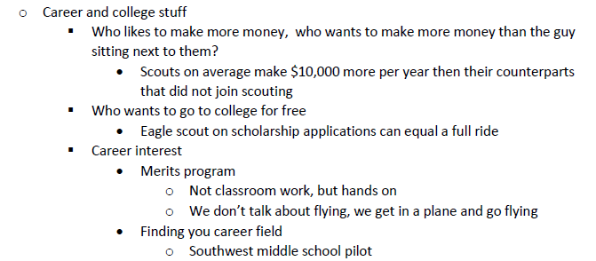
The rally itself

Slide 39
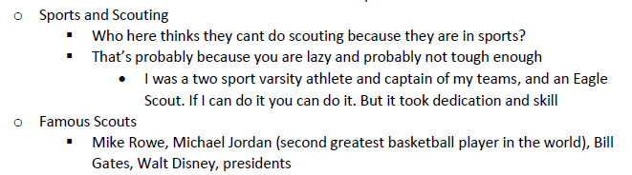
The rally itself

Slide 40

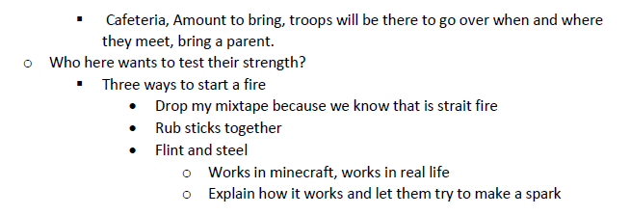
The rally itself

Slide 41
The rally itself
Tomorrow’s meeting
  Time, location, bring a parent
Who thinks they are tough and wants to test their strength
  Pick a volunteer to try to start a fire using the fire starter
  Show after the volunteer
Give out flyers to take home…

Slide 42
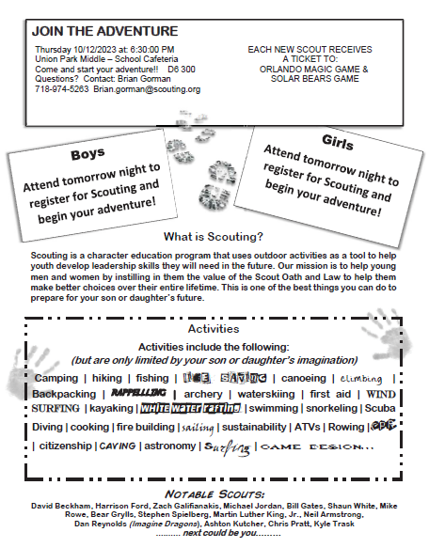



Flyer
Takes middle schooler or parent to website to gain more information and register online

Slide 43
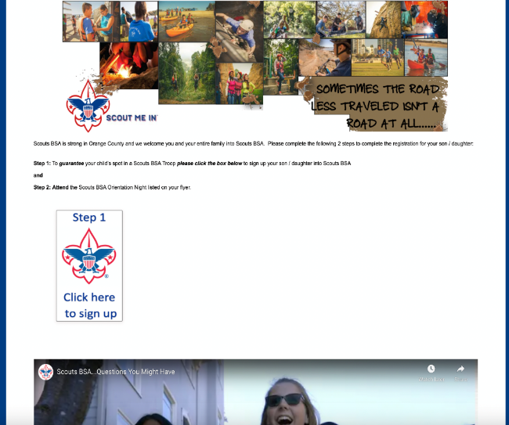
www.JoinScoutsFL.com
Website

Slide 44



School Night
Mechanics

Slide 45
Items to Bring
2 Presenters (One District Executive, One Lead Volunteer
from District Membership Team)
Junior Leaders (SPL’s and ASPL’s) and Adult Leaders from
Area Troops
Each Troop will setup a Display Board to highlight their strengths
Youth Applications
Change for registration fee
Popcorn Family Guides
Orlando Magic Ticket Vouchers

Slide 46


School Night Agenda

Slide 47
School Night Agenda
6:20pm: Arrive with Lead Volunteer from District Membership Team.
6:30pm: Junior Leaders and Adult Leaders from Area Troops arrive and begin to setup Display Boards.
6:35pm: Meet with all Scouts and Scouters and go over Middle School Night plan for evening.
6:45pm: Junior Leaders are stationed at entrances and doors of Middle School to welcome new families. When families arrive they “check in” and receive youth application and popcorn family guide.
7:00pm: Open the evening with Opening Ceremony lead by Junior Leaders.
7:02pm: Lead Volunteer from District Membership Team gives overview of Scouting.

Slide 48
www.JoinScoutsFL.com
School Night Agenda
7:12pm: Junior Leaders give short overview / highlights of their Troop
7:25pm: New families visit Troops at their displays and are instructed once they are ready to complete electronic application or fill out youth application and submit at “check out” area. At this
point, once youth application is received at “check out” new
Scout will receive Orlando Magic Basketball Ticket Voucher
and hot spark.
7:45pm: Lead Volunteer from District Membership Team, District
Executive and Adult Leaders from Area Troops meet to
debrief and develop action plans for new Scouts
8:00pm: School Night Ends

Slide 49
Some Middle School Nights get 50-60 new Scouts in one night

Slide 50
Dynamic Peer-to-Peer Inviting: Making Scouting Contagious Year-round
Mike Matzinger
Troop 219G and Troop 600B Scoutmaster
Membership Lead for Council Service Territory 15

Slide 51
How Scouts Join Troops is Changing
What do you see when you ask....
"Raise your hand if you joined the Troop because a friend invited you?"
The majority of Troops that are growing today have shifted from "static recruiting" to "dynamic inviting"

Slide 52
Why Peer-to-Peer Inviting Works
Trust Factor – friends trust friends more than flyers
Relevance – youth know what their peers find fun and exciting
Compare someone seeing a flyer vs. being personally invited to a campfire or an overnight hiking trip

Slide 53
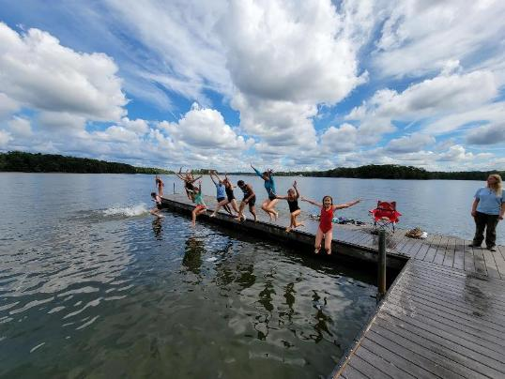
Benefits of an Elevator Pitch
A quick message
Great for hallway chats and lunch breaks
Quick and casual
Confidence-building
More likely to be repeated

Slide 54
Use the Acronym C.A.M.P.
Connection
Activity
Meaning
Pitch

Slide 55
CONNECTION
Start with something personal or relatable.
  “I know how you like building stuff…”
  “Remember that time you said you wanted to try rock climbing?”

Slide 56
ACTIVITY
Mention a cool thing you’ve done in Scouting.
“We built catapults and launched tennis balls across the field.”
“We cooked chili over a fire we built ourselves.”

Slide 57
MEANING
Share why it mattered or was fun.
“It made me feel independent—like I could actually survive outdoors!”
“It’s fun doing stuff without screens and just hanging out.”

Slide 58
PITCH
End with a clear, low-pressure invitation.
“You should come to our next meeting and try it.”
“Want to come to the rocket launch next weekend?”

Slide 59
Create Pitch-Builder Cards
My favorite Scout activity is ...
Why I liked it is because …
What I'd say to a friend is ...

Slide 60
Practice but Keep It Low Stress
Pair Scouts up to swap and share pitches
Run a "1-Minute Pitch" round at troop meetings
Pitch card game – flashcards with Scouting activities
Let them record themselves on a phone

Slide 61
Barriers and How to Overcome Them
Fear of rejection? Normalize it. Not everyone will say yes – and that's ok.
"My friends won't be into it." Remind them: focus on shared interest – like the outdoors, adventure, service – not on the "organization."
Over-explaining kills interest. Keep it simple. Just say: "Come see it for yourself."

Slide 62
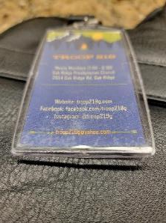
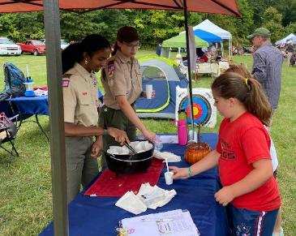
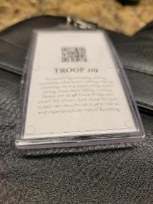
Provide the Tools
Pocket Cards and Opportunities

Slide 63
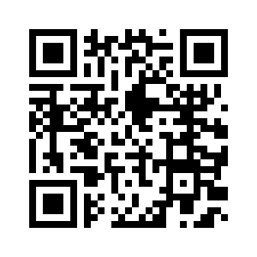
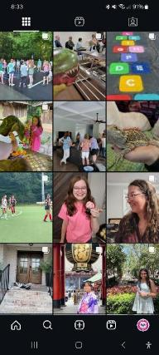
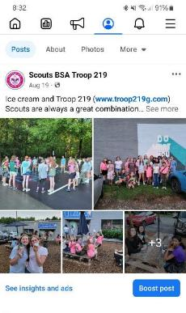
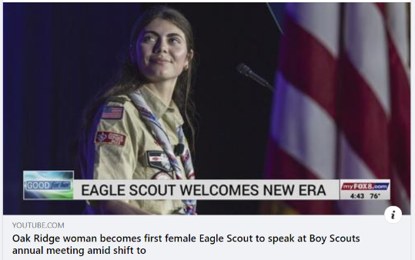
Provide the Tools
Social and Traditional Media
https://www.youtube.com/watch?v=Ul7YARRBBNE

Slide 64
Challenge and Incentives
Now that you've equipped them with tools, let's give them a mission -
"Each Scout bring one friend in the next 30 days."
Offer fun motivators:
Pizza night for the patrol with the most invites
The recruiter patch
Recognition at a court of honor

Slide 65
Following your council’s membership plan
Otto Goedhart
Manager Membership Growth, Scouting America

Slide 66
Closing thoughts
Ken Gordon

