Slide 2
Welcome to the
scouts bsa Spring Recruitment kickoff
Freddy Norton
Chair, National Membership and Relationships Committee

Slide 3
Tonight’s topics
Opening Remarks
Scouting America Marketing update
National High Adventure Bases
Middle School Recruitment
Peer-to-Peer Recruitment
Following your Council’s Membership Plan

Slide 4
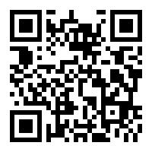
Are you recording this?
Yes…
www.scouting.org/recruitment

Slide 5
Safety moment
Tree Kiester
Director of Environmental, Health & Safety,
Scouting America

Slide 7
Ken Gordon
Chair, Growing Scouting
National Commissioner Service Team
National Membership Committee

Slide 8
Member conversion
Onboarding
Getting new Scouts to summer camp

Slide 10
Marketing and Media
Michael Ramsey
SVP and Chief Marketing Officer

Slide 11
How Do People Find Out About Scouting?
See us in the community
See us on social / digital media
Word of mouth

Slide 12

Community
Flag Raisings
Parades
Veterans Day / Memorial Days
Fourth of July
...

Slide 13


Social Media
Instagram
TikTok

Slide 14
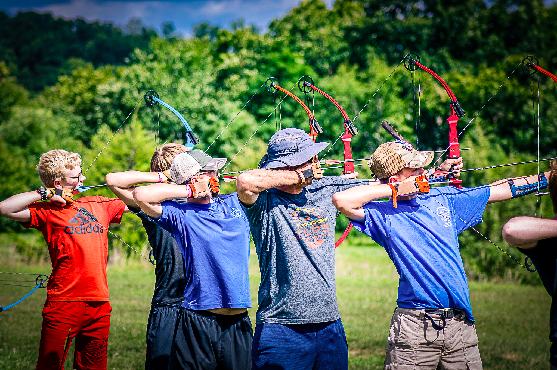
Brand Center

Slide 15
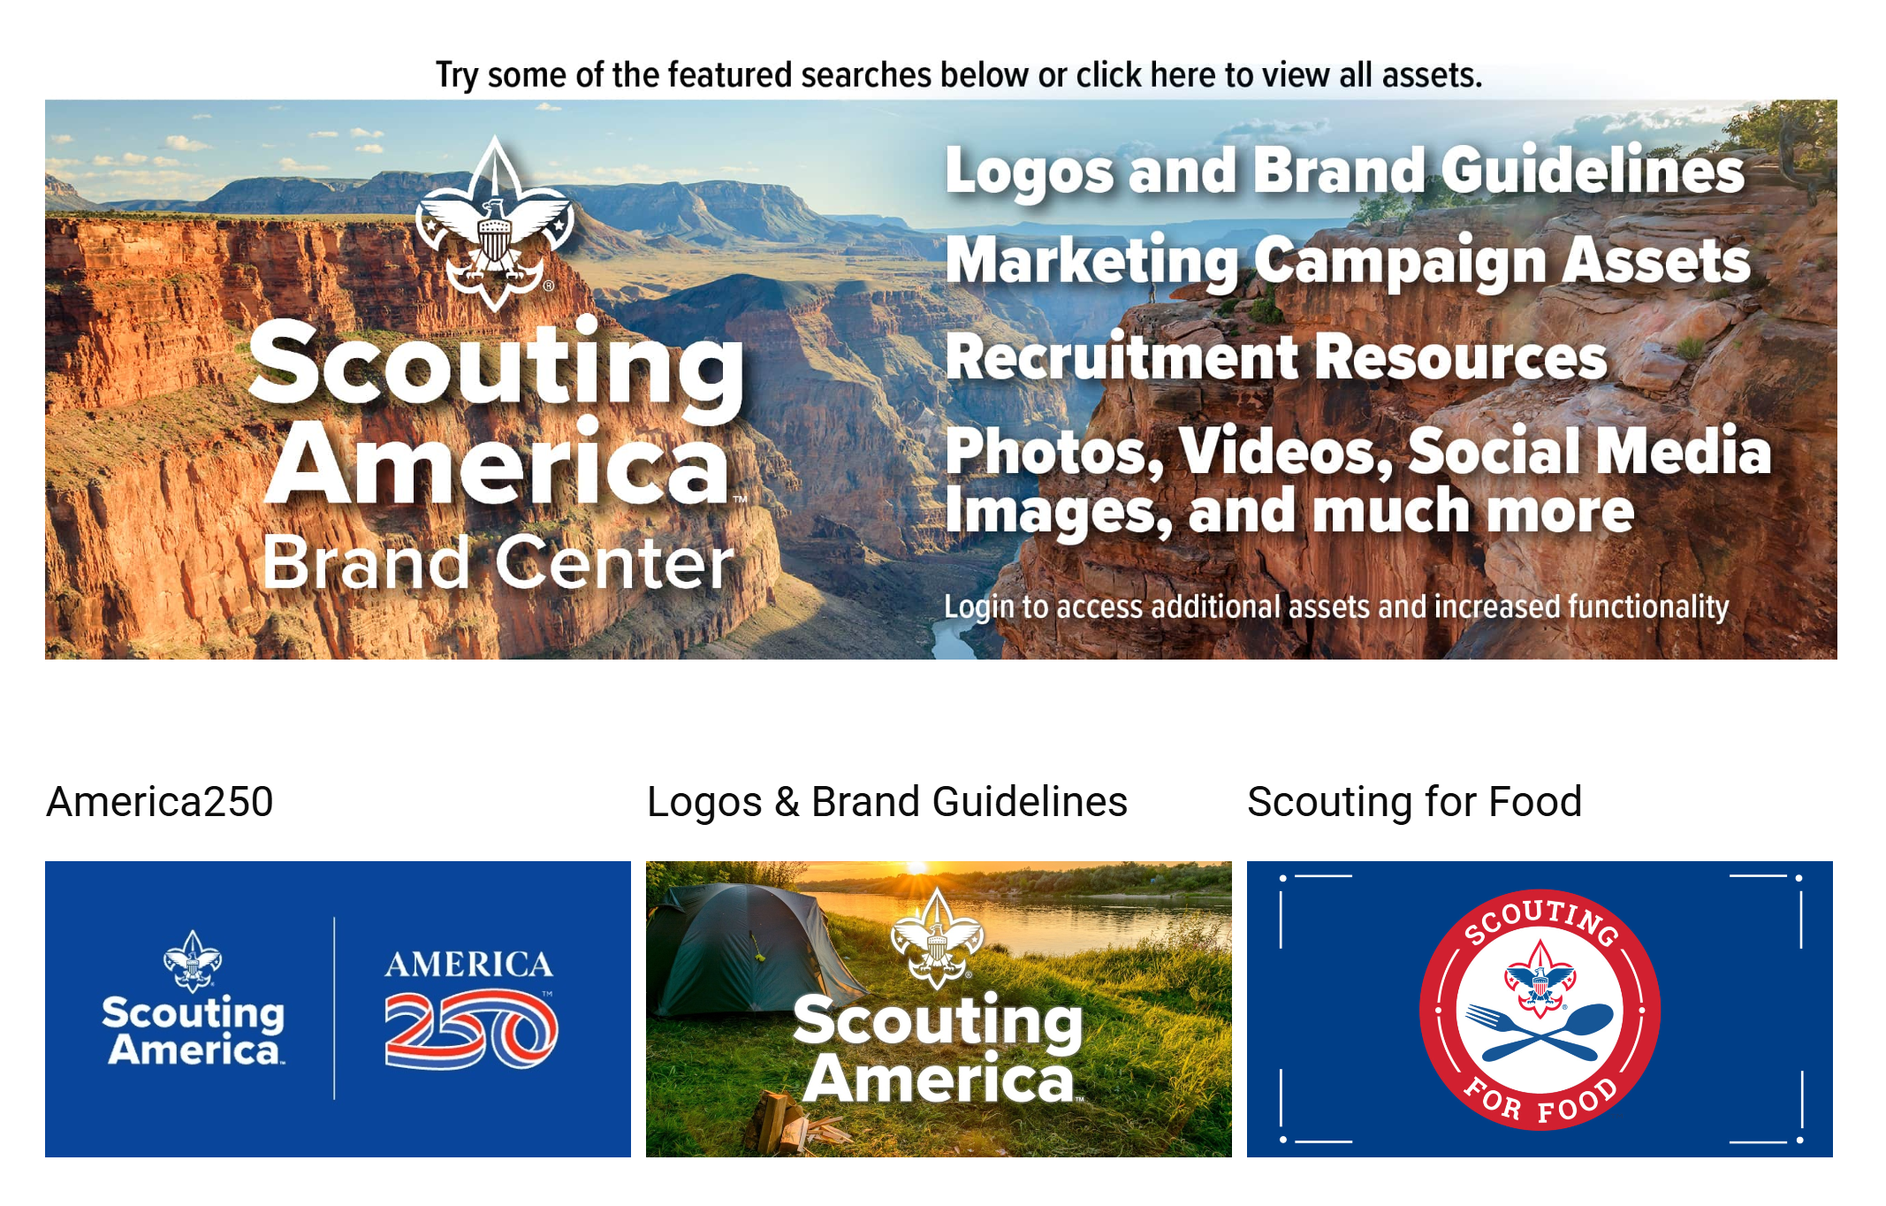
Brand Center​

Slide 17
National High Adventure Bases
Andrea Watson
General Manager, Philmont Scout Ranch
Scouting America

Slide 18
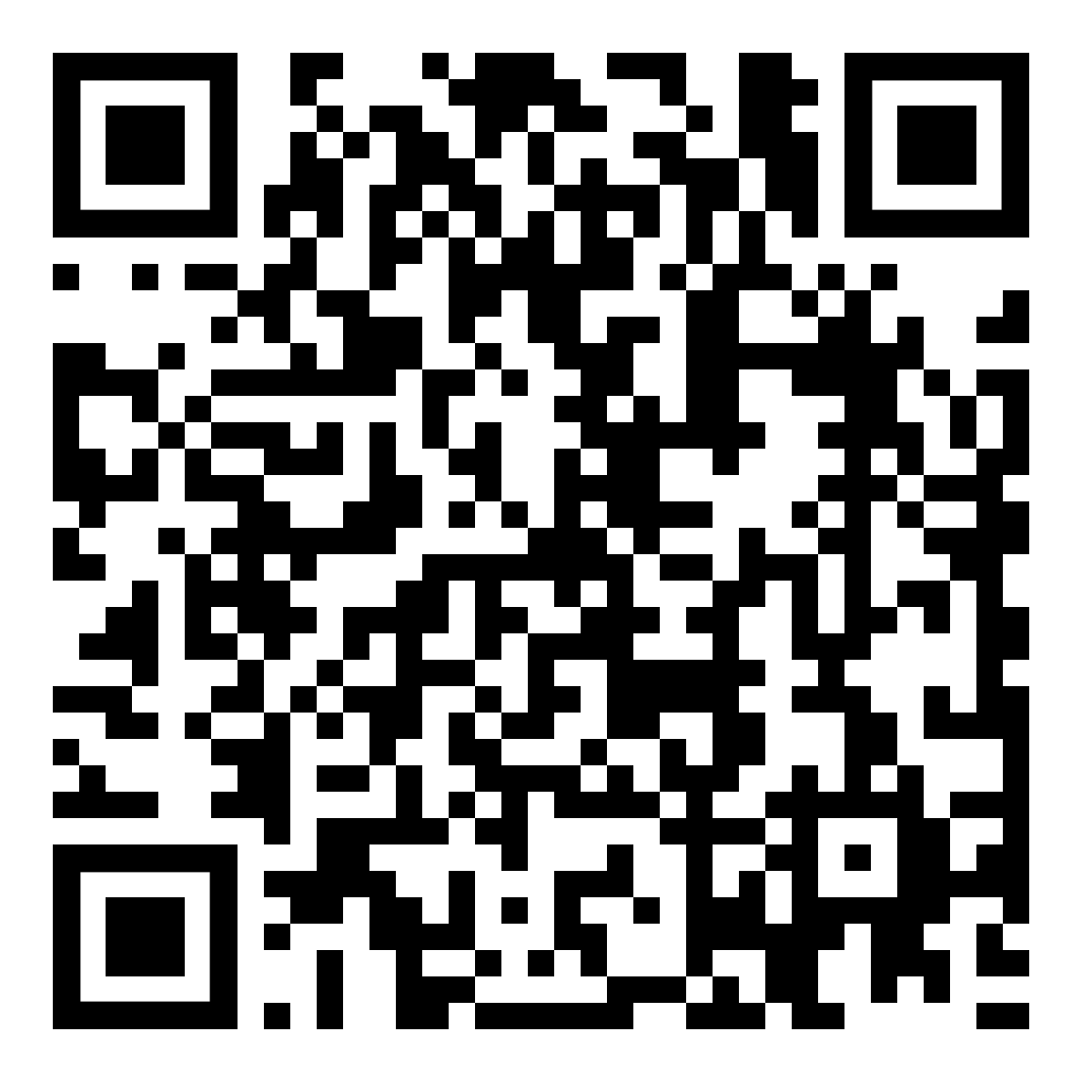
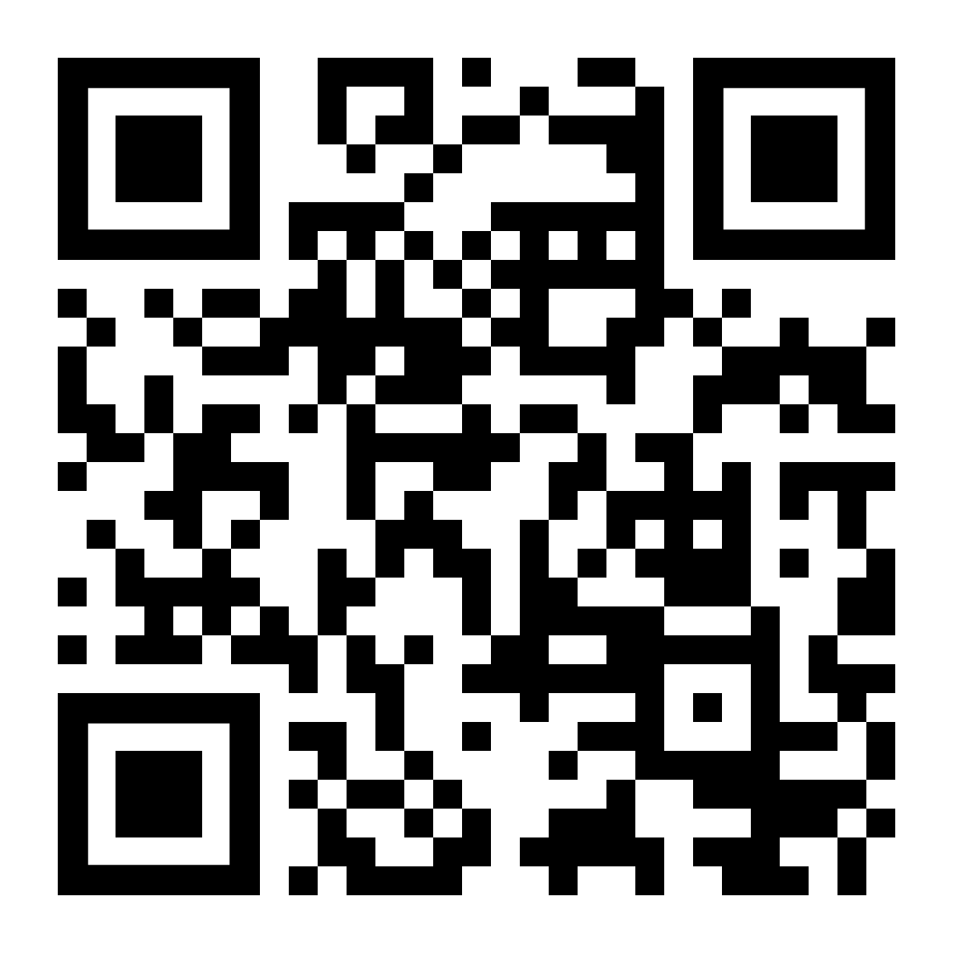




National High Adventure Bases
2026 & 2027 Registration Open Now!
LEARN MORE
WIN A PRIZE!
High Adventure Treks
Summer Camp Experiences
Family Camping
And more!

Slide 19

Membership WEek
Contact Rick Bausher with Questions:
Scoutingmemberhipgrowth@gmail.com

Slide 21
Troop and Pack partnership
Ben Buckelew
VP, Membership Engagement, Scouting America

Slide 22

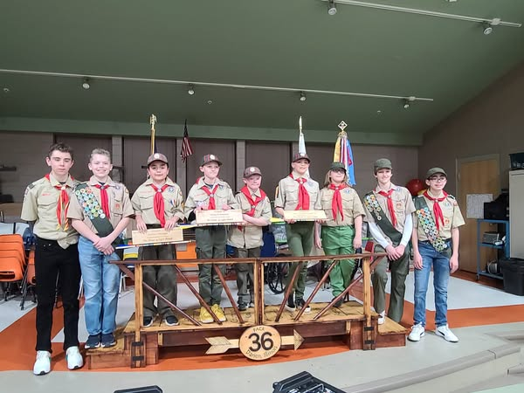
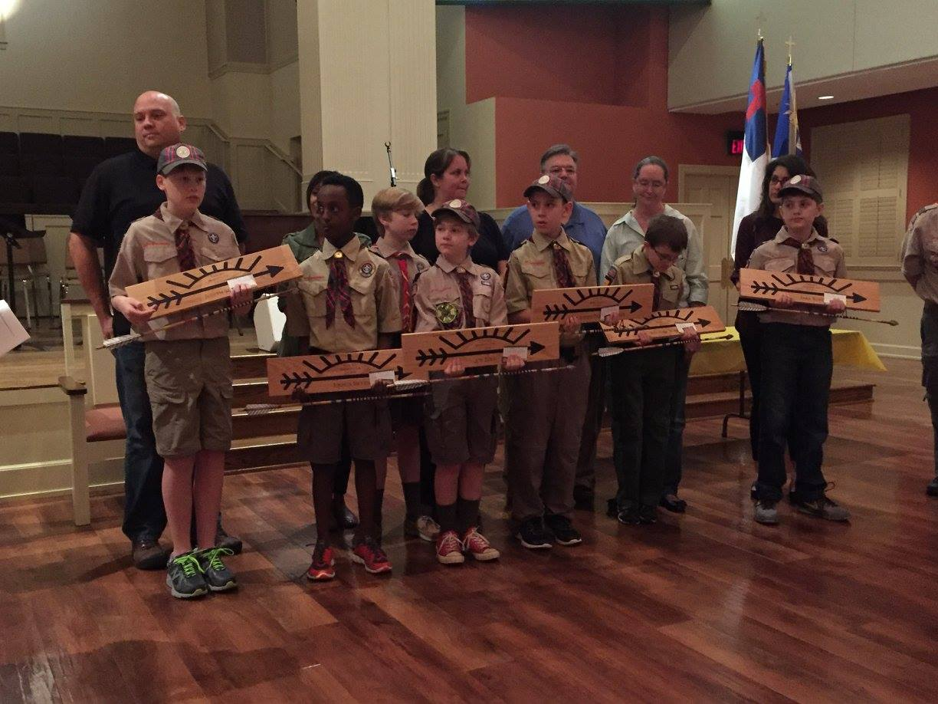
Troop and Pack partnership

Slide 23
Scouts BSA middle school recruitment
Chris Crowley
Scout Executive
Central North Carolina

Slide 24


Middle School Recruitment

Slide 25


Setting the Stage

Slide 26

School Relationships

Slide 27
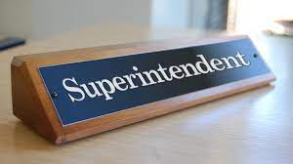
Superintendent Visits

Slide 28

Principal Visits

Slide 29
Scoutmaster Visits

Slide 30
The in-school rally

Slide 31
The in-school rally setup
Mock campsite setup with tents, hiking backpacks, kayak, high adventure items, etc.
Area setup to test the fire starter
Each period social study classes come (class by class) to visit the campsite to listen and interact for 12-15 minutes.

Slide 32
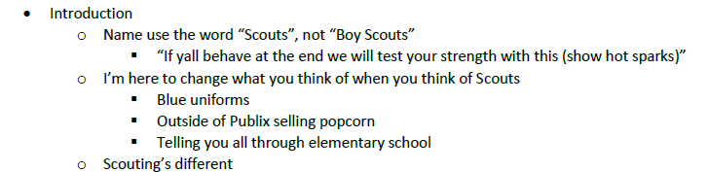
The rally itself

Slide 33
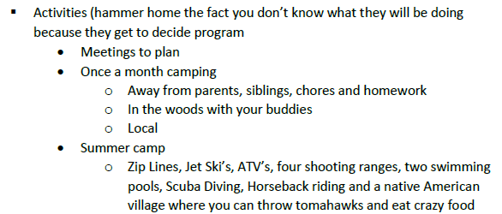
The rally itself

Slide 34
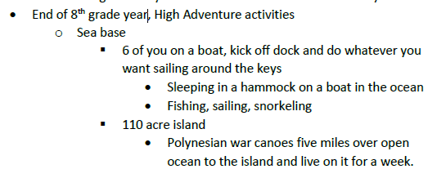
The rally itself

Slide 35
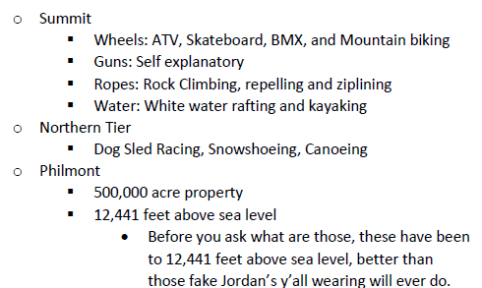
The rally itself

Slide 36
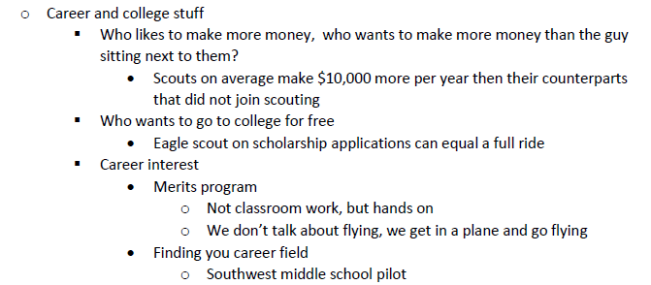
The rally itself

Slide 37
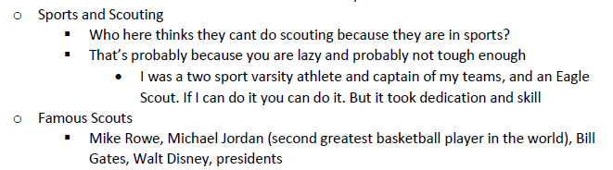
The rally itself

Slide 38
The rally itself
Tomorrow’s meeting
Time, location, bring a parent
Who thinks they are tough and wants to test their strength
Pick a volunteer to try to start a fire using the fire starter
Show after the volunteer
Give out flyers to take home…

Slide 39

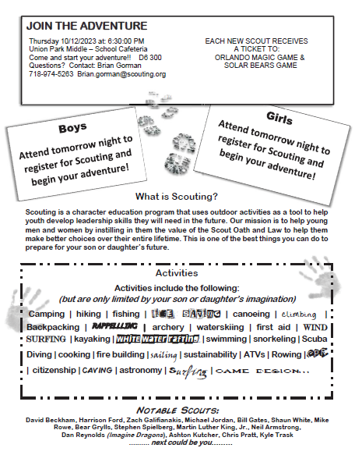


Flyer

Slide 40


School Night Mechanics

Slide 41
Items to Bring
2 Presenters (One District Executive, One Lead Volunteer
from District Membership Team)
Junior Leaders (SPL’s and ASPL’s) and Adult Leaders from
Area Troops
Each Troop will setup a Display Board to highlight their strengths
Youth Applications
Change for registration fee
Popcorn Family Guides

Slide 42

School Night Agenda

Slide 43
School Night Agenda
6:20pm: Arrive with Lead Volunteer from District Membership Team.
6:30pm: Junior Leaders and Adult Leaders from Area Troops arrive and begin to setup Display Boards.
6:35pm: Meet with all Scouts and Scouters and go over Middle School Night plan for evening.
6:45pm: Junior Leaders are stationed at entrances and doors of Middle School to welcome new families. When families arrive they “check in” and receive youth application and popcorn family guide.
7:00pm: Open the evening with Opening Ceremony lead by Junior Leaders.
7:02pm: Lead Volunteer from District Membership Team gives overview of Scouting.

Slide 44
www.JoinScoutsFL.com
School Night Agenda
7:12pm: Junior Leaders give short overview / highlights of their Troop
7:25pm: New families visit Troops at their displays and are instructed once they are ready to complete electronic application or fill out youth application and submit at “check out” area. At this
point, once youth application is received at “check out” new
Scout will receive Orlando Magic Basketball Ticket Voucher
and hot spark.
7:45pm: Lead Volunteer from District Membership Team, District
Executive and Adult Leaders from Area Troops meet to
debrief and develop action plans for new Scouts
8:00pm: School Night Ends

Slide 45
Some Middle School Nights get 50-60 new Scouts in one night

Slide 47
Peer-to-peer inviting
Mike Matzinger
CST-15 Membership Lead
Scoutmaster, Troop 219G and 600B
mike@scoutdude.com

Slide 48
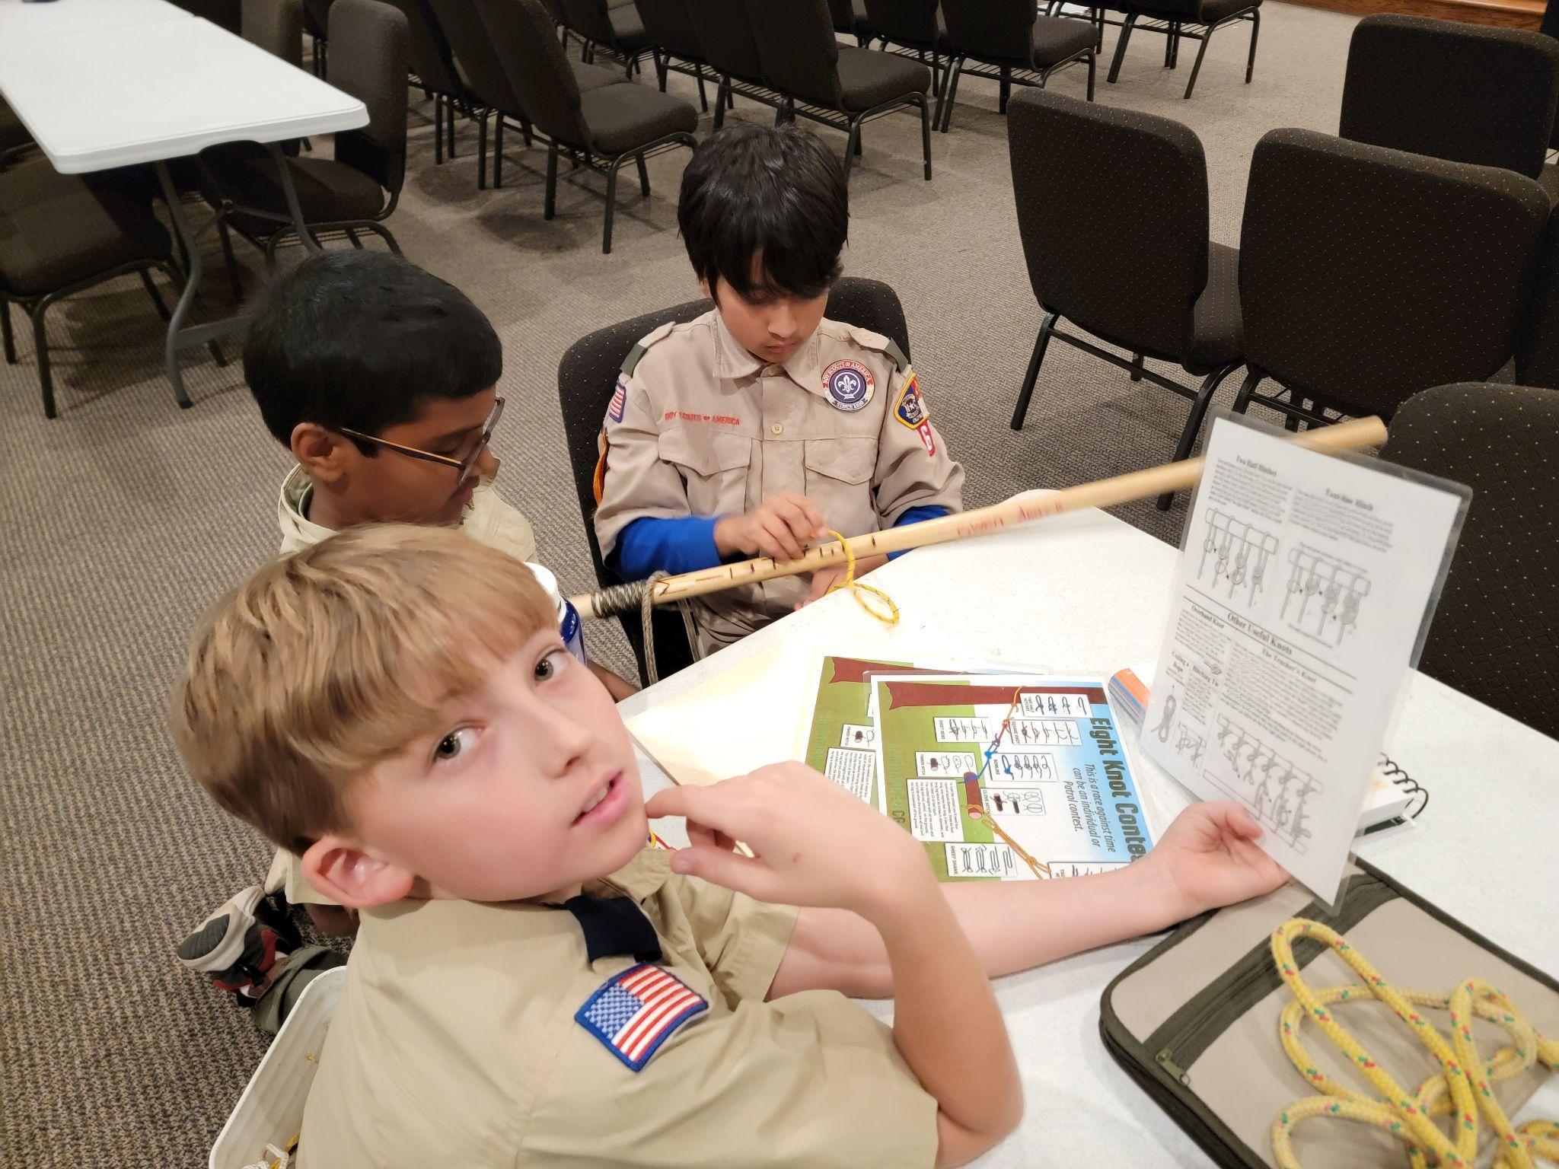
Peer-to-Peer (P2P) Benefits
Engagement
Authenticity
Leadership Development

Slide 49
Strategies for P2P Inviting – Scout Led
Let Scouts own the plan
Design plans that entice
Host a “hands-on” open house
Sponsor service projects
Attend festivals or fairs
Include Normal Friend Activities
Offer Zoom campfires

Slide 50
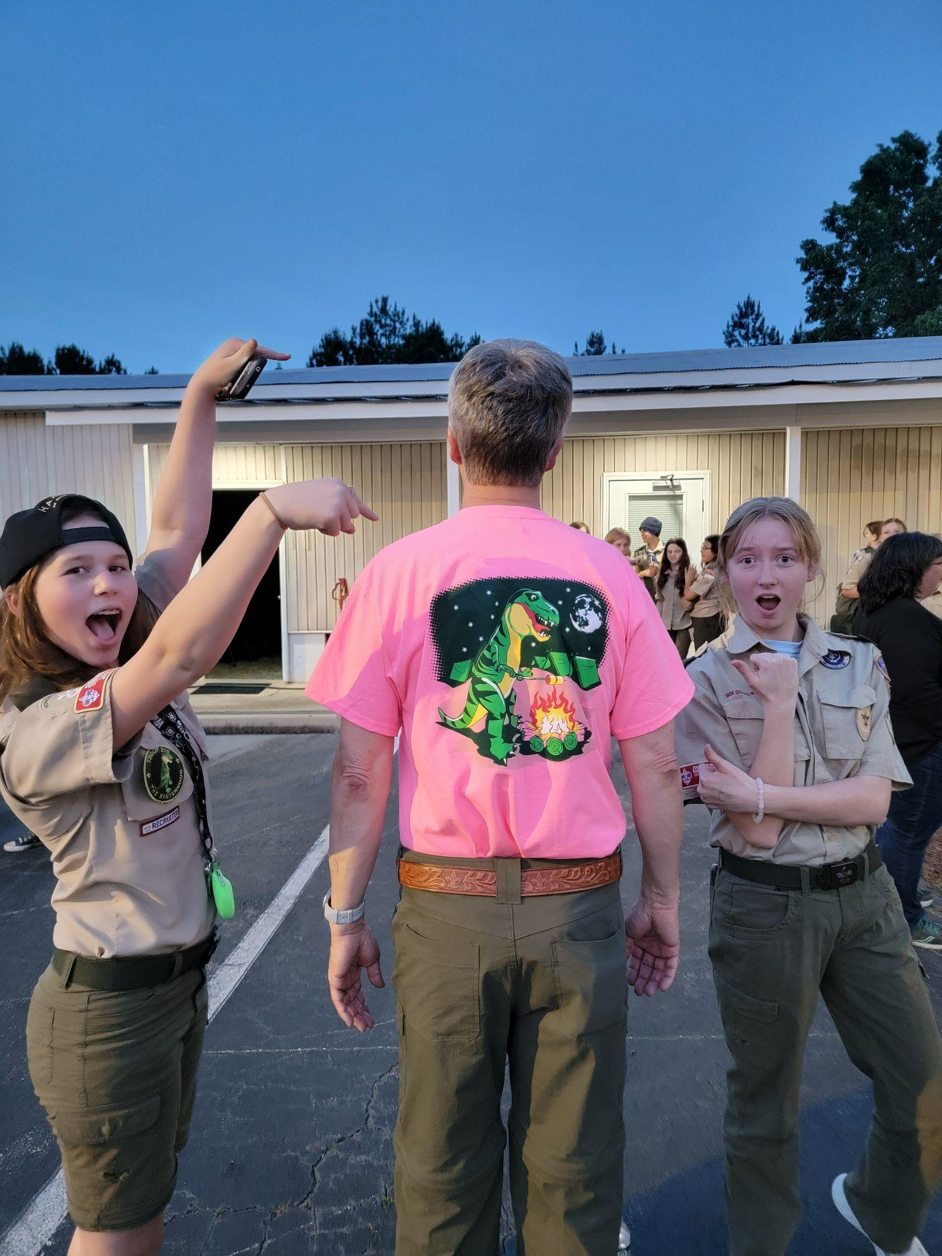
Strategies for P2P Inviting – Enabling Tools
Create invitations, handouts, flyers, calendars, and digital media
Schedule time to create and share fun (videos > photos)
Feed social media accounts (personal > troop)

Slide 51
Strategies for P2P Inviting - Welcoming Environment
Offer workshops to help Scouts feel confident sharing, inviting, and welcoming
Have an open-door policy for newcomers to join without feeling pressured
Pair visitors with a "buddy" to help them feel connected
Train older Scouts as ambassadors
Teach Patrol Leaders how to integrate a new member

Slide 52
Overcoming Common Challenges
Never force P2P inviting; an opportunity to share something exciting and meaningful
Encourage Scouts to view rejection as part of the process and not take it personally
Teach Scouts how to engage parents to learn more about the program's benefits

Slide 53
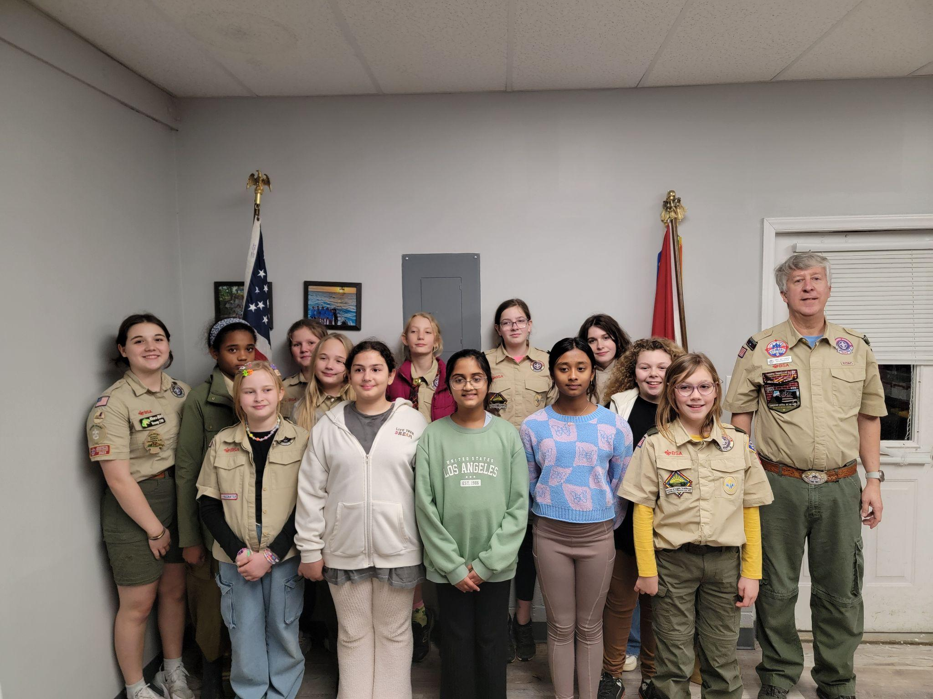
Conclusion and Call to Action
Benefits: engagement, authenticity, leadership development
Effective Strategies: Scout-led, enabling tools, welcoming environment
Next Step: PLC sets 2-3 membership SMART goals

Slide 55
Following your Council’s Membership Plan
Otto Goedhart
Manager, Membership Growth, Scouting America
Notes:
Please feel free to reach out to your local council to find out what role your unit can play in the overall council membership plan.

Slide 56
Closing thoughts
Freddy Norton

