Slide 1
MARKETING BOOTCAMP
WELCOME TO
Session 1: March 14, 2024
Session 2: March 21, 2024
7 pm CT / 8 pm ET

Slide 2
No PT!
No Expertise Needed
We Supply The Tools!

Slide 3
Certified Marketer Digital Badge
Available to those who attend both Bootcamp sessions
Honor system
Available through a link emailed with surveys
Perfect for:
Email signatures
Social profiles
Way for us to thank you and recognize you for the time you are investing in marketing the BSA.

Slide 4
March 14, 2024 - 7 pm CT / 8 pm ET
Safety Moment: Using Names & Photos in Marketing Rich Gargas, Managing Partner, Gargas Project Solutions
Digital Safety & Challenging Topics Gordon Andrew, Chair, National PR & Communications
Scott Armstrong, Director, National Media Relations
Scouting’s Value Proposition: Outcomes Study Pat Wellen, Director, Research and Strategy
Building a Great Scouting Website Ron Clary, Graphic Designer, Clary Creative
Lido Vizzutti, Director of Marketing, Montana Council
Using Camp Experiences to Market Scouting Beth Stockner, President & CEO, Taking Stock PR Firm
Closing and Preview of Session 2 Tom Kraeutler, Chair, National Marketing Committee

Slide 5
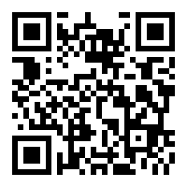
HOUSEKEEPING
Staying on schedule
Post questions in the chat.
National Marketing Committee as well as staff will help answer.
We’ll also stay on for 30 mins after the presentations for Q & A.
Presentations will be sent at the conclusion of both sessions
Webinar is being recorded! Available at scouting.org/recruitment.

Slide 6
2024 Marketing Bootcamp Safety Moment

Slide 7
Safe Use of Scout Names and Photos
Print
Website
Social Media

Slide 8
DOs and DON’Ts
DO:
Use First Name, Last INITIAL
Use Town, City, State
Check for identifiers/guests in the background
Attain an annual photo release each year
Use Brand Center Content
DO NOT:
Use Full Names
Use Addresses
Use phone, email or social media IDs
Reference School or Venue (when possible)

Slide 9
Sarah J Cheers on her fellow Scouts

Slide 10
2024 Marketing Direction
Michael Ramsey
Sr. VP, Marketing & Communications

Slide 11
Digital Safety & Challenging Topics
Gordon G. Andrew
Chair, National Public Relations & Communications Sub-Committee
Scott Armstrong
Director, BSA National Media Relations & Government Affairs

Slide 12
Scouting, Safety and Social Media
Safety Culture and Transparency
• Abide by Terms of Service of the platform you are using.
• All channels should be public, available and transparent.
• Two-deep leadership applies; make sure you have at least two admins.
• No one-on-one adult to youth messages or emails, this includes messaging apps. You must include a second adult.
• Personal profiles attached to Scouting platforms should be Scout-like in their presentation and messaging. Please be appropriate.

Slide 13
Scouting, Safety and Social Media, Part II
Safety Culture and Transparency
• Be careful in providing data about youth – no full names, no addresses
• Do not delete negative comments unless they violate the BSA Social Media Digital Contract.
• Threats and dangerous language should be reported to unit and Council leadership. Social media must be monitored.
• External media requests should always be referred to your Council’s Scout Executive or to pr@scouting.org.

Slide 14
Talking about the tough things...
Chapter 11 Reorganization:
The BSA’s Chapter 11 was the largest, most complicated bankruptcy re-organization in U.S. not-for-profit history. It should generally be avoided as a unit level topic and if there are questions or concerns, please refer them to your Council Scout Executive. Media inquiries of this nature should ALWAYS be referred to pr@scouting.org.
The settlement, supported by 86% of the claimants, allows for the dual imperative of compensation to victims as well as enabling the important mission of Scouting to continue for today’s youth.

Slide 15
Youth Protection Communications...
Scouting embraces a safety culture and this should be apparent in your communications. A reminder that Scouting has a robust youth protection system in place that includes:
• Two-deep leadership
• Mandatory registration, background check and YPT training for all staff and adult leaders
• Mandatory reporter status for all BSA leaders and staff
• Scouts First Helpline 1-844-726-8871
• Barriers to Abuse policies

Slide 16
Emergencies & Crisis Communications...
Anytime you are in a situation where there is significant injury, fatality, police intervention or media interest you have now entered the world of “crisis communications.”
First priority: Call 911 if fire, ambulance or police are needed
Second: Contact your Scout Executive with an assessment of the situation; he or she can bring to bear the BSA’s considerable assets in Health & Safety, Membership Standards, Legal, Public Relations and Council Support
Third: Please do not speak to media. Refer all media to pr@scouting.org

Slide 17
THANK YOU!

Slide 18
THE SCOUTING EDGE: An updated Values of Americans and National Outcomes Study

Slide 19
Methodology
Conducted by The Harris Poll on behalf of the BSA between November 29th and December 14th, 2023.
Nationally Representative Sample
1,617 youth ages 10-17 (Sample data is accurate to within + 3.0 percentage points at the 95% confidence level.)
1,614 adults ages 18+ (Sample data is accurate to within + 3.4 percentage points at the 95% confidence level.)
Scout and Scouting Alumni Sample
440 Scouts ages 10 -17 (Sample data is accurate to within + 4.7 percentage points at the 95% confidence level.)
226 Scouting Alumni ages 18+ (Sample data is accurate to within + 6.5 percentage points at the 95% confidence level.)

Slide 20
American’s personal values align with Scouting’s values

Slide 21
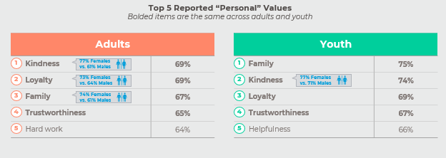
Base: All Qualified Respondents (Total Adults n=1614; Total Youth n=1617)
Q1035/1035T. Which of the following, if any, would you describe as being your values? Please select all that apply.

Slide 22
Scouting Alumni and Scouts recognize the positive impact Scouting has in their lives

Slide 23
Base: All Qualified Respondents (Total Alumni n=226; Total Scouts n=440)
Q3030. To what degree has being a Scout influenced your life?

Slide 24
Base: All Qualified Respondents (Total Alumni n=226)
Q3040/3040T. To what degree has being a Scout influenced the development of the following traits in yourself?

Slide 25
Base: All Qualified Respondents (Total Scouts n=440)
Q3040/3040T. To what degree has being a Scout influenced the development of the following traits in yourself?

Slide 26
Scouting Alumni and Scouts are more likely than those who have never been Scouts to live the values of the Scout Oath and Law

Slide 27
Base: All Qualified Respondents (Total Alumni n=226; Total Non-Alumni n=1305; Total Scouts n=440; Total Non-Scouts n=1432)
Q1035/1035T. Which of the following, if any, would you describe as being your values? Please select all that apply.

Slide 28
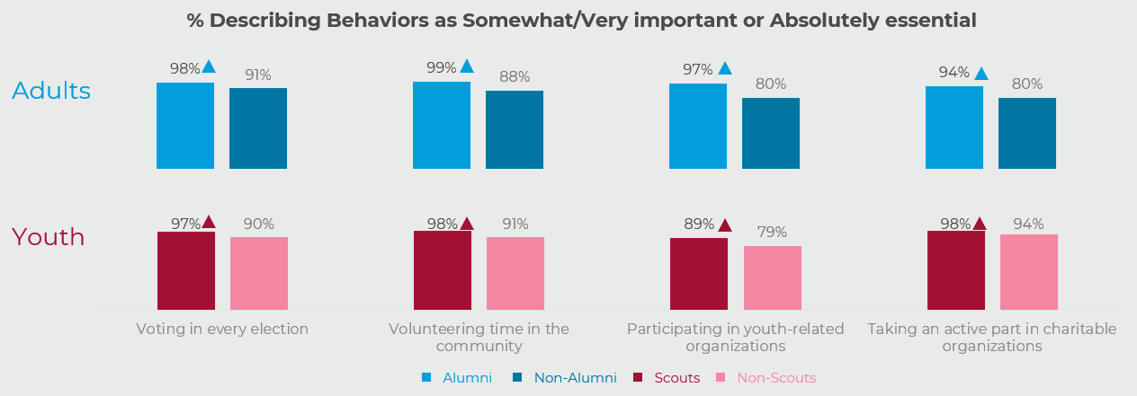
Base: All Qualified Respondents (Total Alumni n=226; Total Non-Alumni n=1305; Total Scouts n=440; Total Non-Scouts n=1432)
Q1045. Please indicate the extent to which you think the following behaviors are important in being a good citizen, if at all.

Slide 29
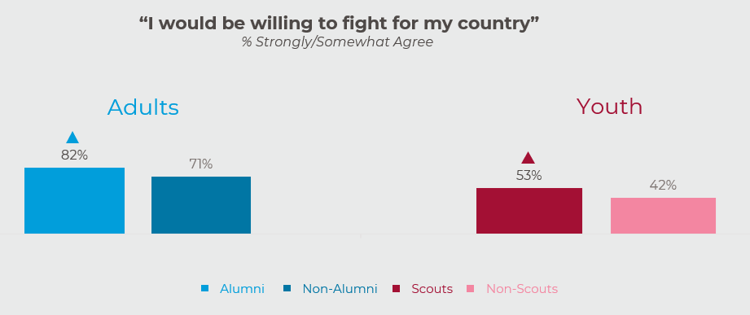
Base: All Qualified Respondents (Total Alumni n=226; Total Non-Alumni n=1305; Total Scouts n=440; Total Non-Scouts n=1432)
Q1040A/1040AT_6. Please indicate the extent to which you agree or disagree with the following statements.

Slide 30
Base: All Qualified Respondents (Total Alumni n=226; Total Non-Alumni n=1305)
Q1040B/Q1040BT_5. Please indicate the extent to which you agree or disagree with the following statements.
Q1040B/Q1040BT_8. Please indicate the extent to which you agree or disagree with the following statements

Slide 31
Base: All Qualified Respondents (Total Scouts n=440; Total Non-Scouts n=1432)
Q1040B/Q1040BT_5. Please indicate the extent to which you agree or disagree with the following statements.
Q1040B/Q1040BT_8. Please indicate the extent to which you agree or disagree with the following statements

Slide 32
Base: All Qualified Respondents (Total Alumni n=226; Total Non-Alumni n=1305)
Base: All Qualified Respondents (Total Scouts n=440; Total Non-Scouts n=1432)
Q1010/1010T. Which of the following, if any, would you describe as being ''American'' values? Please select all that apply.
Q1035/1035T. Which of the following, if any, would you describe as being your values? Please select all that apply.

Slide 33
Adults and youth who have never been Scouts also recognize the positive impact of Scouting

Slide 34
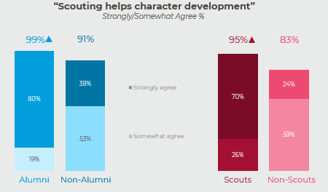
Base: All Qualified Respondents (Total Alumni n=226; Total Non-Alumni n=1305; Total Scouts n=440; Total Non-Scouts n=1432)
Q3050/3050T Please indicate the extent to which you agree or disagree with the following statements.
Q4030/4030T Please indicate the extent to which you agree or disagree with the following statements.

Slide 35
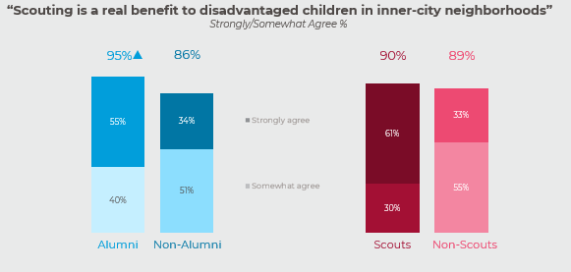
Base: All Qualified Respondents (Total Alumni n=226; Total Non-Alumni n=1305; Total Scouts n=440; Total Non-Scouts n=1432)
Q3050/3050T Please indicate the extent to which you agree or disagree with the following statements.
Q4030/4030T Please indicate the extent to which you agree or disagree with the following statements.

Slide 36
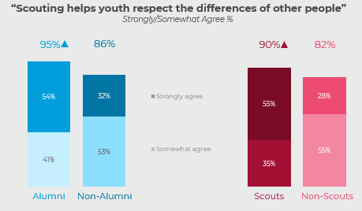
Base: All Qualified Respondents (Total Alumni n=226; Total Non-Alumni n=1305; Total Scouts n=440; Total Non-Scouts n=1432)
Q3050/3050T Please indicate the extent to which you agree or disagree with the following statements.
Q4030/4030T Please indicate the extent to which you agree or disagree with the following statements.

Slide 37
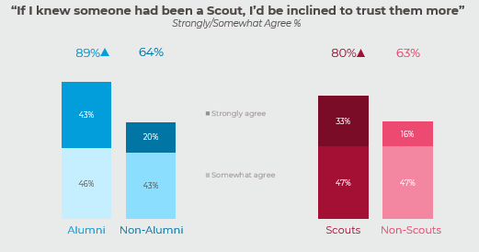
Base: All Qualified Respondents (Total Alumni n=226; Total Non-Alumni n=1305; Total Scouts n=440; Total Non-Scouts n=1432)
Q3050/3050T Please indicate the extent to which you agree or disagree with the following statements.
Q4030/4030T Please indicate the extent to which you agree or disagree with the following statements.

Slide 38
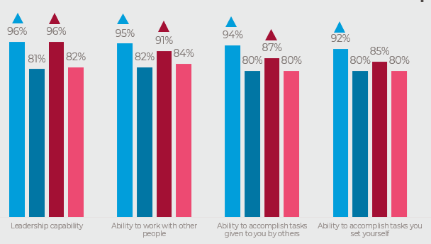
*Only asked of adults
Base: All Qualified Respondents (Total Alumni n=226; Total Scouts n=440)
Q3060. What effect has your experience as a Scout had on your...?
Base: Non-Boy Scouts (Total Non-Alumni n=1305; Total Non-Scouts n=1432)
Q4020. What effect do you think having been a Scout has on a person's...?

Slide 39
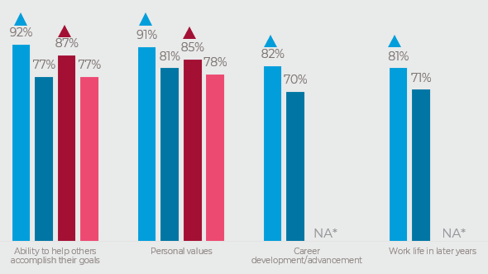
*Only asked of adults
Base: All Qualified Respondents (Total Alumni n=226; Total Scouts n=440)
Q3060. What effect has your experience as a Scout had on your...?
Base: Non-Boy Scouts (Total Non-Alumni n=1305; Total Non-Scouts n=1432)
Q4020. What effect do you think having been a Scout has on a person's...?

Slide 40
Thank You!

Slide 61
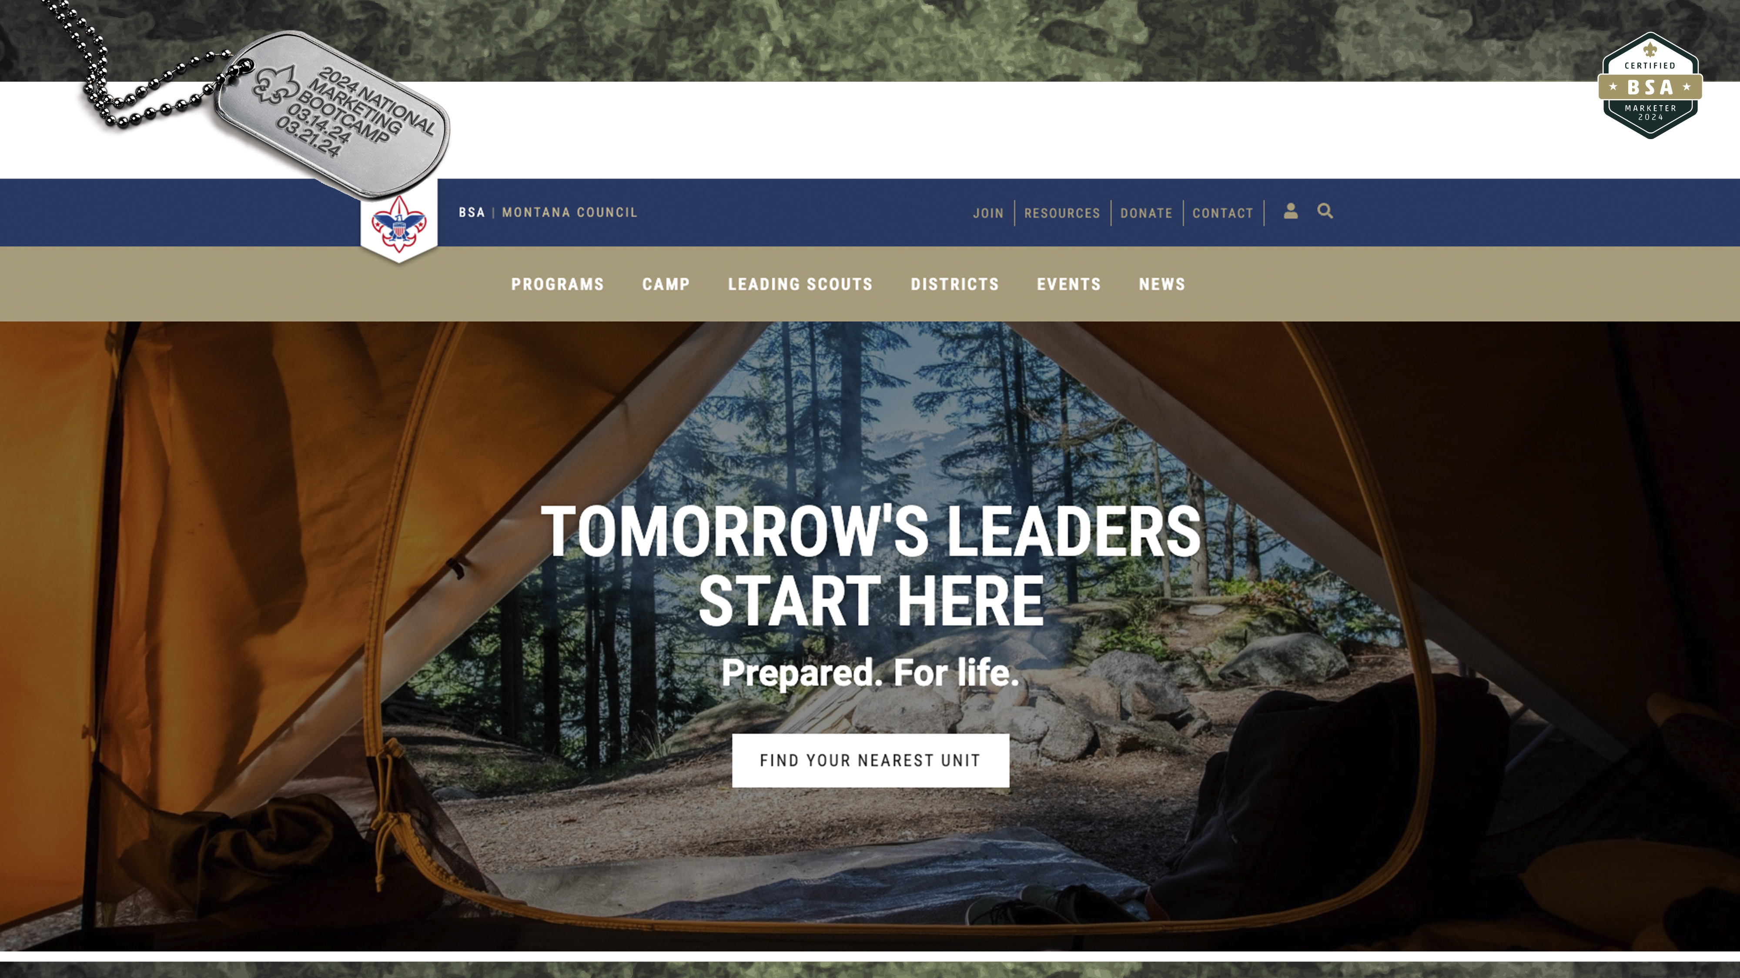

Slide 62
Who Is The Target Audience?
First Tier
How to Join
How to Donate
How To Contact

Slide 63
Who Is The Target Audience?
First Tier
How to Join
How to Donate
How To Contact
Second Tier
Camp Information
Program Information
By age and not by Program Name

Slide 64
Who Is The Target Audience?
First Tier
How to Join
How to Donate
How To Contact
Second Tier
Camp Information
Program Information
By age and not by Program Name
Third Tier – Those who speak Scouting
Unit Resources
Training
Event Registration
Program Guides
Scouter Resources

Slide 65
Reasons to Join Scouting

Slide 66
Reasons to Join Scouting
Tomorrow’s Leaders Start Here
Prepared. For life.

Slide 67
Reasons to Join Scouting
Tomorrow’s Leaders Start Here
Prepared. For life.
Lighting The Path: Scouting helps youth find their path through life’s wilderness.

Slide 68
Reasons to Join Scouting
Tomorrow’s Leaders Start Here
Prepared. For life.
Lighting The Path: Scouting helps youth find their path through life’s wilderness.
Montana Scouts improve themselves, their community and their country
Local language

Slide 69
Reasons to Join Scouting
Tomorrow’s Leaders Start Here
Prepared. For life.
Lighting The Path: Scouting helps youth find their path through life’s wilderness.
Montana Scouts improve themselves, their community and their country
Local language
4 Join Buttons

Slide 70
District Specific & Customizable
Introduction
Resource Links
News Feed
District Contact Directory
Event Calendar
Photos Gallery
+ more upon district request

Slide 72
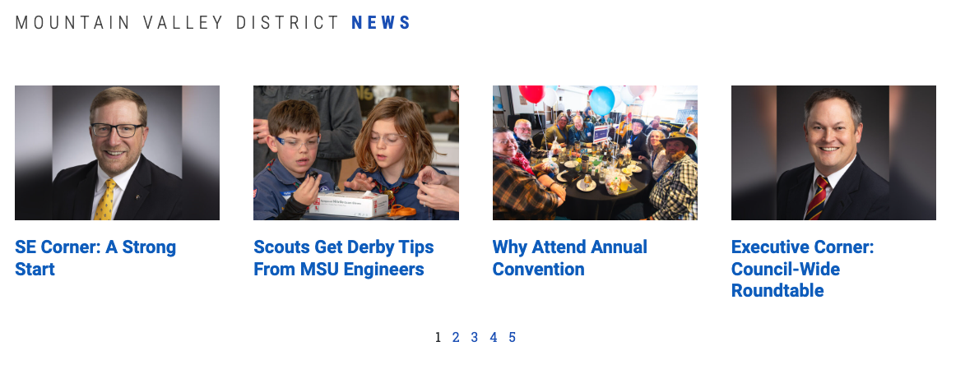
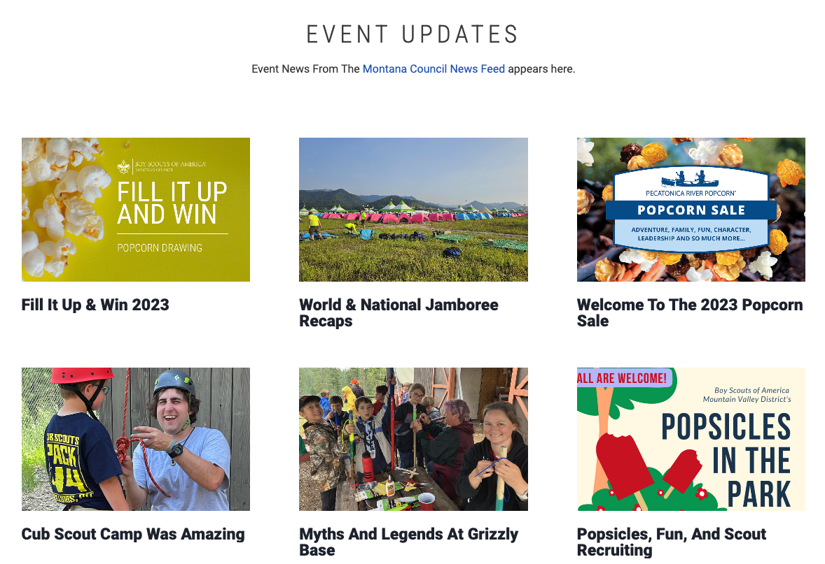
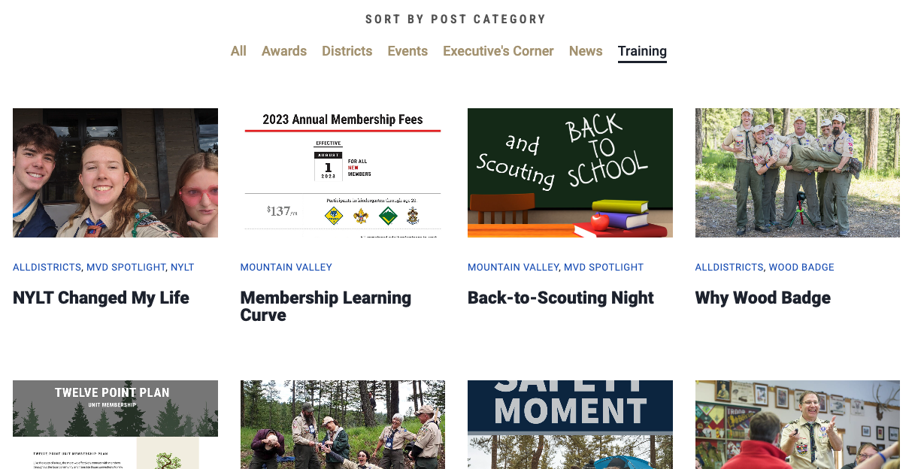

Slide 73
Discover Page
Simple Design
Call to Action: Join
Language focused on character development
Easy way to request more information

Slide 75
Thank You!
Lido Vizzutti | lido.vizzutti@scouting.org
WWW.MONTANABSA.ORG

Slide 76
Campaign Kit For Marketing your Council Summer Camps

Slide 77
Table of Contents
Welcome to Your Summer Camp Marketing Kit- Every Camp Has a Story
New Approach- Creating an Emotional Connection
Successful Camp Marketing Strategies
Know your Target Audience
Identifying your Targets particular needs
Highlight your Unique selling points- What makes your camp special?
Don’t follow the Stereotypes
Build Your Campaign
UPDATE YOUR WEBSITE!
Social Media Campaign
Use Video
Visuals (lots of them)
Spreading the Word: Mobilizing Your Scouting Family
Start Your Campaign: Timelines & Schedule
Resources and examples

Slide 78
Every Camp has a Story… What is Yours? Introduction- Summer Camp Marketing New Approach- Creating an Emotional Connection
Summer Camps are part of the Boy Scouts of America’s “Ultimate Retention Strategy” if kids attend summer camp, they are much more likely to stay in scouting.
While the program, kids and offerings have changed, the way we promote camps has become stagnate. When we market a camp, we are not just promoting a place we are creating a memory, emotion a feeling. You want to spark an emotional desire to see and experience the summer camp in your area.

Slide 79
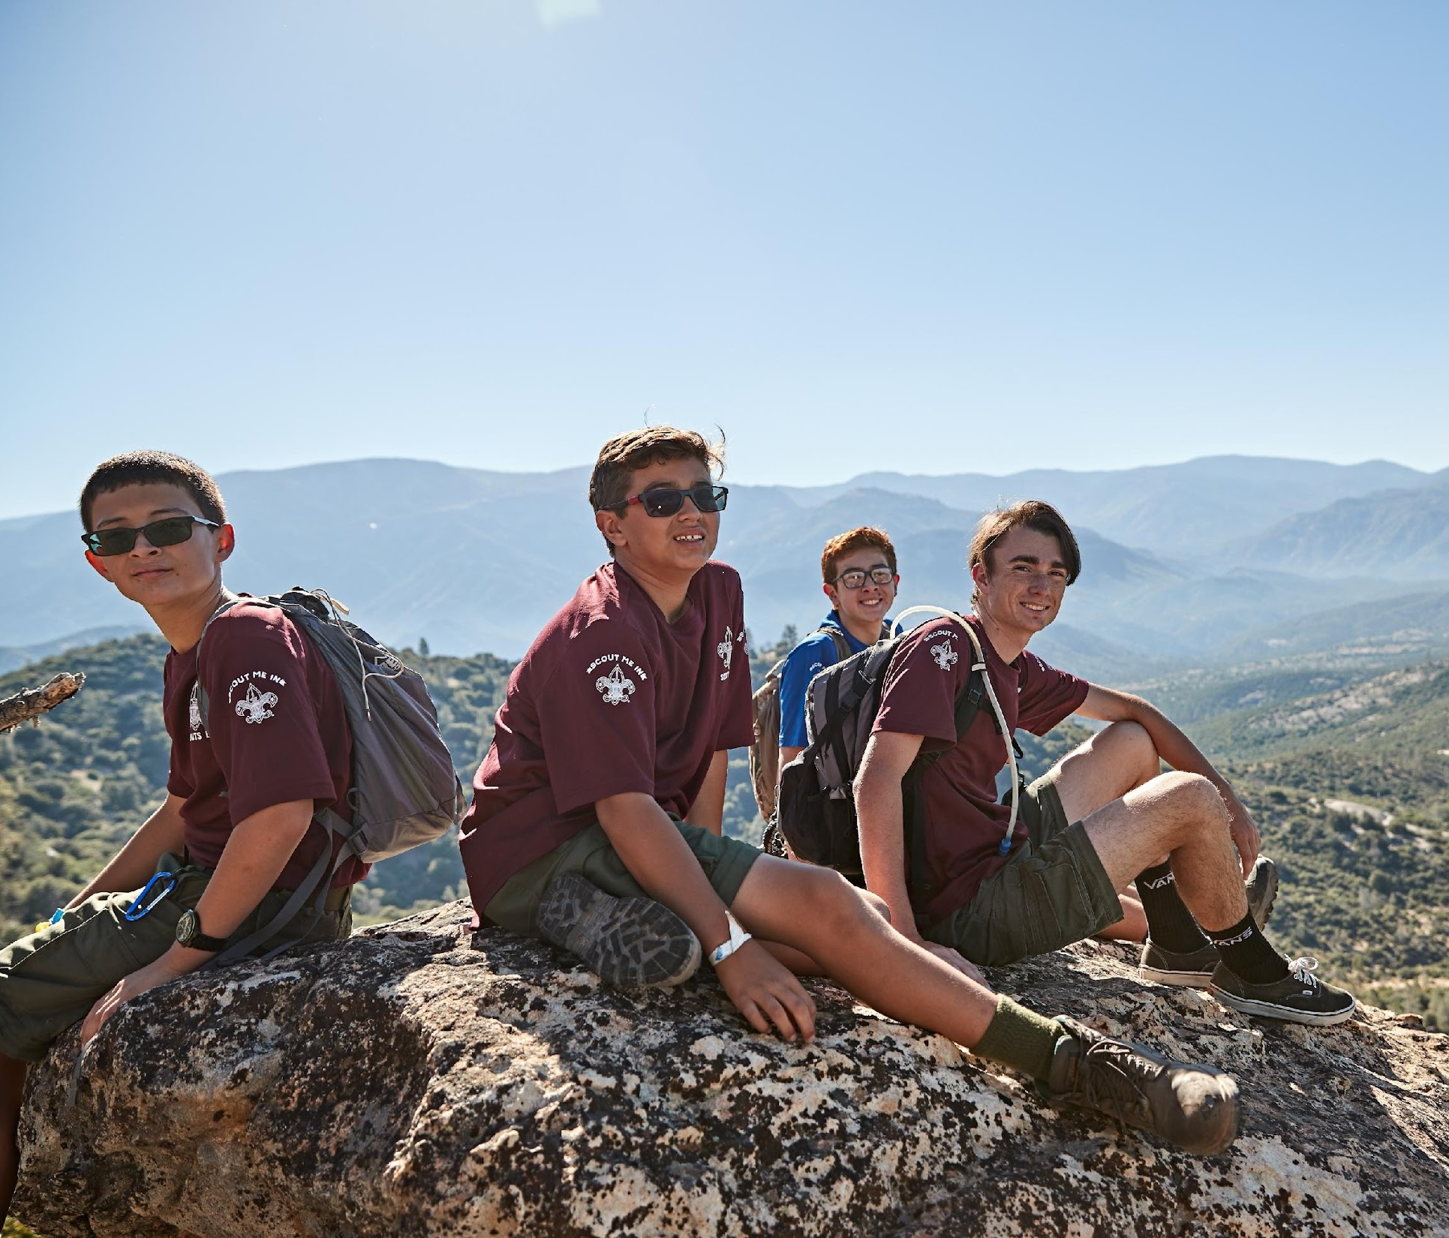
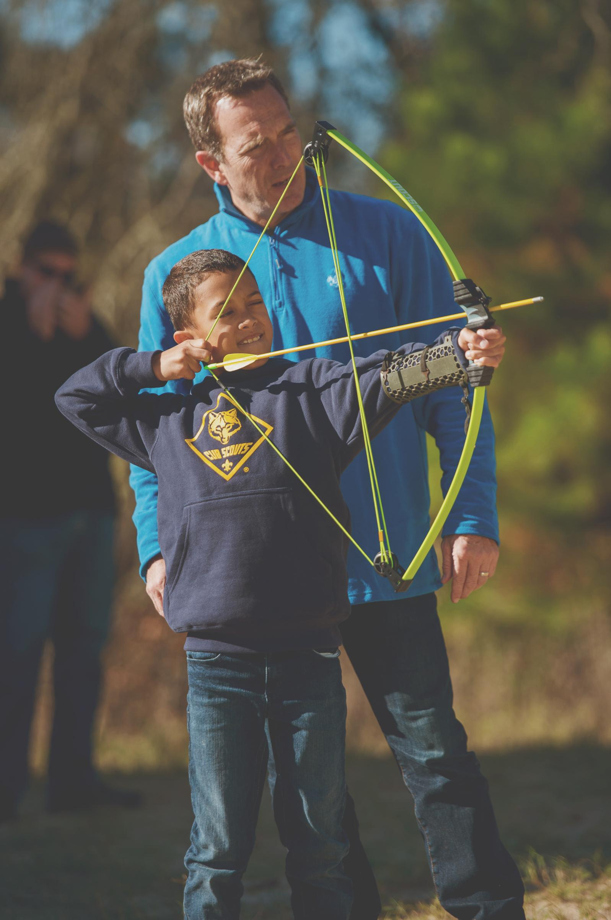
Know Your Audience: Older Scouts, Cubs, and Parents
In marketing and promotion, it’s important to know your audience. For Summer camps that offer different programs it means creating different campaigns for different opportunities.
For Cub Scouts, the target audience is typically a mom. For older scouts it is the scouts themselves.
As you develop your campaign, it’s critical you keep these audiences in focus to make sure your message is heard by the right audience at the right time.
To help, we’ve combined some primary focus needs for each audience.

Slide 80
Different Audience = Different Approach
Parents and Leaders (Cub Scouts and crossovers)
Cub Scouts
Older Scouts: Scouts BSA, Venturers, Explorers

Slide 81
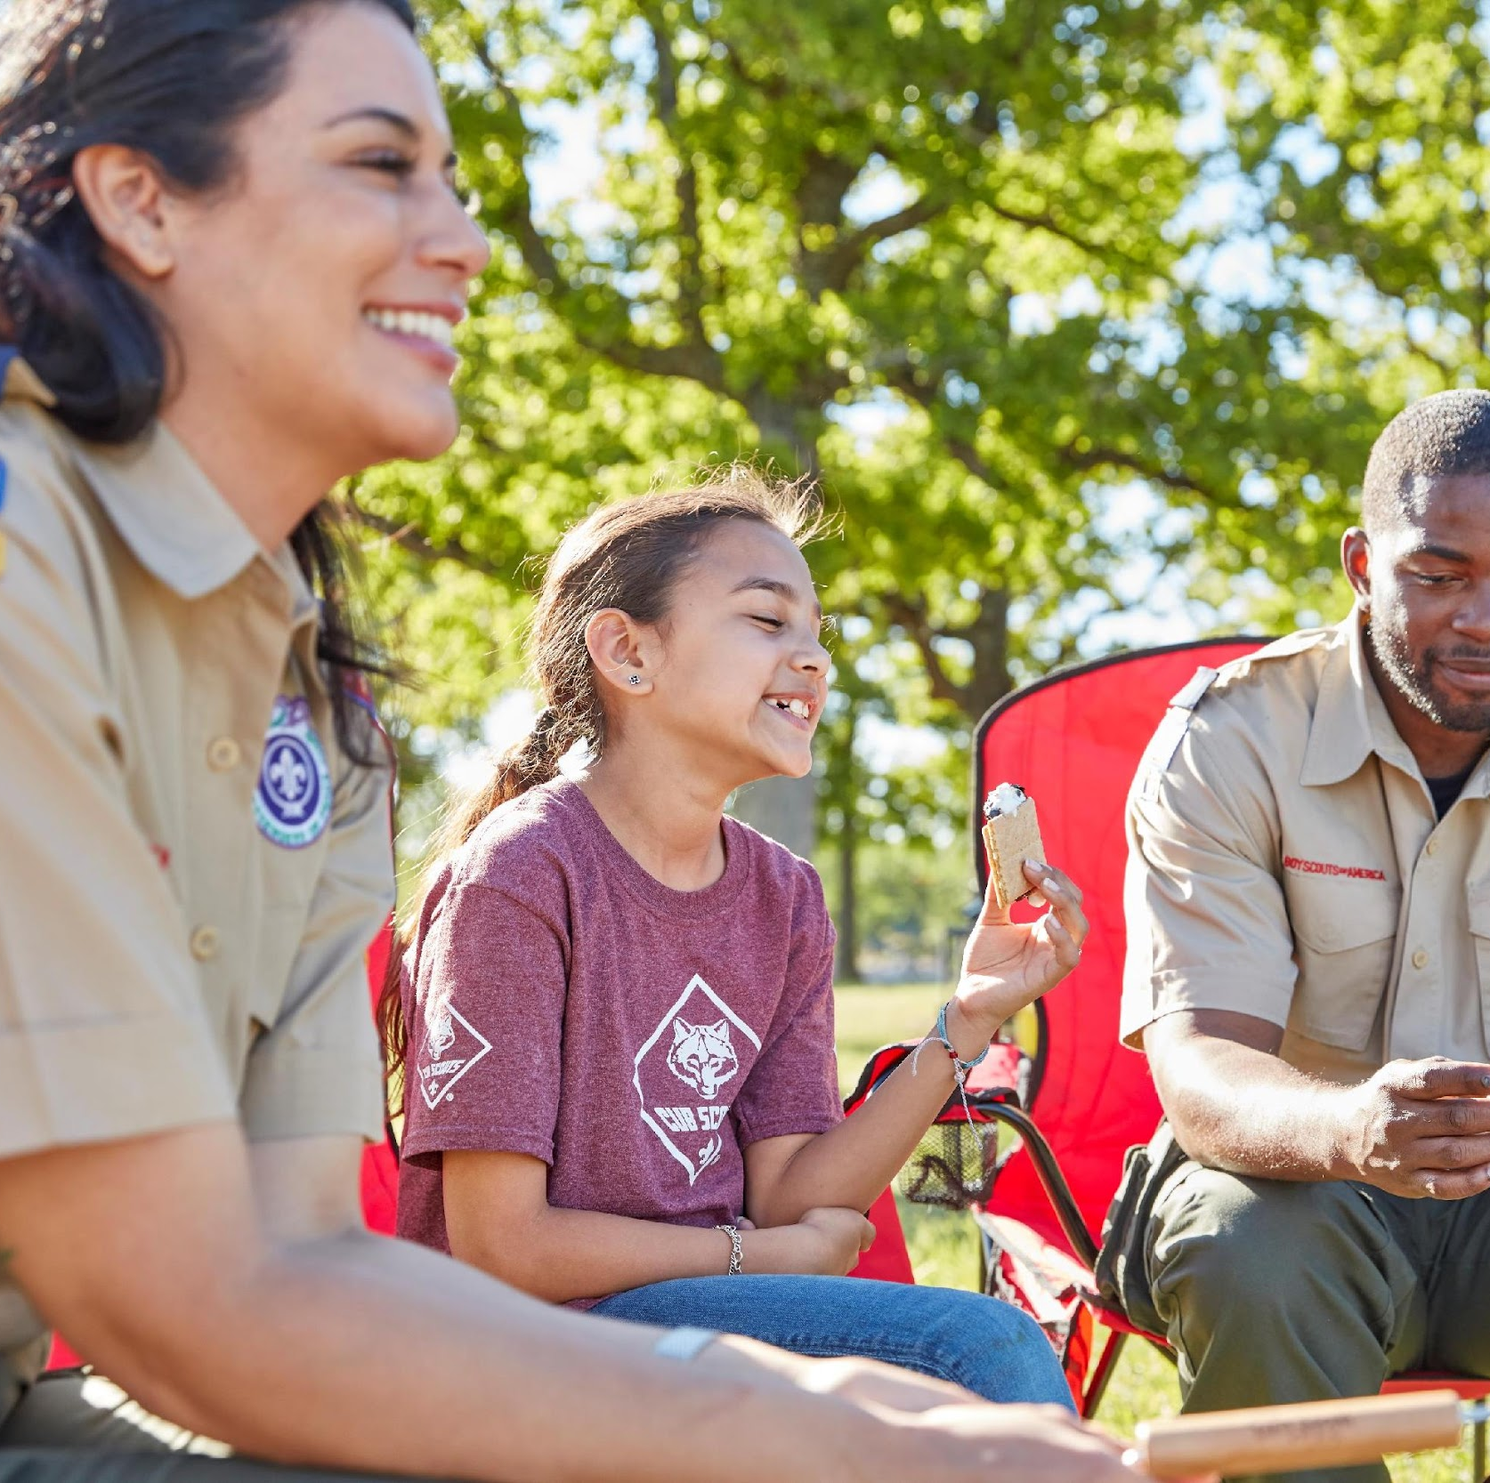
Parents and Leaders (Cub Scouts and crossovers)
Parent led and Leader affirmed decision process.
Want kids to have opportunities for socialization.
Looking for organized program with a focus on SAFETY and clearly listed opportunities.
Influenced by word of mouth and social media. They will do their research.
Want information and materials to be readily available.
Details on food, shelter, packing and facilities. Need to be easy to find.

Slide 82
Cub Scouts
Parent led and Leader affirmed decision process.
Looking for excitement and new experiences.
Provide opportunities for socialization.
Influenced by word of mouth and visuals, will have limited access to social media.
These kids will not make the decision but do help to influence the adults.
Tell personal stories and keep marketing fun!

Slide 83
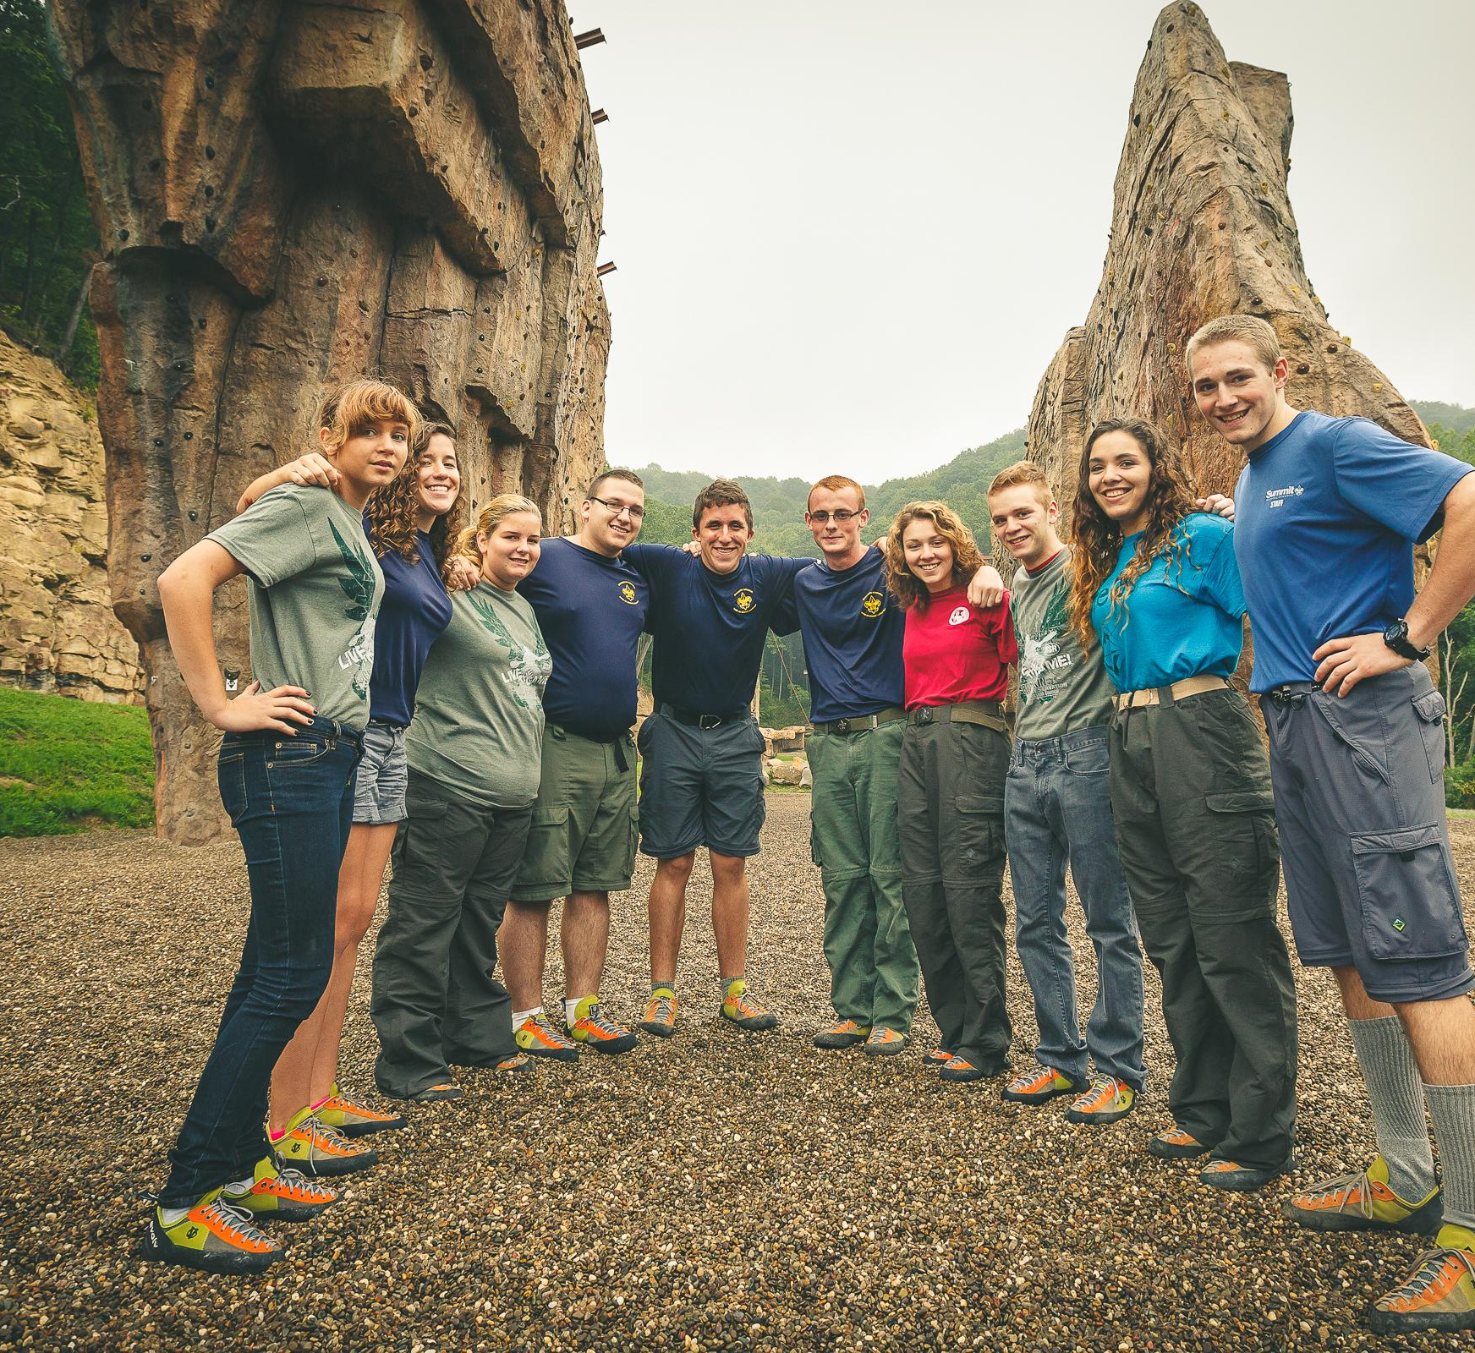
Older Scouts: Scouts BSA, Venturers, Explorers
Scout led- Scouts have a lead role in decision making.
Looking for excitement and new experiences.
Not highly influenced by rules and schedules.
Influenced by word of mouth, social media and great visuals.
Tell personal stories and keep marketing fun.

Slide 84
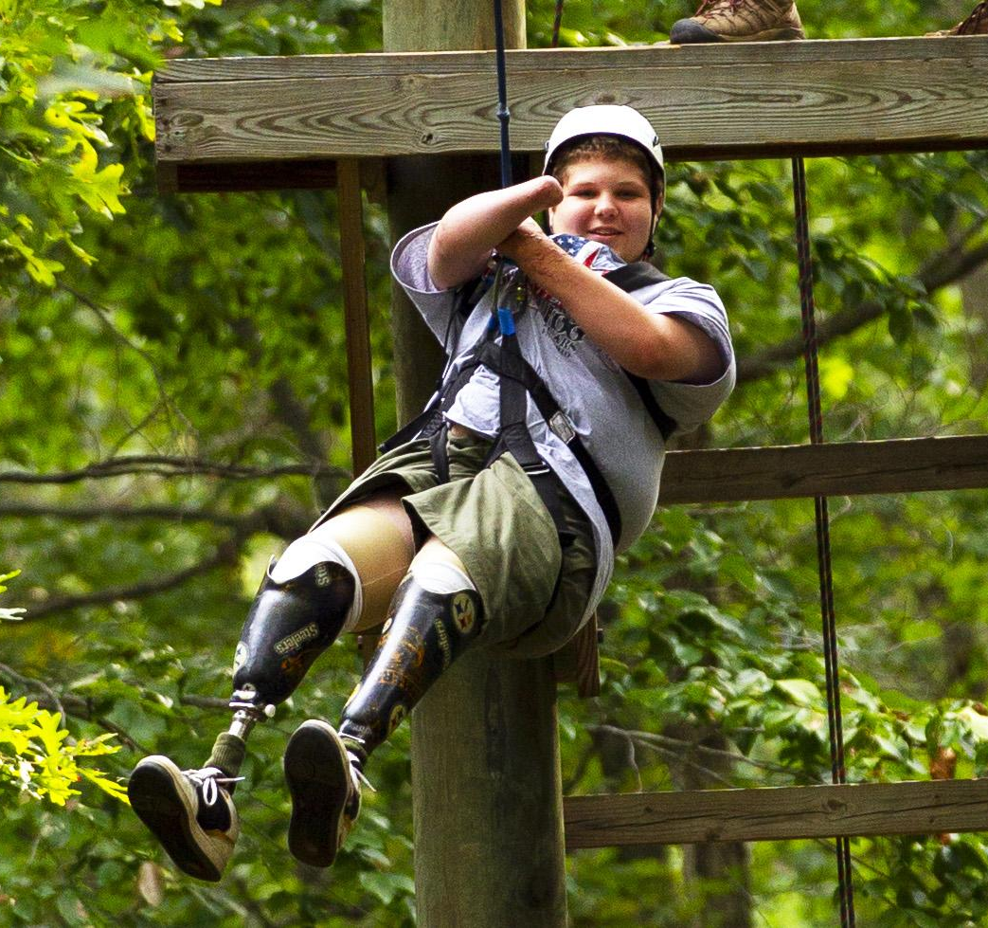
Identifying your targets’ needs and wants
This is a particularly successful approach because destination marketing is a strategy that engages potential customers’ emotions by tapping into their desires and offering an experience instead of just a product.
You can take this emotional response even further by targeting their specific needs and offering a solution to an issue.
Examples:
Heat (or lack of)
Special Facilities
Menus
Location

Slide 85
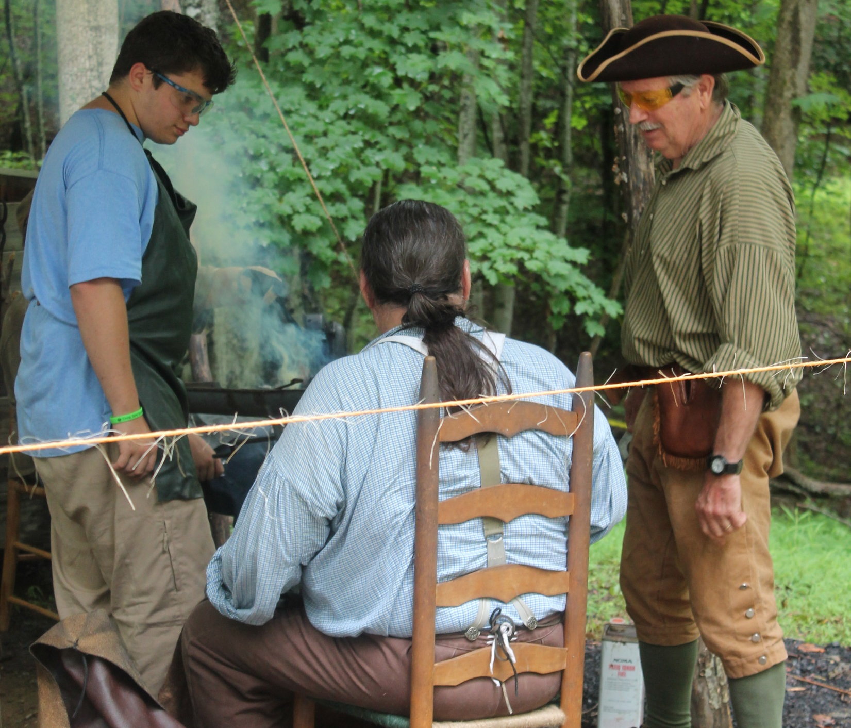
Identify your “USP”- What makes you special”
The start of every destination marketing campaign should begin by listing all of the unique selling points of wherever you are focusing on. This approach is all about standing out from other popular destinations, and the only way to do this is to shout about what makes your location so special.
Put yourself in your camper’s shoes! Your USP is not what you think is special about your camp but what your campers and audience thinks is special.

Slide 86
Don’t highlight the norms
Stand out! Don’t highlight activities that are common to every other camp.
Keep images fresh, bright and fun!
Keep your photo’s up-to date. Fashions, haircuts and equipment can date your marketing fast.
Unless you are highlighting history, tradition or a special anniversary make sure you use newer photos.

Slide 87
Build Your Campaign
Let’s get to work setting up the 5 key elements of your promotional plan.
UPDATE YOUR WEBSITES
Social Media Campaign
Use Video
Visuals (lots of them)
Spreading the Word: Mobilizing Your Scouting Family

Slide 88
UPDATE YOUR WEBSITES!
Make sure you have a unique and highly visual site.
Keep it separate but connected to your Council.
It needs a UNIQUE look and feel.
Remember your target audiences and compartmentalize under different sections.
Landing Page (first page) must focus on pulling a positive emotional response.
Provide separate information for leaders and parents.

Slide 89
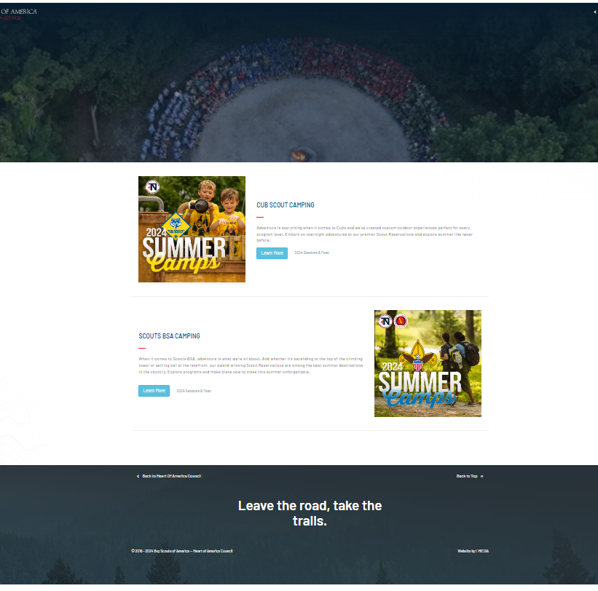
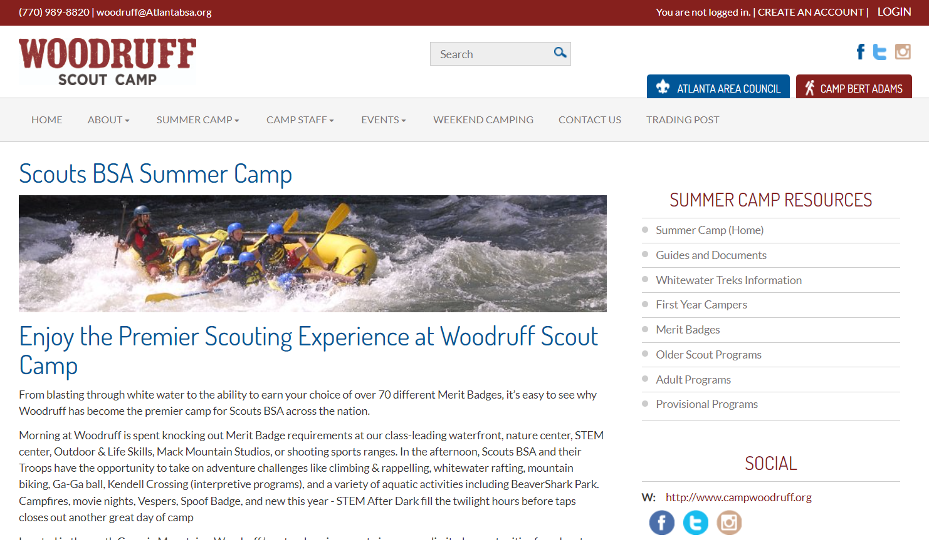
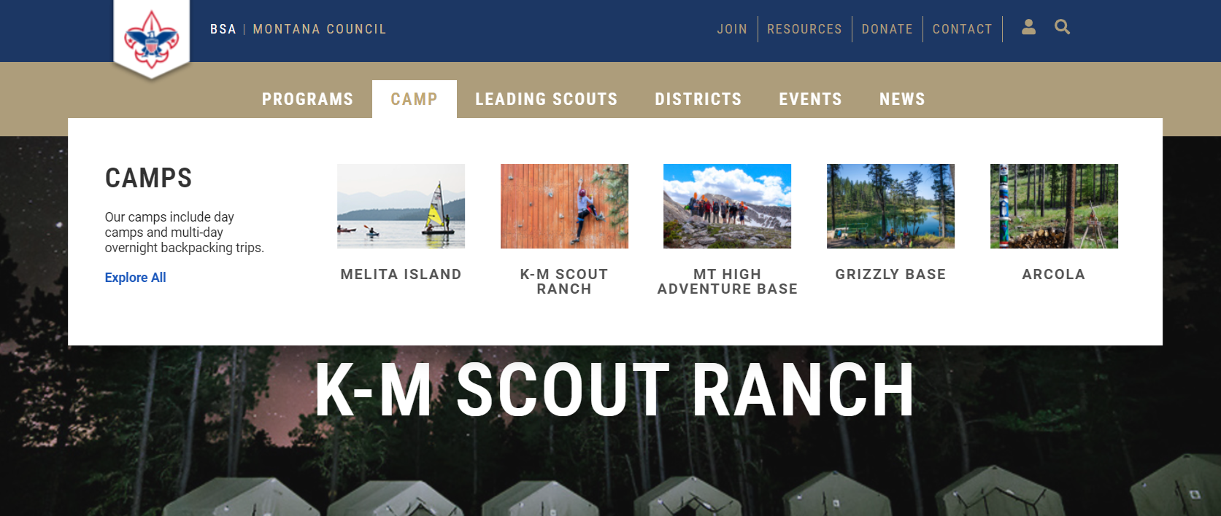
Great Examples!
https://montanabsa.org/km-scout-ranch/
https://www.campwoodruff.org/summer-camp
https://www.hoac-bsa.org/camping

Slide 90
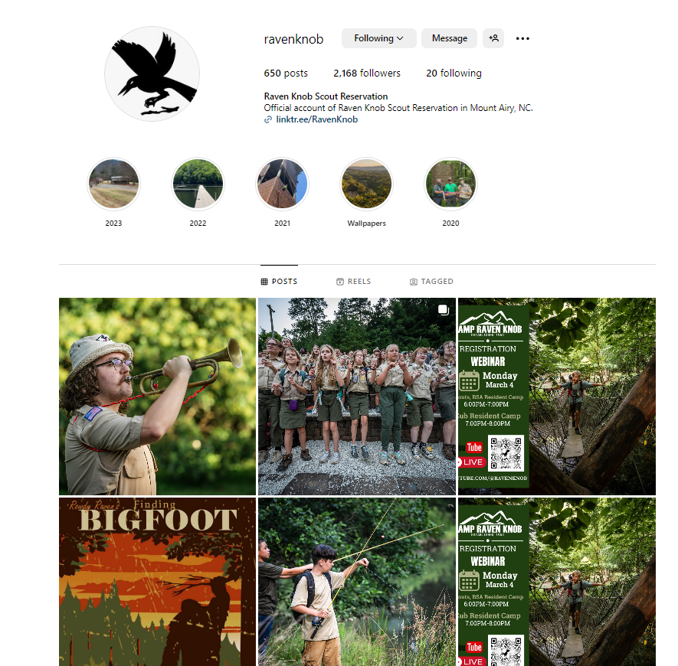
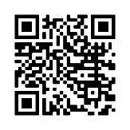
Set Up Your Social Media Pages
Make sure you have a Facebook page and Instagram Page. Post weekly photos and video so people can see the fun Scouts have in your unit.
Learn how to set up your own Facebook page.
Learn how to set up your own Instagram page

Slide 91
Camp Marketing is a YEAR-ROUND activity!.
Timelines and Schedules
Planning is the key to successful marketing efforts (and almost every other effort, too!)
We highly recommend good old-fashioned backdating. For example, if you are planning an event, grab a calendar and count backwards from the date of your event. Schedule out all your marketing activities!
Make sure you keep a calendar and planning timeline for all special camps and activities.
For example:
Note Camp dates and special activities and start backtracking 6-12 months out.
Plan weekly posts throughout the year highlighting unique experiences.
Set up and boost your special events 3-4 weeks prior to your signup goals.
Don’t skip this step! Map it all out…Ask campers, camp staff and volunteers to help make a plan.
Camp

Slide 92
Example Social Media Calendar - Make it your own- What is your USP/Story?

Slide 93
Good luck!

Slide 94
March 21, 2024 - 7 pm CT / 8 pm ET
Importance of a Safety Culture in the Digital Space Brad VanAuken, Author and Founder, BrandForward
2024 Marketing Direction Michael Ramsey, Sr. VP, Marketing & Communications
National Marketing Resources Darin Kinn, Director, Marketing & Brand
Membership Marketing to Maximize Recruitment Ron Clary, Graphic Designer, Clary Creative
Otto Goedhart, Manager, Membership Growth
Creating a Welcoming Scouting Environment Lisa Schuchart, VP, HR and Chief Diversity Officer
Social Media Matters Mitch Leonard, RTX Corporation
Nick Hessler, Vanderbilt University Athletics
Tips for Capturing Great Photography Michael Roytek, BSA Sr. Photographer
Recap and Closing Tom Kraeutler, Chair, National Marketing Committee

Slide 95
MARKETING BOOTCAMP
Thank You!
Session 2: March 21, 2024
7 pm CT / 8 pm ET

